Slide 1


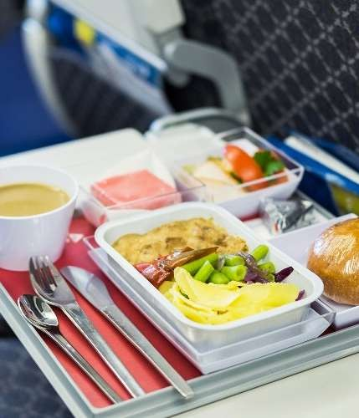
Communication Problems at Flight Foods Ltd
Group Member: Iryna Tyminska
ID: 2442194
Course: Effective Teamwork and Communication
Module Code: LCLM4003
Tutor’s Name: Nadeem Minza

Slide 2


Introduction to Flight Foods Ltd.
Overview of the Presentation
Key Communication Issues
Barriers Identified in the Case Study and Solutions
Recommendations
Conclusion
References

Slide 3





Introduction to Flight Foods Ltd.
Medium-size food manufacturer.
Produced ready meals for airlines.
Falling market share.
Quality complaints increasing.
Multicultural workplace.
Outdated equipment used.
Notes:
Losing market share due to complaints of poor food standards (undercooked food, poor packaging, meat in vegetarian meals. 40 staff from 5 distinct cultural groups (ages 16–60). Spacious, well-lit factory floor but old noisy machines.

Slide 4

Key Communication Issues
Language Differences
No Formal Training
Cultural Misunderstandings
Confusing Instructions
Manager’s poor example
Stressful Environment
Notes:
Staff speak their own languages with limited English. Difficulty in understanding instructions.

Slide 5

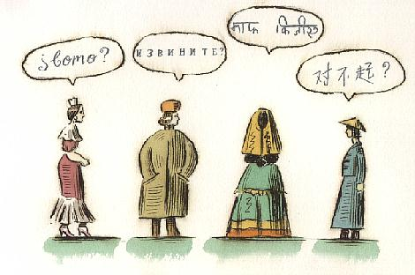

Language Differences and Solutions
Many languages spoken
English poorly understood
Misinterpreted instructions
Solution:
Translate key rules
Use visuals & symbols
Provide language support
Notes:
The majority of staff speak different languages with minimal English. Provide language classes or use visual aids to enhance communication. Translations, use visuals and symbols, simple wording.

Slide 6

Lack of Training and Solutions
No hygiene training
Learning “on the job”
Repeated food errors
Solution:
Mandatory workshops
Clear hygiene modules
Regular skills checks
Notes:
No food hygiene training before starting. Staff rely on Gary’s informal explanations. Mandatory training, clear modules, regular skills checks.

Slide 7

Cultural Differences and Solutions
Different working styles
Different views on rules
Misaligned expectations
Solution:
Cultural awareness training
Mixed teams & support
Unified workplace standards
Notes:
Training to help staff understand each other’s cultures. Cultural awareness training, mixed teams, unified workplace standards.

Slide 8

Age Barrier and Solutions
Age gap (16-60)
Uneven understanding
Solution:
Age-adapted training
Mentoring
Notes:
B: different learning speed, younger staff misunderstand rules. Sol; step-by-step demonstrations.

Slide 9
Provide structured training
Translate key instructions
Recommendations
Use clear visuals
Improve leadership style
Regular hygiene checks
Update workflow

Slide 10



Conclusion
Multiple barriers identified
Communication theories explain issues
Training is essential
Clear messages improve safety
Better teamwork improves quality
Strong communication builds trust

Slide 11

References
Food Standards Agency. (2023). Food safety and hygiene for businesses. UK Government. https://www.food.gov.uk/business-guidance/food-safety-and-hygiene
Health and Safety Executive. (2022). Training and competence. HSE. https://www.hse.gov.uk
International Air Transport Association. (2022). In-flight catering quality and safety guidelines. IATA.
Luning, P. A., & Marcelis, W. J. (2020). Food quality management: Technological and managerial principles and practices (2nd ed.). Wageningen Academic Publishers.
Reason, J. (2016). Managing the risks of organizational accidents. Routledge.
Reeves, B., & Kreshel, P. (2019). Cross-cultural communication in the workplace: Challenges and strategies. Journal of Business Communication, 56(4), 512–528.
Sloan, D. (2019). Catering for airlines: Managing food and beverage service on board. Routledge.
World Health Organization. (2023). Food safety: Key facts. WHO. https://www.who.int/news-room/fact-sheets/detail/food-safety

