Slide 1
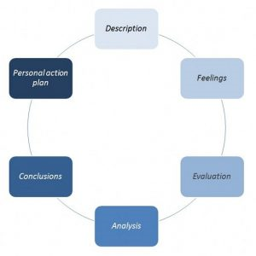
Skills and personal qualities that influence development of critical thinking in education
What is critical thinking
Skills
Personal qualities
conclusion
A scientific approach to thinking
Integral to success in education
(Judge 2009)
-Reflection
Gibbs (1988)
cited by Brown (2017)
-Analytical thinking
-in reading
- identify and evaluate line
of reasoning
- question surface appearances
- identify and evaluate evidence
- identify writers conclusions
and evaluate
(Cottrell,2008)
-in writing
- write for a purpose
- avoid impressionistic writing
- write reflectively
- write to learn
(Paul and Elder (2006)
-Egocentrism / Sociocentrism
-memory
-righteousness
-hypocrisy
-oversimplification
-blindness
(Paul, Elder 2006)
-Fairmindedness
-intellectual humility
-intellectual courage
-intellectual empathy
-Intellectual integrity
-intellectual autonomy
(Paul and Elder 2006)
As students, we should strive to be at least a practicing thinker as it is this stage which utilises the skills and personal qualities that are needed to critically think and succeed at the university level. We must overcome the obstacles that egocentrism creates and place our thinking outside the social constraints that inhibit it in order to achieve a fair-minded approach which is needed in order to critically undertake tasks and reflect upon ourselves.
We should engage in systems of thought that will help us to reflect, such as the learning journal, in order to be able to critically analyse our own reading and writing and make sure that it adheres to the frameworks that ensure that it is in itself, critical.
Stages of development
-unreflective
-challenged
-beginning
-practicing
-advanced
-master
(Paul, Elder 2006)
references
(Brown.N, 20015, Reflective model according to Gibbs, para 2, www.nicole-brown.co.uk/reflective-model-according-to-gibbs, accessed 17/10/19)
(Burns.S, Sinfield.S, 2012, Essential study skills, 3rd edition, Sage, London)
(Cotrell.S, 2008, The study skills handbook, 3rd edition, Palgrave and Macmillan, Hampshire)
(Halpenny.A M, 2014, Introducing Piaget : a guide for practitioners and students in early years education, Routledge, London)
(Judge.B et al, 2009, Critical thinking skills for education students, Learning matters, Exeter)
(Paul.R,Elder.L, 2006, Critical thinking: learn the tools the best thinkers use, concise edition, N.J, Pearson Prentice Hall)

