Slide 1
Documenting Experiments

Slide 2
Assessment
The assessment for ACCA5023 (NOSS) involves documenting practical exercise done in class.
These MUST be document correctly.
  It should not be a how-to guide.

Slide 3
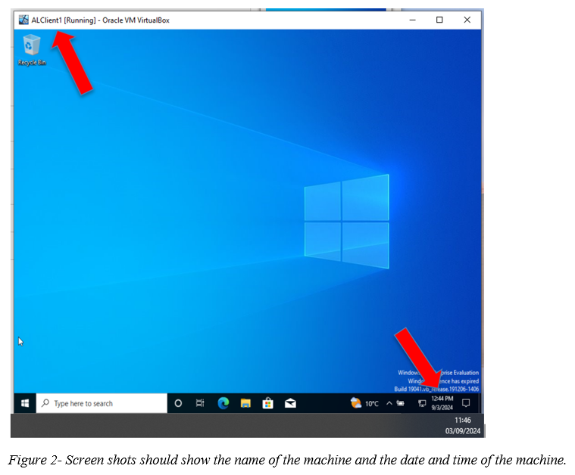
Screen shots
Note:
Screen shots must clearly show that the work is yours by
having the date and time of the Machine and
showing the name of the virtual machine.
You do not need screenshots for all steps.
Select appropriate screenshots to support your explanation.
  “The timestamp must prove that the task was done on a regular basis rather than a last-minute work to be considered as excellent work.
  Without Timestamp in the screenshots submitted, the task 2.2 work will be marked Zero.”

Slide 4
Explanation/Narrative
Explain what you did and why.
  Not a step-by-step guide on how to do the it.
  We do not need you to tell us how to do the practical exercises.
  We want to know if you did the practical exercises
  and if you understand what you did (concepts etc)
Select appropriate screenshots to support your explanation.
Add captions to your screenshots – should indicate what the image is about.
  Reference the captions in the explanation e.g., “Figure 1 shows ….”

Slide 5
Word Limits
TOO MUCH
If the specified word limit for an assessment has been exceeded, the following penalties would normally apply. The penalty cannot take the work into the fail category.
Up to 10% above the word limit – No deduction off final mark
Between 10% and 25% above the word limit – Deduction of 5 marks off final mark, or reduce the mark to the capped mark, whichever is the lesser penalty.
Between 25% and 50% above the word limit – Deduction of 10 marks off final mark, or reduce the mark to the capped mark, whichever is the lesser penalty.
50% or more over length – Maximum mark of capped mark (reduced to 40%)
TOO LITTLE
A failure to meet the word limit (or minimum word limit if a range is given) may result in lower marks based on the quality of the work because the work may not include the necessary information required for the assessment to meet the stated learning outcomes.
The feedback on the assessment will explicitly mention any mark deduction and the reason for it.

Slide 6
Task 1 - Report: Research– 60 Marks Maximum [Word Limit: 1500 words]
Research on Hypervisor: (Maximum: 400 Words)
  Do detailed research on different types of hypervisors in virtualization.
    Discuss about their architecture,
    address their features,
    hardware requirements,
    advantages,
    scalability, security and compatibility.
    Find out details about different types of hypervisor solutions available in the market.
Research on IP Addressing: (Maximum: 400 Words)
Refer to your Group Activity during one of your lectures asking you to discuss in a group about
How does data get from one computer to another on the Internet and what is the role of IP addresses in the transmission of data on the Internet?
How do you think routers and switches work on the Internet to facilitate the flow of data between different networks?
  Based on the above Group Activity, reflect your understanding with appropriate and adequate in-text citations on IP Addressing.
    Explore how IP Addressing contributes to the functionality and effectiveness of the network.
    You need to address the structure, format, and representation of IPv4, IPv6 addressing, concept of subnetting, efficient utilization of IP addresses.
    Include diagrams and examples of IP Addressing concepts and their practical applications.
3. Research on Routing: (Maximum: 400 Words)
  Do detailed research on
    the fundamental concepts of routing protocols,
    including how they work, their role, what is their purpose etc.
    Focus on the key differences between static and dynamic routing protocols.
    Refer to real-world examples and/or case studies on how routing protocols are deployed in a real time network.
    Analyse different routing protocols used in network scenarios and reflect on the benefits and challenges on each routing protocols based on those scenarios.
4. Research on Network Services: (Maximum: 300 Words)
  Do a detailed research to summarize the key concepts, features and best practices associated with
    VPNs,
    DHCP,
    Active Directory Domain Services and
    Certificate Authorities.
Note: As stated above, you are not expected to answer “what is what”. Review recent academic/ industry credible literatures and reflect on your understanding on the above concepts by summarizing and writing critical appraisals. Appropriately in-text cite your work.

Slide 7
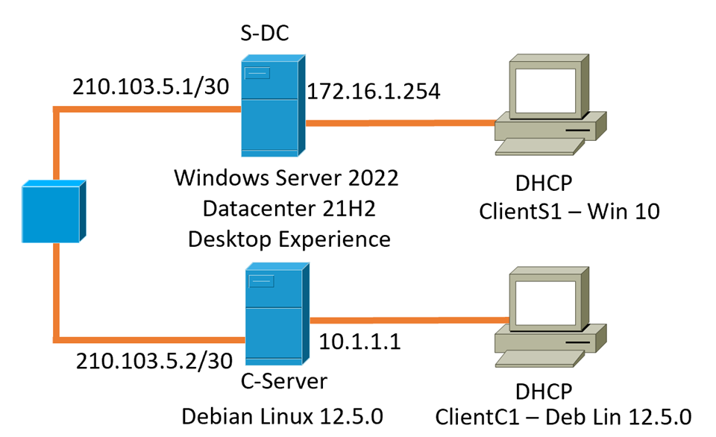
Task 2 - Report: Technical Documentation – 30 Marks Maximum [Word Limit: 900 words]
  Choose your Hypervisor: Based on the above research, justify with concreate evidence and strong statements that influenced your choice of hypervisor to complete this network. Consider the fact that you will be continuing this topology to manage different network services in Coursework 2.
  Download and Setup:
    Download the chosen Hypervisor and Server, Client Operating Systems for the relevant Sources. Evidence for downloading from relevant/ appropriate resources will be considered as exceptional work.
    Deploy your network as per the given topology. The setup needs to be taken screenshots with Timestamp
  Configure IP Addressing
    Use appropriate IP addresses to configure your network.
    The above topology gives network address for the networks. However, it is up to you to use the same network or a different network/ IP Addressing Scheme.
Note: Designing your own IP Addressing scheme for the network will be considered as exceptional work.
  4. Test and Troubleshoot
  You need to achieve the following:
    Perform Connectivity tests
Outcome 1: Successful connectivity within same networks.
Outcome 2: Unsuccessful connectivity within different networks.
LAN 1 - Swansea
LAN 2 - Cardiff

Slide 8
Task 3 - Report: Reflection – 10 Marks Maximum [Word Limit: 100 words]
  Reflect on the following
    Write a Technical reflection covering network deployment and testing.
  Hint:
  Throughout Task 2, reflect on any issues/ challenges during deployment and testing. (like IP Address conflicts, DNS resolutions, firewall configurations etc.)
  Document 2 with necessary evidence on how you diagnosed and troubleshooted any issues systematically (if occurred).
      Write your Personal Reflection

