Slide 1
Media and Aggression
By Lily Jennings

Slide 2


What is 'Media'?
Media – means of communication that reaches people widely (dictionary.com, N.D.).
Types of media include:
Radio
Television
Internet (for instance, social media)
Newspapers and magazines
(Seetharaman, 2013)
(Chandak, 2020)

Slide 3

What is 'Aggression'?
Aggression - 'any behaviour, including verbal events, which involves attacking another person, animal, or object with the intent of harming the target' (Soreff et al, 2023)
Violence – similar to aggression, violence involves intentionally using physical force to hurt or damage someone, or something (Soreff et al, 2023).
(Brandt, 2018)

Slide 4
Aims:
This presentation intends to discuss the following-
The degree to which the different types of media may have an influence on aggressive and violent behaviours in an individual.
Psychological theories, for instance social learning, desensitisation theory and cultivation theory.
Evidence from research studies that support and contradict the idea that media impacts levels of aggression in an individual.

Slide 5
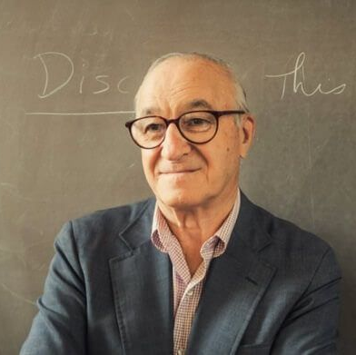
Relevant Psychological Theories
Social Learning Theory (Bandura, 1977) - developed as a result of his findings in his Bobo doll experiments.
This theory suggests that learning takes place within a social setting, with an active and mutual exchange between the individual, their environment, and behaviour.
Social learning theory can provide further insight into the relationship between media and aggression. This theory posits that upon exposure to aggressive media content, individuals may observe and imitate aggressive behaviours modeled by characters or personalities they see on a television programme, for example.
(Moore, 2016)

Slide 6
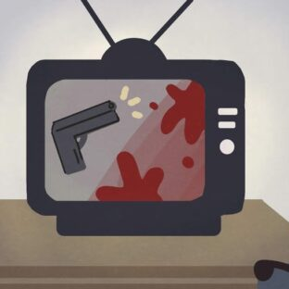
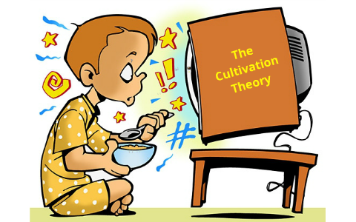
(Hoang, 2019)
2) Desensitisation Theory – refers to the process by which an individual becomes less impacted by violence and aggression displayed in media, this is due to increased exposure.
A study conducted by Krahé (2011) found that several of their findings supported their theory that weakening fear and anxiety in response to media violence through repeated exposure ultimately encourages the likelihood of proactive aggressive behaviours.
3) Cultivation Theory (Gerbner, 1969) - posits that repeated exposure to media over an extended period of time can have an influence on an individual's perceptions of social reality. This theory primarily refers to media exposure in the form of television.
However, a criticism of this theory is that it does not consider the personal experiences of the individuals, for instance there could be other contributory factors to a viewer's perceptions.
(Jones, 2012)

Slide 7
Supporting Evidence:
Bushman & Huesmann (2006) - conducted a meta-analysis on the short term and long-term effects of violent media on aggression in children and adults. They found that the short-term effects of violent media were greater for adults than for children, whereas the long-term effects were greater for children than for adults.
Deshpande et al (2011) - conducted a multi-method study to explore the fronto-parietal regulation of media violence exposure in adolescents. Their findings supported the desensitisation theory as they established that aggressive media activates an emotion-attention network which has the ability to weaken emotional responses through reduced attention with repeated aggressive media exposure.

Slide 8
Supporting Evidence:
Huesmann & Taylor (2006) - conducted research on various types of media and found that the relationship between media violence and real-world violence and aggression is impacted by the nature of the media content, along with the social influences on and characteristics of the individual being exposed to the content. They found that video games may produce an increase in aggression and violence in the short term.
Coyne & Padilla-Walker (2015) - explored the longitudinal effects of music on aggression, and prosocial behaviour during adolescence. Their results revealed that listening to aggression in music was correlated with increased aggression and decreased prosocial behaviour over one year. Listening to prosocial behaviour in music was not related to any behavioural outcome longitudinally.

Slide 9
Further Studies:
Mitrofan et al (2014) – conducted a study on aggression in children attending CAMHS with behavioural or emotional difficulties. The main source of violence and aggression viewed by the children was reported to be video games and television. The results of this study demonstrated that the children did not think that viewing aggression around them, either in the real world or in media, influences their own actions but believed it impacted others. This study also included carers as participants, and they attributed aggression to a combination of internal and external factors. The carers concluded that seeing aggression/violence in real life has more of an influence than television or video games.
Przybylski & Weinstein (2019) - conducted a study on the relationship between violent video game engagement and aggressive behaviour in adolescents. They interviewed 1004 British adolescents aged 14 and 15 years old, along with an equal number of their carers. The hypothesis of this study stated that recent video game engagement is positively and linearly related to carer assessments of aggression. The results did not support this hypothesis. The researchers conducted further analyses and found that these results extended across multiple areas of violent video game exposure, including when the focus of the research was on another behaviour, for instance, prosocial behaviour.

Slide 10

Conclusion:
The degree to which the various types of media may influence aggression in an individual can vary.
A potential topic idea for future research could be to study the effect the news has on aggression levels, this could include newspapers, online news articles etc. Future research could study how the content of the news influences aggression levels in people.
It is important to study the relationship between types of media and aggression levels as this would allow for a further understanding of human behaviour, whilst providing an opportunity for individuals to be mindful of what they are exposing themselves to.
(Deselaers, 2019)

Slide 11
Reference List:
Arif. H., Gupta. V., Soreff. S. M. & Wadhwa. R. (2023) Aggression. StatPearls. https://www.ncbi.nlm.nih.gov/books/NBK448073/#:~:text=Aggression%20is%20any%20behavior%2C%20including,or%20kill%20someone%20or%20something
Behavioural Change Models (N.D.) The Social Cognitive Theory. https://sphweb.bumc.bu.edu/otlt/mph-modules/sb/behavioralchangetheories/behavioralchangetheories5.html#:~:text=Social%20Cognitive%20Theory%20(SCT)%20started,person%2C%20environment%2C%20and%20behavior
Berger. A., Felber. J., Huesmann. L. R., Kirwil. L., Krahé. B. & Möller. I. (2011). Desensitisation to Media Violence: LInks with Habitual Media Violence Exposure, Aggressive Cognitions, and Aggressive Behaviour. J Pers Soc Psychol, 100(4), 630-646. doi: 10.1037/a0021711
Brandt. C. (2018) Aggression neurons identified. https://news.ki.se/aggression-neurons-identified
Bushman. B. J. & Huesmann. L. R. (2006) Short-term and Long-term Effects of Violent Media on Aggression in Children and Adults. Arch Pediatr Adolesc Med, 160(4), 348–352. Doi: 10.1001/archpedi.160.4.348
Chandak. S., (2020) INTRODUCTION TO THE STUDY OF MEDIA AND COMMUNICATION. Adamas University. https://adamasuniversity.ac.in/introduction-to-the-study-of-media-and-communication/

Slide 12
Reference List:
Coyne. S. M. & Padilla-Walker. L. M. (2015) Sex, violence, & rock n' roll: Longitudinal effects of music on aggression, sex, and prosocial behavior during adolescence. Journal of Adolescence, 41, 96-104. https://doi.org/10.1016/j.adolescence.2015.03.002
Deselaers. P., James. K., Mikhael. R. & Schneider. L. (2019) More than Money: Rethinking Media Viability in the Digital Age. https://www.comminit.com/global/content/more-money-rethinking-media-viability-digital-age
Deshpande. G., Grafman. J., Krueger. F., Lenroot. R. K., Strenziok. M. & van der Meer. E. (2011). Fronto-parietal regulation of media violence exposure in adolescents: a multi-method study. Social Cognitive and Affective Neuroscience, 6(5), 537–547, https://doi.org/10.1093/scan/nsq079
dictionary.com. (N.D.) MEDIA Definition & Meaning. https://www.dictionary.com/browse/media
Huesmann. L. R. & Taylor. L. D. (2006) the Role of Media Violence in Violent Behaviour. Annual Review of Public Health, 27, 393-415. Doi: https://doi.org/10.1146/annurev.publhealth.26.021304.144640

Slide 13
Reference List:
Mitrofan. O., Paul. M., Spencer. N. & Weich. S. (2014). Aggression in children with behavioural/emotional difficulties: seeing aggression on television and video games. BMC Psychiatry, 14. Doi: https://doi.org/10.1186/s12888-014-0287-7
Moore. C. (2016) Albert Bandura: Self-Efficacy & Agentic Positive Psychology. https://positivepsychology.com/bandura-self-efficacy/
Przybylski. A. K. & Weinstein. N. (2019) Violent video game engagement is not associated with adolescents' aggressive behaviour: evidence from a registered report. Royal Society Open Science, 6(2), https://doi.org/10.1098/rsos.171474
Seetharaman. M. (2013) The new world of Social Media integration! iLink Digital. https://www.ilink-digital.com/insights/blog/the-new-world-of-social-media-integration/

Slide 14
Script:
Title Slide - 'I'm Lily Jennings, and this is my presentation on media and aggression.'
Slide 2 – Read slide.
Slide 3 – Read slide. 'A variety of research has been conducted on the relationship between media and aggression, and this presentation aims to explore and evaluate the evidence.'
Slide 4 – Read slide.
Slide 5 - Read slide. 'This theory could explain aggression in children, for instance. This is due to children being more likely to imitate or copy behaviours.'
Slide 6 – Read slide.

Slide 15
Slide 7 - Read first bullet point. 'This clearly suggests a link between media and aggression.' Read second bullet point. 'This may limit the linking of consequences with an emotional response, therefore, this could potentially promote aggressive attitudes and behaviours.'
Slide 8 – Read first bullet point. 'However there is a lack of studies exploring the long term effects.' Read second bullet point. 'These results clearly indicate that exposure to certain content in music, such as violence or aggression, can influence the behaviour of an adolescent overtime.'
Slide 9 – Read slide. 'These studies suggest that other elements play a stronger role than media in influencing aggression levels.'
Slide 10 - 'As emphasised in the presentation...(read first bullet point)' 'For instance, types of media.' Read rest of slide.
Slide 11 - 'These slides demonstrate a list of sources used within the presentation.'

