Slide 1
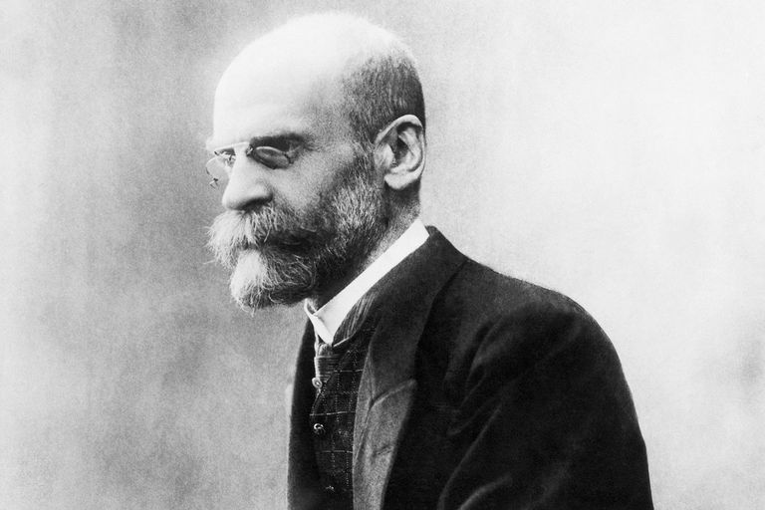
Founding Scholar of Anthropology of Religion
Emile Durkheim

Slide 2
These were the learning objectives:
Identify and discuss key themes of anthropology of religion
Demonstrate knowledge of the main debates in anthropology of religion
Discuss the main features of the anthropological method in studying religions
Questions to ask
What does he believe? And why? (Why does he view things through the lens of functionalism?)
Where is the source of his views? How does Durkheim reach his conclusions?
Also we could look for critics of Durkheim and functionalism (where?)
Lindsey also makes the point that you could ask what is the applicability of Durkheim’s views to the subject of Anthropology

Slide 3
Background on Durkheim
Questioned the value to which reductionism played within scientific enquiry as he felt that the whole is invariably greater than the sum of its parts (Barnard and Spencer, 1996, p. 249)
Although functionalists seem him as a founding father of the anthropological school of functionalism, he never himself used the term, and this was more historical revisionism on part of the actual functionalists (Barnard & Spencer, 1996, p. 249)
Notes:
Durkheim developed the theoretical school of functionalism which purported to provide explanations of phenomena in terms of the function, or purpose, they purportedly serve (Barnard and Spencer, 1996, pp. 246-247).

Slide 4
How Durkheim analysed `religion` within society
To answer that question how did Durkheim decide what was religion was in the first place
Durkheim has a number of assumptions when it comes to Anthropology.
He argues that it is a `fundamental postulate` that a human institution cannot rest upon error and falsehood. He argued that if it did, it could not endure (Durkheim, 1912, p. 2)(I personally find this questionable, but okay)
That is why he felt that religions had some element of `the real` (Durkheim, 1912, p. 2)
Durkheim also assumed that `all the essential elements of religious thought and life ought to be found, at least in germ, in the most primitive religions` (Lukes, 1973, p. 455-456) (though what is meant as primitive here, as Lukes points out, can be somewhat ambiguous)
Feels religion has a certain role and fulfils specific needs (Durkheim, 1912, p. 3)
Durkheim regarded `primitive` civilisations offered privileged cases due to the fact the constituent elements of these religions were especially visible and thus “since the facts are simpler, the relations between them are more apparent”
Does say that some religions are greater than others – ?
Notes:
I mean if you view religions as pretty much representations of society then if you view societies as scalable on a hierarchy as well then it would follow
Acknowledged the role that mystery had played in the history of religions (Durkheim, 1973, p. 22-23)

Slide 5
Durkheim’s view of religion
By his own testimony, he was heavily influenced by Robertson Smith… and he use smith’s sociological definition of religion was `a relation of all the members of a community to the power that has the good of the community at heart` (Lukes, 1973, p. 451)
Clearly felt that religion represented something; he simply rejected the way that religious explain and justified their religious beliefs (Lukes, 1973, p. 460).
For Durkheim that something is society (Lukes, 1973, p. 461), and he had his own ways of investigating that.
He rejected animist and naturist theories (Lukes, 1973, p. 460)
Believed that clan totenism was the earliest form of religion (Lukes, 1973, p. 451)
Also saw religion as an effect of the sentiment to “attach the individual to the whole social being” (Lukes, 1973, p. 238)
Notes:
He felt that religion represented something very real (Durkheim, 1912, p. ) and that even if men
Thus he defined religion as
He rejected animist and naturist theories as the way he saw it, they were super-imposing an `unreal world, made up entirely of the fantastic images which excite his mind during a dream, or of the aberrations, often monstrous, allegedly generated by the mythological imagination under the bewitching, but deceiving influence of language` (Lukes, 1973, p. 460)

Slide 6
Criticisms of Durkheim
Much modern sociology, including sociology in Durkheim’s home country is more focused on the individual (in contrast to Durkheim’s philosophy) (Obadia, 2014, p. 549)
Some scholars, such as Daniele Hervieu-Leger, argued that modernity would have a `disintegrating` effect on religion (Durkheim’s definition of such being a social fact that reflects the reality of society), as the rapid development of individualistic behaviours empirically and theoretically dissolves the phenomenon described by Durkheim (Obadia, 2014, p. 552)

Slide 7
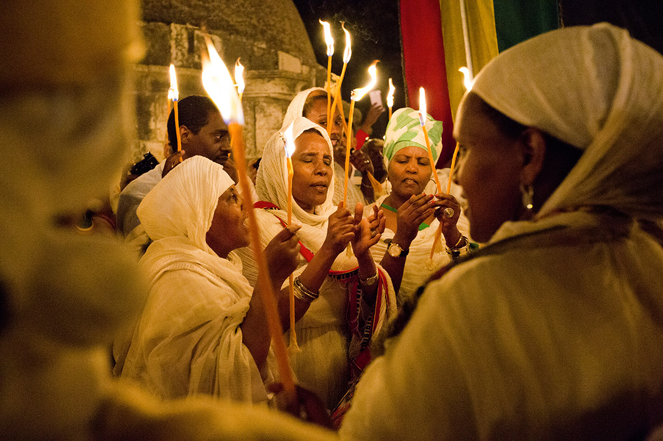
Does Durkheim’s schema have much utility to actually studying Anthropology of Religion
Having this functionalistic view of religion (it being something which serves a function within society, i.e. it helps people have active engagement and communion with their own society) means you would be smart to analyse people’s own collective reasons for doing things. It’s good to seeing things.
It is smart to analyse people’s public collective ways to do things
It’s a theoretical bridge that can be applied to ethnographic analysis
Granted some people might have their own private reasons for doing things, so maybe Durkheim’s view of people itself could definitely be scrutinised
Also although Durkheim believed that religion represented society, I’m not sure how Durkheim used religious practice to extrapolate statements about what society was

Slide 8
Bibliography
Barnard, A. & Spencer, J. (1996) Encyclopaedia of Social and Cultural Anthropology. Routledge: 11 New Fetter Lane, London EC4P 4EE
Durkheim The Elementary Forms of Religious Life, The Free Press, A Division of Simon & Schuster Inc.: 1230 Avenue of the Americas, New York, N.Y. 10020
Lukes, S. (1975) Emile Durkheim, His Life and Work: A Historical and Critical Study, Penguin Books ltd: Harmondsworth, Middlesex, England
Obadia, L. (2014) `Is Durkheim's "sociologism" outdated? Debating "individualism" in contemporary French sociology of religion` Canadian Journal of Sociology/Cahiers canadiens de sociologie, 39(4),

