Slide 1

ADVANCED RESEARCH METHODS IN COUNSELLING:
Lesson 2
Dr Beverly cole

Slide 2
Aims of this lesson: To understand more about:
Philosophical paradigms
Research documentation
Research ethics

Slide 3

Any questions from the asynchronous learning and/or your reading?

Slide 4

Part 1: Philosophical paradigms
Notes:
This is quite a complex issue, but we don’t have to go into this very deeply here. We just need to understand the basics#

Slide 5

Opening round: How are we doing?
Notes:
So, before we start, remember that whilst this PowerPoint will INTRODUCE you to these concepts, you’ll become more familiar with them as you undertake your reading, and we work through the module. You can also ere-ngage with the material on Moodle as we work through the module#

Slide 6
This lesson will address:
Methodological positioning
Looking through a critical lens
Philosophical paradigms
General principles and philosophical assumptions of quantitative and qualitative research
Notes:
What do we mean by ‘Philosophical paradigms’? Well, it's said that these define a researcher’s worldview. By this, we mean that a paradigm constitutes the abstract beliefs and principles that shape how a researcher sees the world, and how s/he interprets and acts within that world…… It’s the lens through which a researcher looks at the world…So, A research paradigm is “the set of common beliefs and agreements shared about how problems should be understood and addressed”.. You’ll hear some difficult sounding words, which will become common place to you…for example…ontology – What is reality? Epistemology – How do we know what we know…………our ontology and epistemology create a holistic view of how knowledge is viewed, and how we can see ourselves in relation to this knowledge. These concepts lead to the methodological strategies that we use. Awareness of philosophical assumptions will result in quality research and can contribute to the creativity of the researcher#

Slide 7
Ontology:
Theories about the nature of reality, or being
How we specify the relationship between the world and our human interpretations and practices
Determines whether we think that reality exists separately from human practices and understanding or it cannot be separated from human practices so knowledge always reflects our perspective.
Notes:
So, first of all, let’s get an understanding of these difficult words … As we’ve just heard, and you will have seen from your reading, ontology relates to ‘What is reality?’#

Slide 8
Epistemology
Epistemology: the theory of knowledge. It is concerned with the mind’s relation to reality
Epistemology: the researcher’s view regarding what constitutes acceptable knowledge
Notes:
Whilst epistemology relates to how we know what we know#

Slide 9

Epistemology and Ontology:
Why are these concepts important?
Notes:
Why are these concepts important – well Epistemology and Ontology dictate what we can, and can’t, count as meaningful knowledge and inform our methodology and the process of producing that knowledge#

Slide 10
Epistemology and Ontology
Epistemology – The branch of philosophy concerned with the theory of knowledge. This involves the thinking of knowledge itself - How can we know?
Ontology – Concerned with nature of the world - What is there to know?
We need to be able to identify our goal and to justify our choice and be clear about the objectives for our research
To what extent does the epistemological position predict which method you use?
Methodology’ – A general approach to studying research topics
‘Method – A specific research technique
‘
Notes:
So, Epistemology is concerned with the theory of knowledge. This involves the thinking of knowledge itself - How can we know? Ontology is concerned with the nature of the world - What is there to know? We need to be able to identify our goals, justify our choices and be clear about the objectives for our research…Read up on the extent to which our ontological and epistemological position predicts which methodologies we use…remembering that…., ‘Methodology’ – relates to our general approach to studying research topics, such as IPA or Grounded theory…Method – relates to a specific research activity, such as interviews, focus groups, etc#

Slide 11

Quantitative and qualitative research have differing underlying philosophies and worldviews
Notes:
Brought down to the most basic level, we have seen how, whilst quantitative research is based on numerical data, analysed statistically, qualitative research uses non-numerical data…The difference between quantitative and qualitative research is often seen as quite fundamental, with many researchers defining themselves as either quantitative or qualitative. This definition is linked to different underlying philosophies and world views of researchers, with two fundamentally different world views underlying quantitative and qualitative research. The quantitative view is described as ‘realist’ or ‘positivist’, while the world view underlying qualitative research is seen as being ‘subjectivist’#

Slide 12

Worldview…
Notes:
So, Paradigms are also known as ‘World views; As researchers, we bring philosophical assumptions to our research – the way we see the world and what happens within it …. Remember, Worldviews are a general philosophical orientation about the world, and the nature of research that a researcher brings to a study…., and they arise from … discipline orientations, our inclinations, and past research experiences… The types of beliefs held by individual researchers, based on these factors, will often lead to a researcher embracing qualitative or quantitative research…and as we also know that the quantitative worldview is said to be = ‘realist’ or ‘positivist’, whilst the world view underlying qualitative research is ‘subjectivist’#

Slide 13
How can we understand these positions better
Quantitative view = ‘realist’ or ‘positivist
Qualitative research = ‘subjectivist’.
Notes:
This is the position in the most simplistic terms, but there is a lot more depth to this topic, which you will find out from your further reading.#

Slide 14
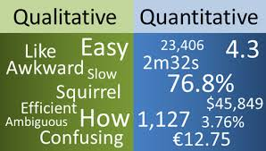
What is the process of research?
QUANTITATIVE
OR
QUALITATIVE

Slide 15
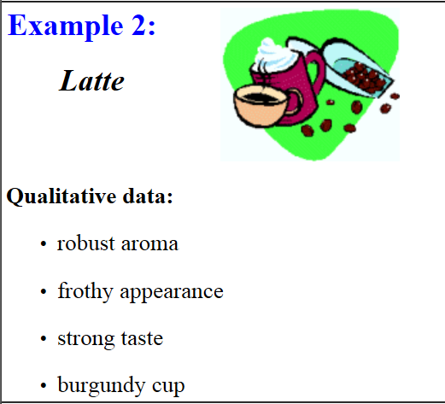
Qualitative Data

Slide 16
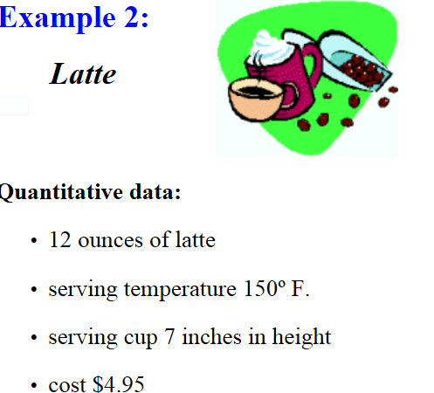
Quantitative Data

Slide 17
Further reading:
Guba, E., & Lincoln, Y. S. 2005. Paradigmatic controversies, contradictions, and emerging confluences. In N. K. Denzin & Y. S. Lincoln, The Sage handbook of qualitative research (3rd ed., pp. 191-215). Thousand Oaks, CA: Sage.

Slide 18

Philosophical lens and methodological approach … … …
What do you know about your philosophical lens and methodological approach?
Notes:
So, What is your immediate reaction? Do you see yourself as an archaeologist, digging to uncover a reality that exists independently [Positivist] or a sculptor, creating reality and involved in the production of that reality [Constructionist]. Thinking of this in this way may, again, be a good place to start ▲▲▲▲ ►►►►

Slide 19
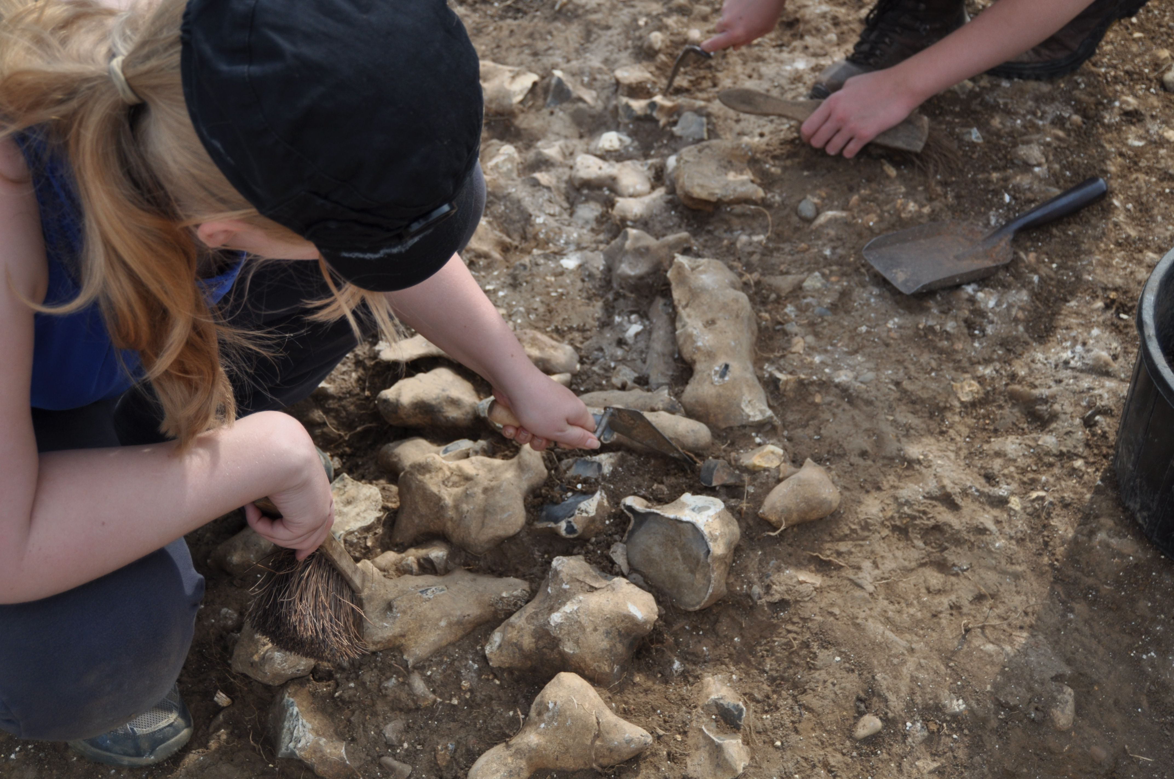

What do you know about your philosophical lens?
archaeologist
sculptor
Notes:
You’ll hear more about these concepts on this slide from the PP on Ontology and Epistemology on Moodle and on the Thematic Analysis PP, but what is your immediate reaction? Take some time to reflect upon this and we’ll pick this up at the end of this PP………………………………….#

Slide 20
Reflecting on forms of knowing - Take a few moments to think about your own life and work
Notes:
Two groups, break out rooms for 20 mins

Slide 21
Now is a good time to read up on worldviews and decide your own stance …

Slide 22
Here are four worldviews widely discussed in the literature, along with the main elements of each position.
Postpositivism
• Determination
• Reductionism
• Empirical observation and measurement
• Theory verification
Constructivism
Understanding
• Multiple participant meanings
• Social and historical construction
• Theory generation
Transformative
• Political
• Power and justice oriented
• Collaborative
• Change-oriented
Pragmatism
Consequences of actions
• Problem-centered
• Pluralistic
• Real-world practice oriented
Notes:
These are four worldviews or paradigms widely discussed in the literature: Postpositivsm / Constructivism / Transformative / Pragmatism PAUSE

Slide 23
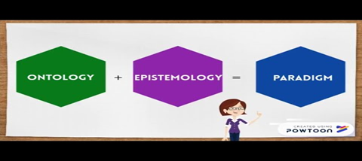
Your philosophical lens [3 mins] ……….
Understanding Ontology and Epistemology

Slide 24
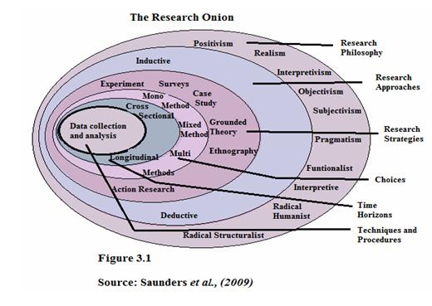
Check out this article:
The Research Onion
Notes:
Engage with this article – there is also a link to this on Moodle. How do we peel back the layers in order to understand research and research paradigms?

Slide 25

Reading resources:
Don’t forget to check out all the information on:

Slide 26

What can we learn from qualitative research?
Notes:
.
The strength of qualitative research is its ability to provide complex, textual descriptions of how people experience a given research issue. …It provides information about the “human” side of an issue – that is, the often contradictory behaviours, beliefs, opinions, emotions, and relationships of individuals.

Slide 27

Any questions

Slide 28
Part 2: Workshop on Assignment 2 [See next PP]

Slide 29
Aims of this lesson: Do you understand more about:
Philosophical paradigms
Assignment 1: Research ethics [See next PP]
Research documentation [See next PP]
Notes:
Research ethics

Slide 30

Any questions?

Slide 31
I’ll leave you with this thought for the week:
No research without action, no action without research”
- Kurt Lewin
Lewin (1890-1947) was a German-American social psychologist. He’s known for his theory that human behaviour is a function of our psychological environment.

Slide 32
Glossary of some research terms used in lesson:
Axiology - the study of value. In qualitative research, there is an assumption that all research is value-laden, and includes the value systems of the researcher, the theory, research methodology, and research paradigm, as well as the social and cultural norms of the researcher and participants.
Epistemology - The branch of philosophy concerned with the theory of knowledge. This involves the thinking of knowledge itself - How can we know? What Constitutes Valid Knowledge and How Can We Obtain It?
Methodology - A general approach to studying research topics. How we do what we do
Method - A specific Research Technique – What we do
Ontology – Concerned with nature of the world - What is there to know? What Constitutes Reality and How Can We Understand Existence?
For further information on research terms, follow this link: Glossary of research terms
For further information on Ontology and Epistemology in particular, see the PowerPoint posted under this lesson on Moodle.

Slide 33
References
Creswell, J.W. and Poth, C.N. 2018. Qualitative Inquiry and Research Design Choosing among Five Approaches. 4th Edition, SAGE: London.
Harper, D. 2012, Qualitative research methods in mental health and psychotherapy: a guide for students and practitioners, Oxford: Wiley-Blackwell. Online.
McLeod, J. 2011. Qualitative Research in Counselling and Psychotherapy. 2nd Ed. London: Sage
McLeod, J. 2013, Doing counselling research. Sage Publications: London

