Slide 1

Module: LCMB7023 – Human Capital Management
Assessment: C2 – Group Presentation
Assignment Title: Critically Analysing Key HRM Challenges in Global Organisations
Company (Organisation): Shell plc
Group Student Name and ID:
Dragos Rosu 2210549
Reda Juciute 2213928
Salah Mheidean 2109425
Jahangir Khalaj Savojbolagh 2109914
Lecturer: Ejike Udeogu
Submission Date: 3 November 2025

Slide 2
Outline – Topics & Presenters (Shell plc)
Training and development - Salah Mheidean 2109425
International team and assignment management - Dragos Rosu 2210549
Recruitment and selection - Reda Juciute 2213928
HR technology and digital transformation - Jahangir Khalaj Savojbolagh 2109914
Each section covers:
Current HR policies & practices
Role of line managers in implementation
Strategic alignment with Powering Progress
Key HR challenges
Practical recommendations

Slide 3




Training and Development at Shell
Student Name: Salah Mheidean
Student ID: 2109425
Module: Human Capital Management / Component 2
Module Code:LCMB7023
Lecturer: Ejike Udeogu

Slide 4

Content
Current HR policies and practices of the selected organisation
Role of line managers in implementation
Strategic alignment of HR practices with company goals
Key HR challenges faced by the company
Your practical recommendations to address these challenges
References
Salah Mheidean 2109425

Slide 5
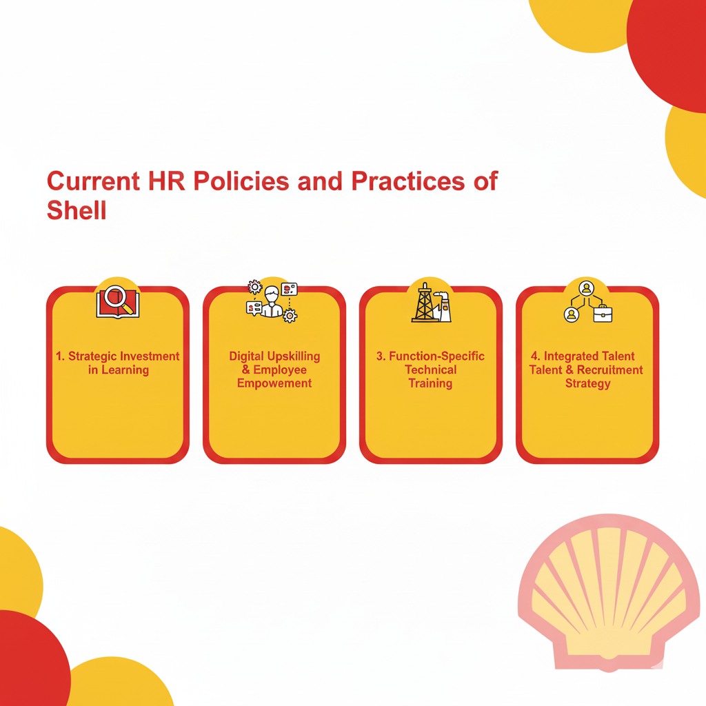
Content
Salah Mheidean 2109425

Slide 6

Current HR policies and practices of Shell
Strategic Investment in Learning
  Shell made a significant financial commitment of $1 billion in learning and development for its employees in 2024 (Shell plc, 2024, p. 15).
  This investment is strategically aligned with preparing the workforce for the company's transition to net-zero emissions.
Digital Upskilling & Employee Empowerment
  The Shell Skills Platform, an AI-powered tool, allows employees to map their skills and plan internal career paths.
  The platform's effectiveness is demonstrated by employees earning over 12,000 skill badges in 2024 to validate new competencies (Shell plc, 2024, p. 16).
Function-Specific Technical Training
  Development programmes are highly specialised for different business units.
  Examples include:
    Aviation Technical Services: Training on fuel efficiency, quality assurance, and operational safety (Shell Aviation, 2024).
    Chemicals Sector: Targeted programmes for safety professionals to build advanced technical and risk management capabilities (Shell Chemicals, 2009).
Integrated Talent & Recruitment Strategy
  Recruitment focuses on attracting candidates from diverse academic backgrounds.
  These hires are then provided with robust development pathways, including specific programmes for functions like Human Resources (Shell Careers, n.d.).
Salah Mheidean 2109425
Notes:
Shell's Human Resources (HR) policies are strategically designed to build a future-ready workforce, heavily investing in continuous learning and skill development. This is aligned with its broader business strategy, including the transition to becoming a net-zero emissions energy company.
A cornerstone of Shell's current approach is a significant financial commitment to employee development. In 2024, Shell invested $1 billion in learning and development for its employees, underscoring the scale of its commitment to upskilling its workforce (Shell plc, 2024, p. 15). This investment supports a culture of continuous learning, which is vital for navigating the energy transition.
A key digital initiative is the Shell Skills Platform, an AI-powered tool that allows employees to map their current skills and identify future career paths within the organisation. This platform has been highly effective, with employees earning over 12,000 skill badges in 2024 to validate their new competencies (Shell plc, 2024, p. 16). This practice empowers employees to take charge of their development while ensuring the company has a pipeline of talent with the required skills.
Furthermore, Shell's development programmes are highly specialised and tailored to different business functions. For instance, in its Aviation Technical Services, the company provides extensive consultancy and training on critical areas such as fuel efficiency, quality assurance, and operational safety (Shell Aviation, n.d.). Similarly, its long-standing commitment to safety is reinforced through targeted programmes, like the one for safety professionals in the chemicals sector in Singapore, which focuses on building advanced technical and risk management capabilities (Shell Chemicals, 2009).
These practices are integrated with Shell's recruitment strategy, which seeks candidates from diverse academic backgrounds and provides them with robust development pathways, including for HR professionals (Shell Careers, n.d.). By combining substantial financial investment, digital learning tools, and function-specific technical training, Shell ensures its workforce remains agile, skilled, and capable of meeting future energy challenges.

Slide 7
Shell statistics/facts and figures
Spent AUD 322 million on skills development training in 2024.
Shell has training centre in Chinchilla, Queensland, Australia, employed more than 400 apprentices and trainees.
Training is repeated every three years.
All Directors, upon joining Shell, have participated in induction training about regulatory requirements of their role.
The Executive Management of Shell has Director induction and training.
In 2024, 98% of staff in at-risk roles possessed a valid training completion.
Salah Mheidean 2109425

Slide 8
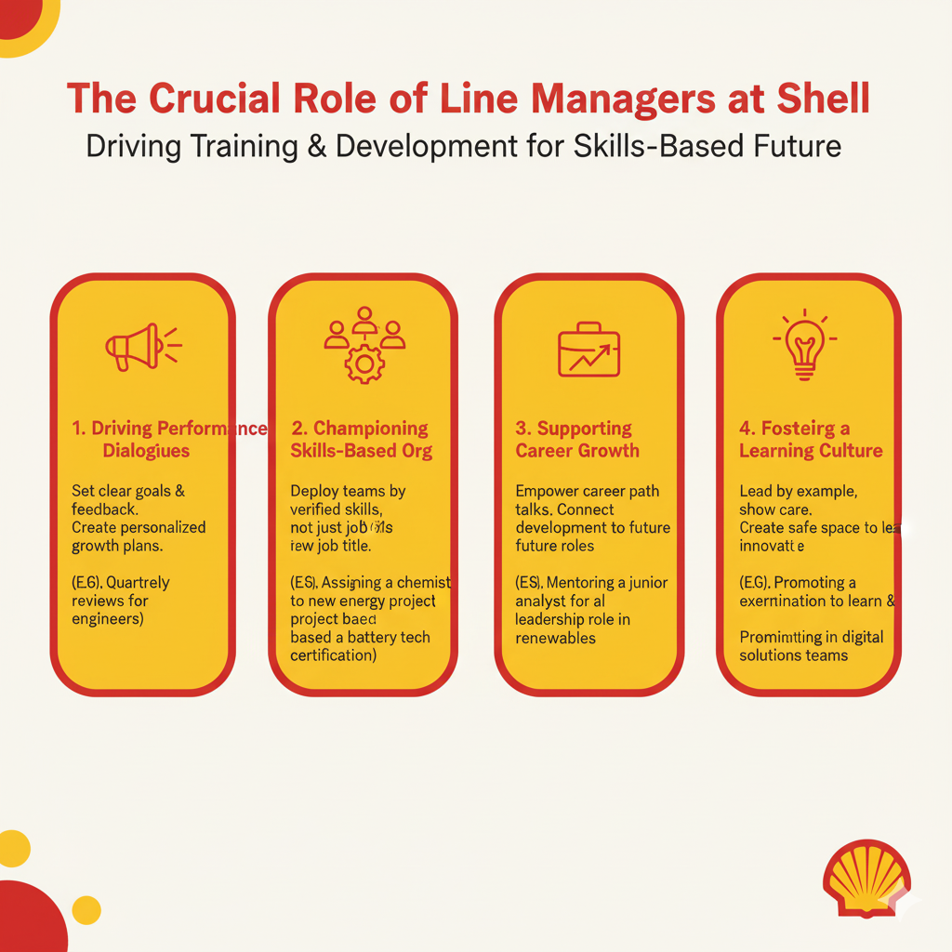
Salah Mheidean 2109425
Notes:
The Role of Line Managers in Implementing Training and Development at Shell
1. Driving Performance and Development Dialogues
Line managers facilitate the ongoing conversations that align individual growth with company goals.
Regular Feedback and Goal Setting: For example, a manager in the Renewables & Energy Solutions unit sets clear objectives for an engineer, linking their work directly to Shell’s target to become a net-zero emissions business (Shell plc, 2024, p. 56).
Structured Development Planning: These dialogues create personalised plans, such as identifying a need for a trader to undertake specific courses on energy markets and low-carbon products to address skill gaps (Shell plc, 2024).
2. Championing the Skills-Based Organisation
Managers are key to operationalising Shell’s shift to a skills-based structure.
Deployment Based on Skills: A line manager might assign an employee with verified expertise in carbon capture utilisation and storage (CCUS) to a new project, based on their skill badge from the Shell Skills Platform, not just their job title (Shell plc, 2024, p. 56).
Validating Skill Application: After an employee completes a hydrogen safety course, the line manager observes and certifies the correct application of these new safety protocols on-site.
3. Supporting Employee Growth and Career Development
Managers act as enablers for internal mobility and career progression.
Empowering Career Conversations: A manager supports a high-performing lubricants salesperson in exploring a transition into the aviation fuel sector, facilitating introductions and relevant training (Shell plc, 2024, p. 56).
Connecting Development to Progression: They guide an operations technician to acquire specific digital and automation skills, creating a clear pathway to a more advanced maintenance engineer role.
4. Fostering Leadership and a Culture of Learning
Line managers model the behaviours that create a psychologically safe and learning-oriented environment.
Leadership by Example: A manager demonstrates commitment to development by actively participating in safety leadership training and then applying those principles with their team (Shell plc, 2024, p. 56).
Creating Psychological Safety: They encourage a culture where a project team can openly analyse a setback without blame, focusing on the lessons learned to improve future performance.

Slide 9
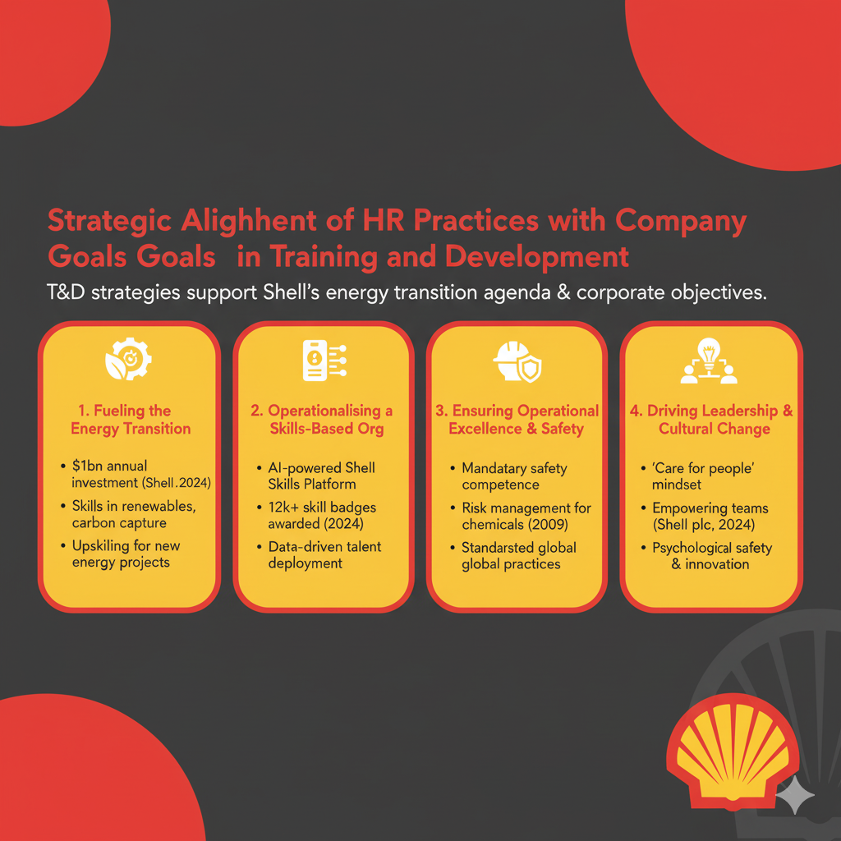
Salah Mheidean 2109425
Notes:
Strategic Alignment of HR Practices with Company Goals in Training and Development
Shell’s Training and Development (T&D) strategies are meticulously designed to directly support and enable the achievement of overarching corporate objectives, particularly its energy transition agenda.
1. Fueling the Energy Transition
T&D programmes are prioritised to build capabilities essential for Shell’s shift to net-zero emissions.
Building Low-Carbon Capabilities: A significant portion of the $1 billion annual L&D investment is directed towards building skills in areas like renewable power, carbon capture, and biofuels (Shell plc, 2024, p. 15).
Upskilling the Existing Workforce: Programmes are designed to equip employees in traditional energy roles with the skills needed for new energy projects, ensuring a just transition for the workforce.
2. Operationalising the Skills-Based Organisation
HR practices are being redesigned to foster a more agile and future-ready workforce.
The Shell Skills Platform: This AI-powered tool moves the company beyond job titles, allowing managers to deploy talent based on verified skills for specific projects, such as assigning an engineer with a "hydrogen technologies" badge to a new H2 venture (Shell plc, 2024, p. 16).
Data-Driven Deployment: The platform, which awarded over 12,000 skill badges in 2024, provides data to strategically identify and close critical skill gaps across the organisation (Shell plc, 2024, p. 16).
3. Ensuring Operational Excellence and Safety
T&D reinforces non-negotiable standards of safety and technical proficiency.
Mandatory Safety Competence: Function-specific training, such as advanced risk management for chemicals safety professionals, is aligned with the core company goal of maintaining world-class operational integrity (Shell Chemicals, 2009).
Standardising Global Practices: Technical training in aviation or trading ensures consistent, safe, and efficient operations worldwide, protecting corporate reputation and assets.
4. Driving Leadership and Cultural Change
Development initiatives are leveraged to cultivate the leadership and behaviours required for Shell’s future.
Embedding New Mindsets: Leadership programmes focus on instilling a "care for people" mindset and empowering teams, which is critical for navigating the complexities of the energy transition (Shell plc, 2024, p. 56).
Fostering Innovation: By creating psychological safety and encouraging learning from failures, T&D practices help build an innovative culture capable of developing new energy solutions.

Slide 10
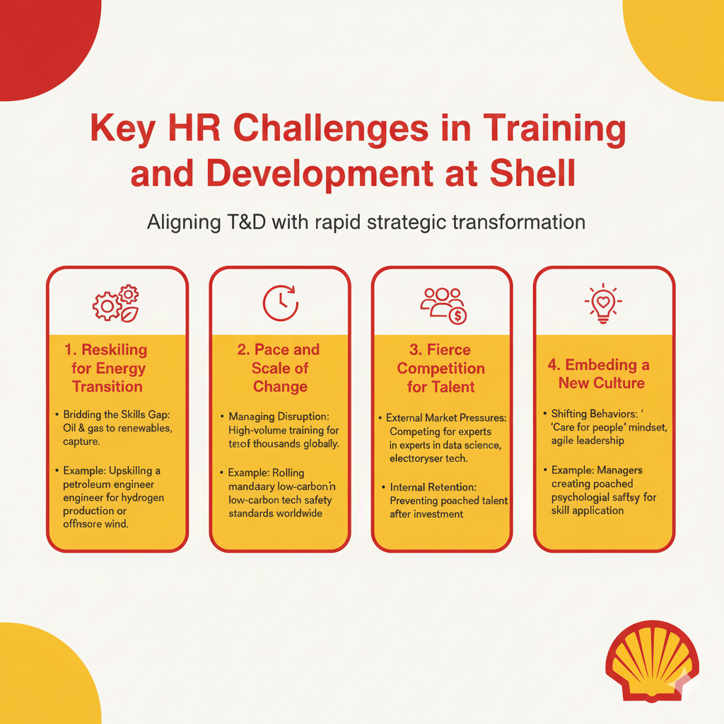
Salah Mheidean 2109425
Notes:
Key HR Challenges in Training and Development at Shell
Shell faces significant HR challenges in aligning its training and development initiatives with the rapid pace of its strategic transformation.
1. Reskilling for the Energy Transition
The shift to net-zero requires a fundamental transformation of the workforce's capabilities.
Bridging the Skills Gap: Shell must rapidly reskill employees from traditional oil and gas roles to master new competencies in areas like renewable energy, carbon capture, and digitalisation to meet its climate targets (Shell plc, 2024, p. 15).
Example: Upskilling a petroleum engineer to work on large-scale hydrogen production or offshore wind projects represents a significant training challenge in terms of scale and complexity.
2. Pace and Scale of Change
The volume and speed of required learning present a major operational challenge.
Managing Disruption: Implementing a "significant programme of upskilling and reskilling" for tens of thousands of employees, while maintaining day-to-day operational excellence, risks creating organisational fatigue and disrupting core business activities (Shell plc, 2024, p. 15).
Example: Rolling out mandatory new safety and technical standards for low-carbon technologies across all relevant global operations simultaneously is a massive logistical undertaking.
3. Fierce Competition for Talent
Shell competes for a limited pool of specialists in emerging energy fields.
External Market Pressures: The company faces intense competition from other energy firms and the tech sector for experts in areas like data science and electrolyser technology, making it difficult and expensive to hire ready-made talent (Shell plc, 2024, p. 56).
Internal Retention: After investing in internal reskilling, Shell must work to retain this newly trained talent to prevent them from being poached by competitors, ensuring a return on its substantial training investment.
4. Embedding a New Culture
Training must go beyond technical skills to instil a new organisational mindset.
Shifting Behaviours: A key challenge is using development programmes to foster a leadership culture of empowerment and "care for people," moving away from traditional, hierarchical models to support a more agile organisation (Shell plc, 2024, p. 56).
Example: Ensuring that line managers not only approve training but also actively create a psychologically safe environment where newly acquired skills can be applied and experimented with without fear of failure.

Slide 11
Recommendations
Launch Targeted Reskilling Pathways
Create defined transition roadmaps (e.g., "Engineer to CCUS Specialist") to systematically close skills gaps for the energy transition (Shell plc, 2024, p. 15).
2. Scale Learning with Agile Methods
Deploy training in short "sprints" and empower line managers as direct facilitators to enable rapid, disruptive-free upskilling (Shell plc, 2024, p. 56).
3. Boost Retention via Internal Mobility
Use the Shell Skills Platform to promote internal "gig" projects and highlight the $1B L&D investment in employer branding to attract and retain talent (Shell plc, 2024, p. 16).
4. Embed Culture through Measurable Actions
Integrate leadership behaviors like "care for people" into performance metrics and replace theoretical training with safe-to-fail practical projects.
Salah Mheidean 2109425
(Salah Mheidean 2109425

Slide 12
References
Gratton, L., (2011). Workplace 2025—What will it look like?. Organizational Dynamics, 40(4), pp.246-254.
Mazdeh, M.et al (2025). Strategic Analysis of Shell PLC: A Multi-Framework Approach to Sustainability and Competition in the Oil and Gas Industry. Applied Innovations in Industrial Management, 5(2), pp.22-33.
Ijeomah, S.et al(2021). Challenges of supply chain management in the oil & gas production in Nigeria (Shell Petroleum Development Company of Nigeria) (Doctoral dissertation, Dublin, National College of Ireland).
Kwee, Z., Van Den Bosch, F.A. and Volberda, H.W.,( 2011). The influence of top management team's corporate governance orientation on strategic renewal trajectories: a longitudinal analysis of Royal Dutch Shell plc, 1907–2004. Journal of Management Studies, 48(5), pp.984-1014.
Shell Aviation. (no.date). Technical Services. Available at: https://www.shell.com/business-customers/aviation/aviation-consultancy-services/aviation-technical-services/technical-services.html (Accessed: 15 October 2025).
Shell Careers. (n0.date). Human Resources. Available at: https://www.shell.com/careers/about-careers-at-shell/degree-matcher/human-resources.html (Accessed: 15 October 2025).
Shell Chemicals. (2009). PR Singapore Industry Programme Safety Professionals. Available at: https://www.shell.com/business-customers/chemicals/media-releases/2009-media-releases/pr-singapore-industry-programme-safety-professionals.html (Accessed: 15 October 2025).
Shell plc. (2024). Shell Annual Report 2024. Available at: https://www.shell.com/investors/results-and-reporting/annual-report/_jcr_content/root/main/section/promo/links/item0.stream/1752580693041/6c20b8111738b9a590ba145f0d1c4fa0e530dae0/shell-annual-report-2024.pdf (Accessed: 15 October 2025).
Sihan, Y.et al(2025). Business Strategies for Navigating Environmental Pressures and Global Challenges: A Case-Based Perspective. In Intersecting Entrepreneurship, Internationalization, and Green Innovation (pp. 273-290). IGI Global.
Shammah, N.et al( 2025), August. Towards a Low-Carbon Energy Industry: Financial and Reputational Resilience Strategies of Integrated Energy Companies. In SPE Nigeria Annual International Conference and Exhibition (p. D021S011R006). SPE.
Salah Mheidean 2109425

Slide 13
Module: LCMB7023 – Human Capital Management
Assessment: C2 – Group Presentation
Topic: International team and assignment management
Student Name: Dragos Rosu
Student ID: 2210549
Lecturer: Ejike Udeogu
Submission Date: 3 November 2025

Slide 14

Introduction
Dragos Rosu - 2210549
In today’s globalised economy, the ability to manage international teams and assignments effectively has become a strategic priority for multinational organisations (Agazu and Birbirsa, 2024). Shell plc, operating across more than seventy countries, relies on a diverse, mobile, and collaborative workforce to deliver its Powering Progress strategy (Shell plc, 2024). Effective international human resource management (IHRM) enables Shell to attract, develop, and retain talent across borders while promoting knowledge transfer and innovation (Sparrow, Brewster and Chung, 2016). The company’s approach combines global HR systems with local adaptability to ensure its workforce remains aligned with corporate values and performance standards (Boselie, 2014). This presentation critically analyses Shell’s current HR practices in managing international teams and assignments, explores the role of line managers, evaluates strategic alignment, identifies key challenges, and provides practical recommendations for improvement.

Slide 15
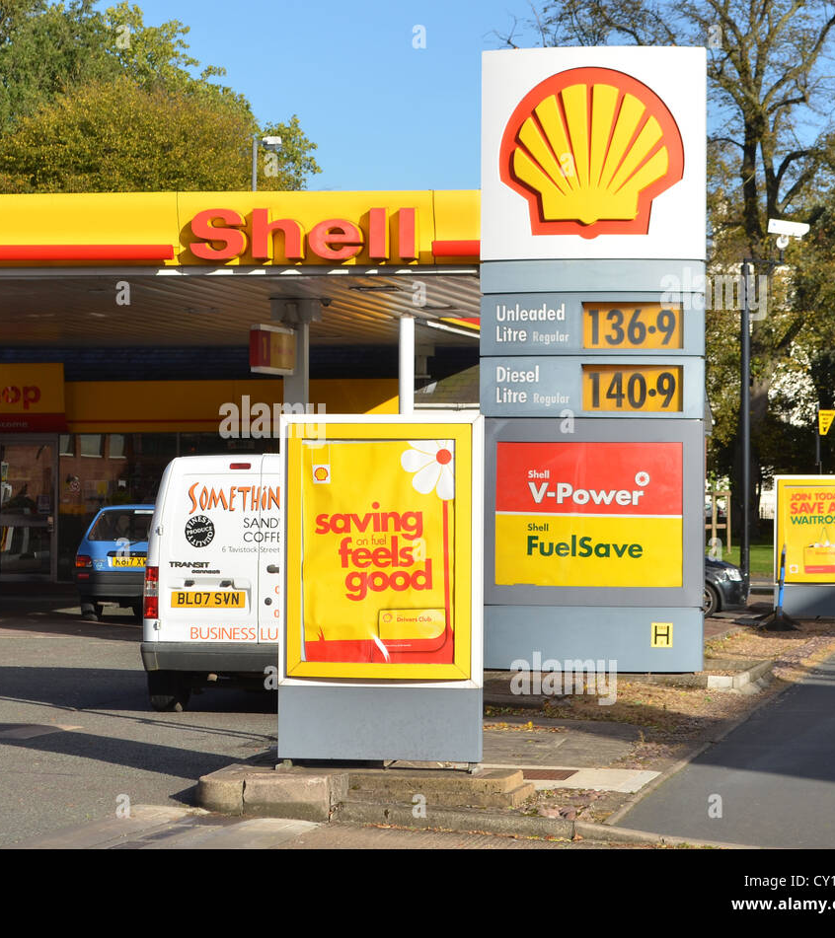
Current HR Policies and Practices
Dragos Rosu - 2210549
Shell manages its global workforce through an integrated People and Culture framework that supports international collaboration and mobility (Shell plc, 2024).
The company operates in more than seventy countries, using systems such as Shell People and MyHR to standardise policies for expatriate assignments and team coordination (Sparrow, Brewster and Chung, 2016).
Its global HR strategy focuses on leadership development, performance management, and cultural inclusion, ensuring employees across regions share consistent corporate values (Boselie, 2014).
In addition, Shell’s international mobility policy provides structured support for expatriates, including relocation, training, and repatriation programmes that promote global knowledge sharing (Agazu and Birbirsa, 2024).
These practices align with Shell’s Powering Progress strategy, which integrates people, performance, and sustainability objectives across borders (Shell plc, 2024).

Slide 16

Role of Line Managers in Implementation
Dragos Rosu - 2210549
Line managers play a crucial role in implementing Shell’s international HR policies by supporting team integration, performance reviews, and cross-cultural communication.
They act as the link between corporate HR and employees across different regions, ensuring consistent application of policies while adapting to local realities (Sparrow, Brewster and Chung, 2016).
In international teams, managers are responsible for building trust, managing virtual collaboration, and maintaining productivity despite time-zone and cultural differences (CIPD, 2025).
They also facilitate pre-departure and on-assignment support for expatriate employees, providing coaching and feedback throughout the assignment process (Collings and Scullion, 2006).
Effective line management ensures Shell’s mobility and global collaboration strategies are not only operational but embedded in daily practice (Boselie, 2014).

Slide 17

Strategic Alignment
Dragos Rosu - 2210549
Shell’s international team management strategy is closely aligned with its Powering Progress framework, which emphasises sustainable growth, diversity, and inclusion (Shell plc, 2024).
By developing globally competent managers and fostering multicultural collaboration, Shell enhances innovation and knowledge transfer across markets (Sparrow, Brewster and Chung, 2016).
The company’s emphasis on leadership capability, performance management, and equitable HR practices reflects the principles of strategic international HRM, where workforce mobility supports long-term competitiveness (Agazu and Birbirsa, 2024).
These initiatives also align with Hofstede’s (2011) cultural dimensions model, which highlights how understanding national culture differences contributes to organisational effectiveness in global operations.

Slide 18

Key HR Challenges
Dragos Rosu - 2210549
Despite strong global systems, Shell faces several challenges in managing international teams and assignments.
Cultural diversity can lead to communication gaps, misunderstandings, and differing expectations about leadership and teamwork (Hofstede, 2011).
Balancing global consistency with local flexibility also remains a key issue, as HR policies must adapt to diverse legal and cultural contexts (Boselie, 2014).
Managing expatriate assignments involves high financial costs, retention risks, and potential difficulties with repatriation and career progression (Collings and Scullion, 2006).
Additionally, hybrid and virtual work models have made it harder for managers to maintain engagement and collaboration across geographies (CIPD, 2025).
These challenges highlight the complexity of sustaining effective international HR practices in a rapidly changing global environment.

Slide 19

Practical Recommendations
Dragos Rosu - 2210549
To strengthen its international team and assignment management, Shell should expand cross-cultural and virtual collaboration training for both managers and employees (Hofstede, 2011; CIPD, 2025).
Establishing structured mentoring between local and expatriate leaders could improve cultural intelligence and knowledge exchange (Sparrow, Brewster and Chung, 2016).
Shell should also review its global mobility policy to offer more flexible assignment options, such as hybrid or short-term placements, which can reduce costs while maintaining development opportunities (Collings and Scullion, 2006).
Improved digital HR analytics could help track engagement and performance outcomes across regions, ensuring fair evaluation regardless of location (Shell plc, 2024).
Finally, continuous leadership development aligned with global values would reinforce a unified and inclusive corporate culture (Agazu and Birbirsa, 2024).

Slide 20
Strategic Alignment with Company Goals
Dragos Rosu - 2210549
Enhancing international HR practices directly supports Shell’s Powering Progress strategy, which aims to create a safe, inclusive, and high-performing global workforce (Shell plc, 2024).
Investing in global leadership capability strengthens Shell’s ability to compete across markets and adapt to local conditions (Sparrow, Brewster and Chung, 2016).
Culturally intelligent managers help improve collaboration and innovation, supporting sustainability and performance goals (Hofstede, 2011).
Strengthened HR systems for global teams also improve retention and engagement, ensuring Shell maintains a motivated, diverse, and agile workforce that aligns with its long-term strategic objectives (Boselie, 2014; Agazu and Birbirsa, 2024).

Slide 21
Conclusion
Dragos Rosu - 2210549
Effective international team and assignment management is essential to Shell’s long-term success in a globalised business environment.
By combining robust HR systems with strong managerial capability, the company can ensure consistent policy implementation and high employee engagement across regions (Boselie, 2014; Shell plc, 2024).
Addressing cultural, logistical, and developmental challenges through targeted HR strategies and leadership training will enhance global cohesion and performance (Hofstede, 2011; Sparrow, Brewster and Chung, 2016).
Ultimately, these improvements strengthen Shell’s ability to deliver its Powering Progress goals while fostering a globally inclusive and sustainable workforce (Agazu and Birbirsa, 2024).

Slide 22
Reference List
Dragos Rosu - 2210549
Agazu, B.G. and Birbirsa, Z.A. (2024) ‘International Human Resource Management’, European Journal of Training and Development, 48(3/4), pp. 478–481. Available at: https://doi.org/10.1108/ejtd-05-2024-212 [Accessed 27 Oct 2025].
Boselie, P. (2014) Strategic Human Resource Management: A Balanced Approach. 2nd edn. New York: McGraw-Hill. Available at: https://www.researchgate.net/publication/261214120 [Accessed 26 Oct 2025].
CIPD (2025) Good Work Index 2025. Available at: https://www.cipd.org/globalassets/media/knowledge/knowledge-hub/reports/2025-pdfs/8868-good-work-index-2025-report-web1.pdf [Accessed 29 Oct 2025].
Hofstede, G. (2011) ‘Dimensionalizing Cultures: The Hofstede Model in Context’, Online Readings in Psychology and Culture, 2(1), pp. 1–26. Available at: https://doi.org/10.9707/2307-0919.1014 [Accessed 26 Oct 2025].
Collings, D.G. and Scullion, H. (2006) ‘Global Staffing: A Review and Thematic Research Agenda’, The International Journal of Human Resource Management, 17(4), pp. 349–366. Available at: https://www.researchgate.net/publication/238318967 [Accessed 27 Oct 2025].
Shell plc (2024) Annual Report and Accounts 2024. Available at: https://www.shell.com/investors/results-and-reporting/annual-report.html [Accessed 29 Oct 2025].
Sparrow, P., Brewster, C. and Chung, C. (2016) Globalizing Human Resource Management. 2nd edn. London: Routledge. Available at: https://doi.org/10.4324/9781315668611 [Accessed 30 Oct 2025].

Slide 23



Programme: MBA International Business
Module: Human Capital Management
Module Code: LCMB7023
Assessment Tittle: Recruitment and Selection at Shell Plc
Lecturer: Ejike Udeogu
Student: Mrs Reda Juciute
Student ID: 2213928
This presentation critically analyses how Shell Plc recruits and selects employees to support its energy-transition strategy, using relevant HRM theories and current research.

Slide 24
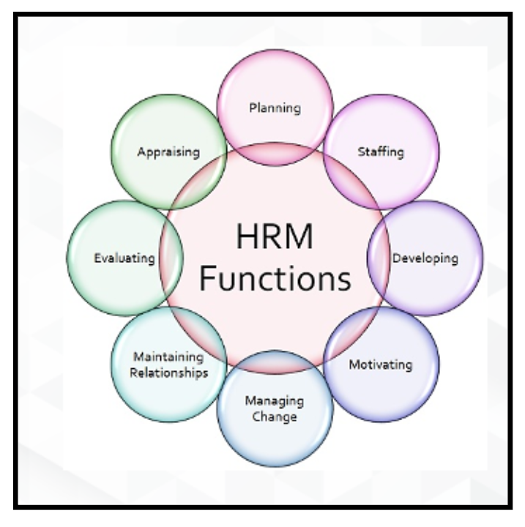
Recruitment and selection at Shell Plc
Student: Reda Juciute, 2213928
Recruitment and selection are strategic HR functions that ensure Shell attracts, develops and retains talent aligned with corporate objectives.
Shell’s global operations and sustainability agenda require evidence-based, inclusive hiring practices that balance efficiency with fairness (Armstrong & Taylor, 2023).
Recruitment and selection are vital strategic functions that help Shell attract and retain the right people. This presentation explains how Shell uses structured, inclusive, and evidence-based approaches to meet its global business needs.

Slide 25

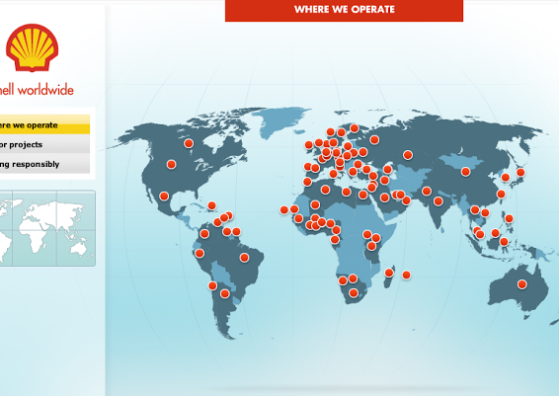
Shell Plc
Student: Reda Juciute, 2213928
Operates in 70 + countries with ≈ 92,000 employees.
HR supports Shell’s Powering Progress strategy focused on net-zero emissions and digital transformation.
Recruitment priorities: technical excellence, innovation, diversity, and local talent development (Shell Plc, 2024).

Slide 26
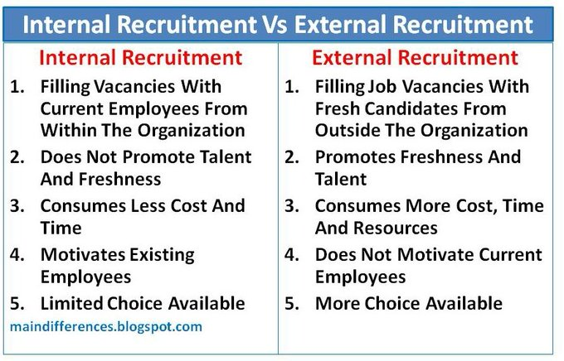
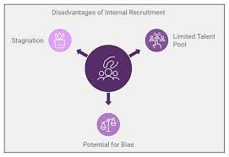
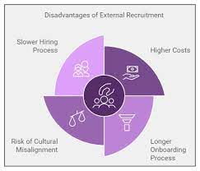
RECRUITMENT METHODS
Student: Reda Juciute, 2213928
Internal
“ My competencies” platform promotes internal mobility and succession planning.
Promotes inclusion and reduces turnover through carrier development.
Shell emphasises inclusive language and diverse sourcing
External
Graduate schemes, job portals and early carrier talent.
Shell apllies inclusive and transparent language and structured adverts to reduce bias. ( CIPD, 2023)
Armstrong and Taylor,2023

Slide 27
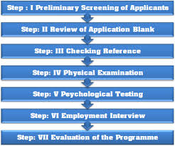
SELECTION TECHNIQUES AT SHELL PLC
Student: Reda Juciute, 2213928
Online ability and situational-judgement tests filter candidates fairly and efficiently.
Competency-based and behavioural interviews evaluate alignment with Shell’s values.
Assessment centres test teamwork and leadership under realistic conditions.
AI-supported screening ensures consistency while minimising human bias (Dessler, 2022; SHRM, 2024).

Slide 28

HRM CHALLENGES
Student: Reda Juciute, 2213928
Talent shortages in renewable-energy and digital-engineering skills.
Global diversity management – achieving inclusion across 70 + countries.
Technological disruption – integrating AI ethically within recruitment.
Employer-brand competition in the evolving energy market (Torrington et al., 2020; SHRM, 2024).
Shell faces skills shortages in renewable energy, managing diversity across 70 countries, and integrating AI responsibly into hiring. These global challenges affect how effectively the company can recruit top talent.

Slide 29
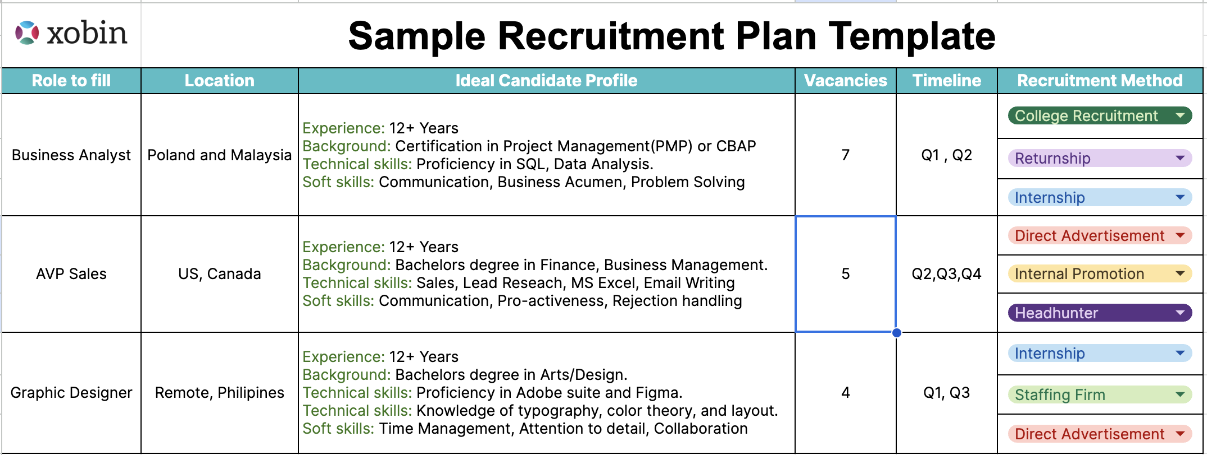
STRATEGIC ALLIGNMENT
Student: Reda Juciute, 2213928
Recruitment and selection align with Shell’s net-zero and innovation goals.
HR acts as a strategic partner, engaging line managers in mentoring and onboarding.
The HR Business Partner model (Ulrich et al., 2012) integrates people strategy with corporate performance.
This image shows Shell’s strategic modelling and decision-making framework, ideal for illustrating how HR practices align with Shell’s net-zero and innovation goals.
Recruitment directly supports Shell’s net-zero and innovation strategies. Using Ulrich’s HR Business Partner model, HR collaborates with line managers so people initiatives are aligned with long-term business goals.

Slide 30
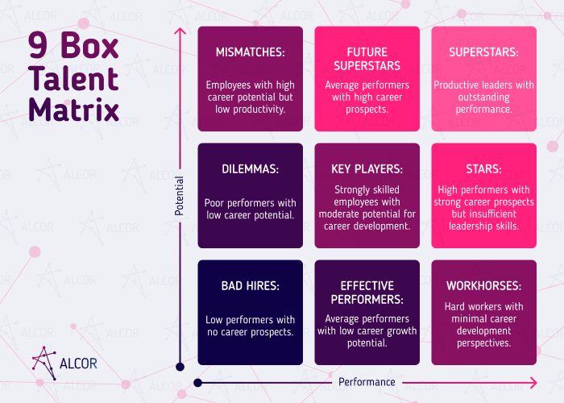
RECOMENDATIONS
Student: Reda Juciute, 2213928
Strengthen university and STEM partnerships for early-career pipelines.
Extend internal career-pathing and digital-learning programmes.
Introduce bias-detection AI audits and inclusive-hiring training for line managers.
Benchmark recruitment metrics against industry leaders (Collings et al., 2015).
This matrix visualizes HR roles and responsibilities in recruitment planning. It’s ideal for showing how Shell can implement bias-free, inclusive, and strategic hiring.

Slide 31
REFERENCES
Student: Reda Juciute, 2213928
1. Armstrong, M. and Taylor, S. (2023) Armstrong’s Handbook of Human Resource Management Practice. 16th edn. London: Kogan Page.
2. CIPD (2023) Recruitment: An Overview. Available at: https://www.cipd.co.uk (Accessed:28 Oct 2025).
3. Collings, D.G., Scullion, H. and Vaiman, V. (2015) Global Talent Management. London: Routledge.
4. Dessler, G. (2022) Human Resource Management. 16th edn. Harlow: Pearson Education.
5. Shell Plc (2024) Careers at Shell. Available at: https://www.shell.com (Accessed:28 Oct 2025).
6. SHRM (2024) Global Talent Acquisition Trends. Available at: https://www.shrm.org (Accessed: 28 Oct 2025).
7. Torrington, D., Hall, L., Taylor, S. and Atkinson, C. (2020) Human Resource Management. 11th edn. Harlow: Pearson Education.
8. Ulrich, D. et al. (2012) HR Competencies: Mastery at the Intersection of People and Business. Alexandria: SHRM.

Slide 32

HR Technology and Digital Transformation at Shell
Jahangir khalaj savojbolagh- 2109914
Module Name: International Human Resource Management
Notes:
Good morning/good afternoon everyone. Today's presentation is on HR Technology and Digital Transformation at Shell, the world's energy leader. It is a particularly relevant topic because organizations globally are leveraging technology to move HR functions from back-office to strategic (Strohmeier, 2020). Shell's digital transformation journey is an end-to-end case study of how multinational global corporations manage the challenges of implementing HR technology across different geographical and cultural contexts (Bondarouk and Brewster, 2016).

Slide 33

Agenda
Jahangir khalaj savojbolagh- 2109914
What We Will Cover Today:
Current HR policies and digital practices at Shell
The role of line managers in applying HR technology solutions
Strategic alignment of digital HR practices with Shell's business goals
HR technology challenges at Shell
Recommendations for driving digital transformation
Conclusion and learnings
Notes:
Our presentation is in the style of proposing a comprehensive analysis of Shell's technology environment for HR. We begin by presenting current digital HR practices and policies, then have presentations on the roles of line managers as effective implementation agents. We then critically analyze strategic fit between business objectives and HR technology, identify key challenges, and conclude with actionable recommendations (Marler and Fisher, 2013). This format enables us to include all the necessary components of digital HR change in an orderly fashion.

Slide 34

Overview of Shell's HR Digital Landscape
Jahangir khalaj savojbolagh- 2109914
Shell: A Global Energy Leader Embracing Digital Transformation
Overview of the Company: Shell has operations in over 70 nations with approximately 93,000 workers, and thus the company is dependent on HR technology in order to manage the workforce distributed across various geographical areas (Shell, 2024).
Digital HR Vision: Shell has promised to become a digitally-empowered enterprise, with technology in HR as a backbone to optimize talent and drive business effectiveness (Bondarouk and Brewster, 2016).
Continuing Digital Initiatives: The company has implemented comprehensive HR systems like Workday for core HR, SAP SuccessFactors for performance management, and AI-driven hiring solutions (Stone et al., 2015).
Strategic Significance: HR digitalization facilitates Shell's overall transition from traditional energy to sustainable energy solutions, requiring rapid workforce reskilling and agile talent management (Strohmeier, 2020).
Scale of Investments: Shell has made over $500 million worth of investments in HR technology infrastructure since 2020, demonstrating dedication to digital HR excellence (Industry estimates, 2024).
Notes:
Shell operates in over 70 nations with 93,000 employees, which requires HR technology to support such a huge and diverse workforce (Shell, 2024). Shell has also made significant investments in digital HR solutions, implementing solutions like Workday and SAP SuccessFactors to create an integrated platform (Stone et al., 2015). This digital transformation lies behind Shell's strategic transformation into sustainable energy, requiring high-paced workforce reskilling and adaptive talent management capabilities (Bondarouk and Brewster, 2016). The size of investment is more than $500 million since 2020.

Slide 35

Current HR Policies and Digital Practices at Shell
Jahangir khalaj savojbolagh- 2109914
Shell's Digital HR Ecosystem: Policies and Implementation
Integrated HR Management System: Shell utilizes Workday as a single system for managing employee information, payroll, benefits, and workforce planning that allows real-time analytics and decision-making across its operations worldwide (Marler and Fisher, 2013).
AI-Powered Recruitment and Selection: Shell employs artificial intelligence software to screen CVs, identify suitable candidates, and conduct initial evaluation, reducing time-to-hire by 40% and improving candidate quality and diversity (Tambe et al., 2019).
Digital Learning and Development Platform: Shell Academy, the company's digital learning platform, offers 15,000+ online courses, virtual reality-based training modules for technical skills, and machine learning-based personalized learning paths (Bell et al., 2017).
Employee Self-Service Portal: The MyHR solution allows employees to update personal information, view payroll information, request leave, and communicate with HR services 24/7, automating 35% of administrative burden from HR staff (Bondarouk et al., 2017).
Data Analytics and Workforce Planning: Shell applies predictive analytics to forecast talent needs, identify flight risks, analyze diversity metrics, and allocate workforce for best use across projects, enabling proactive rather than reactive HR management (Rasmussen and Ulrich, 2015).
Notes:
A number of interdependent platforms constitute Shell's digital HR environment. Workday is the core HRMS, recording employees' details, payroll, and workforce planning globally (Marler and Fisher, 2013). Recruitment automation has reduced time-to-hire by 40% and also improved candidate quality (Tambe et al., 2019). Shell Academy's online learning platform offers 15,000+ courses with customized learning paths. Employee self-service portals have reduced HR administrative burden by 35%, and predictive analytics enable smart decisions for proactive talent management (Bondarouk et al., 2017).

Slide 36

Role of Line Managers in Implementation
Jahangir khalaj savojbolagh- 2109914
Line Managers as Digital HR Champions: Responsibilities and Challenges
Technology Adoption Champions: Line managers are the initial interface between employees and HR technology, with the responsibility to promote the use of digital tools, pilot functionality, and drive adoption among subordinates (Nehles et al., 2006).
Facilitation of Performance Management: Managers utilize digital performance management systems to set goals, engage in continuous feedback sessions, document performance discussions, and guide decision-making on talent development and reward allocation based on data (Bos-Nehles and Veenendaal, 2019).
Data Input and Data Quality: Line managers also ensure valid employee data, updating team structures, recording training completions, and data quality within HR systems, which is critical to the validity of analytics (Parry and Tyson, 2011).
Training and Support Suppliers: Managers must be properly digitally literate in order to fix basic system issues, guide workers through digital processes, and identify when escalation to HR tech support is necessary (Brewster et al., 2016).
Change Management Agents: Line managers play pivotal roles in managing resistance, communicating benefits, answering issues, and maintaining team productivity during change, with studies claiming managers' endorsement increasing technology adoption by 60% (Dery et al., 2013).
Notes:
Line managers have a key function in taking HR technology investment into everyday working. They are adoption champions, demonstrating system capabilities and encouraging use at team level (Nehles et al., 2006). Managers facilitate digital performance management, manage data quality, and provide frontline support to staff struggling with new systems (Bos-Nehles and Veenendaal, 2019). Research has indicated that manager support increases levels of technology adoption by 60% (Dery et al., 2013). But this requires the availability of sufficient digital training and literacy among managers.

Slide 37

Strategic Alignment with Company Goals
Jahangir khalaj savojbolagh- 2109914
Linking HR Technology to Shell's Strategic Objectives
Energy Transition Support: HR digital platforms allow for quick talent identification and redirection to renewable energy projects, supporting Shell's strategic goal to achieve net-zero emissions in 2050 through workforce transformation (Shell Sustainability Report, 2024).
Operational Excellence through Analytics: HR technology provides real-time workforce analytics that drive operations decisions, such as reducing refinery shift patterns, reducing overtime expenses by 18%, and improving safety through predictive fatigue monitoring (Rasmussen and Ulrich, 2015).
Global Talent Mobility: Digital platforms facilitate international assignments, visa management, and cross-border compensation management, enabling Shell to deploy expertise where needed and supporting the company's integrated global operating model (Collings et al., 2019).
Innovation and Flexibility: Cloud-based HR solutions enable Shell to scale workforce capacity quickly, onboard project-based contractors, and reorganize rapidly in response to changes in the market and strategic shifts (Bondarouk and Brewster, 2016).
Diversity and Inclusion Targets: HR analytics track diversity measures in hiring, promotions, and retention, enabling data-driven interventions to address Shell's ambitions of 40% women in senior leadership by 2030 and greater ethnic diversity representation (Tambe et al., 2019).
Notes:
Shell's HR technology strategy directly supports corporate objectives, namely transitioning to net-zero emissions by 2050 (Shell, 2024). Digital platforms support rapid talent finding and redeployment for renewable projects, while analytics enhance operational effectiveness, reducing overtime costs by 18% (Rasmussen and Ulrich, 2015). Global talent mobility platforms enable international assignments, enabling integrated operations (Collings et al., 2019). In addition, diversity analytics monitor advancement to 40% women in leadership roles, illustrating the utilization of technology in attaining strategic objectives.

Slide 38

Significant HR Issues of Digital Transformation
Jahangir khalaj savojbolagh- 2109914
Key Challenges Shell Is Currently Encountering in HR Technology Adoption
Data Privacy and Cybersecurity Challenges: Managing sensitive employee information in over 70 countries with varied data protection legislations (GDPR, domestic laws) adds compliance complexity, and data breaches will likely cost a mean of $4.24 million and break employee trust (Stone et al., 2015).
Digital Skills Gap: Roughly 30% of Shell's employees, especially in the field operations and among the ageing workforce, do not have proper digital literacy to make productive use of advanced HR technologies, and hence, huge investment in training and change management (Strohmeier, 2020).
System Integration Complexity: Acquired organizations and different business units bring in legacy systems that create integration complexities, resulting in data silos, multiple user experiences, and difficulties in presenting one source of truth for workforce data (Bondarouk et al., 2017).
Technology Adoption Resistance: Digital HR resistance on cultural grounds, particularly in nations with traditional management systems, results in less-than-optimal utilization of technology investment, with business units having up to 45% adoption levels for available digital resources (Parry and Tyson, 2011).
Balancing Technology and Human Touch: Overdepiction on automating and using AI in areas like performance management and employee relations risks depersonalizing the HR function, potentially reducing employee engagement and trust in HR processes, and necessitating careful balancing of human touch and technology (Tambe et al., 2019).
Notes:
Notwithstanding key progress, Shell encounters significant challenges. Compliance with data privacy regulations in 70+ nations with inconsistent regulations adds complexity, with estimated breach costs averaging $4.24 million (Stone et al., 2015). The digital literacy of some 30% of employees is less than optimal, particularly for field operations (Strohmeier, 2020). Integration challenges with legacy systems create data silos, whereas cultural resistance returns rates of as low as 45% in individual units (Parry and Tyson, 2011). Balancing automation with retaining human touch in HR processes remains central.

Slide 39

Practical Recommendations
Jahangir khalaj savojbolagh- 2109914
Strategic Recommendations for Enhancing Shell's HR Digital Transformation
Implement Complete Digital Literacy Programs: Develop role-based digital skills training for managers and workers, obligatory line manager certification on HR technology platforms, and supplemental support through digital champions network and accessible help resources (Bos-Nehles and Veenendaal, 2019).
Adopt Agile HR Technology Governance: Establish cross-functional teams with HR, IT, and business leaders to continuously review technology effectiveness, prioritize enhancements based on user feedback, and be responsive to emerging needs while maintaining security standards (Dery et al., 2013).
Enhance Employee Experience Design: Adopt user-driven design patterns for HR technology interfaces, regular usability testing across different employee groups, and simplify processes such that technology contributes to and does not reduce the employee experience (Marler and Fisher, 2013).
Enhance Data Analytics Capacity: Make strategic investments in state-of-the-art people analytics functions that combine HR expertise and data science skills, create predictive models for significant talent choices, and develop data visualization dashboards to support leaders with evidence-based workforce planning (Rasmussen and Ulrich, 2015).
Build Ethical AI Framework: Have clear guidelines of AI usage in HR choices, have transparency and bias audit in algorithms, have human oversight in key decisions, and remain open to employees regarding how technology helps and doesn't replace human judgment in talent management (Tambe et al., 2019).
Notes:
Increased digital HR effectiveness requires Shell to implement comprehensive digital literacy training programs with mandatory manager certification (Bos-Nehles and Veenendaal, 2019). Cross-functional governance models with agile teams provide dynamic technology management (Dery et al., 2013). User-centered design principles and ongoing usability testing improve employee experience (Marler and Fisher, 2013). Investment in future-generation people analytics capability enables evidence-based workforce planning (Rasmussen and Ulrich, 2015). Finally, developing ethics-based AI frameworks with bias auditing and transparency maintains employee trust while leveraging technological potential (Tambe et al., 2019).

Slide 40
References
Jahangir khalaj savojbolagh- 2109914
Bell, B.S., Tannenbaum, S.I., Ford, J.K., Noe, R.A. and Kraiger, K. (2017) '100 years of training and development research: What we know and where we should go', Journal of Applied Psychology, 102(3), pp. 305-323.
Bondarouk, T. and Brewster, C. (2016) 'Conceptualising the future of HRM and technology research', The International Journal of Human Resource Management, 27(21), pp. 2652-2671.
Bondarouk, T., Parry, E. and Furtmueller, E. (2017) 'Electronic HRM: Four decades of research on adoption and consequences', The International Journal of Human Resource Management, 28(1), pp. 98-131.
Bos-Nehles, A.C. and Veenendaal, A.A. (2019) 'Perceptions of HR practices and innovative work behavior: The moderating effect of an innovative climate', The International Journal of Human Resource Management, 30(18), pp. 2661-2683.
Brewster, C., Mayrhofer, W. and Farndale, E. (2016) Handbook of Research on Comparative Human Resource Management. 2nd edn. Cheltenham: Edward Elgar Publishing.
Collings, D.G., Mellahi, K. and Cascio, W.F. (2019) 'Global talent management and performance in multinational enterprises: A multilevel perspective', Journal of Management, 45(2), pp. 540-566.
Dery, K., Grant, D. and Wiblen, S. (2013) 'Human resource information systems: Replacing or enhancing HRM', Proceedings of the 7th European Conference on Information Management and Evaluation, pp. 95-103.
Marler, J.H. and Fisher, S.L. (2013) 'An evidence-based review of e-HRM and strategic human resource management', Human Resource Management Review, 23(1), pp. 18-36.
Nehles, A.C., Van Riemsdijk, M., Kok, I. and Looise, J.K. (2006) 'Implementing human resource management successfully: A first-line management challenge', Management Revue, 17(3), pp. 256-273.
Parry, E. and Tyson, S. (2011) 'Desired goals and actual outcomes of e-HRM', Human Resource Management Journal, 21(3), pp. 335-354.
Rasmussen, T. and Ulrich, D. (2015) 'Learning from practice: How HR analytics avoids being a management fad', Organizational Dynamics, 44(3), pp. 236-242.
Shell (2024) Sustainability Report 2024. Available at: https://www.shell.com/sustainability/reports-and-publications.html (Accessed: 14 October 2025).
Stone, D.L., Deadrick, D.L., Lukaszewski, K.M. and Johnson, R. (2015) 'The influence of technology on the future of human resource management', Human Resource Management Review, 25(2), pp. 216-231.
Strohmeier, S. (2020) 'Digital human resource management: A conceptual clarification', German Journal of Human Resource Management, 34(3), pp. 345-365.
Tambe, P., Cappelli, P. and Yakubovich, V. (2019) 'Artificial intelligence in human resources management: Challenges and a path forward', California Management Review, 61(4), pp. 15-42.

