Slide 1
Welcome to Chinese class
李金屏 lǐ jīn píng
jinping.li@uwtsd.ac.uk

Slide 2

jīn píng
金屏
lǐ
李
wǒ jiào
我 叫
Family name
Given name
lǐ lǎoshī
李 老 师

Slide 3

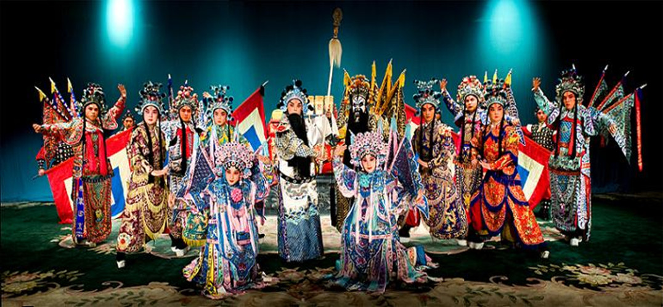
ABOUT ME（我）
❖ 我叫李金屏。
（My name is lǐ jīn píng )
❖ 我喜欢……
（I like……）

Slide 4
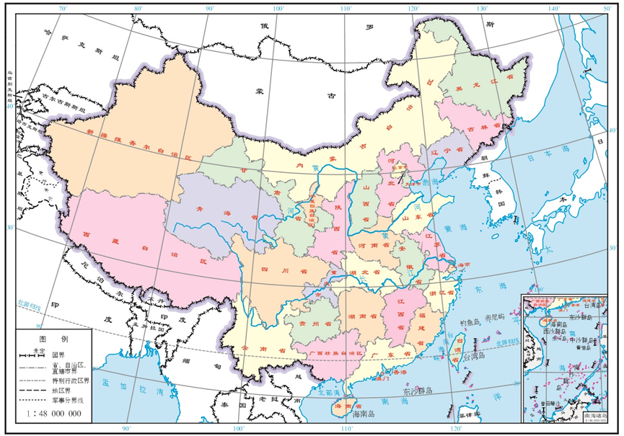
My Hometown(北京)

Slide 5

Forbidden City (故宫)

Slide 6
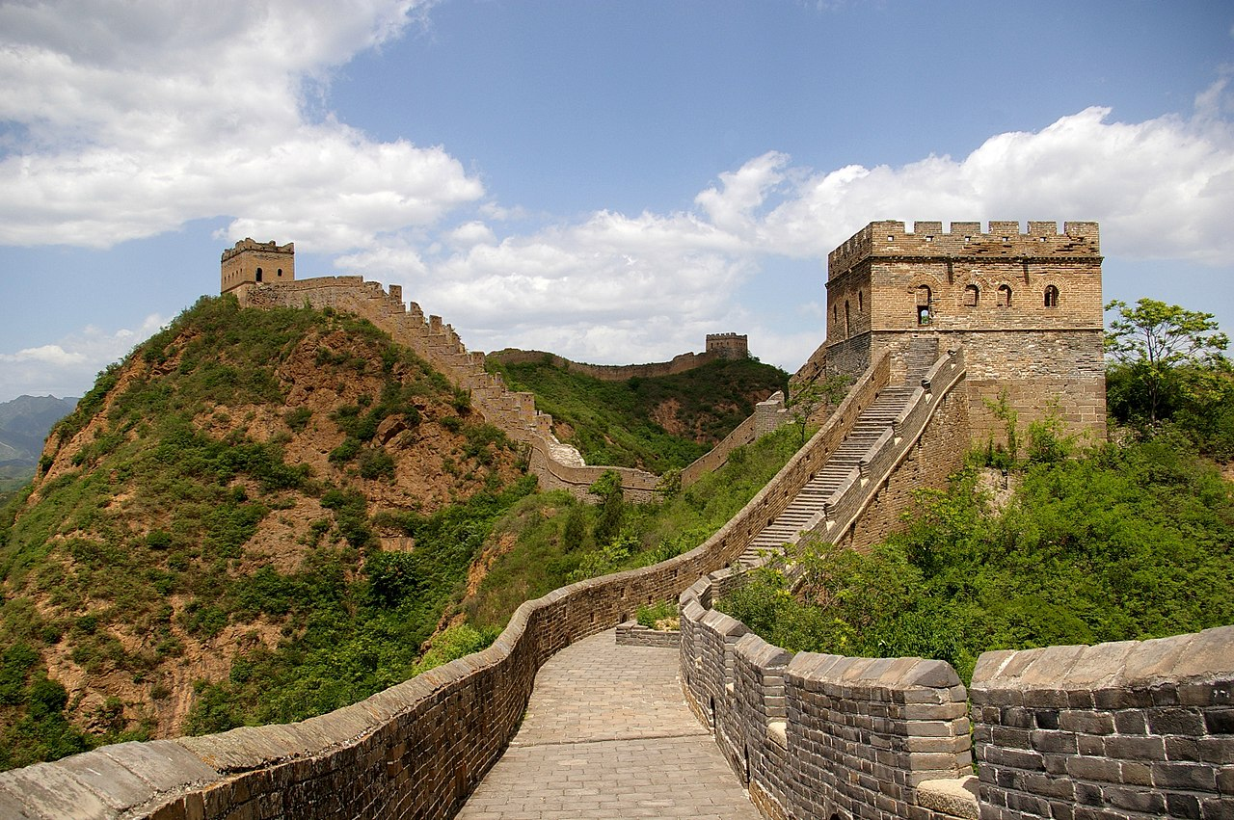
Great Wall(长城)

Slide 7

Skyline of Beijing CBD（北京CBD天际线）

Slide 8
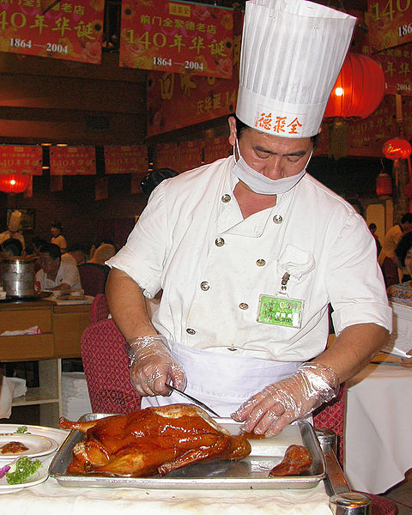
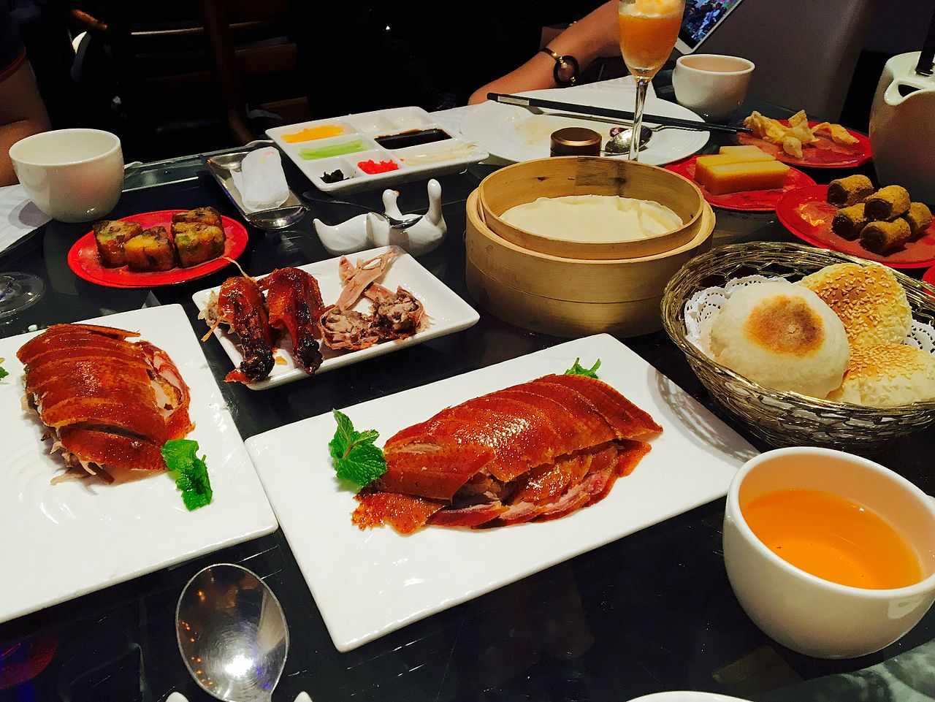
Beijing Roast Duck(北京烤鸭)

Slide 9
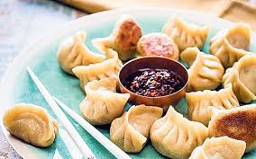
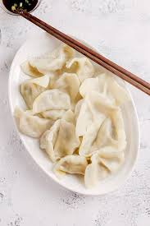
Chinese dumplings

Slide 10
Course Objectives
 Understand and communicate in Mandarin. Communicate effectively in both written and spoken language within set hospitality, business and professional contexts.
 Read and write Pinyin correctly. Correctly copy Chinese characters and write some basic Chinese characters. You will learn: More than 150 commonly used words; around 50 key grammar points; pass HSK1.
 Practice Mandarin in pairs, make dialogues and do role-plays to complete tasks according to different situations.

Slide 11

HSK 1
Standard Course
What is HSK test?
HSK stands for Hànyǔ (Chinese) Shuǐpíng (level) Kǎoshì (test), which is the most important Chinese proficiency test in use today.
The HSK is an international standardized exam that tests and rates Chinese language proficiency. It assesses non-native Chinese speakers’ abilities in using the Chinese language in their daily, academic and professional lives.
HSK consists of six levels, namely the HSK (level I), HSK (level II), HSK (level III), HSK (level IV), HSK (level V), and HSK (level VI).

Slide 12
The levels of the new HSK correspond to the levels of the Chinese Language Proficiency Scales for Speakers of Other Languages (CLPS) and the Common European Framework of Reference for Languages (CEF) as follows:
New HSK | Vocabulary | CLPS | CEF
HSK (Level VI) | Over 5,000 | Level V | C2
HSK (Level V) | 2500 |  | C1
HSK (Level IV) | 1200 | Level IV | B2
HSK (Level III) | 600 | Level III | B1
HSK (Level II) | 300 | Level II | A2
HSK (Level I) | 150 | Level I | A1

Slide 13
Let’s start our journey!

Slide 14
第 1 课
你好

Slide 15
课堂用语Classroom Expressions
上课！ Shàngkè! Class begins!
下课！ Xiàkè! Class is over!
现在休息！ Xiànzài xiūxi！ Take a break now!
看白板！ Kàn Báibǎn ! Look at the whiteboard！
跟我读！ Gēn wǒ dú! Read after me!

Slide 16





Greeting
Nǐ hǎo
你好！
Nǐ hǎo
你好！

Slide 17
Greeting
Nǐ hǎo
你 好 Hello.
Nǐmen hǎo
你们 好 Hello.(pl. to people more than one)
Dàjiā hǎo
大家 好 Hello everyone/guys.
Lǎoshī hǎo
老师 好 Hello teacher.
Tóngxuémen hǎo
同学们 好 Hello students.

Slide 18
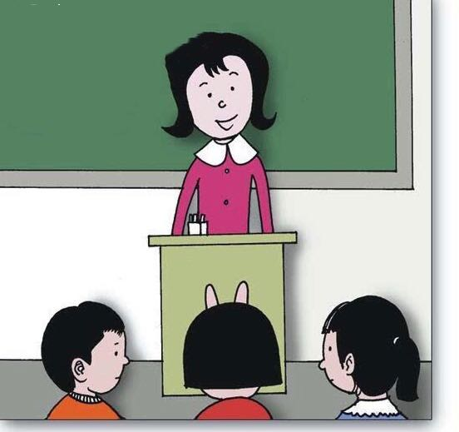
Tóngxuémen hǎo
同学们 好！
Lǎoshī hǎo
老师 好！

Slide 19
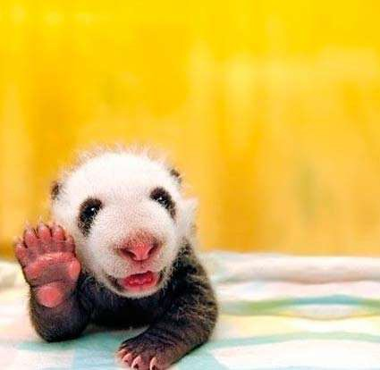
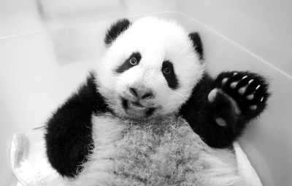
Let’s greet each other.
7

Slide 20
拼音（pinyin）
Initials
Tones
nǐ hǎo
Finals

Slide 21
shēngmǔ
声母（initials）
initials(23)
b p m f d t n l
g k h j q x
zh ch sh r z c s
y w

Slide 22
shēngmǔ
声母（initials）
b p m f d t n l
g k h j q x z c s zh ch sh r
y w

Slide 23
yùnmǔ
韵母（finals）
finals(24)
a o e i u ü
ai ei ui ao ou iu
ie üe er an en in
un ün ang eng ing ong
元音（vowel）

Slide 24
shēngdiào
声调（tones）
Tones(4)
the first tone： high and flat, a little longer (easy) ā
the second tone： up (see?) á
the third tone： down and up again (uh-huh) ǎ
the fourth tone： down (go ! ) à

Slide 25
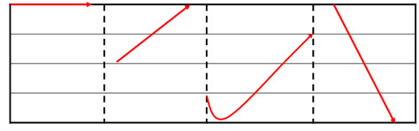
5
4
3
2
1
一声 二声 三声 四声
first tone second tone third tone fourth tone
ā á ǎ à

Slide 26
整体认读音节（ whole-syllable ）
whole-syllables(16)
zhi chi shi ri
zi ci si
yi wu yu
ye yue yuan
yin yun ying

Slide 27
拼音Pinyin
2. 汉语的声调（四声）Tones(Four Tones)
5
mā
5
má
4
4
妈
麻
3
3
2
mother
2
fibrous crops
1
1
5
mǎ
5
mà
4
4
马
骂
3
3
2
horse
2
to scold
1
1

Slide 28
拼音Pinyin
朗读下列音节，注意声调的不同
Read the syllables aloud and pay attention to the tones
ā | á | ǎ | à
ō | ó | ǒ | ò
ē | é | ě | è
ī | í | ǐ | ì
ū | ú | ǔ | ù
ǖ | ǘ | ǜ | ǜ

Slide 29

课文Text 1
nǐ hǎo
A：你好！
nǐ hǎo
B：你好！

Slide 30
课文Text 1
A：你好！
B：你好！

Slide 31

课文Text 2
nǐn hǎo
A：您 好！
nǐ men hǎo
B：你 们 好！

Slide 32
课文Text 2
A：您 好！
B：你 们 好！

Slide 33

课文Text 3
duì bù qǐ
A：对不起！
méi ɡuān xi
B：没 关 系！

Slide 34
课文Text 3
A：对不起！
B：没 关 系！

Slide 35
拼音Pinyin
3. 汉语的音节 Chinese Syllables
汉语的音节 Syllable | 声母 Initial | 韵母 Final | 声调 Tone
māo （猫，cat） | m | ao
yú （鱼，fish） |  | ü
jiě （姐， elder sisiter） | j | ie
èr （二，two） |  | er

Slide 36
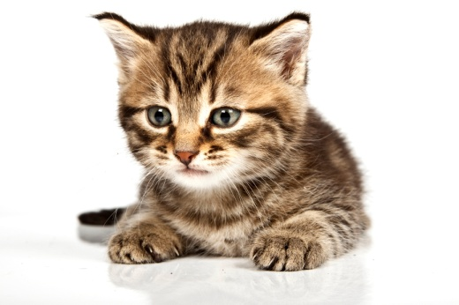


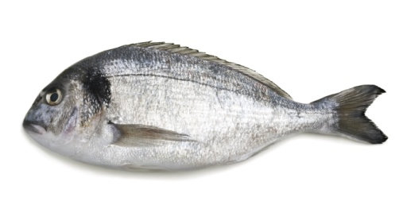
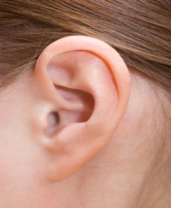



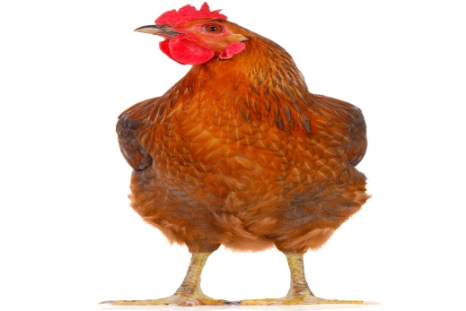

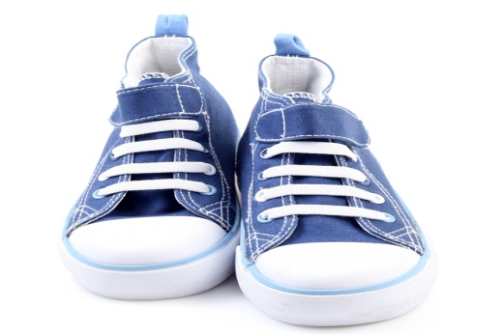

拼音Pinyin
看图片，朗读下列单音节词语
Look at the pictures and read the monosyllabic words aloud
yī
wǔ
yú
ěr
bǐ
māo
dǎo
huā
jī
qī
xié
xuě

Slide 37

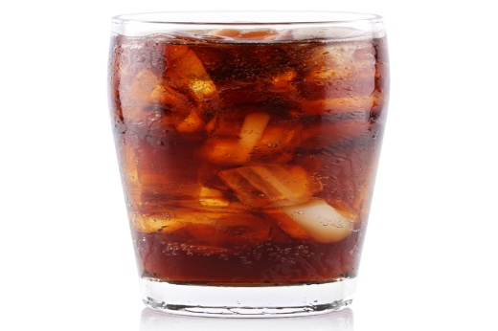
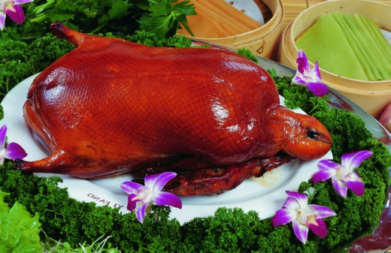
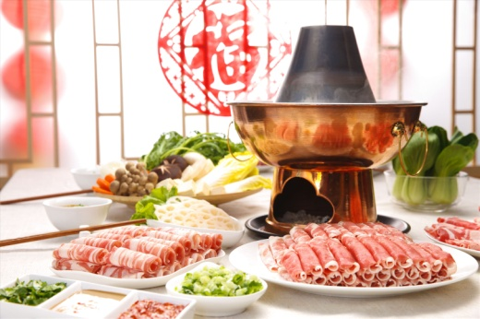
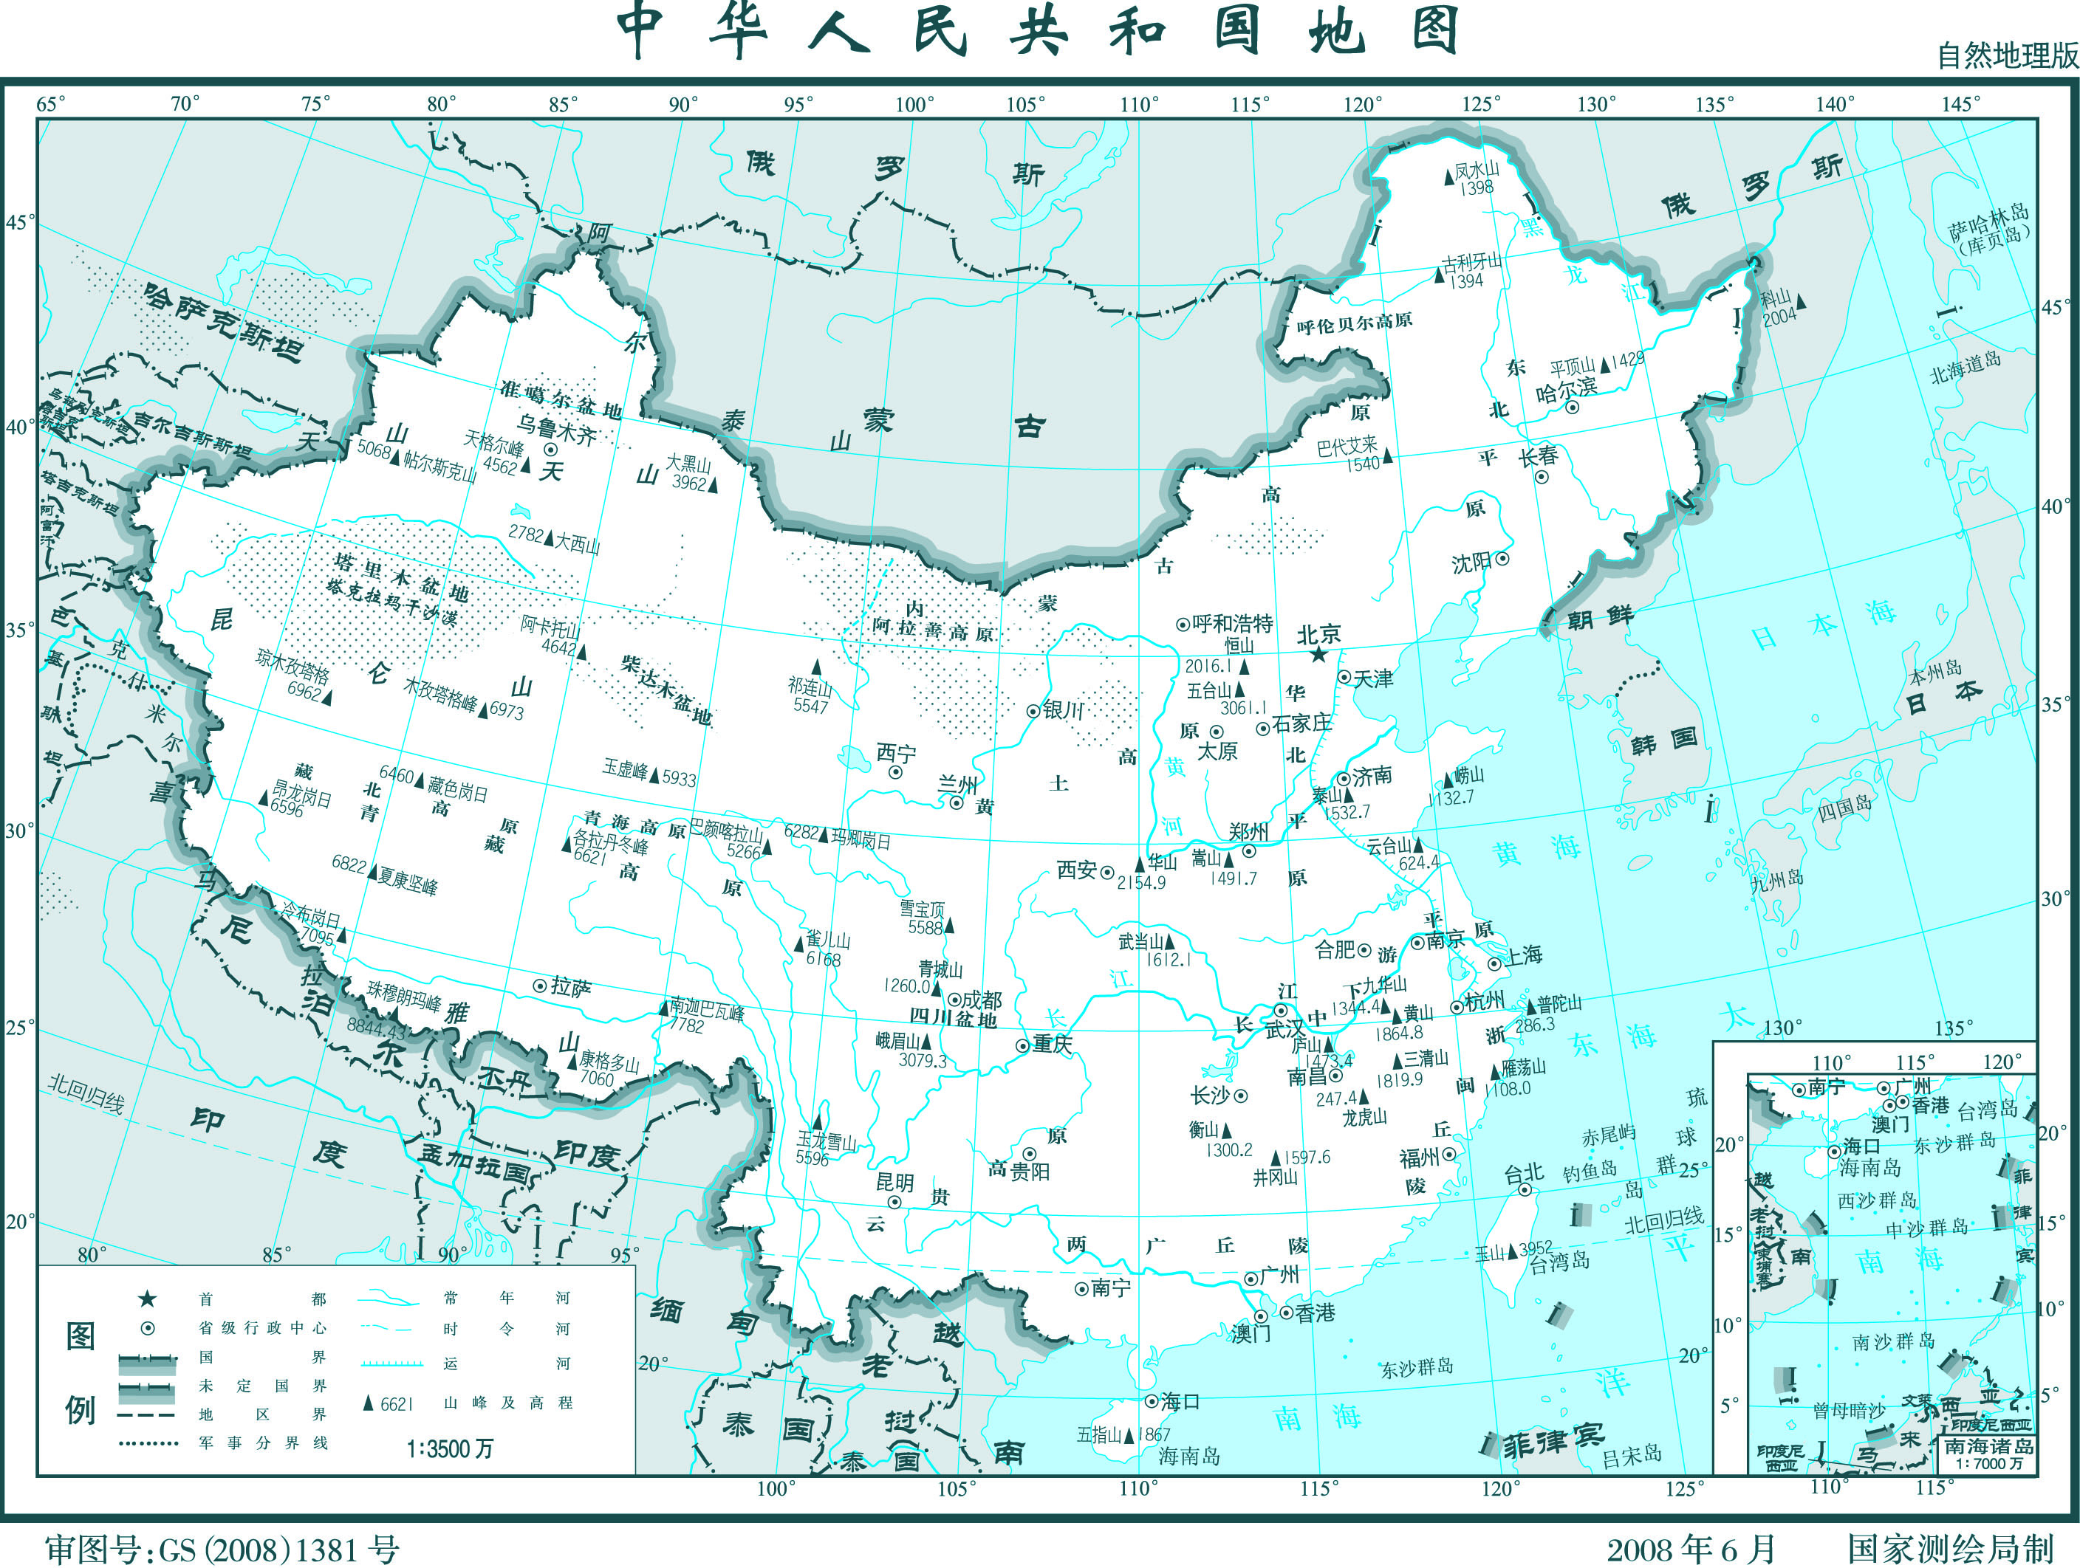



拼音Pinyin
看图片，朗读下列双音节词语
Look at the pictures and read the disyllabic words aloud
kāfēi
kělè
kǎoyā
huǒɡuō
dìtú
fēijī
máobǐ
ěrjī

Slide 38
拼音Pinyin
4. 两个三声音节的连读变调 3rd Tone+ 3rd tone= 2nd tone +3rd tone
+
+
nǐ （你） | hǎo（好） | ní | hǎo
kě （可） | yǐ（以） | ké | yǐ
fǔ （辅） | dǎo（导） | fú | dǎo

Slide 39
拼音Pinyin
朗读下列词语，注意第三声音节的读音
Read the following words aloud and pay attention to the change in the tone of the 3rd tone syllables
nǐ hǎo
kěyǐ
fǔdǎo
xiǎojiě
kǒuyǔ
yǔfǎ
Fǎyǔ
tǎo hǎo
liǎojiě
yǒuhǎo
yǔsǎn
shǒubiǎo

Slide 40





汉字Characters
1. 汉字的笔画（1）Strokes of Chinese Characters(1)
笔画名称 Stroke | 运笔方向 Direction | 例字 Example Characters
横 hénɡ horizontal |  | 一 yī one 二 èr two
竖 shù vertical |  | 十 shí ten 工 ɡōnɡ work，labor
撇 piě left-falling |  | 人 rén human 八 bā eight
点 diǎn dot |  | 不 bù no，not 六 liù six
捺 nà right-falling |  | 大 dà big 天 tiān sky
一
丨
丿
丶

Slide 41
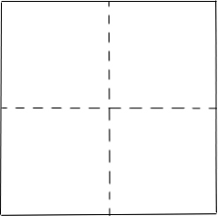
汉字Characters
2. 认识独体字（笔画） Single-Component Characters（Strokes）

Slide 42
汉字Characters
2. 认识独体字 Single-Component Characters
一
二
三
十
八
六

Slide 43


再见！zàijiàn
Goodbye

