Slide 1

Effective teamwork and communication

Slide 2

What is environmental noise ?
Environmental noise refers to physical sounds in the work[lace that interfere with communication, making it difficult for people to hear or understand messages .
According to Shannon- weaver model of communication noise can dispute the transmission between sender and receiver.
This can impact a business as if it is located near a residential noise. Noise pollution can lead to many problems for example annoyance, irritability, and sleep disturbance, affecting the health and well-being of the workers. It is crucial for a business to take this issues inconsideration as it could overcome from this happening.
LCLM4003 - Effective Teamworking and Communication - Jan Term 2026 - Component 2 Assessment Specification - Birmingham (2)

Slide 3
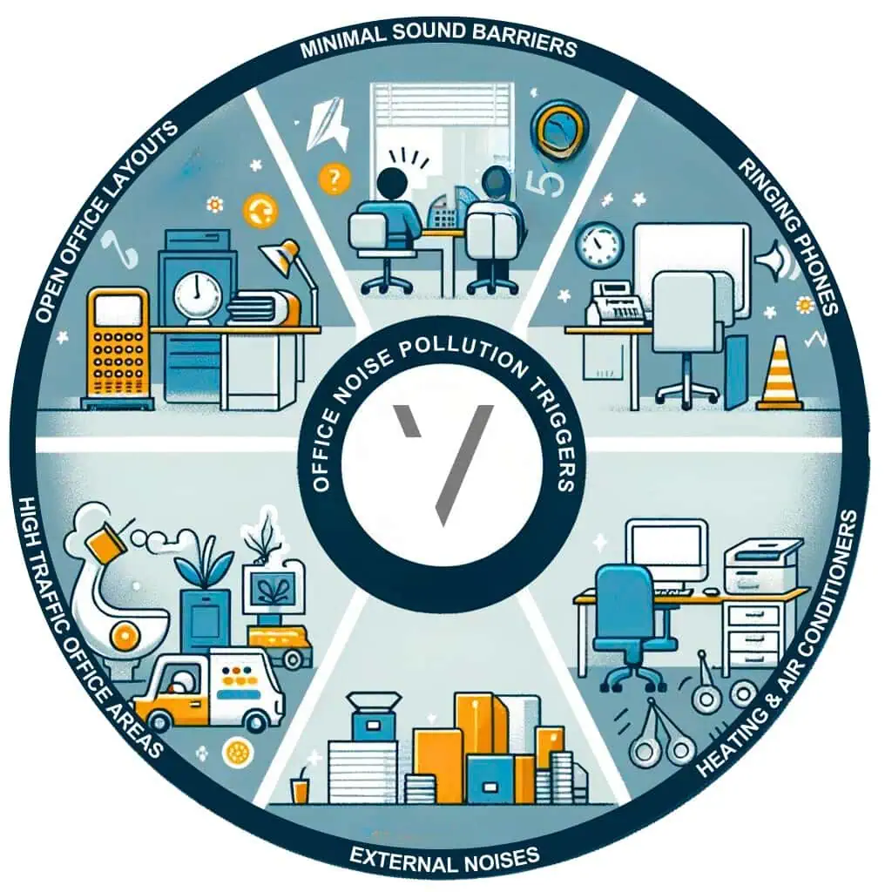
Environmental noise: In flight foods ltd
The factory has old and noise machines tat make it difficult for workers to communicated with each other.
Gary described the factory as “ Clacking clearly hear instructions”
Due to the noise, worker cannot clearly hear instructions clearly.
As a result:
Workers can’t understand task clearly and many mistakes are being made.
Food safety rules are not being followed
Mistakes, are being made for example , the chicken being left outside and cause for cross contaminations.
LCLM4003 - Effective Teamworking and Communication - Jan Term 2026 - Component 2 Assessment Specification - Birmingham (2)

Slide 4
Impact on the business:
Environmental noise in the factory has serval negative effects on the business overall. The loud machines make it difficult for Gary, the floor manger , to be able to communicated with the workers, due to workers not always hear instructions clearly , this led to poor communication between the manger and employees.
Aas a result, employees may misunderstand the importance of food hygiene instructions, such as making sure the met is chilled or following proper food safety procedures . This increased the risk of food hygiene mistakes, like leaving the chicken out overnight or not following hygiene rules. Due to this rules not being followed correctly, the quality of the food decreased , therefore poor-quality meals are served to passengers, such as undercook food or incorrect ingredients being used, can damage the company’s reputation.
Flight Foods supplies meals to airlines, theses quality problems lead to customer complaints for airliners companies. Therefore airlines, are unhappy a with the meals and food quality standards, they choose to stop buying from Flight Foods and switch to other supplies.
Therefore, this ultimate caused the company to lose market share and business, which affects its profitability and log-term success.
LCLM4003 - Effective Teamworking and Communication - Jan Term 2026 - Component 2 Assessment Specification - Birmingham (2)

Slide 5
Solutions:
Noise assessment and monitoring: Flight foods should conduct regular assessments to measure and monitor noise levels, identifying the main problem of the problems in the business.
Change machinery: Flight Foods LTD should invest in machinery that make less noise, this will decrease the problems they are facing as the employees are able to hear instructions clearly and understand food hygiene better.
Noise barriers: install physical barriers and acoustic solutions to reduce noise transmission from business operations to surrounding areas.
Environmental Noise Monitoring: the business could invest in utilize specialized acoustic sensors to collect continuous or periodic data, identifying sources and tracking trends to evaluate the effectiveness of mitigation strategies.
LCLM4003 - Effective Teamworking and Communication - Jan Term 2026 - Component 2 Assessment Specification - Birmingham (2)

Slide 6
References list:
SONAIR (2025). Best Ways to Reduce Noise Pollution: 10 Practical Solutions. [online] Sonair Environmental Inc. Available at: https://sonairenviro.com/2025/06/06/best-ways-to-reduce-noise-pollution/.
LCLM4003 - Effective Teamworking and Communication - Jan Term 2026 - Component 2 Assessment Specification - Birmingham (2)
Environmental Protection UK. (2025). Environmental Noise - Environmental Protection UK. [online] Available at: https://www.environmental-protection.org.uk/policy-areas/noise/environmental-noise/.
World Health Organization (2022). Guidance on environmental noise. [online] www.who.int. Available at: https://www.who.int/tools/compendium-on-health-and-environment/environmental-noise/.

Slide 7
Emotional barriers:
Emotional barriers happen when strong emotion such as anger, stress, or frustration are most likely to hinder effective communication.
In Flight Food Ltd , the floor manger Gary becomes very angry when he sees trays of chicken being left out overnight, due to his frustration, he shouts “idiots!” at the workers. Tis shows that his emotion have taken control therefore this is affecting the way he communicates with his staff.
When the mangers can’t communicate effectively with his workers and lets his emotion take control, the employees may feel afraid to speak up, embarrassed or demotivated to continue to work. This make create more misunderstanding between the workers and manger and lead to more mistakes being made.

Slide 8
Conclusion:
To conclude, environmental noise in the factory make it difficult for workers to hear clear instructions and understand what they are supposed to be doing . This can lead to misunderstanding, mistakes in food preparation, and lower food quality by reducing noise during clear visual communication methods, Flight Foods Ltd can improve communication and reduce errors in the workplace.

Slide 9
Impact of Flight Foods:
Workes may feel demotivated or disrespected to continue to work
Employees won't have the courage to communicate with the manger.
Teamwork and trust between staff and managements may decrease.
Worker may stop asking question therefore mistake are bound to happen.
This will make it difficult for the manger and employees to work together or communicate effectively; therefore, mistake will continue to happen, and the business will continue to have bad reviews.

Slide 10
Solutions:
Open communication channels: ensure that remotes teams have the necessary tools and support to maintain effective communication and collaboration.
Provide stress management training: working in a busy an noisy factory environment can be stressful, being able to train workers and mangers in stress management can help them control their emotions and handle pressure more effectively. Therefore, stress will be decreased, and workers and manger are less likely to become frustrated or angry during communication.
Try and create a supportive work environment: by doing this, it will encourage teamwork and open communication between manger and employees. This will allow workers to feel supported by their mangers and colleagues., they are more confident therefore communication will not be a problem, and less mistake are bound to happen. , therefore the worker will have to courage to question or ask for help if is needed.

Slide 11
Reference:
Smith, D. (2019). 13 Barriers to Effective Communication & What is a Comm Barrier? [online] Making Business Matter. Available at: https://www.makingbusinessmatter.co.uk/barriers-to-effective-communication/
LCLM4003 - Effective Teamworking and Communication - Jan Term 2026 - Component 2 Assessment Specification - Birmingham (2)
.

Slide 12
Generation/age:
Worker of young may be able to learn quicker with faster demonstrations or technology as they able to learn quicker.
As for older workers they may before to be told what to do as it easier for them to get work done. And prefer experience-based learning.
Different attitudes towards authority and teamwork may different due to different age groups.
Due to this these difference, it can affect the way instructions are understood.

Slide 13
Impact on the business:
Many mistake may be made while preparing food
Poor teamwork , workers may feel uncomfortable with each other and the manger therefore misunderstanding are bound to occur.
Reduces food quality and safety, mistake in the production process can result in poor food quality or unsafe handling, such as leaving meat outside overnight and customer complaining about food hygiene.
lower productivity
Customer complaints from airlines.

Slide 14
Solutions:
Provide structured training for all ages: Flight Foods Ltd should provide proper and organised training for all employees, using their ages group. Provide proper training for all employees about food hygiene.
Use simple and clear instructions: mangers should communicate with their staff openly and use simpl and easy language so that all worker cand understand . By doing this clear instruction wll be given out and therefore less mistake will occur and communication between manger and worker will strengths over time.
Encourage teamwork between younger and older staff
Use visual guides and demonstrations

Slide 15
Conclusion:
To conclude, Flight Food Ltd faces serval communication barriers that affect their business, such as noise, language, age gaps, and emotional reactions. Therefore, these problems lead to many misunderstanding, mistakes in food preparations , and customer complaints. By improving training, communication methods, and teamwork, the company can improve food quality, employee's performance and customer satisfaction.

Slide 16
Reference:
Beresford Research (2025). Age Range by Generation. [online] Beresford Research. Available at: https://www.beresfordresearch.com/age-range-by-generation/.
Michelle (2024). Generational differences in the workplace. [online] Jigsaw Discovery Tool. Available at: https://jigsawdiscoverytool.com/generational-differences-in-the-workplace/.
Cooper, B., Loewenhaar-Blauweiss, A. and Adler, J. (2017). Labor. Cambridge University Press eBooks, [online] pp.325–372. doi:https://doi.org/10.1017/9781139017053.018.
LCLM4003 - Effective Teamworking and Communication - Jan Term 2026 - Component 2 Assessment Specification - Birmingham (2)

