Slide 1
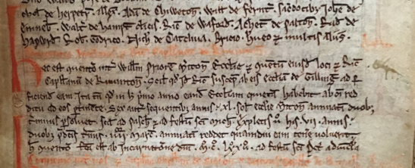
BL, Cotton MS Cleo C viii, Cartulary of Merton Priory, fol. lxxxvj
h[oc] c[on]uento f[ac]ta est ab Incarnat[i]one d[omi]ni M.C.LXXII ad festu[m] S[anc]ti Pet[ri] adu[in]c[u]la
this agreement was made in the year of Our Lord MCLXXII on the feast of St Peter in Chains

Slide 2
Dating
Year of Grace (AD or CE)
Feast Day (St P-ad-V = 1st August)
But if
‘On the Tuesday before the feast of St Michael in the ninth year of King Edward III’
then…???
Reach for Cheney, Handbook of Dates! [Hereafter, HBoD]

Slide 3
Dating
‘On the Tuesday before the feast of St Michael in the ninth year of King Edward III’
Weekday – seems easy, but…
Feast (holy day) = refer to HBoD calendar of saints
Regnal year = refer to HBoD regnal years

Slide 4
Dating
‘On the Tuesday before the feast of St Michael in the ninth year of King Edward III’
29th September 1335
Back to the weekday: using Cheney,
look up Easter tables
look up Calendars for all possible Easter dates

Slide 5
Tuesday, 26th September, 1335

Slide 6
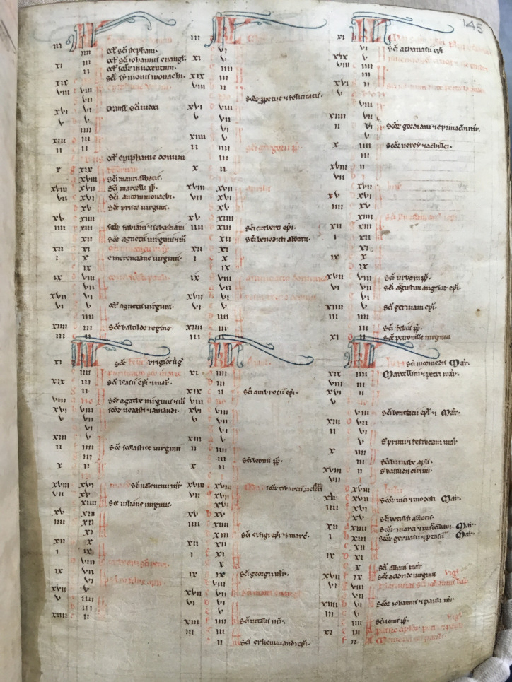
CUL, Ee.6
Bible,
Merton Priory
Roman calendar
Kalends (1st)
Nones (5th or 7th)
Ides (13th or 15th)

Slide 7
Dating
Solar, lunar: v/a equinox; w/s solstice; month
Dates are largely arbitrary
Start of year could be December (25th), January (1st or 6th), March 25th (Lady Day – in use until 1752 and still financial year)

Slide 8
Converting the date
Medieval date: the year 1328 = 25 March – 24 March 1328
Modern dates (the year of grace, CE) between 1 January and 24 March 1328 fall at the end of the medieval year 1327 – the new year 1328 did not begin until 25 March 1328
Medieval dates between 1 January and 24 March 1327 need to be read as modern dates 1 January to 24 March 1328; often written 1327/8 or 1327 [1328]

Slide 9
Oral testimony
PROOF OF AGE OF JOAN, DAUGHTER AND HEIRESS OF WILLIAM DE WELLES, 25 June 1351: witness 1
John Walram examined on oath …says she was 15 years old on the feast of the Nativity of the Blessed Virgin Mary last [8 Sept.]. He knows this because he was present as her godfather at her baptism in Great Sampford church on the feast of the Nativity of the Blessed Virgin Mary in the ninth year of Edward III [1335] and her name was written in the church’s missal.
Oral and written testimony

Slide 10
PROOF OF AGE OF JOAN, DAUGHTER AND HEIRESS OF WILLIAM DE WELLES, 25 June 1351: witness 2
Richard de Welle … says that William de Welle, Joan’s father, was at Sampford on the day of Joan’s birth, and gave Richard a tenement in Sampford by charter dated the feast of the Nativity of the Blessed Virgin Mary in the ninth year of the present king, and he then heard how the news about Joan’s birth came to William, and this is his memory of the birth and age of Joan.

