Slide 1
M5X01572
Entrepreneurship for Film

Slide 2
Entrepreneurship for Film
Introduction to module
Module handbook
Scheme of work
Assessment
Lectures, seminars & workshops

Slide 3
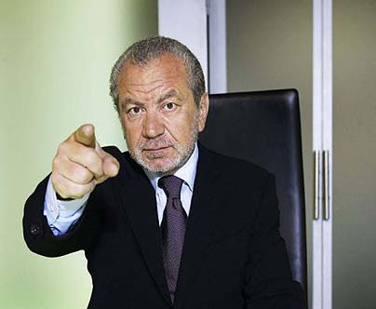
What is an entrepreneur?
Notes:
https://www.youtube.com/watch?v=FoqF2GmbmeQ&list=PL5A4nPQbUF8CJSYgQD17hKmRb15mhibaB&index=1

Slide 4
The Filmmaker as Entrepreneur
What is an entrepreneur?

Slide 6
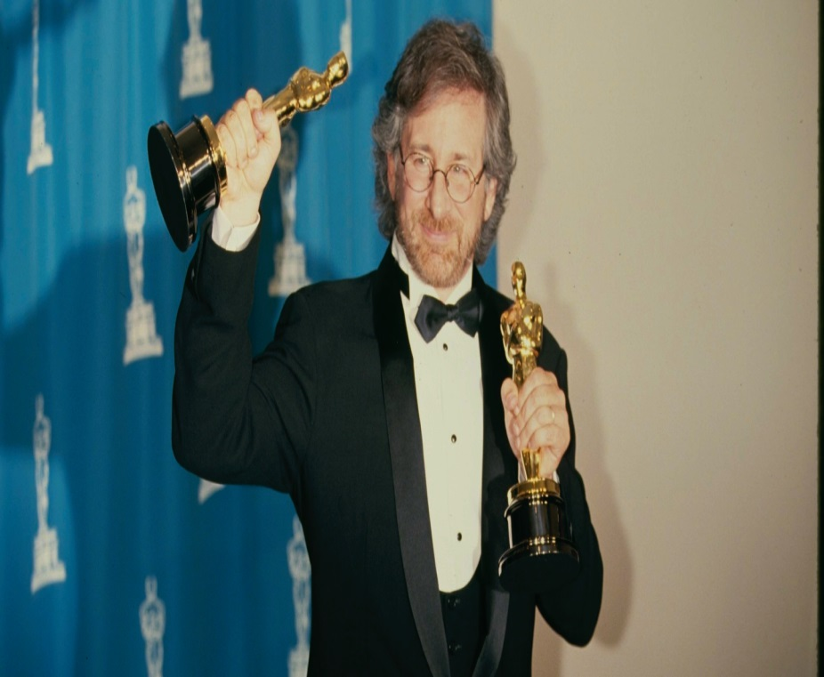
What is an entrepreneur?

Slide 7
Steven Spielberg
Started making short films, then TV episodes, then TV movie, then movies
Started two different production companies

Slide 8
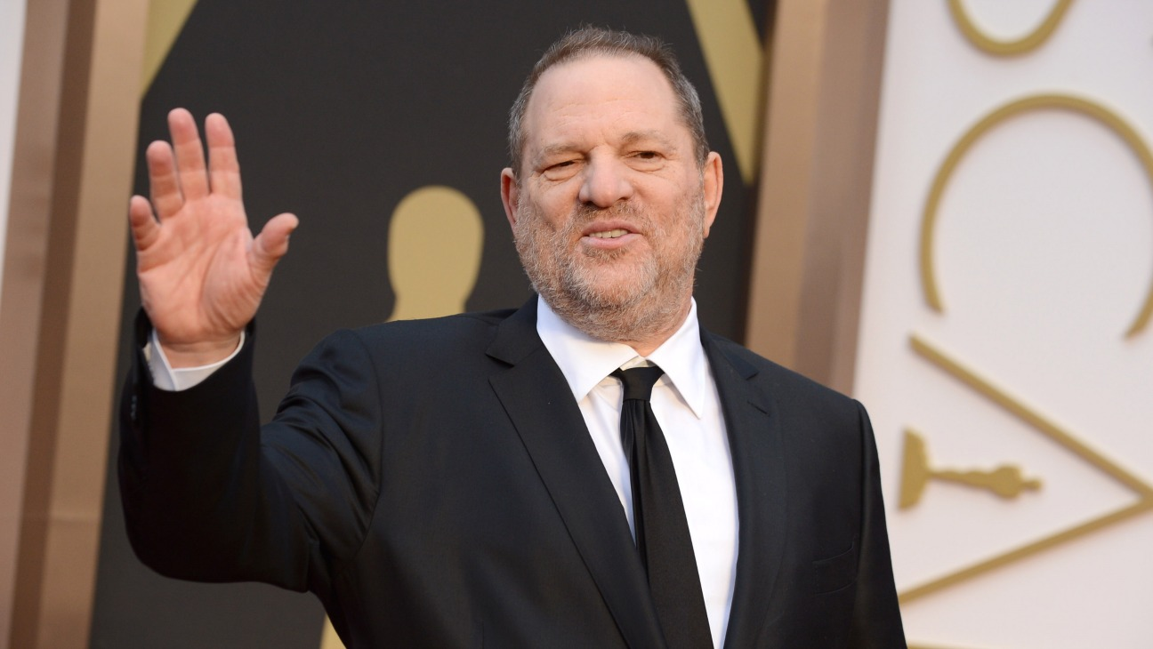
What is an entrepreneur?

Slide 9
Harvey Weinstein
Independent producer, first at Miramax then The Weinstein Company
Started in exploitation filmmaking
Took American independent filmmaking to mainstream
Helped turned Sundance from fringe festival to major market
Regular Tarantino collaborator

Slide 10
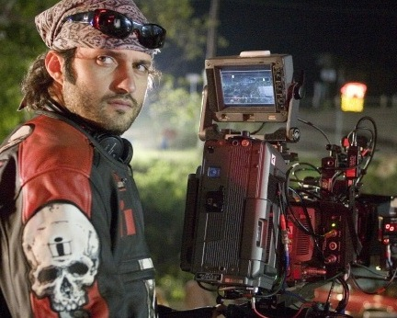
What is an entrepreneur?

Slide 11
Robert Rodriguez
Made his debut film, El Mariachi (1992), in an incredibly low-fi way with $7000 he earned from a residential drug trial in his summer vacation from uni.
Runs own production company, retains considerable control over production process

Slide 12
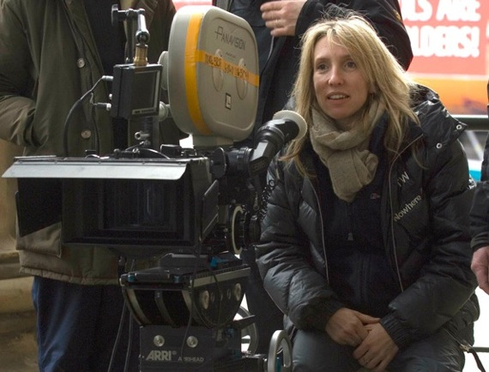
What is an entrepreneur?

Slide 13
Sam Taylor-Johnson
Studied fine art at Goldsmiths
Worked as fine art photography
Moved in to moving image work – David Beckham Sleeping for NPG
Directed Nowhere Boy (2009), Fifty Shades Of Grey (2015)

Slide 14
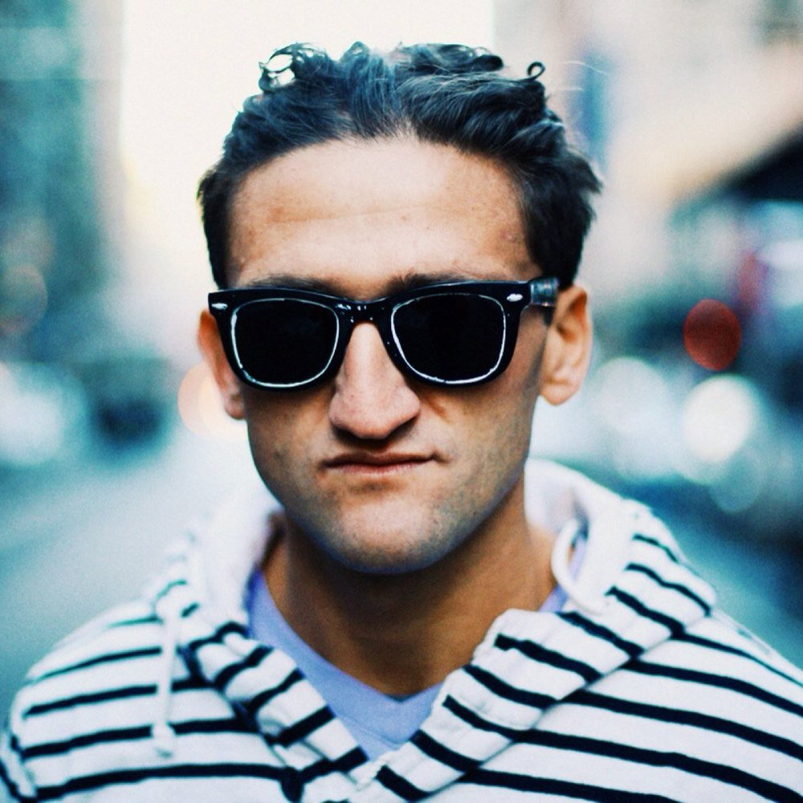
What is an entrepreneur?

Slide 15
Casey Neistat
High school dropout, lived in a trailer park.
Worked in studio of artist Tom Sachs, for whom he made short videos
Made a 3-minute video in 2003, criticizing Apple’s iPod battery
Makes short films, vlogs, TV series
Notes:
iPod’s Dirty Little Secret
https://www.youtube.com/watch?v=SuTcavAzopg
Make It Count
https://www.youtube.com/watch?v=WxfZkMm3wcg

Slide 16
The Filmmaker as Entrepreneur
What is an entrepreneur?

Slide 17
What does an entrepreneur do?
Have ideas
Communicate ideas

Slide 18
Seminar
How do find your story?
How do you pitch your story?

Slide 19
Seminar
What’s a good pitch?
What’s a good story?

Slide 20
Seminar
Organise yourselves into teams of three
Research newspapers for a story idea
Brainstorm the key points of the story
Deliver a one minute pitch

Slide 21
Seminar
Clear communication of the story
Don’t explain the whole story
What’s it about?
Is your concept intriguing?
Does it pose a question?

Slide 22
Seminar
Rehearse (know your material)
Relax (deep breaths, posture, look ahead)
Remember (your first line)

Slide 23
Two Key Questions
Why you?
Why now?

