Slide 1
Sustainability through Technology
Noise Legislation

Slide 2
Legislation
Legislation has grown over years
  Same for numerous environmental controls
Not in the most obvious pattern
Not easy to access or understand

Slide 3
How do Councils deal with Noise Nuisances
Complaints must be investigated
Noise has to meet the councils definition of ‘statutory nuisance’
If proved to be ‘statutory nuisance’, then an Abatement Notice must be served
Councils can decide on their own level of service

Slide 4
Council’s responsibility
Must investigate complaints from
  Premises including land (like gardens) and certain vessels
  Vehicles, machinery or equipment in the street
Statutory noise nuisance laws not apply to
  Traffic or planes (does apply to model planes)
  Political demonstrations and demonstrations about a cause
  Premises occupied by the armed forces or visiting forces

Slide 5
Current Noise Legislation
Noise Act 1996
Anti Social Behaviour Act 2003
  Anti Social Behaviour, Crime & Policing Act 2014
Environmental Protection Act 1990

Slide 6
Noise Act 1996
Enables local authorities to measure noise
Establish whether it exceeds a ‘permitted’ level
Crucially, silence main offenders
Not all councils chose to implement in the same way

Slide 7
Anti-social Behaviour Act 2003
Anti-social Behaviour, Crime & Policing Act 2014
Gives local authorities powers previously adoptable under Noise Act 1996 and makes their use discretionary
New Powers
  Civil Injunction
  Community Protection Notice
  Public Spaces Protection Order
  Closure Notice/Order

Slide 8
Environmental Protection Act 1990
Provides controls over ‘statutory noise’
Along with Noise and Statutory Nuisance Act 1993, it also covers nuisances arriving from vehicles
Local authorities have a duty to inspect areas
If satisfied that statutory nuisance exists, or could exist, they can serve an abatement notice

Slide 9
Noise Nuisance Sectors
Noise at Night
Noise from Intruder Alarms
Noise from Construction Works
Loudspeakers in the street
Model Aircraft Noise
Noise from Industrial, Trade or Business premises

Slide 10
Noise at Night
(from premises other than dwellings)
Responsible party for premises will be guilty if noise exceeds permitted levels during specified time
Penalties for not complying
  Fixed Penalty Notice (FPN) £500 to be paid in 14 days
  Prosecution (straight away or if FPN isn’t paid)
    Leading to a fine £1000 for dwellings, unlimited for other premises
  Removal of noise making equipment

Slide 11
Noise from Industrial, Trade or Business Premises (Special Rules)
Abatement Notice is served
Company uses best practice methods to stop or reduce noise
Then companies can;
  Appeal against abatement notice
  Defend if prosecuted

Slide 12
Other ways Councils deal with Noise
Separate powers to deal with Anti-Social Noise
Consider potential noise nuisances
  Include in planning decisions
    Use Noise Impact Assessment
Issue of entertainment licences
Making decisions about Building Control

Slide 13
Noise Impact Assessment
Mostly conducted by the Environment Agency
Collects General Information and Noise Data
Uses a computer modelling system to determine the level of impact

Slide 14
Noise Impact Assessment -
General Information Required
Description of site location and layout
Map showing site and surrounding areas
Site plan
Proposed noise mitigation and supporting evidence

Slide 15
Noise Impact Assessment –
Noise Data
Noise Sources
Site Traffic
Site Buildings
Site Acoustic Barriers
Terrain Data
Receptors

Slide 16
Noise Sensitive Receptors
Sensitivity | Description | Examples of NSR
High | Receptors where people or operations are particularly susceptible to noise | Residential, including private gardens where appropriate. Quiet outdoor areas used for recreation Conference facilities Theatres/Auditoria/Studios Schools during the daytime Hospitals/residential care homes Places of worship
Medium | Receptors moderately sensitive to noise, where it may cause some distraction or disturbance | Offices Bars/Cafes/Restaurants where external noise may be intrusive. Sports grounds when spectator noise is not a normal part of the event and where quiet conditions are necessary ( e.g. tennis, golf, bowls)
Low | Receptors where distraction or disturbance from noise is minimal | Buildings not occupied during working hours Factories and working environments with existing high noise levels Sports grounds when spectator noise is a normal part of the event Night Clubs

Slide 17
Road Noise

Slide 18
Effect and cause
Noise from road traffic affects 30% of people in UK
Sources include
  Engine Noise
  Tyre Noise
  Car horns
  Stereos
  Doors slamming
  Squeaking brakes

Slide 19
Location, Location , Location
In towns and cities – engine sound
In rural areas – tyre noise on busy roads (which increases with speed)
Two approaches to reduce noise
  Noise coming from the roads
  Vehicle Noise

Slide 20
Reducing Noise from the road
Noise Absorption panels / noise reducing fencing
Evergreens
Tunnels
Reinforced Earth Mounds
Woven Willow
Aero & tyre design

Slide 21
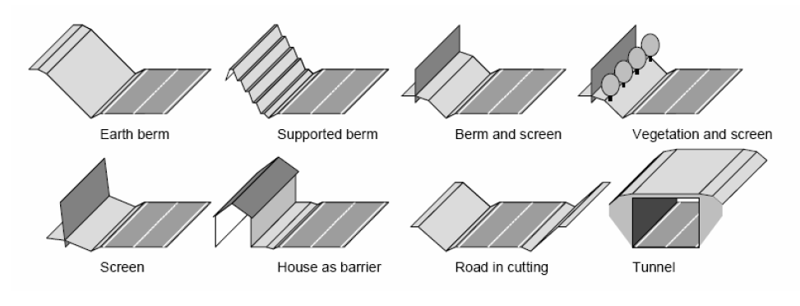
Reducing Noise from the road

Slide 22
Noise from Vehicles
Already identified
Solutions;
  Low noise tyres
  Close windows when playing music
  Avoid use of Boom Box
Legislation via noise limits

Slide 23
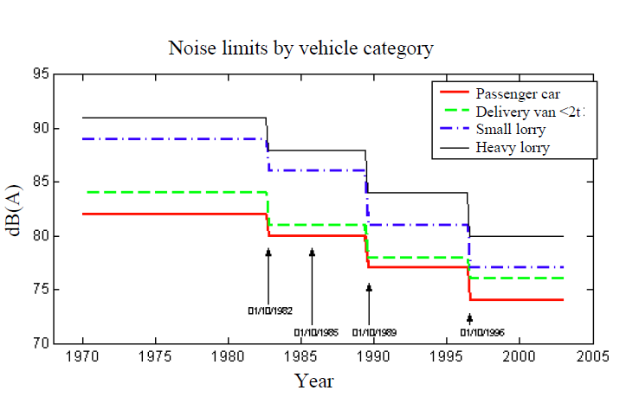
Vehicle Noise Limits over the year

Slide 24
Issues with previous limits
Not been changed since 1995 despite increasing traffic
Currently different rules throughout Europe
By having EU rules should be easier to buy, sell and use vehicles across the EU
Also ensures equal H&S and Environmental standards across EU

Slide 25
New Proposal
Current regulations were updated in July 2016
Further Aligned with International UN standards
New vehicles will produce less noise and measured by a new and more realistic test method
New electric and hybrid vehicles will be fitted with sound devices

Slide 26
What will change
Will reduce vehicle noise nuisance by 25%
2 steps will be taken each of 2dB
  Step 1 will be applied by 2021
  Step 2 in another 4 years
‘Approaching Vehicle Audible System’
  Minimum noise for electric and hybrid electric vehicles
  Will allow harmonisation of technology
  Will be mandatory in 5 years

Slide 27
Benefit to the public and Manufacturers
Public
  Quieter vehicles (especially in urban areas)
  More healthy environment
  Safer electric and hybrid vehicles (to avoid road accidents)
Manufacturers
  Closer international rules
  Promotes free movement of goods within and outside the EU
  Proper regulation for sound generating devices

Slide 28
Any Questions contact me on
kerry.tudor@uwtsd.ac.uk
Room MT406

