Slide 1
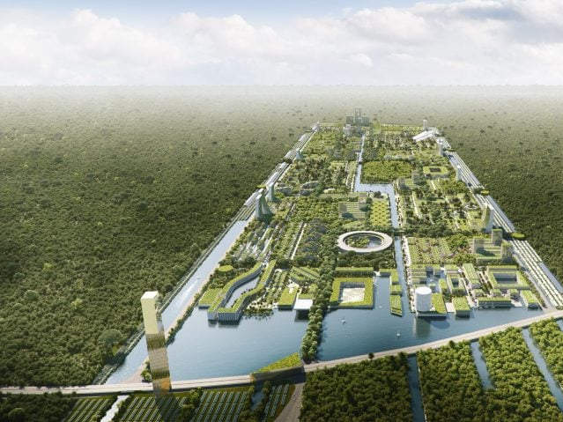

Geofuture
Physical landscapes and the geosphere in the future?
Dr Alissa Flatley
ACNA4007 – Physical Landscape and the Geosphere

Slide 2
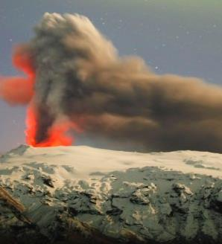
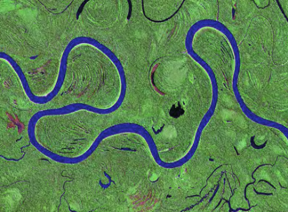
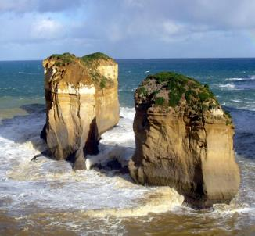
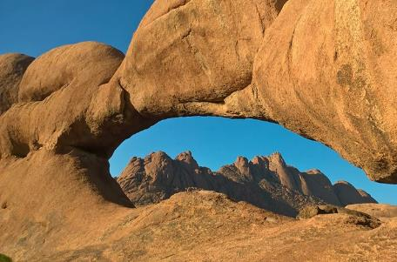
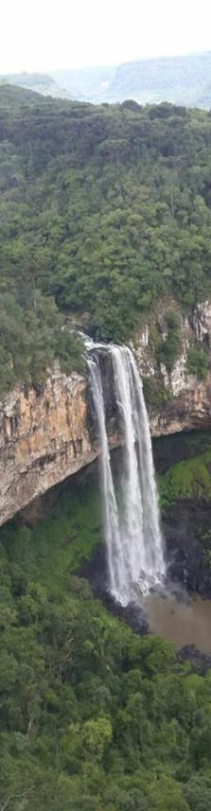
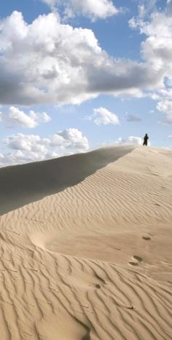
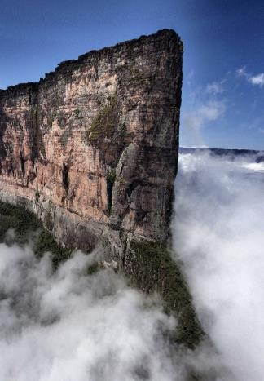
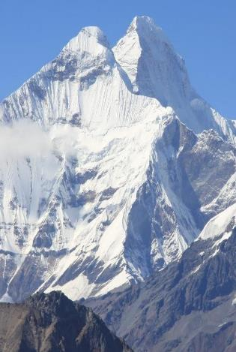
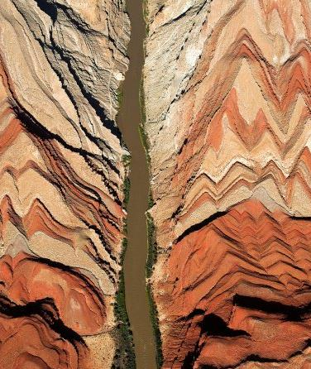
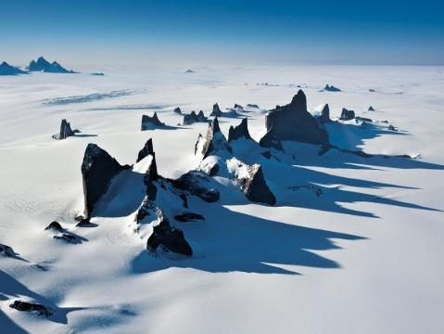
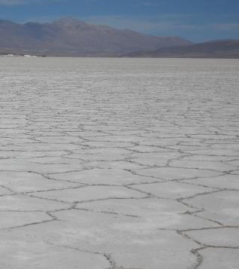
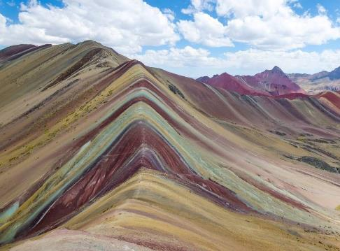

Slide 3
1
2
Interaction between processes
How do climate and people affect the Earth‘s surface

Slide 4
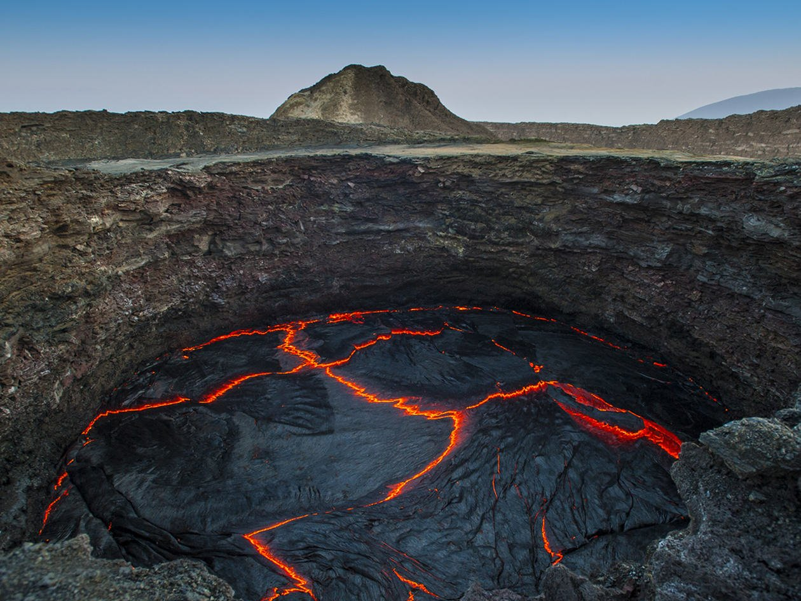
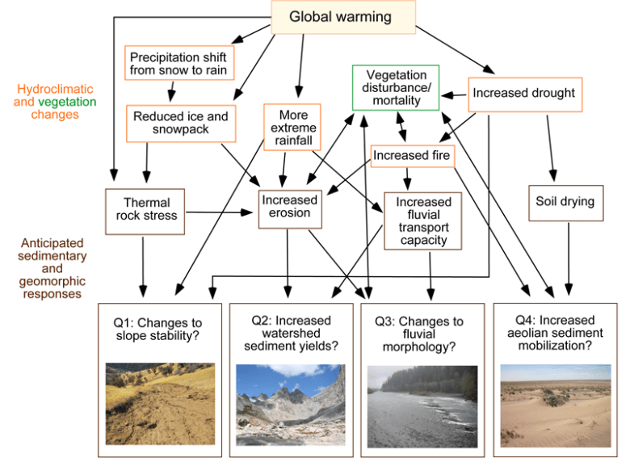
Changes to Landscape Processes
How is Modern Climate Change Affecting Landscape Processes? - Eos

Slide 5
Geosphere of the future
Reminder: What is the geosphere?

Slide 6
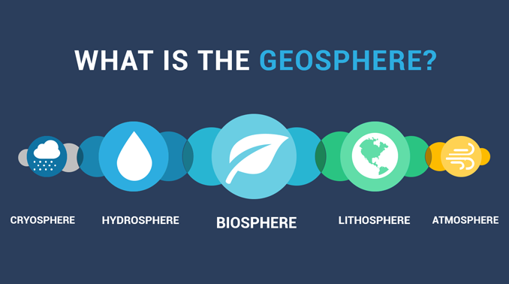
Geosphere of the future
Reminder: What is the geosphere?

Slide 7
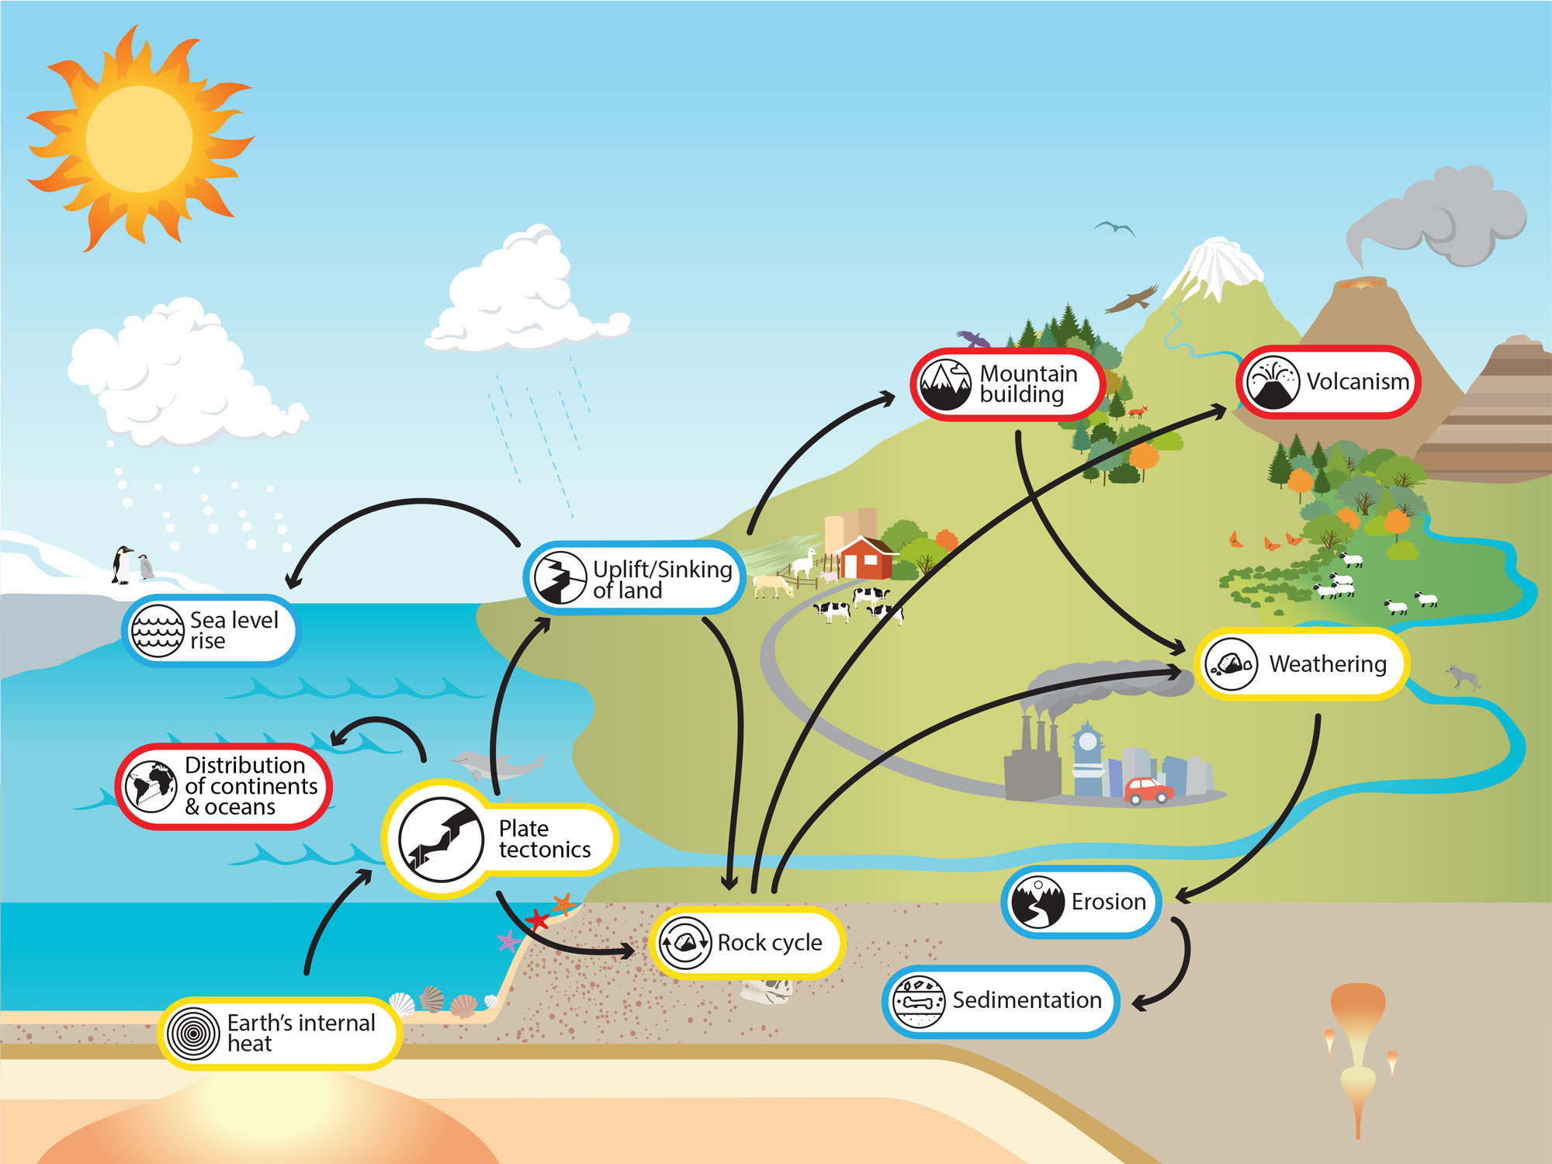
Geosphere of the future
Plate Tectonics - Understanding Global Change (berkeley.edu)

Slide 8
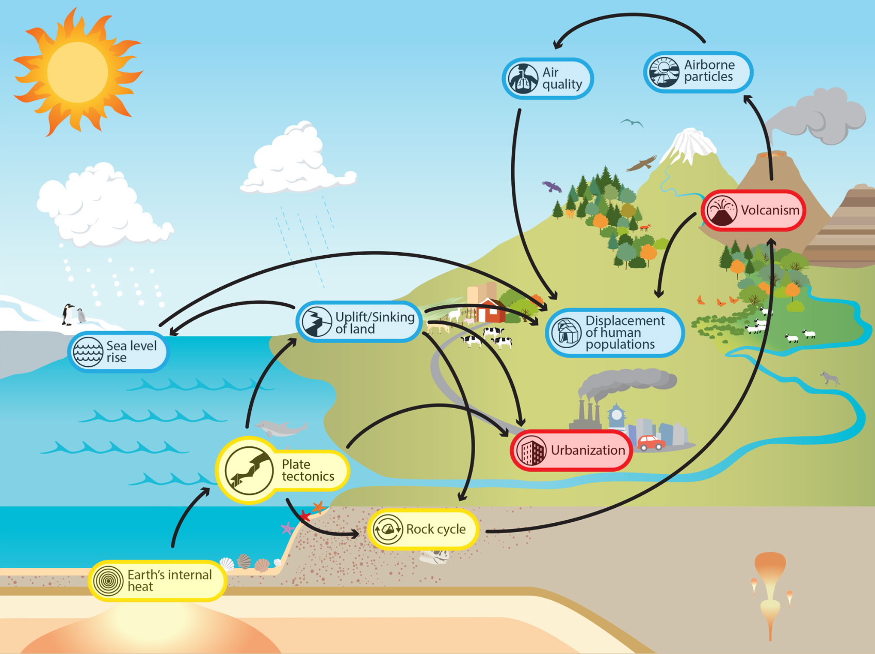
The Future....
Plate Tectonics - Understanding Global Change (berkeley.edu)

Slide 9
The Future....
Plate Tectonics - Understanding Global Change (berkeley.edu)

Slide 10
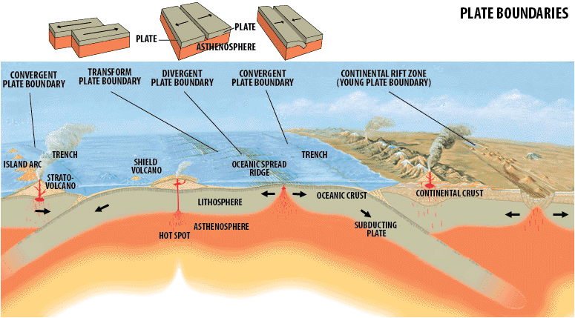
Geosphere of the future
Changes we know about
Plate Tectonics - Understanding Global Change (berkeley.edu)
The growing frequency of climate change–related hazards such as wildfires, floods, landslides, and drought increases the chances that they will coincide in space and time with volcanic eruptions.
Earth's tectonic plates have doubled their speed | New Scientist

Slide 11
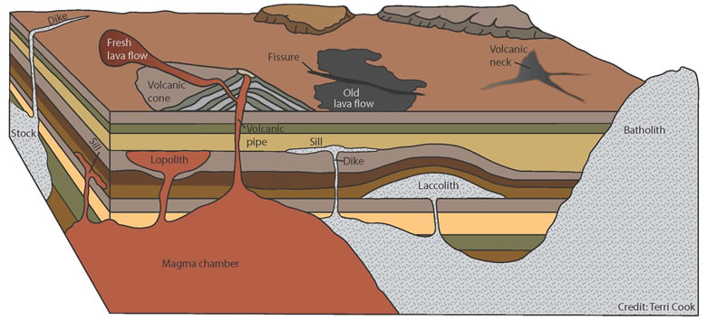
Geosphere of the future
Iceland: Is climate change causing more eruptions? | PreventionWeb
The average eruption rates were found to be up to 100 times higher after the end of the last glacial period, compared to the earlier colder glacial period.
Ice / Snow Cover
Notes:
There’s a long-established link between the large-scale melting of ice in active volcanic regions and increased eruptions.
Research on Iceland’s volcanic systems has identified a heightened period of activity related to the large-scale ice melt at the end of the last ice age. The average eruption rates were found to be up to 100 times higher after the end of the last glacial period, compared to the earlier colder glacial period. Eruptions were also smaller when ice cover was thicker.
But why is this the case? Well, as glaciers and ice sheets melt, pressure is taken off Earth’s surface and there are changes in the forces (stress) acting on rocks within the crust and upper mantle. This can lead to more molten rock, or “magma”, being produced in the mantle – which can feed more eruptions.
The changes can also affect where and how magma is stored in the crust, and can make it easier for magma to reach the surface.
Magma generation beneath Iceland is already increasing due to a warming climate and melting glaciers.

Slide 12
Geosphere of the future
Iceland: Is climate change causing more eruptions? | PreventionWeb
As glaciers and ice sheets melt, pressure is taken off Earth’s surface and there are changes in the forces (stress) acting on rocks within the crust and upper mantle.
Ice / Snow Cover
Notes:
There’s a long-established link between the large-scale melting of ice in active volcanic regions and increased eruptions.
Research on Iceland’s volcanic systems has identified a heightened period of activity related to the large-scale ice melt at the end of the last ice age. The average eruption rates were found to be up to 100 times higher after the end of the last glacial period, compared to the earlier colder glacial period. Eruptions were also smaller when ice cover was thicker.
But why is this the case? Well, as glaciers and ice sheets melt, pressure is taken off Earth’s surface and there are changes in the forces (stress) acting on rocks within the crust and upper mantle. This can lead to more molten rock, or “magma”, being produced in the mantle – which can feed more eruptions.
The changes can also affect where and how magma is stored in the crust, and can make it easier for magma to reach the surface.
Magma generation beneath Iceland is already increasing due to a warming climate and melting glaciers.

Slide 13
Geosphere of the future
Iceland: Is climate change causing more eruptions? | PreventionWeb
This can lead to more molten rock, or “magma”, being produced in the mantle – which can feed more eruptions. The changes can also affect where and how magma is stored in the crust, and can make it easier for magma to reach the surface.
Ice / Snow Cover
Notes:
There’s a long-established link between the large-scale melting of ice in active volcanic regions and increased eruptions.
Research on Iceland’s volcanic systems has identified a heightened period of activity related to the large-scale ice melt at the end of the last ice age. The average eruption rates were found to be up to 100 times higher after the end of the last glacial period, compared to the earlier colder glacial period. Eruptions were also smaller when ice cover was thicker.
But why is this the case? Well, as glaciers and ice sheets melt, pressure is taken off Earth’s surface and there are changes in the forces (stress) acting on rocks within the crust and upper mantle. This can lead to more molten rock, or “magma”, being produced in the mantle – which can feed more eruptions.
The changes can also affect where and how magma is stored in the crust, and can make it easier for magma to reach the surface.
Magma generation beneath Iceland is already increasing due to a warming climate and melting glaciers.

Slide 14
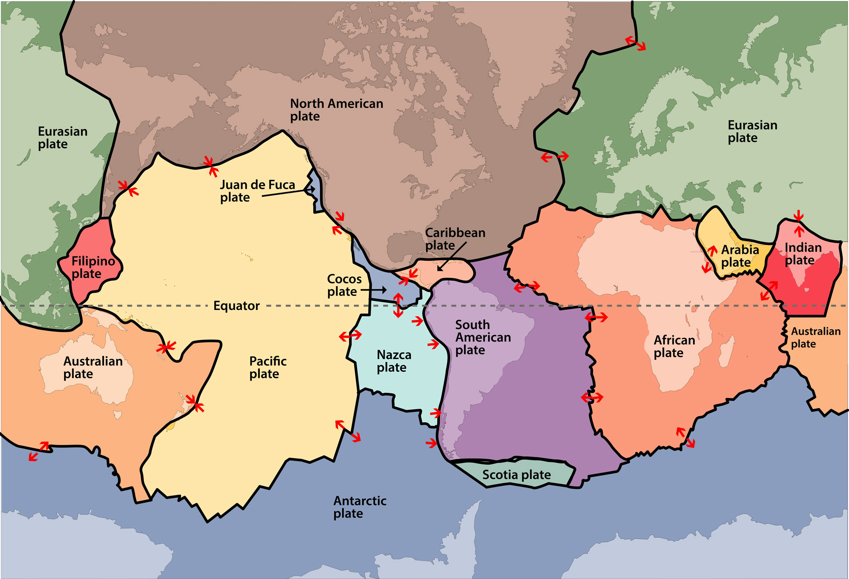
Geosphere of the future
Changes we know about
Plate Tectonics - Understanding Global Change (berkeley.edu)
The majority of research shows that plates move at average rates between approximately 0.60 cm/yr to 10 cm/yr

Slide 15
Changes we know about
Plate Tectonics - Understanding Global Change (berkeley.edu)

Slide 16
Changes we know about
Plate Tectonics - Understanding Global Change (berkeley.edu)

Slide 17
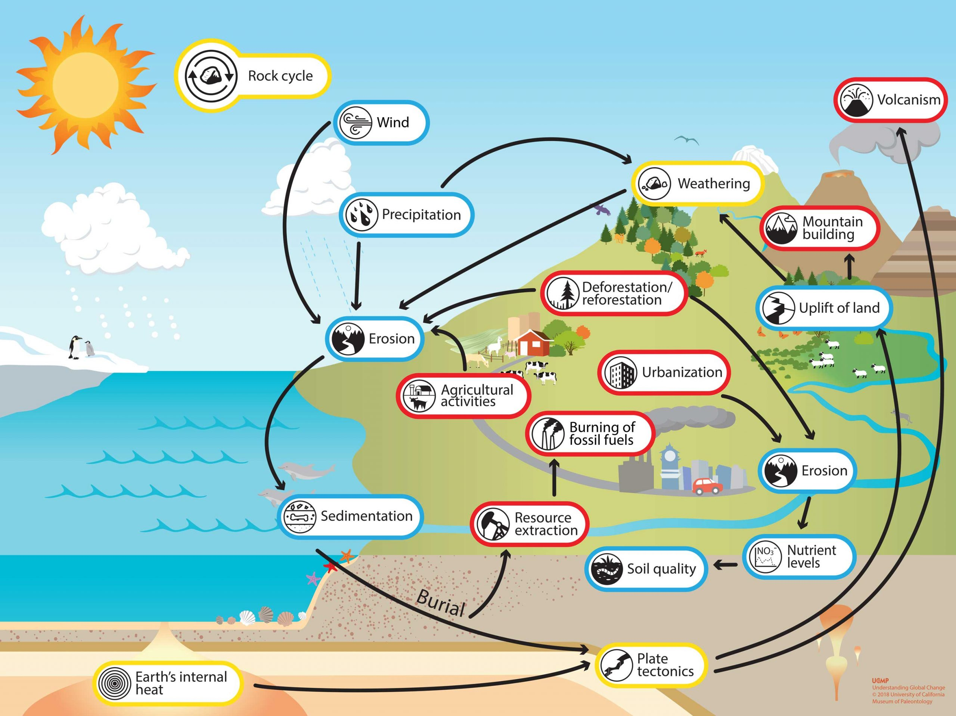
Rock Cycle Impacts
Plate Tectonics - Understanding Global Change (berkeley.edu)

Slide 18
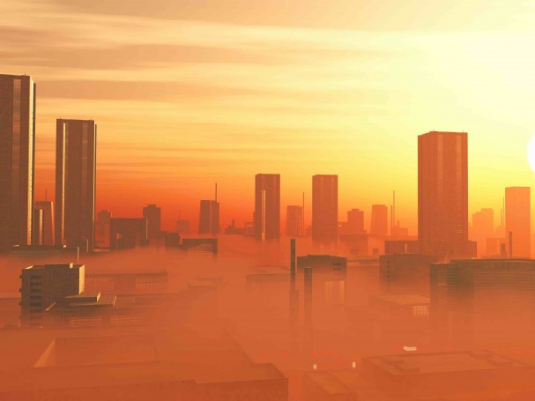
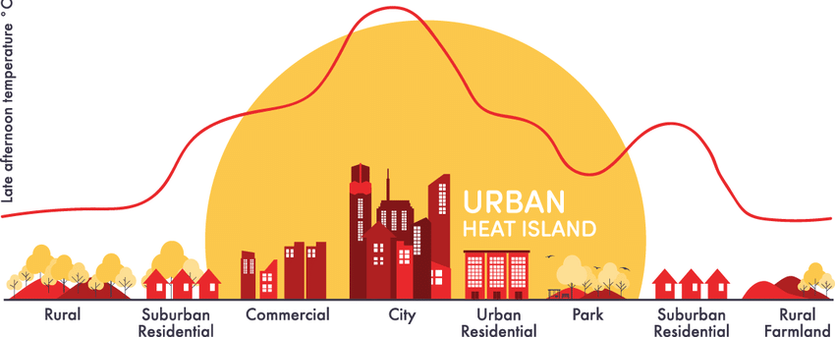
Geosphere of the future
Urban heat islands

Slide 19
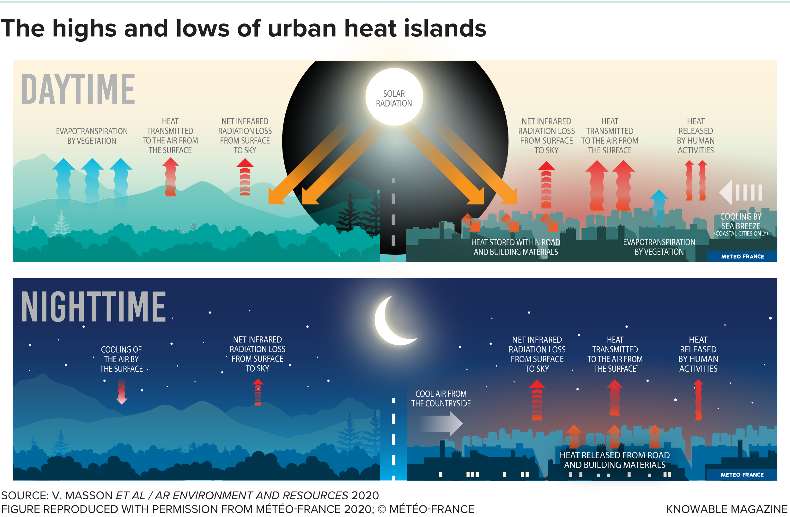
Geosphere of the future

Slide 20
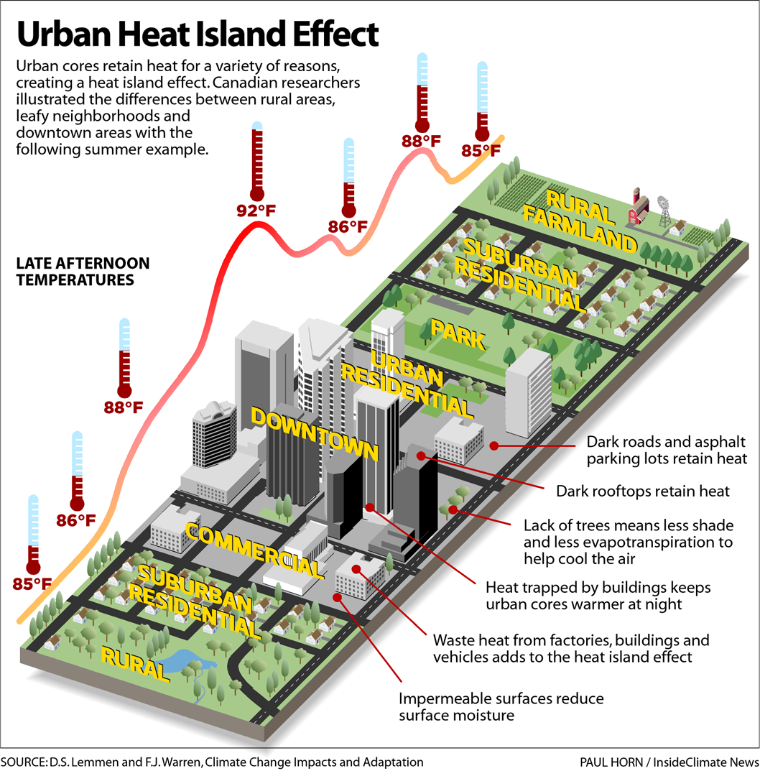
Geosphere of the future
Urban heat islands

Slide 21
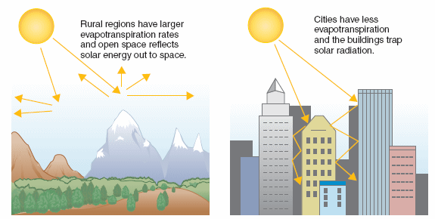
Geosphere of the future
Urban heat islands

Slide 22
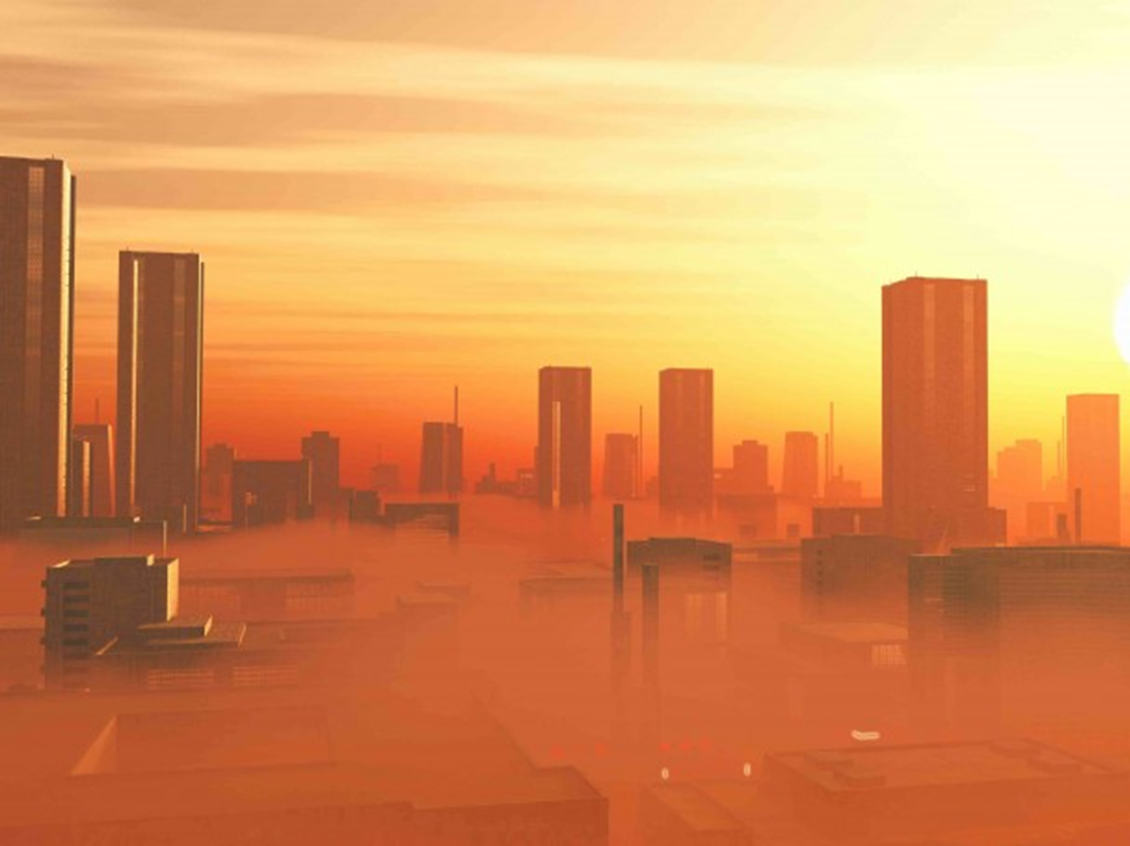
Urban Heat Islands
Meso Scale
• Local Winds
Micro Scale
• Urban Climates
1. Albedo effect. (Heat retaining (non-reflective) and emitting properties of building materials)
2. The lack of vegetation within towns and cities means that less light is intercepted, less evapotranspiration, thus less vapour is released (which naturally cools air surrounding vegetation).
3. Canyon Geometry Traps heat
4. Venturi effect: Buildings change wind velocity
5. Temperature Inversion
Notes:
The Venturi effect is the reduction in fluid pressure that results when a moving fluid speeds up as it flows through a constricted section (or choke) of a ...

Slide 23
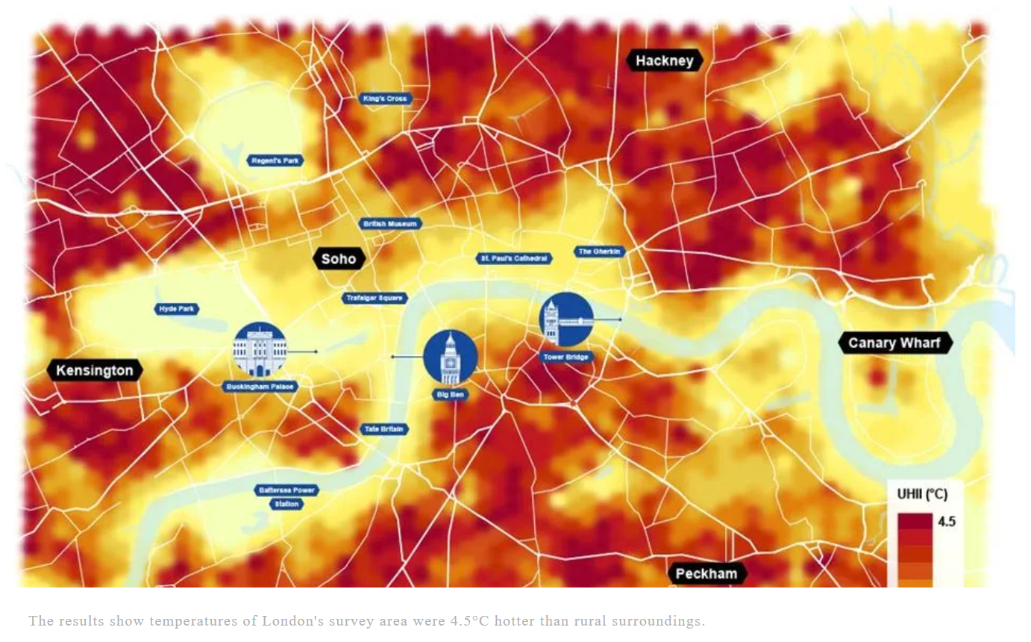
Geosphere of the future
London’s most extreme urban heat island "hot spot" compared to five other global cities in new survey - Arup
Urban heat islands

Slide 24
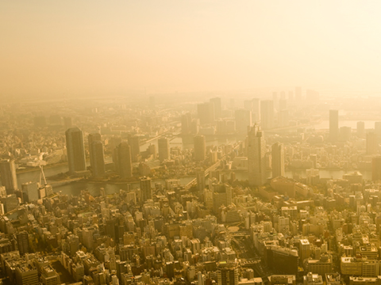
Activity
Click on the icons and words in the infographic to learn more about global change processes and phenomena, or continue your exploration on the CAUSES OF GLOBAL CHANGE, HOW THE EARTH SYSTEM WORKS, and MEASURABLE CHANGES pages.
Understanding Global Change Infographic - Understanding Global Change (berkeley.edu)

Slide 25
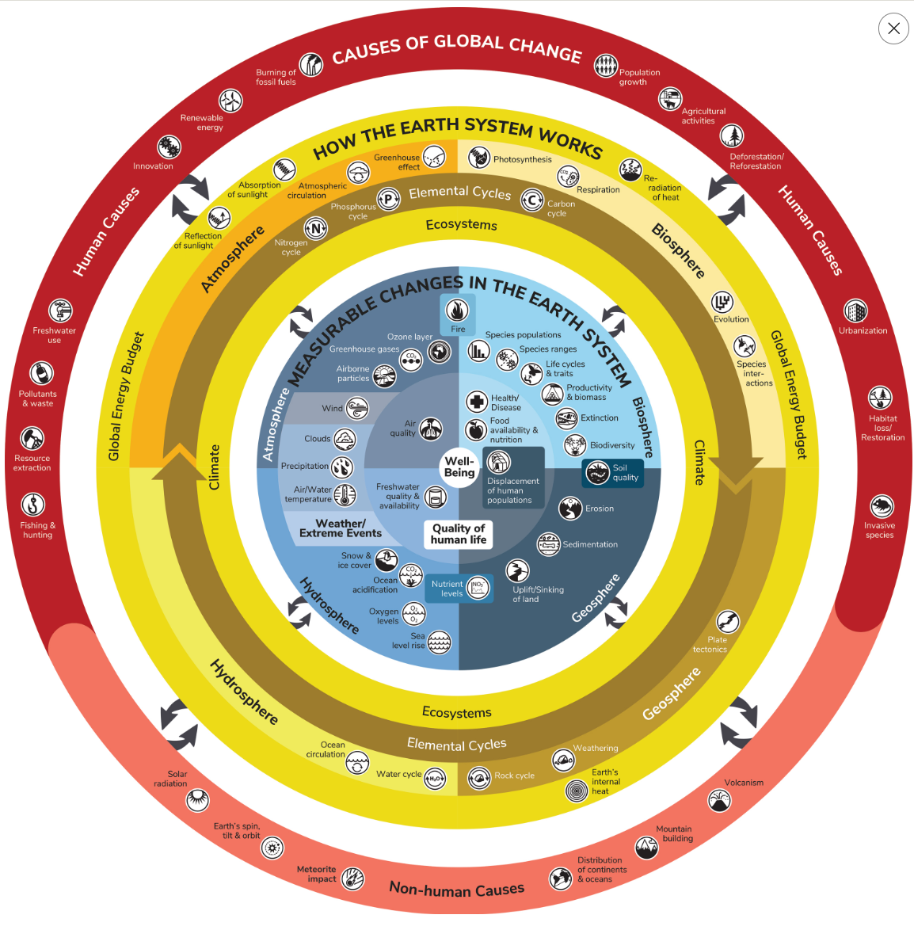
Geosphere of the future

Slide 26
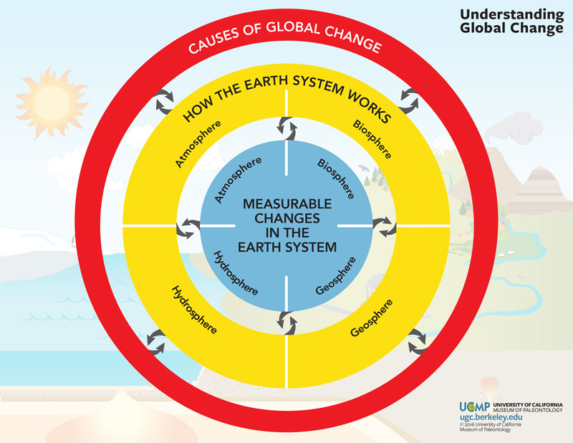
Geosphere of the future
Explore 5 measurable changes in the earth’s system.
Infographic - Understanding Global Change (berkeley.edu)

Slide 27

2 minutes...

Slide 28
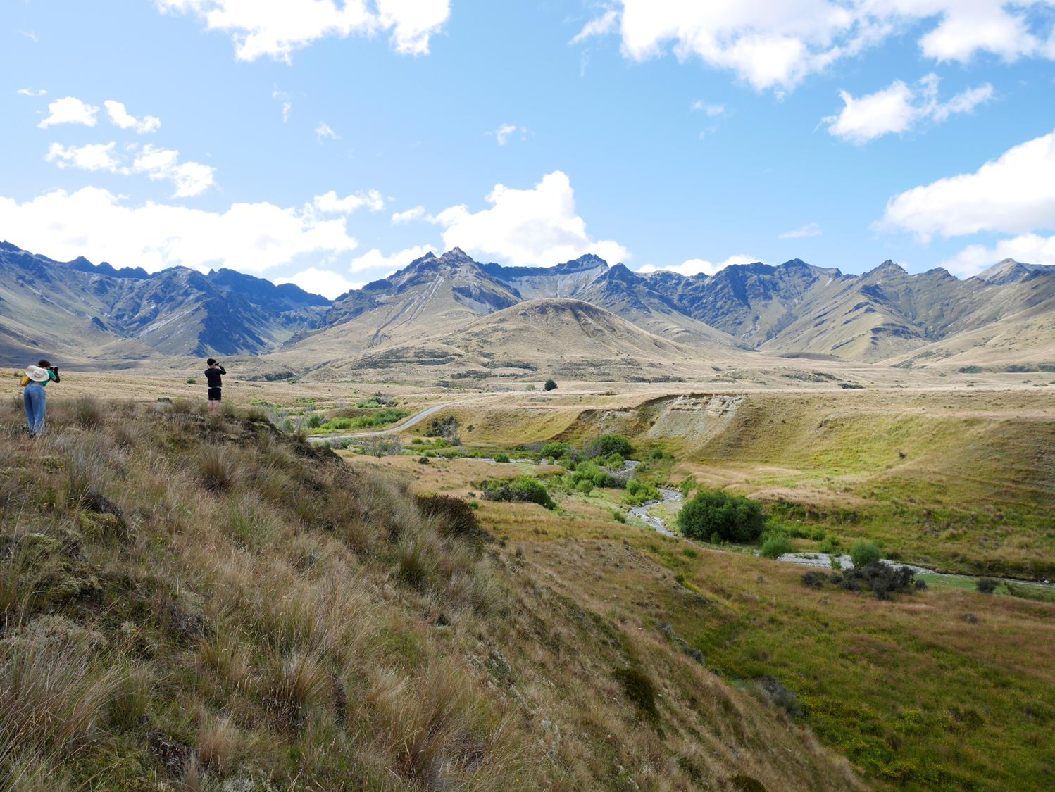
Course Recap
Physical Landscapes and the Geosphere
Dr Alissa Flatley
ACNA4007 – Physical Landscape and the Geosphere

Slide 29
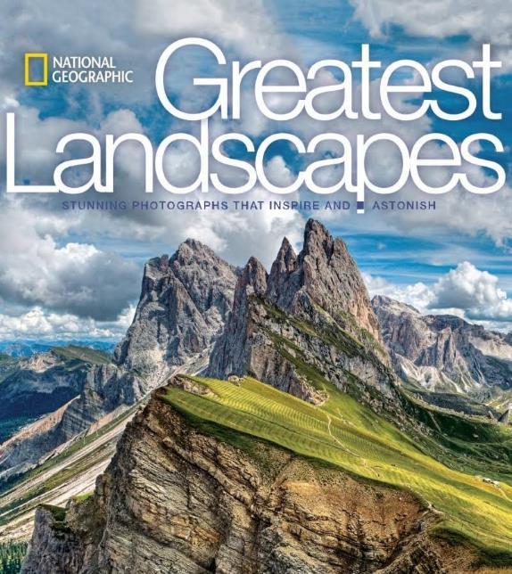
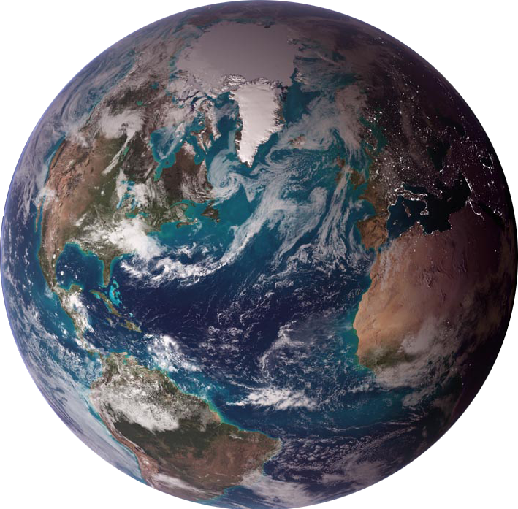

Course aims…
Aim: Upon the successful completion of this module, you should be able to: express an understanding of Earth systems and their influence on the environment, establish an understanding of the physical processes that influence the environment & complete practical fieldwork on a selected physical landscape.
Why is that important... ?
We all live on Earth surface...
1
2
Landscapes are „great“ – global and diverse !!

Slide 30
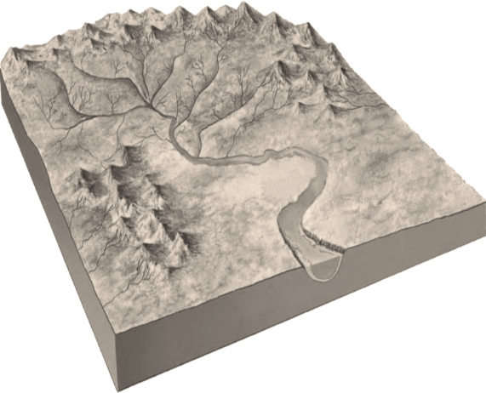

Course themes…
Landscapes beyond the horizon
Climate & Environmental Change
Erosion
Humans
Source-to-sink
(sediment cycles)
Deposition
Tectonics and Interior Drivers
Some tools

Slide 31
Exam Prep
Answer all questions in the exam
First part: Shorter answer questions:
For example:
Name the landform
Draw a diagram of…..
Match the landform description with the landform name…
Second Part: 1 longer answer question (50pts)
Course: Physical Landscape and the Geosphere (ACNA4007) (uwtsd.ac.uk)

