Slide 1
Presentation:
Reflective Practice
Rhian Richards
2212289

Slide 2
Introduction
What is reflective practice?
Why is it important?
My journey
Critically reflecting on a transition in my life.
A metaphor reflecting my growing edge.
Conclusion

Slide 3
What is Reflective Practice?
Not simply looking back and thinking about an event.
Looking deeply and taking learning from our findings.
Many theories can assist our understanding and personal practice.
Considered essential by many professions.

Slide 4

Donald Schön
Referred to by Bager(2010) as the father of reflective practice.
Recognised the limitations of technical rationality (Shön, 1983).
Differentiates between reflection-in-action and reflection-on action.

Slide 5
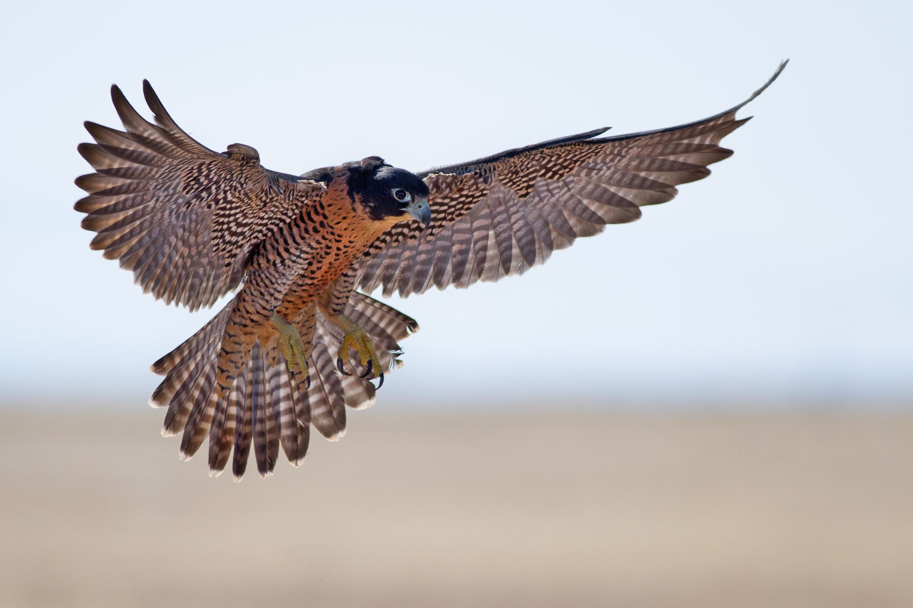
Flying Hawk, Stock Image, Microsoft PowerPoint, accessed 03/11/2022
Bolton and Denderfield (2018, p.9), describe reflection-in-action as a hovering hawk, drawing on our knowledge, skills and experience.
Reflection on action taking place after the event.
This can give us a deeper understanding and reflexivity in our interactions.
Thompson and Thompson (2008, p.16) further the idea with their concept of reflection-for-action to anticipate what may happen next.

Slide 6
Brookfields Four Lenses (1998)
Brookfield highlights four lenses from which to view how we frame our practice; ourselves, the learner, our colleagues and theory.
Looking from these four different views can give us a much fuller picture.
"A critically reflective practitioner can stand outside her practice and see what she does from a wider perspective" Brookfield (1998, p.204)

Slide 7

Why is Reflective practice important?
Opportunity to explore our espoused values and if our actions in practice reflect these or differ.
“Professional integrity can be defined as having values-in-practice as close to the same as espoused values as possible”. (Bolton and Delderfield, 2018, p.27)
Pen, Stock image, Microsoft PowerPoint, accessed 03/11/2022

Slide 8
My Journey of Motherhood
The difficulties experienced to become a parent.
How achieving this goal of motherhood became my priority.
The joy of experiencing motherhood.
The changing stages and challenges.
Feeling a shift in the importance of my role as a mother.

Slide 9

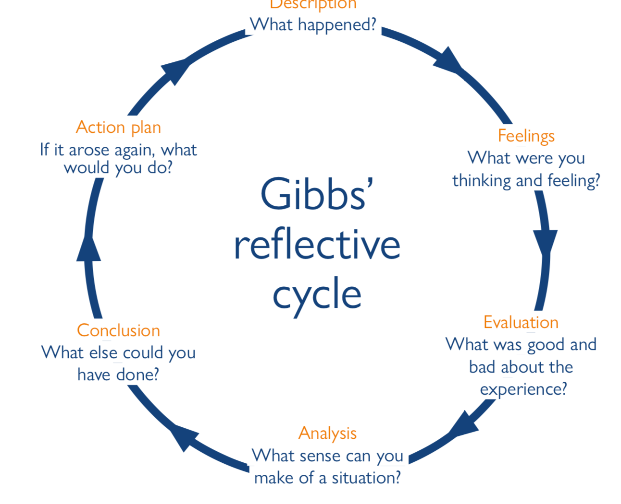



Reflecting on my transition
Brown, D.N. (2022) Reflective Model According to Gibbs, Dr Nicole Brown. Available at: https://www.nicole-brown.co.uk/wp-content/uploads/2015/09/gibbs-300x300.jpg (Accessed: November 5, 2022).

Slide 10
How useful was this Model?
Guided me through step by step.
Added further steps to alternative models such as Jasper's (2013, cited in Bassot 2016 p.43) Experience, Reflection and Action, Driscoll's (2007, cited in Bassot 2016 p.49) What? So what? and What now? Or Kolb's (1984, citied in Bassot 2016 p.43) Reflective Learning Cycle.
Some limited exploration of feelings.
Gave me actions to take forward relating to how I would deal with similar situations.
Led me to consider complimenting this model with another theory to look at my transition again.
Using the learning to then look at Bassot's (2016, p.16) 'Metaphorical Mirrors' developed further self-awareness.

Slide 11
Metaphor
Life is like riding a bicycle, to keep your balance you must keep moving.
Albert Einstein (1930, quoted in Highfield, 1994, p.234)

Slide 12
Conclusion
A useful tool for a variety of professions to compliment the technical knowledge of their work.
An all-encompassing pursuit.
Many theories and models can assist and enhance reflective practice when used appropriately.
Highlight the difference between our hypothetical response to our actual response.
How we used the models and theories is key, we only get out what we put in.
By beginning to undertake reflective practice I have become more self-aware, putting the theories into practice has highlighted the benefits it can provide.

Slide 13
References
Bager-Charleson, S. (2010) Reflective practice in counselling and psychotherapy. Exeter: Learning Matters.
Bassot, B. (2016) The reflective practice guide an interdisciplinary approach to critical reflection. Abingdon, England : Routledge.
Bolton, G. and Delderfield, R. (2018) Reflective Practice: Writing and professional development. 5th edn. London: Sage.
Brookfield, S., (1998) ‘Critically reflective practice’, Journal of Continuing Education in the Health Professions, 18(4), pp.197-205.
Brown, D.N. (2022) Reflective Model According to Gibbs, Dr Nicole Brown. Available at: https://www.nicole-brown.co.uk/wp-content/uploads/2015/09/gibbs-300x300.jpg (Accessed: November 5, 2022).
Flying Hawk, Stock image, Microsoft PowerPoint, accessed 03/11/2022
Gibbs, G. (1988) Learning by doing: a guide to teaching and learning methods. London: FEU.
Highfield, R. (1994) The private lives of Albert Einstein. London: Faber & Faber.
Pen, Stock image, Microsoft PowerPoint, accessed 03/11/2022
Schön, D.A. (2016). The Reflective Practitioner: How Professionals Think in Action 1st edn. Abingdon, England: Routledge.
Thompson, S. and Thompson, N. (2008) The critically reflective practitioner. Basingstoke; Palgrave Macmillan.

