Slide 1

Learning in the digital era
Speciesism what is it ? And is it justified?
Sean Mellars 2110816

Slide 2
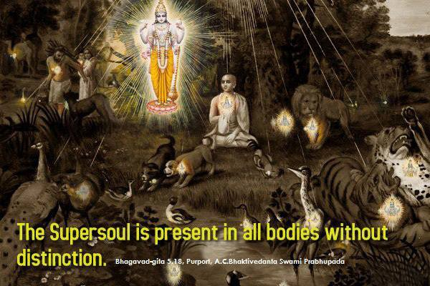
Speciesism & equality
By virtue of true knowledge the humble sage sees with equal vision a gentle and learned brahmana, a cow, an elephant, a dog and a dog eater.
Bhagavad Gita 5:18
https://miro.medium.com/max/828/1*LRAoWb1VutM0KnGRwdqz5A.jpeg

Slide 3

https://www.veganisme.org/wp-content/uploads/2020/06/Stop-speciesism_english-scaled.jpg

