Slide 1
HPAR7007 Archaeological Specialist Practice
Being a specialist
8/2/23

Slide 2
Session outline
Role
Expertise
Standards and guidance
Methods and processes
Language
Knowledge
Reporting
Professional development
Engagement with the community

Slide 3
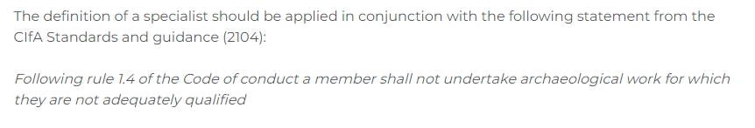
The Specialist role
Job titles- varied
Functional definition: “A specialist is someone who is sufficiently skilled, experienced and knowledgeable to make reliable judgments about a heritage topic”
CIFA competence matrices https://www.archaeologists.net/matrices

Slide 4
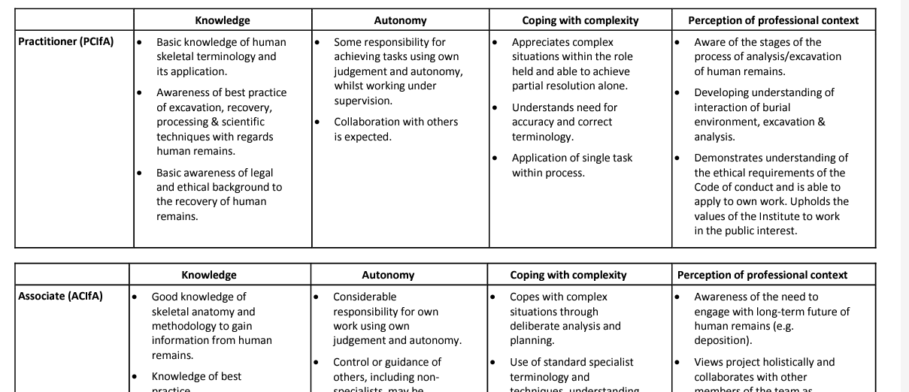
CIfA Specialist competence matrix

Slide 5
Expertise
Late 2nd century coinage in southwest England
Interpreting earthwork sites
Practice based (not just reading/theory)
Repeated/developing
Current
Professional judgement

Slide 6
Standards and guidance
Best practice (need to know even if don’t follow)
Says who? Historic England, CIfA, Society for Roman Pottery Studies, Medieval Pottery Research Group, etc
Typically: written by small group of experts > consultation > issued as common practice/ best practice
Reification of previous practice/ reluctance to adopt new techniques
Mandated by funding body, planning / recommended
Reporting and archive
CIFA Standards and Guidance - enforceable

Slide 7
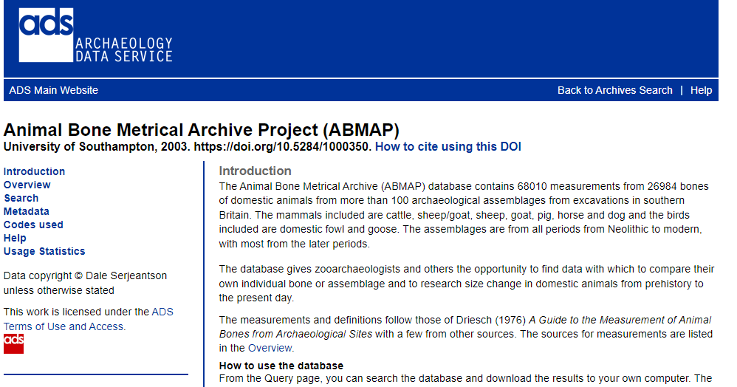
Methods and processes
Record keeping
Explicitly stated methods
Standardisation
Reference material
Reference data - material, datasets
Quantification - EVE, NISP
Quality control

Slide 8
Language
General glossaries http://www.heritage-standards.org.uk/fish-vocabularies/
(specialist glossaries are more specific)
Excludes others? (non-specialists, public)
Consistent terms/ definitions
Hierarchy - specialist text > summary > synthesis > main text
Norm

Slide 9
Competence matrix task
1 Go to the CIfA competence matrix page https://www.archaeologists.net/matrices
2 Choose the Specialist Matrix that corresponds most closely to your specialism
3 Look at the competences required for each level of membership and identify which of them you are currently meeting
4 Look at whether your Knowledge/ Autonomy/ Coping with complexity / Perception of professional context levels are consistent, or some are more advanced than others
5 Identify what evidence you could provide to demonstrate you have achieved that competence

Slide 10
Competence matrix task reflection
Current level
Variation between headings?
Evidence?
Part of being a specialist is awareness of limits of your expertise

Slide 11
Knowledge
Familiar with developments in terminology and method
Aware of general chronology/ distribution and exceptions
Distinguish between good and poor reporting
Analyse and synthesise own and other data
Currency

Slide 12
Reporting
CIFA Toolkit for Specialist Reporting https://www.archaeologists.net/reporting-toolkit
Downloads: https://www.archaeologists.net/sites/default/files/Reporting-Toolkit-Checklist-for-Specialist-Reporting.docx

Slide 13
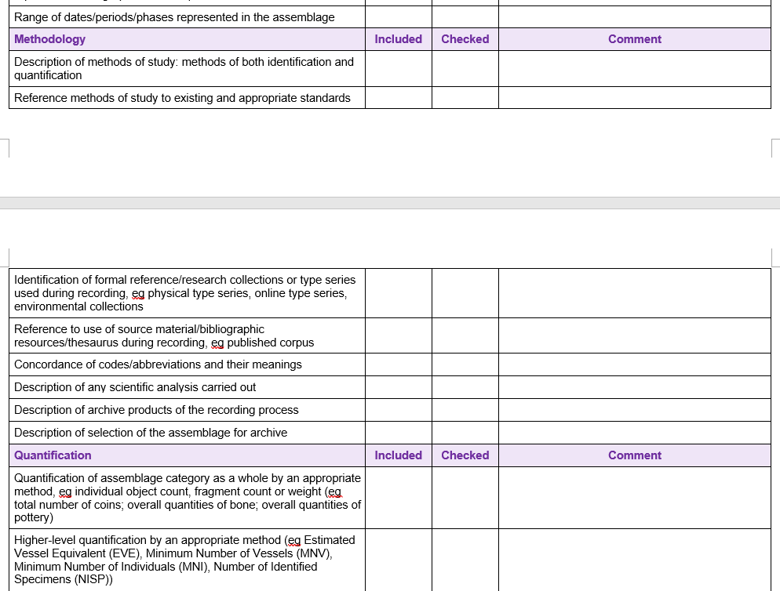

Slide 14
Reporting principles
Explicit methodology
Standardised quantifications including material not analysed
Separation of description, characterisation and interpretation
Linked to other data (stratigraphy etc)

Slide 15
Professional development
Qualifications/ training
Reading
Conferences
Training log

Slide 16
Engagement with the specialist community
Active membership of groups/ societies
Attend seminars
Contribute to publications and guidance
Committee membership
Mentoring / peer support

Slide 17
Conclusion
Responsibilities as lead expert
Need to maintain currency
High standards of practice
Part of specialist community

