Slide 1
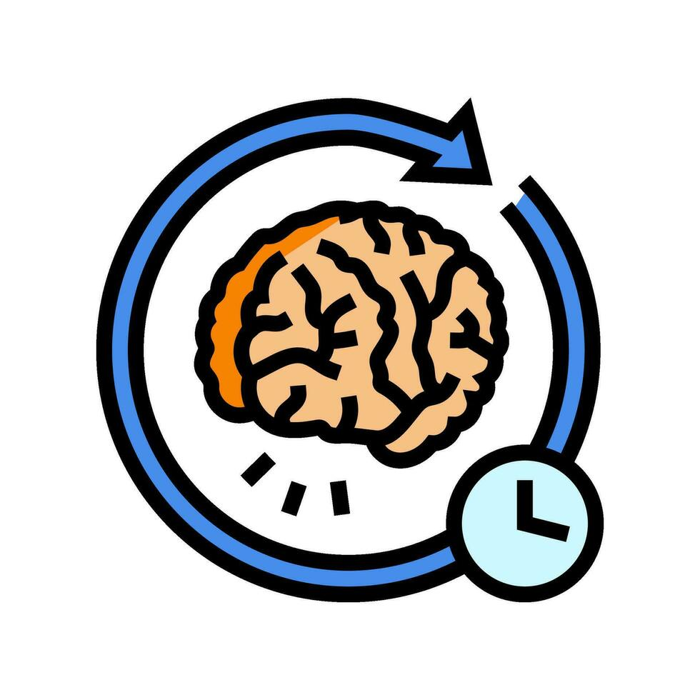

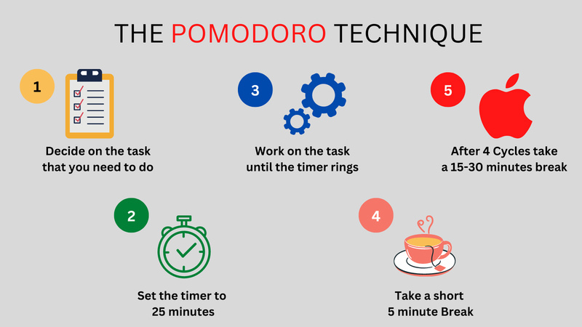
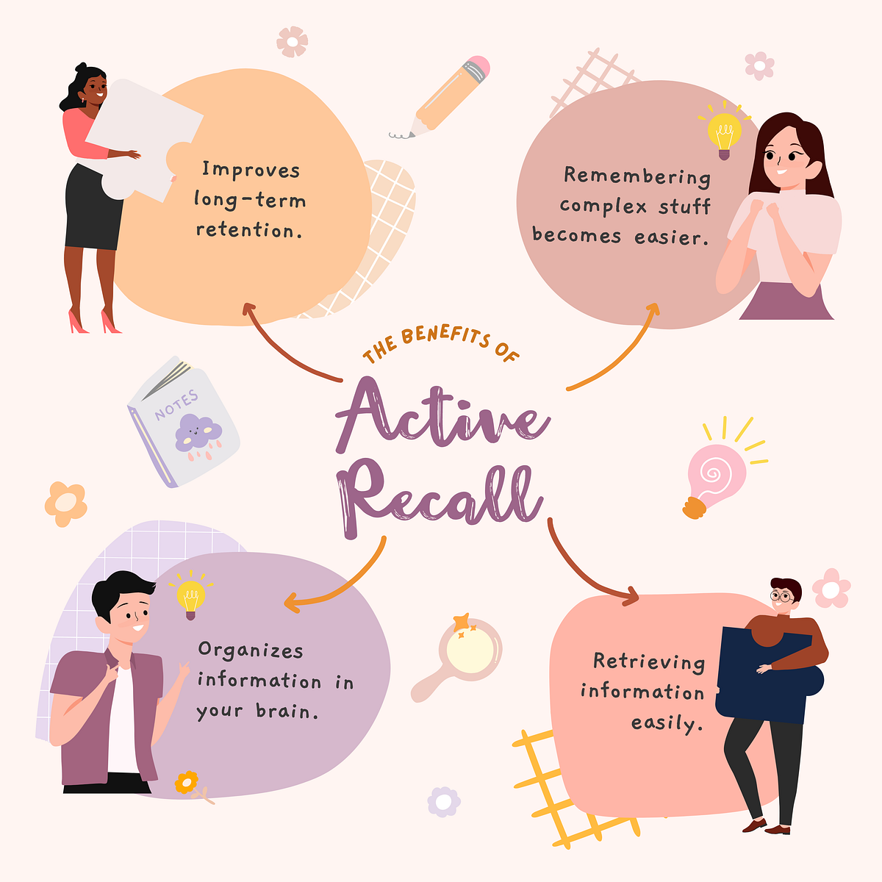
Study smarter: Active recall and pomodoro technique
Introduction
University students need effective study strategies to improve learning ,memory and time management .Active recall and the pomodoro technique are evidence-based approaches that can supports students to be successful throughout their time at university.
Active Recall
Helps students remember information by testing themselves.
Improves long-term memory and understanding.
Research shows that retrieval practice can improve learning and retention.
Linked to higher grades and improved academic achievement.
Early Years Example
Use flashcards or quizzes to help remember child development theories, learning theorists, and safeguarding procedures.
Pomodoro Technique
Study for 25 minutes, then take a 5-minute break.
Helps improve focus and organisation.
Breaks large tasks into manageable steps.
Regular breaks can reduce mental fatigue.
This technique is useful for reading, assignments, and revision.
Why Use Both?
Active recall improves learning and memory.
The Pomodoro Technique improves focus and time management.
Example:
25 minutes revising safeguarding.
5-minute break.
25 minutes self-testing with flashcards.
Together, these techniques can improve academic performance, confidence, and study habits.
Conclusion
Active recall and the Pomodoro Technique are simple but effective study strategies. Using both techniques can improve learning, organisation, memory, and time management. Together, they can help students develop better study habits and achieve greater success at university.

Slide 2
Reference list
Karpicke, J.D. (2012) ‘Retrieval-based learning: Active retrieval promotes meaningful learning’, Current Directions in Psychological Science.
Karpicke, J.D. and Roediger, H.L. (2007) ‘Repeated retrieval during learning is the key to long-term retention’, Journal of Memory and Language.
Roediger, H.L. and Karpicke, J.D. (2006) ‘Test-enhanced learning: Taking memory tests improves long-term retention’, Psychological Science.
Smits, E.J.C., Wenzel, N. and de Bruin, A. (2025) ‘Investigating the effectiveness of self-regulated, Pomodoro, and Flowtime break-taking techniques among students’, Behavioral Sciences
Xu, J., Wu, A., Filip, C., Patel, Z., Bernstein, S.R., Tanveer, R., Syed, H. and Kotroczo, T. (2024) ‘Active recall strategies associated with academic achievement in young adults: A systematic review’, Journal of Affective Disorders.

