Slide 1

BMHP5032 Introduction to Physiology
Component 2 – Presentation
Care Plan
Student ID: 2418938
Student name: CATHERINE CHINWENDU OKONYIA
Lecturer Name: DR SADIQ SOBAN
Submission Date 22/4/2026

Slide 2
Introduction
In this presentation, I am going to discuss a 69-year-old patient with lung cancer. Lung cancer is a malignant condition affecting the lung tissues, characterized by uncontrolled growth of abnormal cells, In the UK, approximately 49,000 cases are diagnosed each year, while worldwide there are about 2.5 million new cases annually (Cancer Research UK, 2024; American Cancer Society, 2024) .
Symptoms typically show up only when the illness has progressed quite a bit, but common signs include a persistent cough, coughing up blood, chest pain, shortness of breath, and unexplained weight loss (World Health Organization, 2023; NHS, 2023) .
📚

Slide 3
Information about the person
• Name: patient V
•⁠ ⁠Age: 69
•⁠ ⁠Gender: Male
•⁠ ⁠Health measurements:
•⁠ ⁠Height: [Insert Height]
•⁠ ⁠Weight: [Insert Weight]
•⁠ ⁠BMI: 19
•⁠ ⁠Blood pressure: [Insert BP]
•⁠ ⁠Oxygen saturation: [Insert SpO₂]
•⁠ ⁠Medical history: Smoker for 40 years, history of chronic cough, fatigue, occasional shortness of breath.

Slide 4
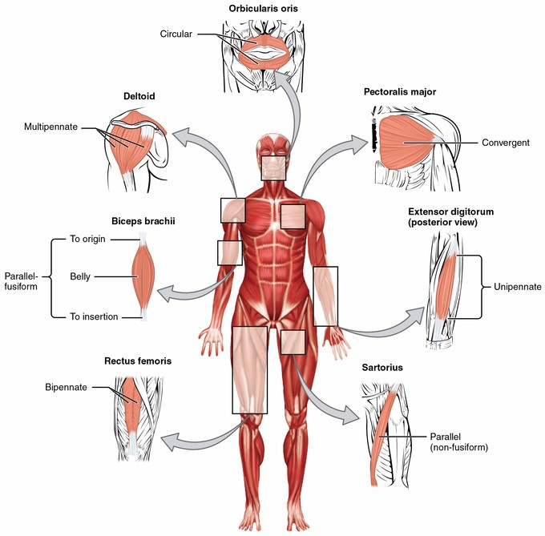
Anatomy
The lungs are paired organs located in the thoracic cavity (Thoracic cavity) (Hall, 2021).
The right lungs consists of three lobes, while the left lungs has only two lobes to accommodate the space taken up by the heart (Hall, 2021).
Air passes through the trachea → bronchi → bronchioles → alveoli (Tortora & Derrickson, 2021).
Gas exchange occurs in the alveoli, where oxygen enters blood and carbon dioxide is removed (Tortora & Derrickson, 2021).
Figure 1 Anbatomy of lung
Muscles of the face and body diagrams (Kenhub)

Slide 5
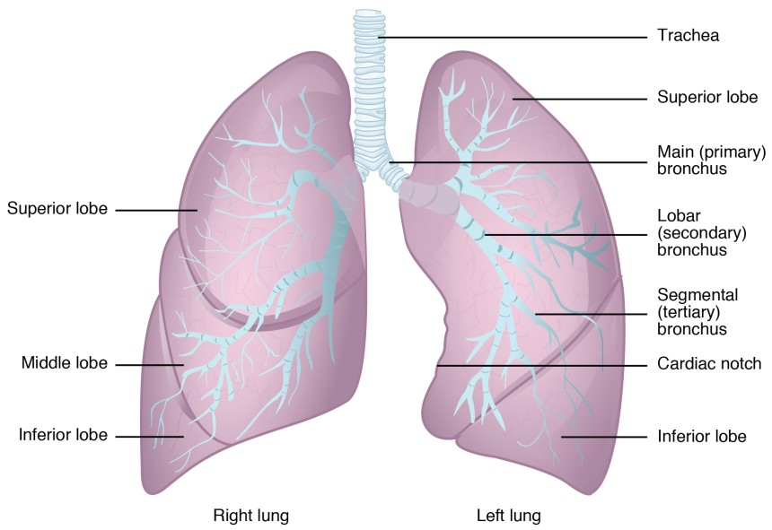
Physiology of the lungs
The lungs exchange oxygen and carbon dioxide in the alveoli Lung cancer occurs when abnormal cells grow uncontrollably in the lungs.
Tumors can block airways and cause lung collapse (atelectasis), reducing airflow (Kumar et al., 2021).
This leads to poor gas exchange, low oxygen levels (hypoxia), and breathlessness (Hall, 2021).
Figure 2 Physiology of the lungs

Slide 6
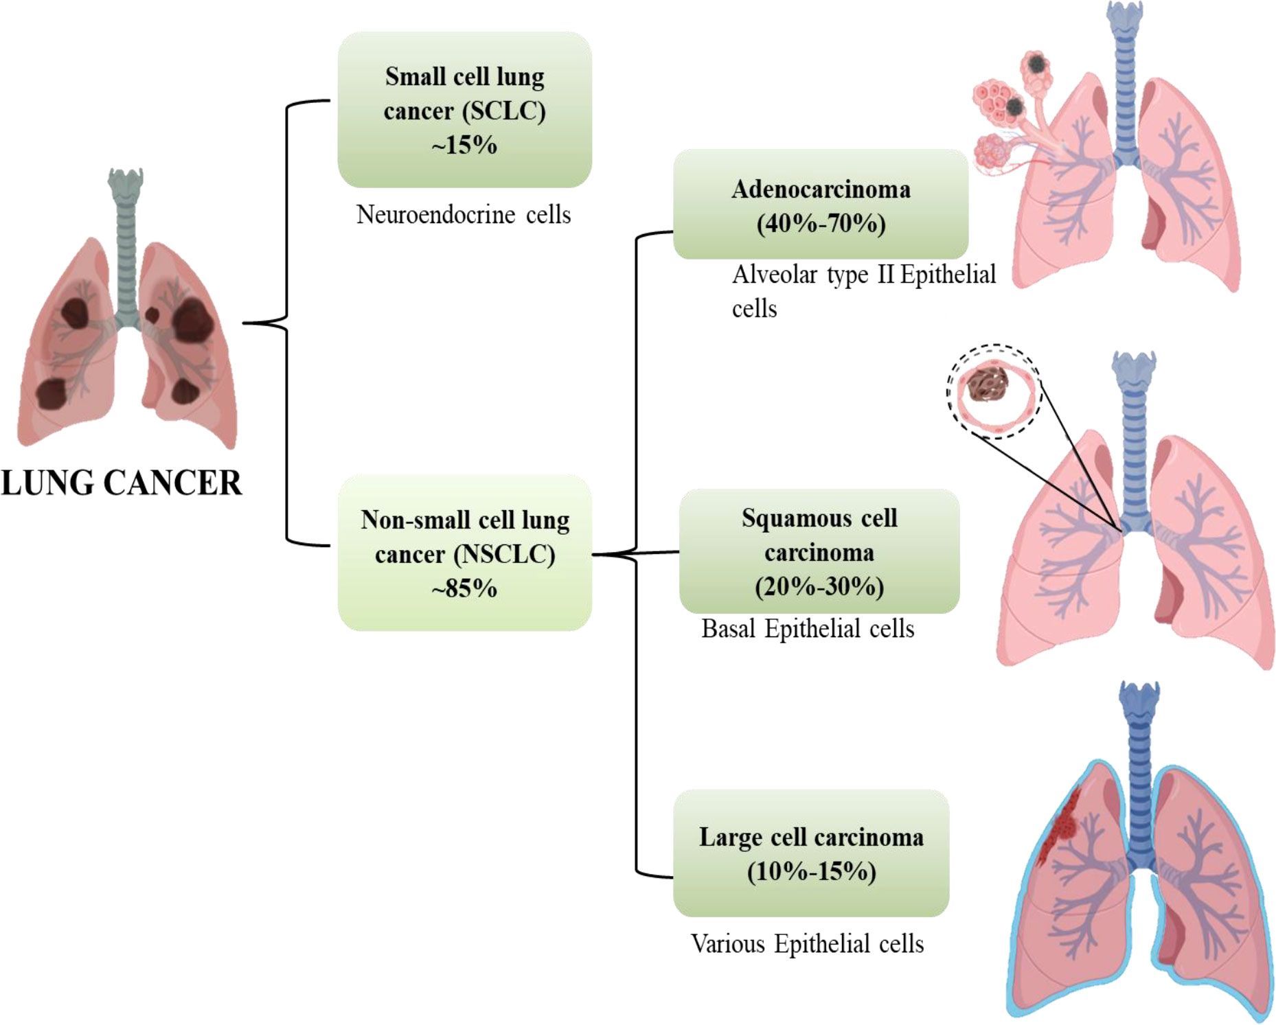
pathophysiology of lung cancer
Lung cancer starts when normal lung cells become abnormal and grow uncontrollably
Genetic mutations cause cells to divide rapidly and avoid normal cell death .a tumour forms and can block airways, reducing airflow.
This may cause lung collapse (atelectasis) and breathing difficulties. Gas exchange is impaired, leading to low oxygen levels (hypoxia).(Kumar et al.,2021).
Figure 3 Pathophysiology of the lung cancer

Slide 7
Risk factors
•⁠ ⁠Age 69 (advanced age increases risk).
•⁠ ⁠Long-term smoking history.
•⁠ ⁠Low physical activity and poor diet.
•⁠ ⁠Chronic exposure to environmental pollutants (if applicable).
•⁠ ⁠Family history of cancer (if applicable).
Figure 4 of Risk Factors

Slide 8

Care Plan (1/3)
Lifestyle and Health Behaviour.
⁠patient V has a history of smoking; currently trying to quit.
Poor diet: The diet is deficient in fruits and vegetables and rich in processed foods ⁠
Low physical activity; spends most time at home
Stress management is minimal; anxiety about diagnosis.

Slide 9

Care Plan (2/3)
Everyday Routine
•⁠ ⁠Morning: Light stretching, breakfast with limited protein
•⁠ ⁠Afternoon: Short walk, rest periods due to fatigue.
•⁠ ⁠Evening: Medication adherence (chemotherapy or prescribed drugs), monitoring symptoms (cough, oxygen levels).
•⁠ ⁠Sleep: 6–7 hours per night; disturbed due to coughing.

Slide 10

Care Plan (3/3)
Communication and Ethical Consideration
• Encourage open communication with healthcare team and family.
•⁠ ⁠Discuss treatment options, side effects, and prognosis respectfully.
•⁠ ⁠Respect patient autonomy; involve patient V in all care decisions.
•⁠ ⁠Provide emotional support and counseling when needed.

Slide 11
Recommendations
•⁠ ⁠Smoking cessation support (counseling, nicotine replacement therapy).
•⁠ ⁠Nutritional support: high-protein, high-antioxidant diet.
•⁠ ⁠Regular low-impact exercise (walking, breathing exercises).
•⁠ ⁠Symptom monitoring: cough, oxygen saturation, weight changes.
•⁠ ⁠Psychological support: counseling, support groups.
•⁠ ⁠Regular medical follow-up and adherence to treatment plan.

Slide 12
Conclusion
Patient V’ lung cancer care requires a holistic and patient-centred approach that addresses not only the physical aspects of the condition but also his emotional and psychological wellbeing. Effective management involves making positive lifestyle changes, maintaining regular monitoring of symptoms, and adhering closely to prescribed treatments. In addition, providing continuously emotional support and clear communication can help him cope better with his diagnosis. Overall, the use of appropriate evidence- Interventions tailored to his needs can greatly enhance his quality of life and boost health results

Slide 13
References
American Cancer Society (2023) What is lung cancer? Available at: https://www.cancer.org (Accessed: 2 April 2026).
Cancer Council (2022) Understanding lung cancer. Available at: https://www.cancer.org.au (Accessed: 2 April 2026).
Cancer Research UK (2023) Lung cancer statistics. Available at: https://www.cancerresearchuk.org (Accessed: 2 April 2026).
Kumar, V., Abbas, A.K. and Aster, J.C. (2021) Robbins & Cotran Pathologic Basis of Disease. 10th edn. Philadelphia: Elsevier.
National Health Service (2023) Lung cancer. Available at: https://www.nhs.uk/conditions/lung-cancer/ (Accessed: 2 April 2026).
NICE (2022) Lung cancer: diagnosis and management. Available at: https://www.nice.org.uk (Accessed: 2 April 2026).
Public Health England (2021) Health matters: preventing cancer. Available at: https://www.gov.uk (Accessed: 2 April 2026).
Siegel, R.L., Miller, K.D. and Jemal, A. (2024) ‘Cancer statistics, 2024’, CA: A Cancer Journal for Clinicians, 74(1), pp. 17–48.
Tortora, G.J. and Derrickson, B.H. (2021) Principles of Anatomy and Physiology. 16th edn. Hoboken: Wiley.

