Slide 1
BA DANCE HEALTH AND WELLBEING
DANCE NUTRITION
The Importance of Hydration

Slide 2
How Beverage Consumption Affects Athletic Performance
https://m.youtube.com/watch?v=uRAYBSZYsdw

Slide 3
Water is one of the most important nutrients required by the body.
Humans can survive for six to seven weeks without food due to the fat, protein and CHO stores in the body.
Humans can only survive two to three days without water.

Slide 4
Water is needed for the body’s cooling system, for transportation of nutrients throughout the tissues, for optimal function of the heart and for the maintenance of blood volume.
Approximately 60% of the body’s weight is water.
In individuals with the same body weight, the total water will be larger in those with greater muscle mass.

Slide 5
Water is lost from the body through
  breathing
  sweating
  urinating
On average we lose around 2 litres of water per day.
For every litre of sweat that evaporates, the body loses about 600 calories of heat.
To stay in fluid balance this means we need to drink at least 2 litres of water per day.

Slide 6
Why do we lose water when we exercise?
During exercise the body temperature rises. The body cools itself by producing sweat. The sweat evaporates from the skin and takes heat energy away.
During endurance exercise water loss can reach up to 1 litre per hour.
This can be even higher if the exercise occurs in hot and humid conditions.
If the fluid lost through sweating is not replaced there is risk of dehydration and performance can suffer.

Slide 7
How does dehydration affect performance?
Dehydration reduces strength, power, and aerobic capacity.
Severe dehydration can cause heat stroke and can be fatal.
Losing only 2% of your body weight through sweat can affect your performance.
Thirst is a poor indicator of hydration state.
If you are thirsty you are already dehydrated!

Slide 8
The effects of dehydration on the ability to perform physical tasks and on health have been known since the era of classical Greece and the ancient Olympic Games. Even small unreplaced fluid losses can impair maximal physical performance , mainly due to decreases in plasma volume which in turn will affect carbohydrate utilization.
(Armstrong, Costill and Fink 1985, Buskirk, Lampietro and Bass 1985)

Slide 9
How can we prevent dehydration?
To minimise the effects of fluid loss during training and performers, they should always be encouraged to begin fully hydrated and drink plenty both during and after the activity.
Establishing patterns of fluid intake should be part of the training process.
Training should be used as an opportunity to practise well-rehearsed fluid replacement strategies that run smoothly in competition.

Slide 10
What is the best way to hydrate?
Many factors can influence the effectiveness of fluid replacement strategies.
Fluid replacement can be speeded by drinking still, cool drinks, not too much and not too concentrated.
Fluid absorption slows as exercise intensity increases.

Slide 11
How can you monitor your hydration state?
Weight and urine checks offer simple ways to monitor the hydration state.
A weight reduction of 1kg during training is equivalent to losing 1 litre of fluid.
Regular trips to the toilet to produce plenty of pale coloured urine are an indicator of good hydration.
Small amounts of dark urine would signal poor hydration.
These simple checks before and after exercise can be useful tools to help determine fluid requirements after training or competition.

Slide 12
A bit about sports drinks…
The main limitations to exercising at higher intensities are dehydration and diminished carbohydrate stores.
The possibility that fatigue may be offset by consuming extra carbohydrates in fluid form has led to the development of numerous sports drinks.
Many sports drinks also contain electrolytes to replace though lost through sweat.

Slide 13
The main purpose of drinking during exercise is to replace lost fluids.
Sports drinks should ensure that fluid absorption is maximised not compromised.
One of the main factors that affect fluid absorption is the concentration of the solution in relation to body fluids.
If the drink is too concentrated (hypertonic) water moves from the gut to dilute it.
Is the drink is less concentrated (hypotonic) water molecules will move into the body.

Slide 14
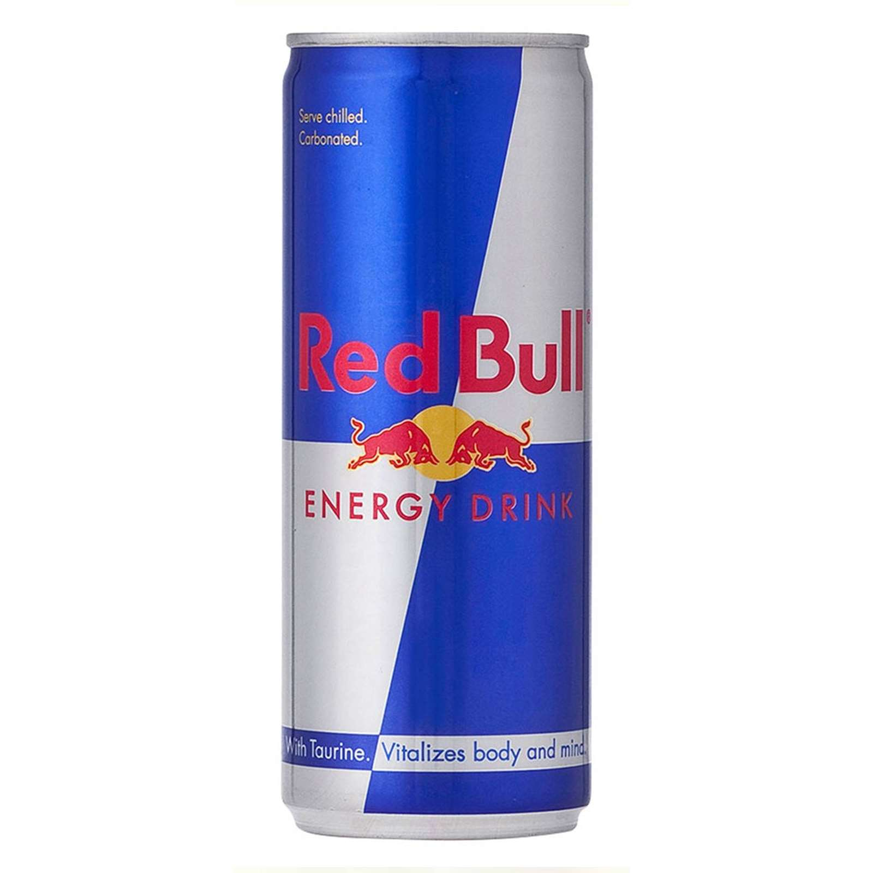
Hypertonic Drinks (Red Bull, Lucozade etc)
Hypertonic drinks have higher osmolality than body fluids.
This means that they are absorbed slower than plain water.
Hypertonic drinks normally contain more than 8g of sugar per 100ml.
These are usually taken after an event to replace fluids and CHO.

Slide 15
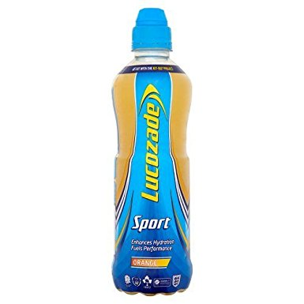
Hypotonic Drinks
(Lucozade Sports Fitness, Fruit Flavoured Water etc)
Hypotonic drinks have low levels of concentration, containing less particles per 100ml than the body’s own fluid.
Hypotonic drinks contain less than 4g of sugar per 100ml.
These drinks promote water intake but refuelling benefits are minimal.
Plain water is just as effective and cheaper.

Slide 16
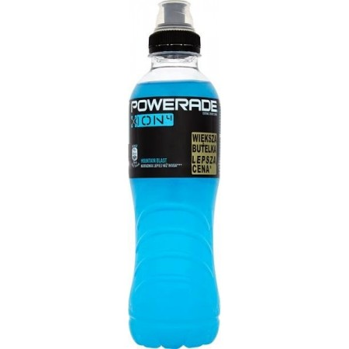
Isotonic Drinks (Lucozade Sport Isotonic)
Isotonic drinks have the same concentration as the body fluids.
Isotonic drinks provide the ideal compromise between refuelling and rehydration.
Isotonic drinks contain between 4-8g of sugar per 100ml.
Isotonic drinks are usually consumed during exercise.

Slide 17
Studies have shown that sports drinks containing small amounts of sodium and CHO can improve performance.
Sodium aids water absorption helping rehydration and the restoration of energy stores.

Slide 18
The choice of sports drink depends on the intensity and duration of the exercise and the weather conditions.
Exercise Conditions | Sports Drink
Exercise under 30 mins | Water/Nothing
Moderate under 1hr | Water, hypotonic, isotonic
Strenuous 1-2 hrs | Hypotonic, isotonic
Srenuous over 2 hrs | Hypotonic, isotonic, CHO drink

Slide 19
  Soft drinks and juices typically contain between 9-20g sugar per 100ml.
They are too concentrated to be used as fluid replacers during exercise.
They have to be diluted by the body’s own water before they are absorbed and can cause a net reduction in body fluid and therefore dehydration.

Slide 20
Diet drinks contain artificial sweeteners in place of sugars.
They also have a very low sodium concentration.
This makes them poor fluid replacers during exercise, although they will replace fluid at the same rate as plain water.
Choose if you don’t like water under the same condition when you would use water.

Slide 21
Caffeine is a stimulant, which has been shown to improve performance in both endurance, and sprint based events.
Caffeine makes you more alert and can lift your mood.
The exact mechanism is unclear.
It is thought that caffeine enhances fatty acid oxidation thus sparing glycogen.
There are disadvantages to caffeinated drinks:
  It is a diuretic causing the body to loose water.
  It can cause anxiety and rapid heartbeat.
  The IOC has banned caffeine at levels over 12 μg in the urine. ( 6 cups of coffee, 9 cans of cola)

Slide 22
Tips for Hydration
Always have a water bottle in your kit bag.
Always start dance class hydrated
Drink small amounts of water at regular intervals within a dance session.
Rehydrate immediately after dance or exercise activity.
A sports drink may be more suitable than water, or to drink alongside water in longer or more intense sessions.
Avoid too much caffeine. It may make you feel more alert instantaneously, but can result in increases in anxiety, insomnia and calcium loss, and can possibly risk fracture.

