Slide 1
CertHE Applied Leadership and Management in the Workplace
Module: BMSK4015
Academic and Research Skills

Slide 2
Blended Learning ​
Session 7

Slide 3
Today’s Session
Research Methods (Data Collection Methods)
Primary Data
Secondary Data

Slide 4
Why Collect Data?
Data can be collected in several ways using both primary and secondary sources.
The collected Data then becomes Information
Information is used at all levels and in all contexts within organisations

Slide 5
There are two kinds of data
Qualitative data uses words or images to describe something.
  Not in numerical form e.g. open-ended questionnaires ‘What did you think of our service?’
Quantitative data uses numbers, or categories, that can be labelled with a number.
  This type of data can be used to construct graphs and tables of raw data.

Slide 6
What is data used for?
Decision-making:
Information used for decision-making is often categorised into three types:
Strategic - looking at the Big Picture
Tactical - measuring effective use of company resources
Operational - how the day-to-day operations are handled
Measurement:
Organisations must measure their performance to be successful.
Information is used as the main way of measuring performance.
This may be done by collecting and analysing information on sales, costs and profits.

Slide 7
Recording:
Organisations collect a wealth of information as part of their normal operations - they record purchases, sales, returns, deliveries etc.
In order to plan, you must have information to base your plans on.
Planning:
Making decisions about staff, premises, equipment, customers.
Accurate and up to date information is required to enable planning to take place.

Slide 8

Primary Source
Collection Methods

Slide 9
Questionnaires
May be delivered in different ways:
Self-completion (e.g. online or postal)
telephone survey
face to face interview
May seek to discover any of the following types of information:
preferences
behavioural
opinion based
attitudes
beliefs

Slide 10
Questionnaire Design
Good Design:
  Respondent knows exactly what to do
  Clear, neat, attractive layout
  Polite and professional tone
  Questions ask what you need to know – no more, no less
Poor Design:
  Too long
  Inappropriate design or language
  Poor questions

Slide 11
Questionnaire Design
  Poor Question types:
  negatives or double negatives
  ambiguous
  questions with the words ‘usually’ or ‘recently’ etc.
  leading questions
  Inconsistent questions
  potentially embarrassing questions
  direct classification questions (how old are you)

Slide 12
Which method to use?
The need to know how many staff would like training in IT skills development.
This requires a little information, in the same format, from a large
number of staff.
Use questionnaires.
The need to know in detail how people feel about a new product.
This requires detailed information on personal views.
Use interviews (either individual or group).

Slide 13
Which method to use?
The need to know how many shoppers enter the store each day of the week.
This requires information about consumer behaviour, most easily obtained by counting events.
Use observation.

Slide 14

Secondary Source
Collection Methods

Slide 15
Secondary Data Sources
Advantages
  Can be a better use of resources
  Many datasets come from large, well-designed surveys that an individual or small company could not have done independently
Disadvantages
  Can be difficult to find appropriate data
  May not have exactly what you want
  You may have to pay for access

Slide 16
Secondary Data Sources
It is important to be discerning and critically examine the data and the sources available.
Is the data / source:
Current – how old is the data?
Relevant – is the data relevant to your context?
Authority – Who is the author?
Accurate – is the data correct and the source reliable?
Purpose – what is the purpose of this information?
Does it pass the CRAAP test?

Slide 17
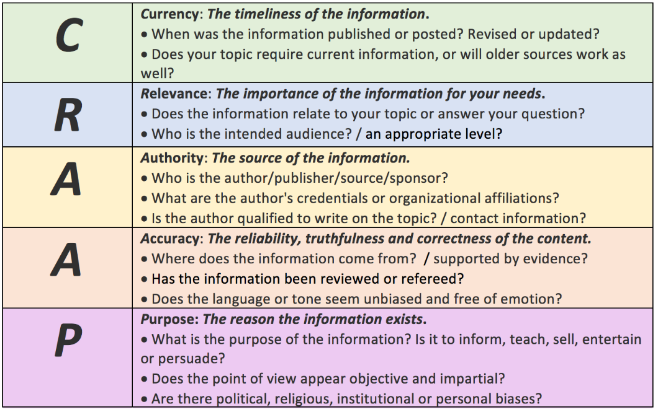
Secondary Data Sources

Slide 18
Other Useful Sources
National Statistics – official source of UK population and economic statistics
Ipsos MORI – specialises in researching advertising, loyalty, marketing, media and public affairs
ISER – longitudinal data (over time) on life events, employment conditions, behaviour and values

Slide 19
References
Maund, et al. (2017) Certificate in Higher Education: Skills for the Workplace Student Yearbook. Sage Publications Ltd.
Morgan, P. (2017) The Business Student’s Guide to Employability. Sage Publications Ltd.
Pierce, R. (2018) ‘Maths is Fun/Data’ [online] available at https://www.mathsisfun.com/data/index.html accessed Feb 2021.

