Slide 1


"Mental Health Care: Then and Now in the UK NHS"
Module name and code: LCHS4003_LON
Introduction to Health and Social Care
Student name: Selma Pacheco
Student number: 2309049
Lecturer name: Dr Diola Bijlhout

Slide 2
Overview
Introduction
What do you mean by mental health?
The Role of Mental Health Services in Healthcare
Old Times and Mental Health Rules (1948-59)
Getting Mental Health Care Right (1960s-1983): Slow Changes, New Rules
Changes in Mental Health Service: 1990s-2000s
70 Seventy Years on – NHS Mental Health
Conclusion
References

Slide 3

Introduction
How mental health care has develop over the years since the NHS was implemented in 1948.
Notes:
In this presentation I will be talking about how mental health care has changed in the UK since 1948 when the NHS began. Imagine taking a journey from really old times to now, understanding important moments, especially after the Mental Health Act of 1959. We're exploring this with the help of smart people like historians, doctors, and decision-makers. The goal? To figure out how mental health has been seen and talked about over time. This quick talk gives us a peek into the past, helping us get why mental health is how it is today.

Slide 4
What do you mean by mental health?
According to the World Health Organization, mental health is how we feel and think. It's about having a positive mindset and dealing with life's challenges.
Taking care of mental health means paying attention to our emotions, thoughts, and behaviours to lead a good life.
(WHO, 2004 )
Notes:
What do you mean by mental health ? According to the World Health Organization ,Mental health is how we feel and think. It's about having a positive mindset and dealing with life's challenges. Taking care of mental health means paying attention to our emotions, thoughts, and behaviours to lead a good life (WHO, 2004 )
On the other hand, when we talk about mental health or doing well, Keyes (2014), says that it includes three important things: how you feel inside , how you think about your responsibilities, and how you get along with others. It's like having positive emotions, good thoughts about what you need to do, and having positive relationships with people around you.

Slide 5


The Role of Mental Health Services in Healthcare
1) Feel good with mental health support
2) Stay healthy with early help
Notes:
The role of mental health services in healthcare . 1) Feel good with Mental Health Support : Mental health services help people feel good by providing support for stress and anxiety. Services like counselling aim to boost positive feelings, like happiness and satisfaction, contributing to overall well-being.
2) Stay healthy with early help : These services are essential for preventing and managing health issues. By addressing mental health early through counselling and support, an approach to staying healthy is promoted, recognizing the strong connection between mental and physical well-being.

Slide 6
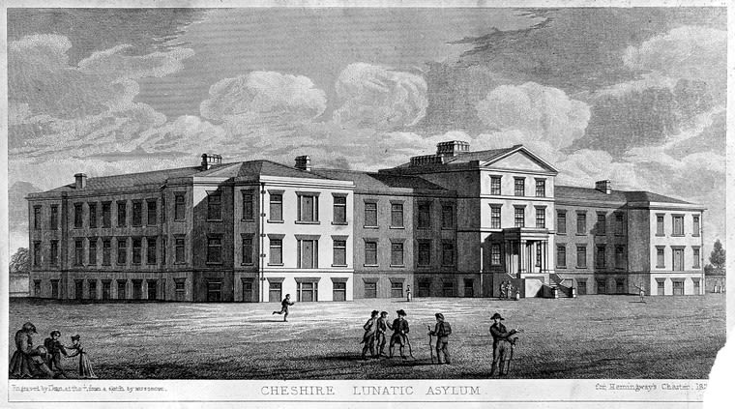
Old Times and Mental Health Rules (1948-59)
Before the NHS, mental health care was poor, with people kept in old-fashioned asylums.
In the 1950s and 1960s, important medicines were created to help people with mental health issues.
Source (Gruber et al, 2021)
Notes:
Old Times and Mental Health Rules (1948-59)
Before the NHS, mental health care was poor, with people kept in old-fashioned asylums. In 1959, The Mental Health Act aimed to improve things, wanting mental health care to be more like regular health care, though changes took time
In the 1950s and 1960s, important medicines were created to help people with mental health issues. These medications aimed to make symptoms better and improve life quality. However, there were challenges because many people needed mental health help, and there weren't enough resources. Society was still learning about mental health. This time laid the groundwork for future progress in mental health care with the start of the NHS (Turner et al., 2015).

Slide 7
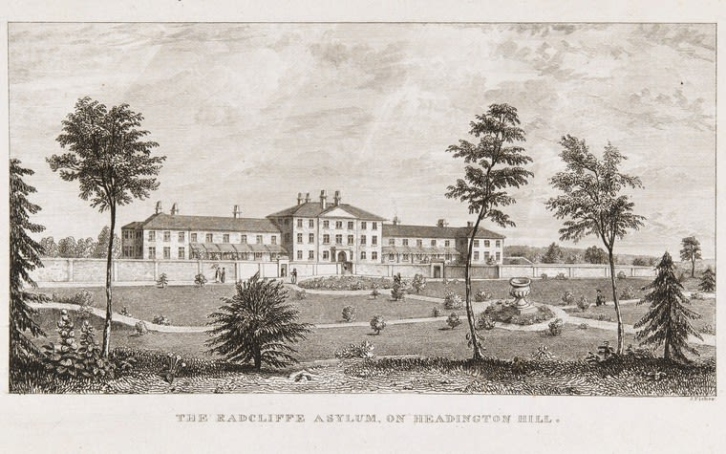
Getting Mental Health Care Right (1960s-1983): Slow Changes, New Rules
Connecting mental health services with the bigger NHS didn't happen fast.
Fast forward to 1983
(Kapur et al.,2016).
Source (Sampasa-Kanyinga ef al, 2020)

Slide 8

"Changes in Mental Health Service : 1990s-2000s"
In the late 1990s, people got worried about patients with mental health issues living in the community after some incidents made it to the news .
In 2002, a group called NICE (National Institute for Health and Care Excellence) made a guide about schizophrenia.
In 2008, a program called IAPT started. It uses things like phone apps and online programs to help with common mental health problems.
(Corker et al., 2013).
Source ( Van der Noordt et al, 2023)
Notes:
"Changes in Mental Health Service : 1990s-2000s"
the late 1990s, people got worried about patients with mental health issues living in the community after some incidents made it to the news .
Then, in 2002, a group called NICE (National Institute for Health and Care Excellence )made a guide about schizophrenia. After that, they made 80 more guides about mental health, saying it's good for lots of different groups to work together.
In 2008, a program called IAPT started. It uses things like phone apps and online programs to help with common mental health problems (Corker et al., 2013).

Slide 9

70 Seventy Years On – NHS Mental Health
The NHS worked to make mental health as important as physical health in its Five Year Forward View. In 2016/17, they spent around £12 billion, hiring more doctors and making wait times shorter.
Notes:
70 Seventy Years On – NHS Mental Health . The NHS worked to make mental health as important as physical health in its Five Year Forward View. In 2016/17, they spent around £12 billion, hiring more doctors and making wait times shorter.
Yet, there are challenges. A 2017 survey found many don't know where to get mental health help, and some wait a long time for treatment.
Still, mental health care has gotten better in 70 years. More treatments are available, and it's easier to get help. People talk more openly, breaking down old ideas about mental health (Durcan , 2021 )

Slide 10
Conclusion
The NHS and groups like NICE are working hard to make mental health care easy to get, without judgment, and made for each person. There's hope for a future where everyone can get the mental health support they need.
Notes:
Conclusion In summary, mental health care has improved a lot since the NHS began. We've made big steps, but it's still not equal to physical health care. The NHS and groups like NICE are working hard to make mental health care easy to get, without judgment, and made for each person. There's hope for a future where everyone can get the mental health support they need.

Slide 11
Thank You

Slide 12
References
Corker, E., Hamilton, S., Henderson, C., Weeks, C., Pinfold, V., Rose, D., Williams, P., Flach, C., Gill, V., Lewis-Holmes, E. and Thornicroft, G., 2013. Experiences of discrimination among people using mental health services in England 2008-2011. The British Journal of Psychiatry, 202(s55), pp.s58-s63.
Durcan, G., 2021. The future of prison mental health care in England. M centre for mental health.
Kapur, N., Ibrahim, S., While, D., Baird, A., Rodway, C., Hunt, I.M., Windfuhr, K., Moreton, A., Shaw, J. and Appleby, L., 2016. Mental health service changes, organisational factors, and patient suicide in England in 1997–2012: a before-and-after study. The Lancet Psychiatry, 3(6), pp.526-534.
Keyes, C.L., 2007. Promoting and protecting mental health as flourishing: a complementary strategy for improving national mental health. American psychologist, 62(2), p.95.
Mental health and the NHS. Available at: https://indepth.nice.org.uk/mental-health-and-the-nhs/index.html
Turner, J. et al. (2015) The history of Mental Health Services in modern England: Practitioner memories and the direction of future research, Medical history. Available at: https://www.ncbi.nlm.nih.gov/pmc/articles/PMC4595954
World Health Organization, 2004. Promoting mental health: Concepts, emerging evidence, practice: Summary report. World Health Organization.

