Slide 1
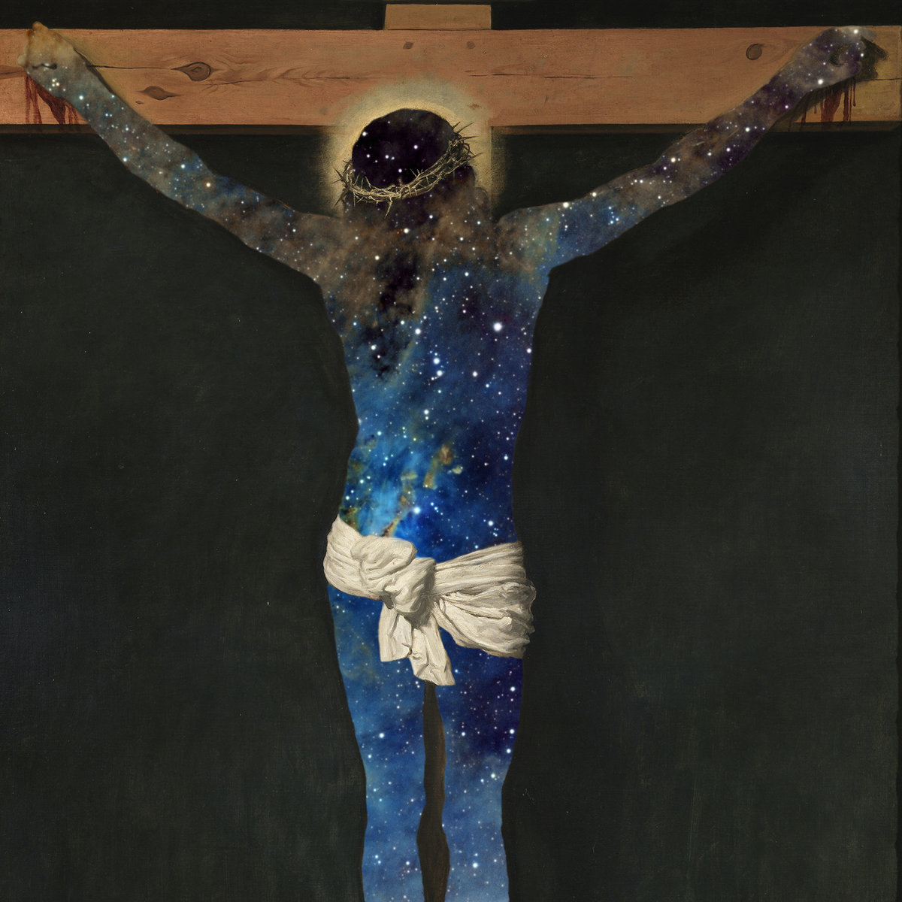
Docetism
An Introduction By Andrew Gowler

Slide 2
Definition
“Docetism is the heresy which denies the full humanity of Jesus Christ. The name comes from the Greek verb dokien, which means ‘to seem’: Docetism holds that Jesus only appeared to be human.”(1)
Jesus in this view is seen as a phantom like creature, one of pure spirit, not made of any matter.

Slide 3
Historical Origins
John Sweet points out that “if many Jews[…]found it hard to believe that the man Jesus was really God, for many Greeks it was even harder to believe that the Christ they worshipped as God could have been really human. Might he have just appeared to be human?” (2)
McGrath tells us that “the first person to have used the word ‘Docetism’ in this sense was Serapion, bishop of Antioch (190-303).”(3)
However, more than anything it’s origins are found in the context in which it arose, namely Greek culture and Greek thought.
This brings us to neo-platonic philosophy current in the early centuries of the Church.

Slide 4
The Platonic Influence
“Plato, distinguished radically between appearance and reality, flesh and spirit. Matter for [Neo-Platonists], was transitory, unreal, even evil; the body was a tomb, and the spirit escaped it at death.” (4)
Moreover, “through philosophy or knowledge (gnosis), you might be set free even before death.” (5)
Therefore, “[f]or God to be human, to be mixed up in matter- that was demeaning, disgusting, unthinkable to the Greek mind; and for God to suffer was a Contradiction in terms.” (6)
One of the solutions being, that Jesus only ‘seemed’ to be human but was in fact a phantom. Hence the rise of Docetism.

Slide 5
Biblical Affirmation
We find in the letters of John, traditionally dated around 95AD, an acclamation of false teachers among the community, some of which point directly toward Docetism;
  “You can tell the spirits which have come from God by this: every spirit which acknowledges that Christ has come in the flesh is from God; but any spirit which will not say this of Jesus is not from God [..]” (1 Jn 4:2-3)
  “There are many deceivers in the world, refusing to admit that Jesus Christ has come in the flesh.” (2 Jn 7)
These texts not only give us a biblical proof of Docetism but also let us know that this heresy most likely arose in the later part of the first century.

Slide 6
Biblical Response
John’s Gospel: Jesus- fully human and fully divine.
“John [goes out of his way] to insist Jesus is fully human. Jesus is seen tired and hungry (4.6-7), weeping at the death of [Lazarus] (11.35). Yet his knowledge is beyond that of any human being. […] He speaks of his own pre-existence (8.58). He knows all about his future passion (13.1) […] and even in death has the power to take up his life again (10.17-18)”. (7)
This revelation in Scripture is surely enough to put to bed the claims that Jesus was never really human. It must also be noted that there are many more passages in Scripture linking Jesus to humanity, especially in the Gospel of Mark who has a very human depiction of Jesus. Therefore, by not drawing on Scripture as whole, one can be led to a distorted Christology of Jesus or simply reject parts of Scripture and look elsewhere; this brings us to other sources used to defend the heterodoxy of Docetism.

Slide 7
Apocryphal Texts
The Gospel of Peter:
This pseudo-gospel begins at Jesus`s passion. What is interesting about this account, when compared to the four canonical Gospels, is when Jesus is being crucified “he [Jesus] was silent, as if he had no pain.” (8) This may well presuppose that Jesus is not human as he is not seen to be suffering.
This one passage can easily be used to bolster Docetism. Moreover, Bart Ehrman explains that “the Gospel of peter was known and used as Scripture in some parts of the Christian Church”. (9) This shows the real disunity in accepted beliefs that Docetism grew out of, if they cannot agree on Scripture how can they agree on Doctrine? However, the debates most likely took place around, what is now canonical Scripture, where there was no real doubt of the authenticity of the Scripture being used.
Before looking into the arguments for and against Docetism, it is important to define the Orthodox position.

Slide 8
Orthodox Position
The Orthodox view, growing more popular in the early church and what is now accepted, on the Christology of Jesus is that Jesus is both fully human and fully divine, co-equal and co-eternal with God the Father and God the Holy Spirit, one God in three persons. Jesus is seen to represent one of the three persons of the triune God-Head, God the Son. Looking purely at the humanity of Jesus`s nature- as this is the orthodox view contrary to Docetism- we will turn to a fragment of The Apostles Creed:
“He [Jesus] suffered under Pontius Pilate, was crucified, died and was buried.”
The key words of importance in this passage are: suffered, crucified, died and buried. Creeds were later formulated to defend the orthodox views from heretical ones; this passage gives us a clear message that Jesus was a human being who suffered and died.

Slide 9
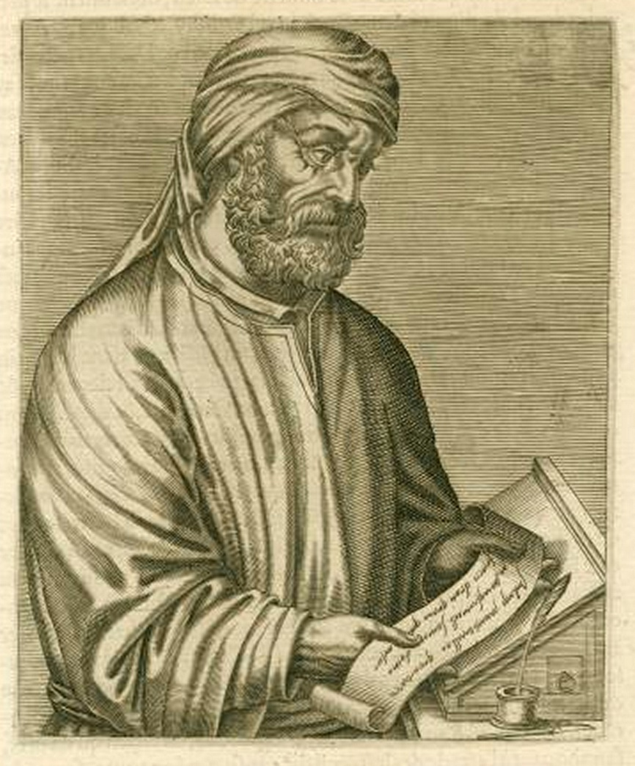
Tertullian Vs Marcion

Slide 10
Marcion’s Gospel -
The writing named The Gospel of Marcion or later known as The Gospel of the Lord begins and tells the reader that “In the fifteenth year of Tiberius Caesar, Pontius Pilate being governor of Judea, Jesus descended [out of heaven] into Capernaum”. (10) This text is to demonstrate that Jesus is not human but purely divine and seems to disassociate Jesus with Bethlehem, by having him come down from heaven in Capernaum.
Tertullian tells us that “one man [Marcion] pervert[ed] the Scriptures with his hand”.(11) Joseph Lynch affirms that “Marcion was probably the first person to create something that resembled a scriptural cannon”. Furthermore, “Marcion removed from Luke`s gospel many favourable references to the Jewish scriptures, such as the Jewish genealogy of Jesus and the infancy stories about Jesus”.(12)
Both from the text itself and comments from Tertullian and Lynch one can see that contentions were high in the early Church. Moreover, people, such as Marcion, were protecting there views so much they were willing to tamper with Scripture. But what are the effects of Marcion’s teachings to the Orthodox position?

Slide 11
Marcion: “I [Marcion] deny that God was truly changed to a human in such wise as to be born and endued with a body of flesh, on this ground, that a being who is without end is also of necessity incapable of change. For being changed into something else puts an end to the former state. Change, therefore, is not possible to a Being who cannot come to an end.” (13)
Tertullian: without a doubt, the nature of things which are subject to change [are] regulated by this law”. Moreover “ [I agree] that they lose [any permanence] in the process of change which they previously were.” However, “nothing is equal with God; his nature is different from the condition of all things.” If it were not “wherein will exist the difference of Divine being from all other things [?]”. (14)
Analysing Marcion’s statement we can take several Orthodox doctrines it denies; the incarnation, the virgin birth, bodily resurrection, Davidic roots and takes away any notion that Jesus may have suffered or died for peoples sins. Tertullian's response charges Marcion with treating God the same as any other part of creation and underestimating God’s power.

Slide 12
The Neo-platonic origin of Docetism seems to resonate highly in Marcion’s reasoning, the idea of a lesser evil God that created all matter seems to match his own thinking.
Ehrman tell us that “Marcion maintained that there was a sharp disjunction between the Law of Moses and the Gospel of Christ; for him, in fact, the God who gave the Law to his people, the Jews, was not the God of Jesus.” Following then as we know from the Old Testament that “the Jewish God had created the world;[for Marcion] the God of Jesus never had anything to do with it”. (15)
This leads not only to a denial of Jesus being involved in creation as John tells us in (Jn 1.3), where all things are made through him, but also lends itself to a Dualistic reality of two God’s one lesser and evil and the Good God, Jesus’s Father. One could make the argument that this goes against the monotheism in orthodox Christian doctrine, although it may be unfair to label all followers of Docetism to this.

Slide 13
Final word from Tertullian.
Tertullian makes the argument that by denying Christ in the Flesh, you also deny love for the flesh and creation, which from Tertullian's perspective was created by God.
  “If Christ is the Creator’s Son, it was with justice that he loved his own (creature); if he comes from another god, his love was excessive, since he redeemed a being who belonged to another. Well, then, loving the human he loved his nativity also, and his flesh as well.” (16)
Tertullian's point here seems to be that God is within his nature just, by redeeming a creature that He did not create God would be going against His nature. By redeeming humankind, surely for Tertullian, this shows Christ loves of all that constitutes a human being, from birth to their very flesh. As the author of Luke describes: “Indeed, the very hairs of your head are all numbered. Don't be afraid; you are worth more than many sparrows.” (Lk 12.7) Luke is demonstrating the worth of human beings in God’s eyes, by taking away the flesh you are also taking away the loving relationship between God and man. Tertullian expands on this by demonstrating that Jesus loved the flesh of man just as much as the spirit as “when leprous, he cleanses it of stain, when blind, he rekindles its light, when palsied, he renews its strength […] when dead, he reanimates it”. (17) By saying Jesus had no flesh, or did not care for it, would be to ignore the very miracles he performed.

Slide 14
Concluding with John Sweet
There are many things that Docetism denies that the church holds as orthodox today and we could argue that the most important is the danger of polytheism as seen from Marcion’s theology. However, perhaps it something more fundamental than that, love.
  “ Sometimes it’s harder to love ourselves than to love others: we can feel ashamed of ourselves. But Jesus is more than an example, more than a sin-bearer: he’s a brother. Paul describes Jesus as the eldest among a large family (see Romans 8.29). We share his relationship with God as beloved children, fellow apprentices learning the Father’s mystery, learning to be divine. He became man that we might become God, united with God in love, as he is.” (18)
Sweet wants to inform the reader that by denying Jesus in the Flesh would be to deny the love he has for us as his brother. It would deny that he took on our sins, as if Jesus did not become man then how can Jesus elevate man to become God. More importantly for Sweet, God became human so we can share in his loving relationship that he shares with the persons within himself, the eternal love of the Trinity.

Slide 15
Reference List
John Sweet, 'Docetism: Is Jesus really human or did he just appear to be so?', in Heresies and How to Avoid Them, ed. by Ben Quash and Michael Ward (London: SPCK, 2010), p. 24.
Ibid, p.25.
Alister McGrath, Heresy: A History of Defending the Truth (London: SPCK, 2009), p. 111.
Ibid
Ibid
Ibid
The CTS New Catholic Bible- New Testament and Psalms ( London: Catholic Truth Society, 2012), p. 162.
Unknown, 'The Gospel of Peter', in After the New Testament: A Reader In Early Christianity, ed. by Bart Ehrman, 2nd edn. (New York: Oxford University Press, 1999), p. 299.
Ibid
Marcion , The Gospel Of The Lord, trans. by C.W. Van Manen (www.gnosis.org: Gnostic Society Library, 1887), in , <http://gnosis.org/library/marcion/Gospel1.html> [accessed 10th October 2018]
Tertullian, 'Tertullian: Prescription of the Heretics and Against Marcion', in After the New Testament: A Reader In Early Christianity, ed. by Bart Ehrman, 2nd edn. (New York: Oxford University Press, 1999), p. 389.
Joseph H. Lynch, Early Christianity A Brief History (New York: Oxford University Press, 2010), p. 60.
Tertullian, 'Tertullian: On the Flesh of Christ ', in After the New Testament: A Reader In Early Christianity, ed. by Bart Ehrman, 2nd edn. (New York: Oxford University Press, 1999), p. 251.
Ibid
Ibid, p. 249.
Ibid, p. 252.
Ibid, P. 253.
John Sweet, 'Docetism‘ ed. by Ben Quash and Michael Ward (London: SPCK, 2010), p. 31.

Slide 16
Bibliography
Lynch, Joseph H. Early Christianity A Brief History (New York: Oxford University Press, 2010)
Marcion, The Gospel Of The Lord, trans. by C.W. Van Manen (www.gnosis.org: Gnostic Society library, 1887), in , <http://gnosis.org/library/marcion/Gospel1.html> [accessed 10 October 2018].
Sweet, John. 'Docetism: Is Jesus really human or did he just appear to be so?', in Heresies and How to Avoid Them, ed. by Ben Quash and Michael Ward (London: SPCK, 2010).
Tertullian, 'Tertullian: On the Flesh of Christ ', in After the New Testament: A Reader In Early Christianity, ed. by Bart Ehrman, 2nd edn. (New York: Oxford University Press, 1999).
Tertullian, 'Tertullian: Prescription of the Heretics and Against Marcion', in After the New Testament: A Reader In Early Christianity, ed. by Bart Ehrman, 2nd edn. (New York: Oxford University Press, 1999).
The CTS New Catholic Bible- New Testament and Psalms ( London: Catholic Truth Society, 2012).
Unknown, 'The Gospel of Peter', in After the New Testament: A Reader In Early Christianity, ed. by Bart Ehrman, 2nd edn. (New York: Oxford University Press, 1999).

