Slide 1

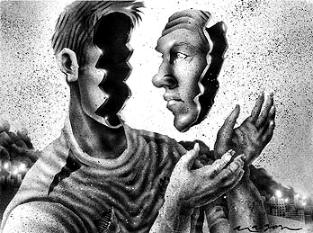
Lecturer Name: Lou Wells
Student name: Monica Ana Oprea
Student number: 2315596
BMHP6029
Psychopathological Classifications and Provisions Component
This Photo by Unknown Author is licensed under CC BY-SA-NC
Acknowledgement of the use of AI tools
I confirm that I have not used any AI tools in the research and creation of this assignment. I confirm that I have not presented any AI-generated materials as my work. I confirm I have copies of my drafts, notes, and other resources I used, which I may be asked to provide in evidence.

Slide 2

6B61-DISSOCIATIVE AMNESIA
Specific Disorder and Definition:
inability to recall important personal information (Sharifi et al., 2021)
Population prevalence:
0.2 - 7.3% due to methodological and cultural factors (Abdellah et al., 2025)
Causes
Aetiology: Strong association with severe stress/trauma, childhood adversity, and ‘two‑hit’ models (trauma model) (Susaimanickam et al., 2023)
Symptoms:
Retrograde autobiographical memory loss, travel or new identity (fugue), emotional numbing, depression, and functional impairment (Metin et al., 2024)
Differential diagnosis:
Organic amnesia (neurology), substance‑related, malingering, dissociative identity disorder, PTSD with dissociative symptoms — rule out neurological/medical causes (Jelicic, 2024).
Diagnosis:
Clinical assessment, medical modelh
history, collateral information and neuro/forensic work‑up (Zago et al., 2024)
This Photo by Unknown Author is licensed under CC BY-SA-NC.

Slide 3
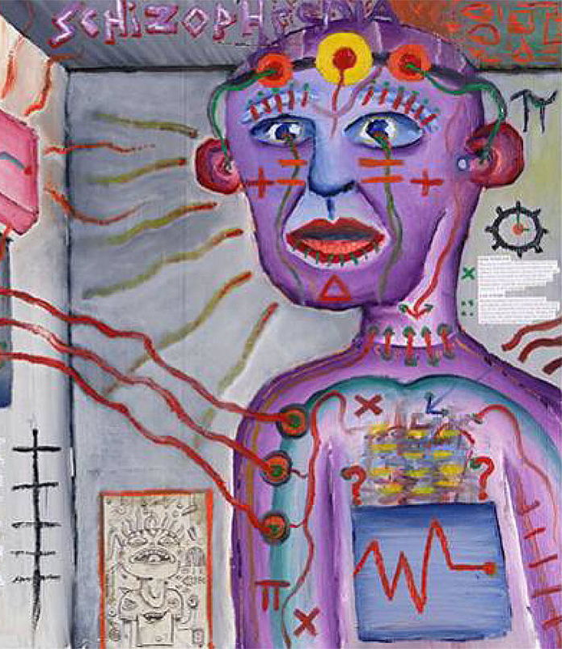
Past Perceptions and Medical Views:
19th and early 20th centuries, possession, hysteria, or moral weakness, psychosis, lack of empirical evidence and gender bias-women' stigmatise “mad,” unstable, or attention-seeking
Freud’s repression of painful, unacceptable memories (McNally, 2024)
Pierre Janet, splitting of consciousness due to trauma (Rampelli, 2024)
PSYCHOANALYTIC INFLUENCE: fabricated especially because memory loss could not be confirmed through physical evidence
This Photo by Unknown Author is licensed under CC BY

Slide 4
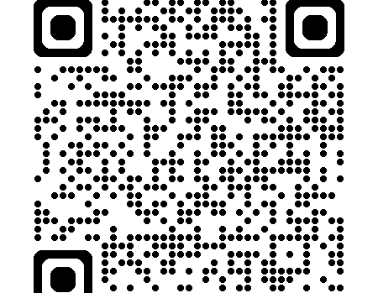

Modern Views
HOLISTIC-PERSON CENTRED
Disruptions in the Hippocampus and Amygdala in PD (Citro et al., 2024)
Combines Psychological and Neurobiological models
Recognised by the ICU as a legitimate mental health disorder.
Protective psychological response to trauma, associated with abuse, combat, or major accidents, not brain injuries (Taib et al., 2023)
More empathy and understanding, PRISMA (Modesti et al., 2022)
Psychotherapy, drug-assisted (Vijayan, 2025)
Trauma-focused therapy, and cognitive behavioural therapy (CBT)

Slide 5
Conclusions and Recommendations
SELF-DIRECTION
HOLISTIC APPROACH
STRENGTH-BASED
HOPE
Diagnosable, and linked to stress rather than physical brain injury (Metin et al., 2024)
Historical stigma replaced by empathy and evidence-based care.
Early trauma assessment and referral to trauma-informed therapy
Awareness and training
Trauma-informed assessment and treatment models
Future research (Otgaar, 2025)

Slide 6
REFERENCES
Abdellah, M.M. et al. (2025) ‘Prevalence of dissociative identity disorder among psychiatric outpatients in different cultural groups’, Middle East current psychiatry (Cairo), 32(1). Available at: https://doi.org/10.1186/s43045-025-00546-6.
Citro, S. et al. (2024) ‘A multiple hits hypothesis for memory dysfunction in Parkinson’s disease’, Nature Reviews. Neurology, 20(1), pp. 50–61. Available at: https://doi.org/10.1038/s41582-023-00905-z.
Jelicic, M. (2024) ‘Dissociative Amnesia? It might be Organic Memory Loss, Topics in cognitive science, 16(4), pp. 770–776. Available at: https://doi.org/10.1111/tops.12640.
Marsh, L.C., Apšvalka D., Kikuchi H., Abe N., Kawaguchi J., Kopelman M. D., and Anderson M. C. (2024) ‘Prefrontally mediated inhibition of memory systems in dissociative amnesia’, Psychological Medicine, 54(16), pp. 4779–4787. doi:10.1017/S0033291724003040. Available at: https://pubmed.ncbi.nlm.nih.gov/39773554/
McNally, R.J. (2024) ‘The Return of Repression? Evidence from Cognitive Psychology’, Topics in cognitive science, 16(4), pp. 661–674. Available at: https://doi.org/10.1111/tops.12638.
Metin, İ.Ç., Yıldırım, S. and Karahan, A. (2024). Can dissociative amnesia be a residual symptom of prolonged complex post-traumatic stress disorder?. Annals of General Psychiatry 23, 51. Available at:. https://doi.org/10.1186/s12991-024-00536-8
Modesti, M.N., et al. (2022) ‘Functional Neuroimaging in Dissociative Disorders: dissociative amnesia and fugue included’, Journal of Personalised Medicine, 12(9), 1405. Available at: https://www.mdpi.com/2075-4426/12/9/1405
Rampelli, M. (2024) ‘Early Images of Trauma in George Eliot’s The Lifted Veil’, Humanities (Basel), 13(3), p. 70. Available at: https://doi.org/10.3390/h13030070.
Sharifi, M., Turner, A., Fuglestad, T., and Bell, C. (2021) ‘A Case Report of Dissociative Amnesia Involving “Detective Work”’, HCA Healthcare Journal of Medicine, 2(5), Article 7. Available at: https://scholarlycommons.hcahealthcare.com/hcahealthcarejournal/vol2/iss5/7
Susaimanickam, B., Korenis, P., Singh, G., Gill, G., and Dumlao, N. (2023) ‘Dissociative amnesia with fugue in a middle-aged man’, Prim Care Companion CNS Disord., 25(2):22cr03306. doi:10.4088/PCC.22cr03306. Available at: https://doi.org/10.4088/PCC.22cr03306
Taïb, S., Yrondi, A., Lemesle, B., Péran, P. and Pariente, J. (2023) ‘What are the neural correlates of dissociative amnesia? A systematic review of the functional neuroimaging literature, Frontiers in Psychiatry, 14, article 1092826. doi:10.3389/fpsyt. 2023.1092826. Available at: https://www.frontiersin.org/journals/psychiatry/articles/10.3389/fpsyt.2023.1092826/full
Otgaar, H. (2025) ‘The neuroscience of dissociative amnesia and repressed memory’, Legal and Criminal Psychology Review, 31(2), pp. 98-116. doi:10.1111/lcrp.12272. Available at: https://bpspsychub.onlinelibrary.wiley.com/doi/10.1111/lcrp.12272
Vijayan, S. (2025) ‘Dissociative Fugue – Unearthing the Lost Memory with Lorazepam-assisted Interview’, Journal of Psychiatric Practice, 31(4), pp. 201-210. Available at: https://journals.lww.com/jops/fulltext/2025/04000/dissociative_fugue___unearthing_the_lost_memory.12.aspx
Zago, S. et al. (2024) ‘Two Cases of Malingered Crime‐Related Amnesia’, Topics in cognitive science, 16(4), pp. 752–769. Available at: https://doi.org/10.1111/tops.12643.

