Slide 1


Empowering Older People:
Promoting Independence, Wellbeing and Person-Centred Care in the UK
Student name: Carla Cardoso
Student ID:1818222
Module name: Empowering the Older Person
Module code: BMHP6027
Lecturer’s name: Dr Laila Surani

Slide 2

 |  | Care, Empowerment and Support Needs Meeting holistic needs empowers older people to maintain independence, wellbeing and quality of life (NICE, 2023; Care Act, 2014). |  | Principles of Empowerment
 |  |  |  | Autonomy Informed choice. Shared decision-making. Control Independence. Self-management. Self-realisation Personal goals. Purpose and identity. Pleasure Meaningful activities. Emotional wellbeing. Dignity Respect. Privacy. Advocacy Protect rights. Promote inclusion. (Care Act, 2014; WHO, 2021)
 |  | Physical Needs Mobility. Nutrition. Falls prevention Emotional Needs Reduce loneliness. Mental wellbeing Social Needs Community participation. Family involvement Psychological Self esteem Confidence Cultural & Religious Needs Respect cultural beliefs Spiritual support Faith preferences
Fig 1. Older adults participating in activities that promote healthy ageing and wellbeing. Empowering Older People: Promoting Independence, Wellbeing and Person-Centred Care in the UK Introduction The UK population is ageing rapidly, increasing demand for health and social care services (ONS, 2023). Empowerment promotes autonomy, dignity, independence and wellbeing and person-centred care (Care Act, 201; WHO, 2021). By 2043 around 24% of the UK population will be aged 65 years and over (ONS 2023).
Notes:
2

Slide 3

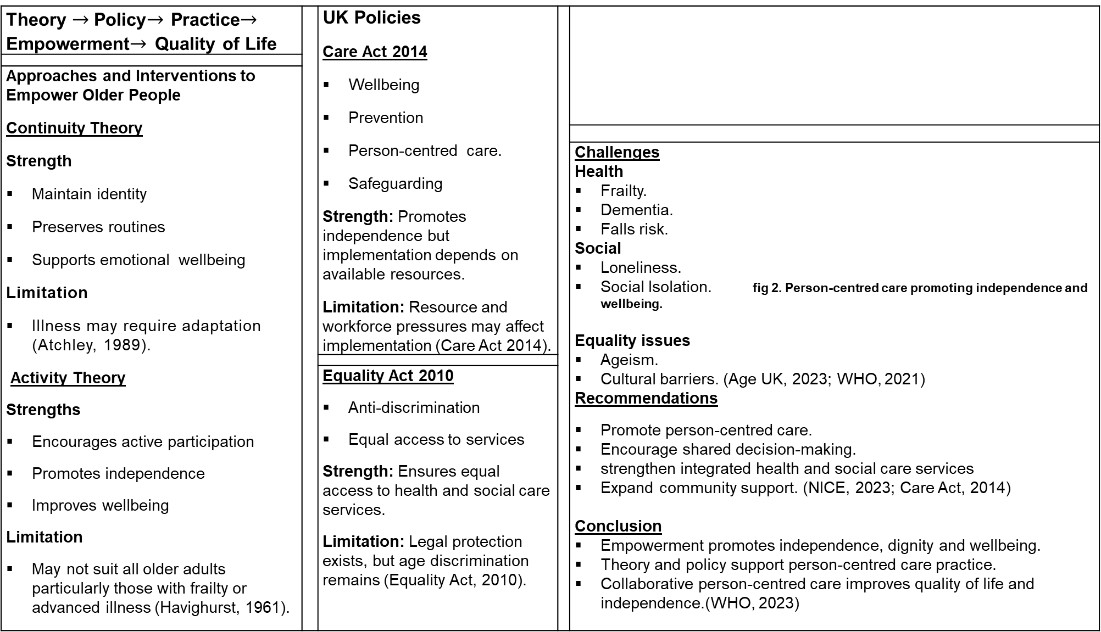
Theory $→$Policy$→$ Practice$→$ Empowerment$→$ Quality of Life |  | UK Policies Care Act 2014 Wellbeing Prevention Person-centred care. Safeguarding Strength: Promotes independence but implementation depends on available resources. Limitation: Resource and workforce pressures may affect implementation (Care Act 2014).
Approaches and Interventions to Empower Older People Continuity Theory Strength Maintain identity Preserves routines Supports emotional wellbeing Limitation Illness may require adaptation (Atchley, 1989). Activity Theory Strengths Encourages active participation Promotes independence Improves wellbeing Limitation May not suit all older adults particularly those with frailty or advanced illness (Havighurst, 1961).
 |  |  |  | Challenges Health Frailty. Dementia. Falls risk. Social Loneliness. Social Isolation. fig 2. Person-centred care promoting independence and wellbeing. Equality issues Ageism. Cultural barriers. (Age UK, 2023; WHO, 2021) Recommendations Promote person-centred care. Encourage shared decision-making. strengthen integrated health and social care services Expand community support. (NICE, 2023; Care Act, 2014) Conclusion Empowerment promotes independence, dignity and wellbeing. Theory and policy support person-centred care practice. Collaborative person-centred care improves quality of life and independence.(WHO, 2023)
 |  | Equality Act 2010 Anti-discrimination Equal access to services Strength: Ensures equal access to health and social care services. Limitation: Legal protection exists, but age discrimination remains (Equality Act, 2010).
Theory | Policy | Practice
Activity Theory Continuity Theory | Care Act 2014 Equality Act 2010 | Promote participation and wellbeing. Support independence through person- centred care

Slide 4
References
Age UK (2023) Later Life in the United Kingdom. London: Age UK.
Atchley, R.C. (1989) ‘A Continuity Theory of Normal Aging’, The Gerontologist, 29(2), pp. 183–190.
Brooker, D. and Latham, I. (2016) Person-Centred Dementia Care: Making Services Better. 2nd edn. London: Jessica Kingsley Publishers.
Department of Health and Social Care (2025) Care and Support Statutory Guidance: Issued under the Care Act 2014. London: DHSC.
Equality Act 2010, c.15. London: The Stationery Office.
Formosa, M. (2021) ‘Activity Theory as a Foundation for Active Ageing Policy’, Labour and Ageing Review.
Havighurst, R.J. (1961) ‘Successful Aging’, The Gerontologist, 1(1), pp. 8–13.
Nolan, M., Davies, S., Brown, J., Keady, J. and Nolan, J. (2004) Beyond “Person-Centred” Care: A New Vision for Gerontological Nursing. Journal of Clinical Nursing, 13(s1), pp.45–53.
Office for National Statistics (2023) Living Longer: Older People in the UK. Newport: ONS.
Royal College of Nursing (2024) Principles of Person-Centred Care. London: RCN.
The Care Act 2014, c.23. London: The Stationery Office.
The King’s Fund (2022) Health and Social Care for Older People. London: The King’s Fund.
World Health Organization (2002) Active Ageing: A Policy Framework. Geneva: World Health Organization.
World Health Organization (2015) World Report on Ageing and Health. Geneva: World Health Organization.
World Health Organization (2018) Integrated Care for Older People (ICOPE): Guidelines on Community-Level Interventions to Manage Declines in Intrinsic Capacity. Geneva: World Health Organization.
World Health Organization (2021) Decade of Healthy Ageing 2021–2030. Geneva: World Health Organization.
Menassa, M. et al. (2023) ‘Concepts and Definitions of Healthy Ageing: A Systematic Review’, BMC Geriatrics, 23.
Murphy, S., McCance, T. and White, P.J. (2025) ‘How Do Older People Experience Person-Centred Integrated Care? An Integrative Review’, International Journal of Integrated Care.

