Slide 1

OME Remote Sensing
- some context
Shaun Dooley
AWE

Slide 2
Why?
Remote sensing is the study of something from a remote location or when there can be no physical contact with the object being studied.
  Generally, this means satellites - gathering information from space.
  Remote Sensing & Imaging – Satellite Industry Association (sia.org)
Examples might be – too hot, too cold, too far, too hazardous.

Slide 3
What is the connection with OME?
An explosion in air is a process by which a rapid release of energy generates a pressure wave of finite amplitude. The energy source can be anything that generates a violent reaction when initiated, in this case, chemical.
The properties of air will cause the front of this pressure wave to "shock up", or steepen, as the front moves away. The result is a shock front moving supersonically, i.e., faster than the sound speed of the air ahead of it, with discontinuities in pressure, density, and particle velocity across the front. But you know all that…

Slide 4
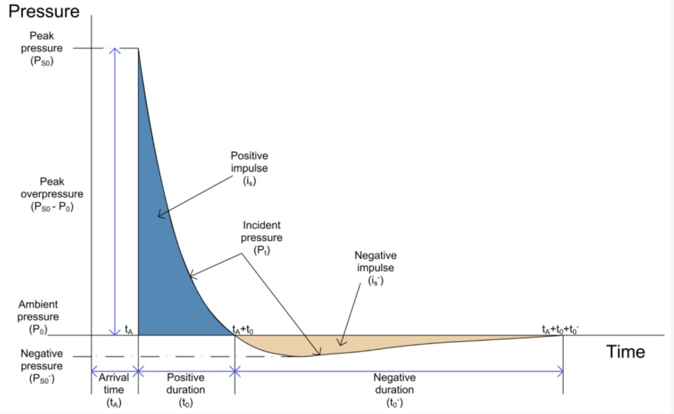
What is the connection with OME?
For designing structures, two important parameters of blast are:
peak (Pso) and
impulse (i) - which relates to the total force (per unit area) applied on the structure (the shaded area under the overpressure-time curve). The impulse is both positive and negative.

Slide 5
Some context
Accurate quantification of blast wave parameters is a significant challenge, particularly for pressure imparted to an obstacle at a short distance from the explosive.
Semi-empirical methods for predicting blast pressure loads are well established;
Kingery & Bulmash [Blast Calculator ] and scaled distance relationships were derived from experiments conducted in the 1960s.
Whilst these predictive methods have been shown to be highly accurate for geometrically simple far-field situations, the ‘near-field’ are complex.
Consequently, numerical analyses in this region demonstrates considerable deviation from empirical predictions. IT’S WRONG.
We need to measure it.

Slide 6
How?
Technical Information | PCB Piezotronics
Early blast-pressure transducers were made by government labs such as the Ballistic Research Laboratory – USA and RARDE – UK. The early commercial pressure transducer developers were Kistler Instrument Corporation and PCB Piezotronics.

Slide 7
How?
Typically, a quartz acceleration compensated piezoelectric sensing element is built into metal housing. The geometry of the sensing element, as well as the velocity of the shock front of the blast wave passing over it, control its rise time.
These transducer need to have working pressure ranges extending over 7000 kPA (1000 psi).
A limitation of the early piezoelectric transducers developed by government labs and/or industry was the influence of the cable on their signal. In hazardous tests, such as those involving explosives, cable lengths of 100s to 1,000s of meters was typical. When these cable lengths were employed with charge-sensing circuits, a variety of damaging effects would result:
‘noise’ generated within the cable due to triboelectric effects
the high cost of special noise-treated cables to eliminate these effects
heat

Slide 8
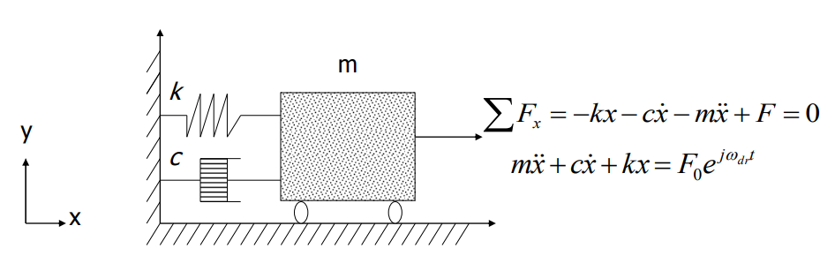
What
Pressure transducers are typically modelled as 2nd Order low-pass systems like this;
M Mass
C dampening
K spring

Slide 9
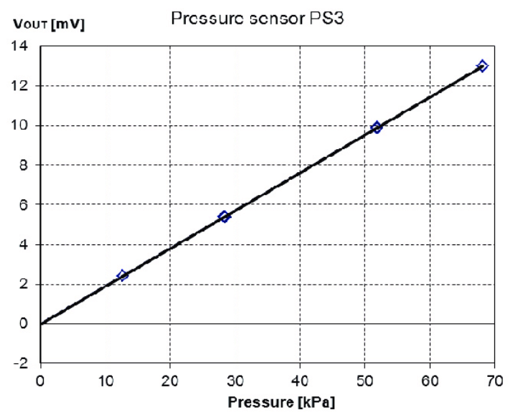
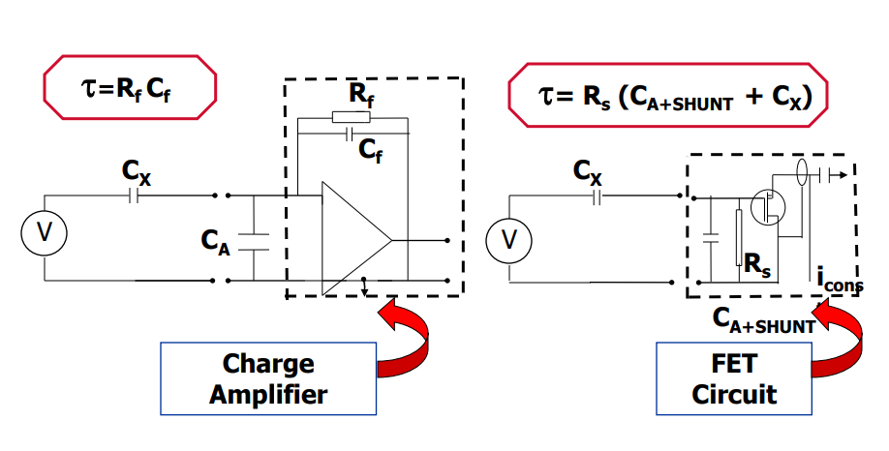
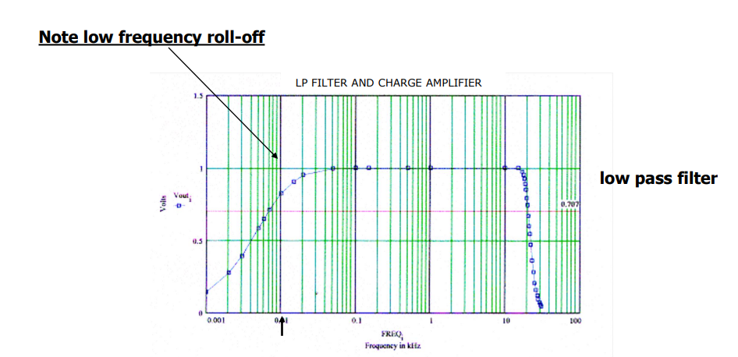
What
Calibration!

Slide 10
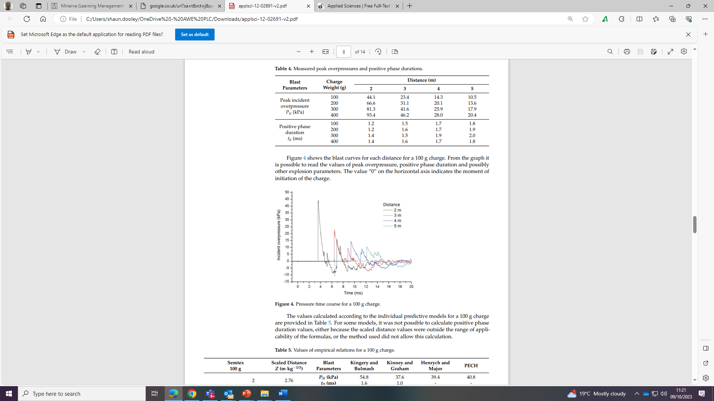
For example

Slide 11
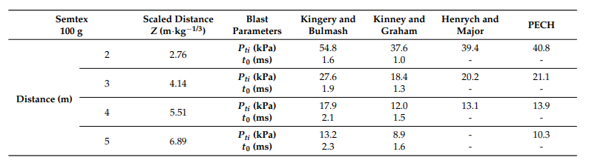
For example
66
31
20
13
Peak Overpressure
100g SEMTEX charge at 1m intervals

Slide 12
Hence, is it ‘right’
Data Validation.
With a pressure transducer is properly mounted, it is important to consider data validation. In addition to pressure, which is the desired environment to be measured, there are competing undesired environments that occur concurrent with the pressure environment.
These include: transient temperatures, light, acceleration, strain, ionization products of detonation, and others.
When considering the potential effects of these undesired environments, strain, acceleration and temperature can all interact with the piezoelectric crystal within the transducer to result an error. In addition, thermoelectric, photoelectric, electromagnetic, triboelectric, and other energy induced effects can result in additive electrical signals that create other errors in the transducer output.
All of these extraneous signals can be viewed as ‘noise’, which ‘contaminates’ the desired pressure measurement. To validate that the transducer output signal is not contaminated (i.e. it is solely attributable to pressure), a combination of placebo and ‘check’ channels can be used.

Slide 13
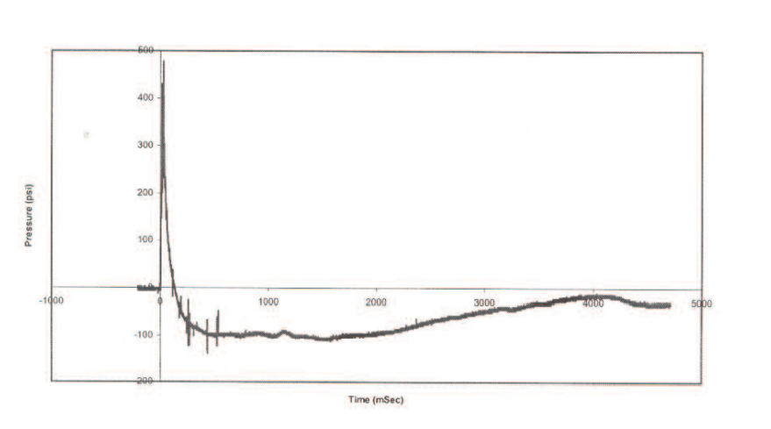
Hence, is it ‘right’
This pressure-time record in a contained explosive environment has been affected by thermal-transient, making a massive ‘vacuum’ (-100 PSI) that isn’t real.

Slide 14
Hence, is it ‘right’
“Measurement of air-blast phenomena is a challenging task for the test engineer or technician. Hopefully this will provide some comprehensive guidance where a lack of it now exists”
Patrick L. Walter, PCB Piezotronics
Thank you to PCB.

Slide 15
?
Time for a break

Slide 16
Some more context
We know that the magnitude of the overpressure of an air blast wave depends on
  the distance,
  the type of HE
  size of the charge.
  And…..
A typical blast wave (and its reflected form off a rigid surface) [next slide]
Characteristics are:
  the arrival time ta, the peak incident overpressure Ps above the reference p0
  the duration of the positive phase td, the minimum pressure, and the
  duration of the negative phase tn. The positive impulse I is the integral of the overpressure curve over the positive phase.
  The time t is measured from the beginning of the positive phase, and b, is a constant influencing the decay of the overpressure curve

Slide 17
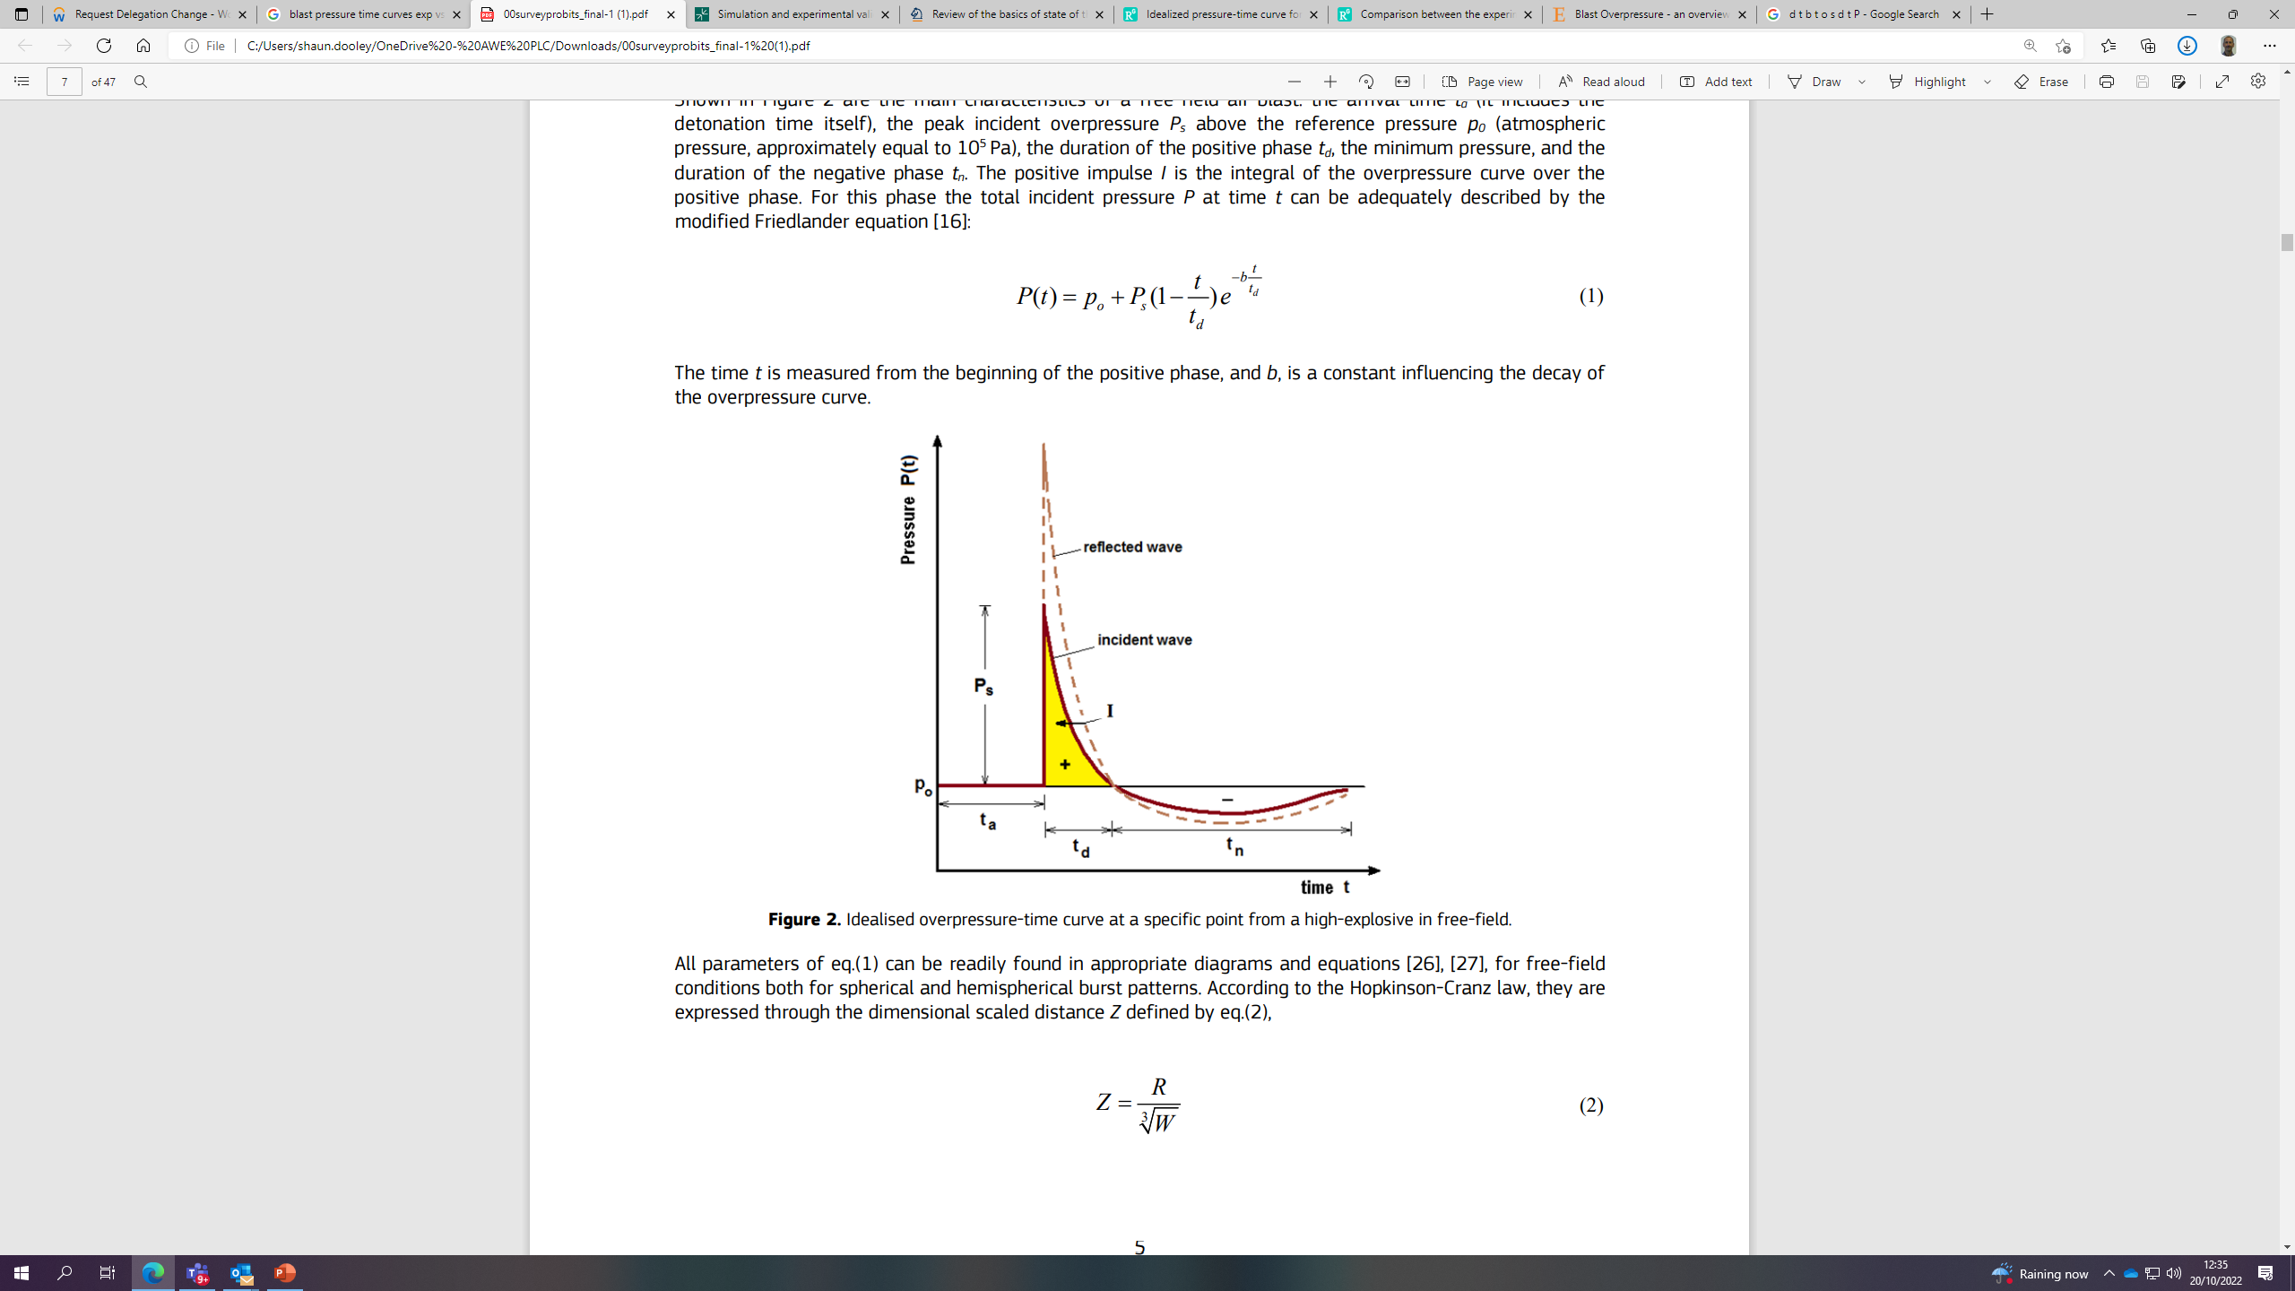
Friedlander equation

Slide 18
Idealised overpressure-time curve

Slide 19
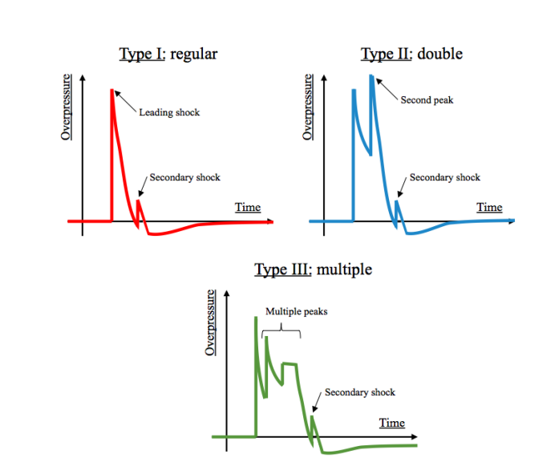
Examples -

Slide 20
Examples -
We can think of 3 global examples –
Type I: regular, peak overpressure. Close to the Friedlander waveform. - Type II: double peak. A second peak (higher or lower) is propagating close behind the leading shock - a nonuniform detonation of the explosive charge. –
Type III: multiple peaks (other complex evolution).
However, are they all ‘correct?’

Slide 21
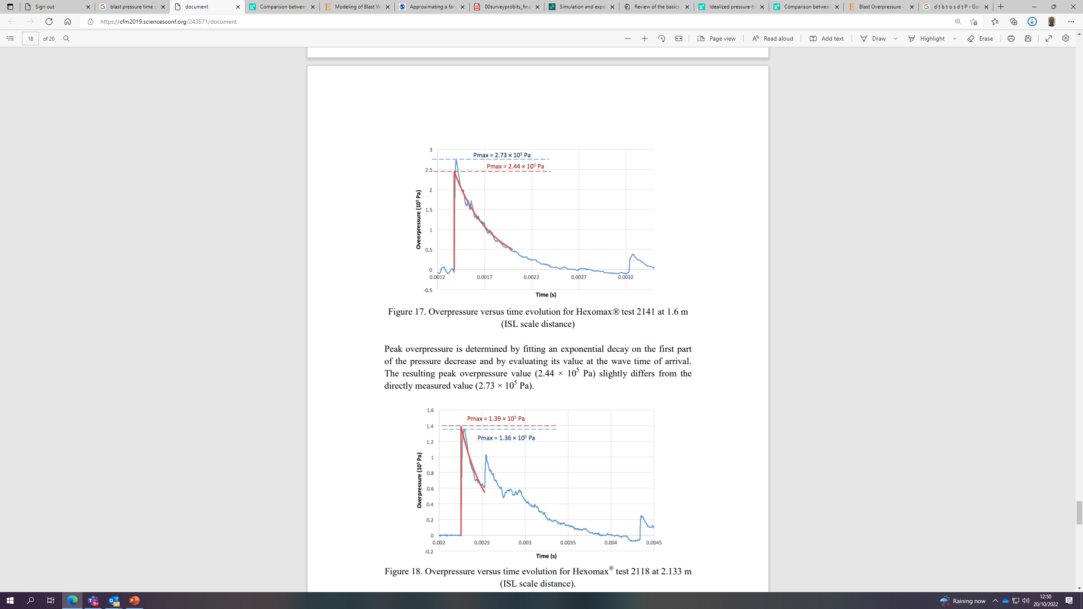
Some techniques
Fit to decay curve
Limit the range of interpretation

Slide 22
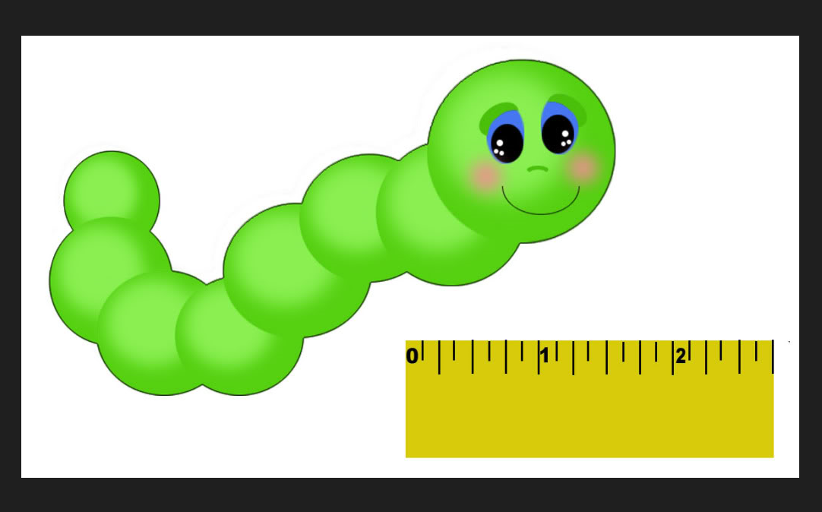
Questions
Think about the measurement

Slide 23
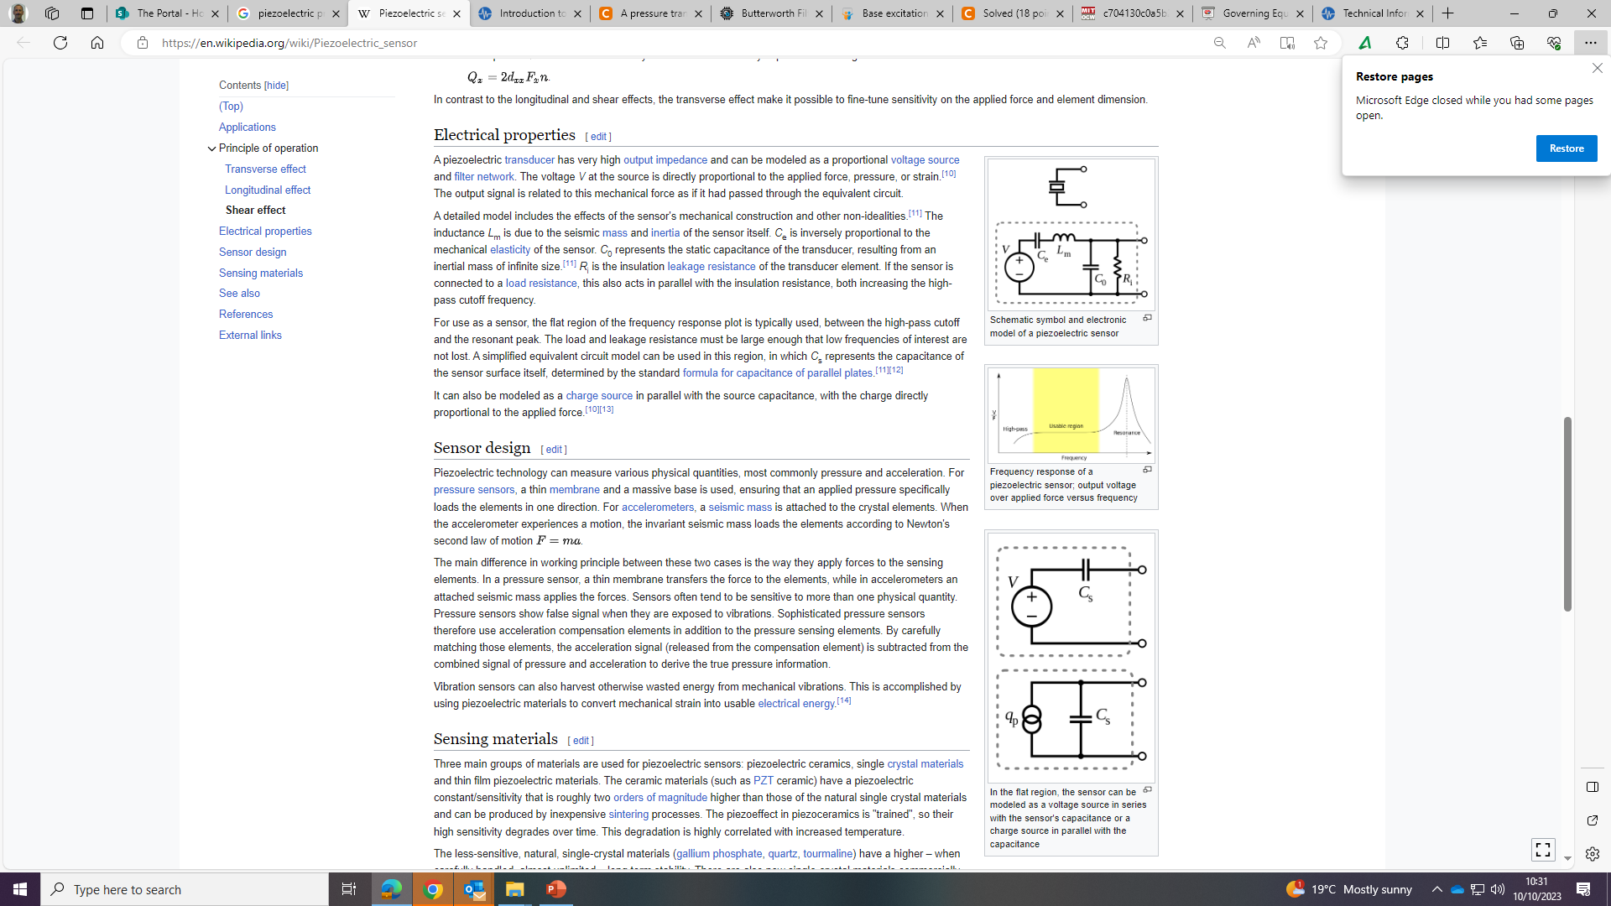
Circuits

Slide 24
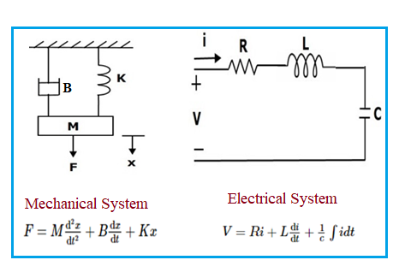
Mechanical: block of mass ('m') and spring. 'B' is damping, 'K' is spring constant and 'X' is the displacement due to Force ('F').
• The second order differential equation of the system is
F = M*d²x/dt² + B*dx/dt + K*x
Electrical: Series LCR electrical circuit.
• Resistor (R), inductor (L) and capacitor (C) all connected in series.
• Input voltage (V) applied across its terminal, current (i) flows through it.
• so that,
• V = R*i + L*di/dt + (1/C)*∫i*dt
• the differential equation of electrical system is
V = R*dq/dt + L * d²q/dt² + q/C
Rearranged to
V = L * d²q/dt² + R*dq/dt + q/C

