Slide 1


Strategies for Effective Communication in a Business Setting(BMSW4002)
Liviu Hadirca(2119291)
Elisabeta Tatulescu (2118581)
Ani Dimova (2119452)
Lectors Name: Dr Obinna Nkwocha

Slide 2
Introduction
Albrecht’s Discount began as a single grocery store founded by Anna Albrecht in 1913 in Essen, Germany. Ownership passed to her sons, Karl and Theo, in 1948, and they soon developed it into a large, family-run franchise.[1]
Aldi is operating in more than 10,000 stores in 20 counties with turnover more than £50 billion.[2]
The first store opened in UK was in 1990 and rises up to 600 stores. [3]
And employing more than 36,000 workers across the UK[4]

Slide 3

What is a communication?
Communication is a system or method that is used for communication with other people

Slide 4
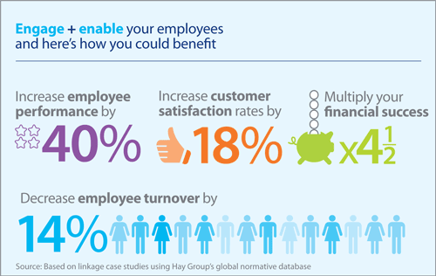
The benefit of good communication within organization
Mitigated conflict
Increased employee engagement
Improved productivity
Improved client relations
Healthy workplace culture
Improved direction for employees
Boosted employee job satisfaction
Increased innovation
Strengthened team building
Improved public impression[7]
This Photo by Unknown author is licensed under CC BY-SA-NC.

Slide 5
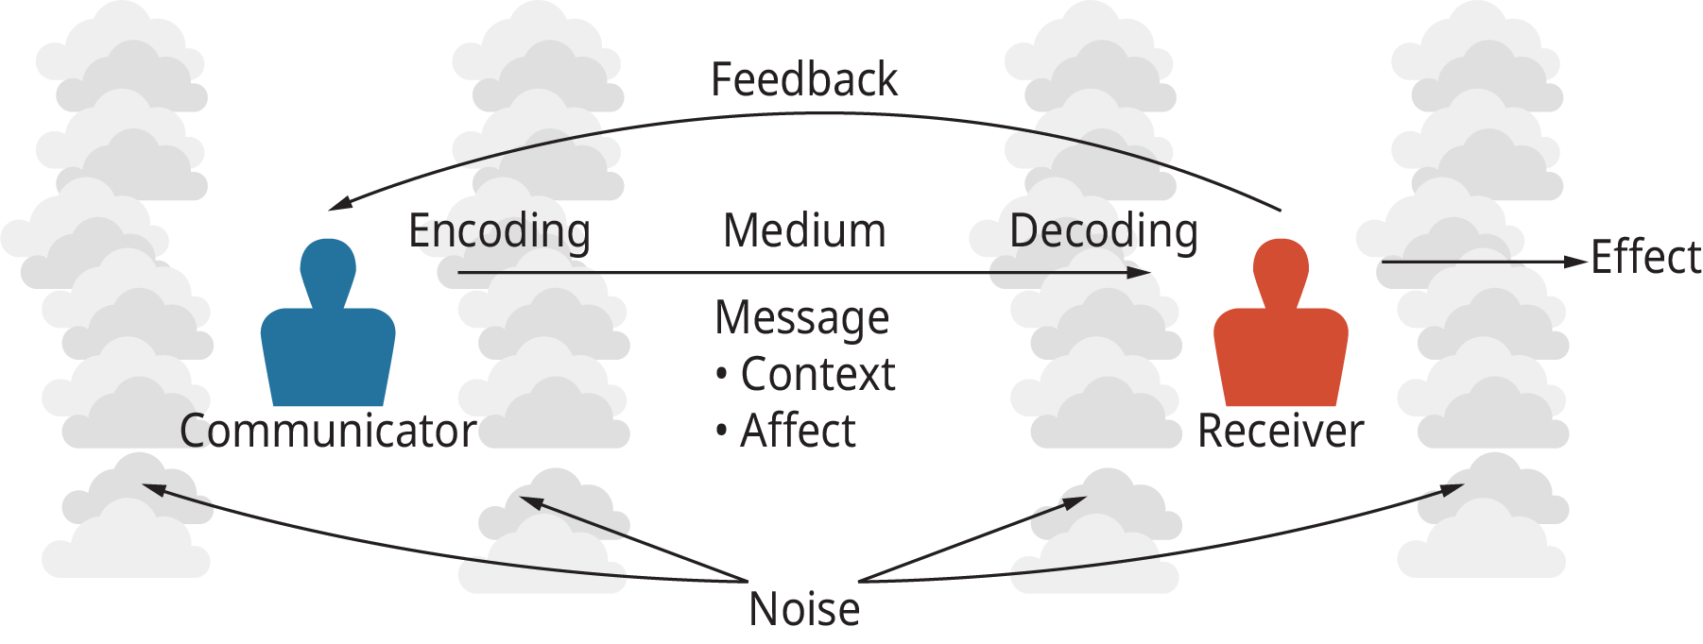
The Aldi organization uses these communication models
The Basic Communication Model
Verbal- making conferences, meetings whiting the team.
Non-verbal- facial expression, body language.
Verbal- sending and receiving massages directly.
Non-verbal- advertising, posters, written emails, letters.
This Photo by Unknown author is licensed under CC BY.

Slide 6
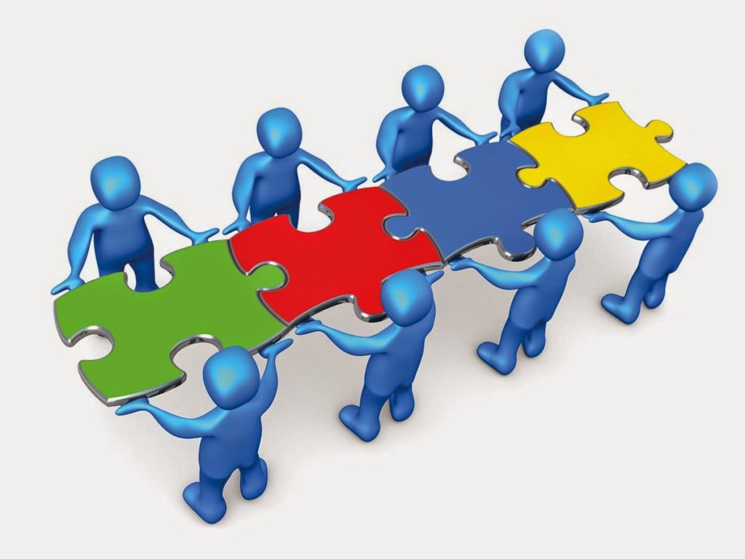
Barriers in communication between the organization and stakeholders.
Language barrier
Cultural barrier
Physical barrier
Organizations barrier
Technological barrier
This Photo by Unknown author is licensed under CC BY.

Slide 7
Solutions on how they can overcome barriers in communication
We are in the day with a lot of opportunities with a lot of translation methods(they can use online translators or hire a special person to be a translator so that their communication barrier is minimal)
Only talking every day can make the barrier between cultures minimal because this will help them understand each other better
They can overcome the physical barrier by to have meetings every month
They can free one hour a week after the working day for discussion and thus the organizational barrier is overcome
They can use the newest communication channels to overcome the technological barrier (Instagram, WhatsApp, Telegram)

Slide 8
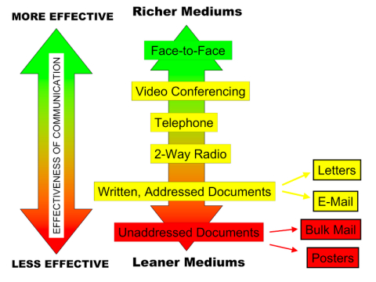
What are the channels of communication used by the organization and channels that can be used to improve communication?
Aldi is using the channel with Low-Richness (Suitable for routine messages. Routine messages tend to be straightforward and have minimal ambiguity; channels low in richness can carry them efficiently.)
But they can use a channel with High-Richness(Suitable for non - routine messages. Non routine communications are likely to be complicated and have the potential for misunderstanding. Managers can communicate them effectively only by selecting rich channels.)
That means they can switch Twitter to talk face-to-face because by the Lendle-Draft model Cahnnel Richness Hierarchy face-to-face speak are more effective than others

Slide 9
References
1.https://www.mentalfloss.com/article/619340/aldi-grocery-store-name-origin
2.https://businessmodelnavigator.com/case-firm?id=5
3.https://web.archive.org/web/20140822041319/http://www.careers.aldirecruitment.co.uk/working-for-aldi/
4.https://www.theguardian.com/business/2020/sep/28/aldi-uk-jobs-sales-covid-crisis-supermarket-stores
5.https://cxm.co.uk/communication-with-customers-five-essential-factors/
6.https://www.duperrin.com/english/2014/08/07/really-benefiting-employee-engagement/
7.https://www.indeed.com/career-advice/career-development/communication-benefits
8.https://opentextbc.ca/principlesofmanagementopenstax/chapter/the-process-of-managerial-communication/
9.https://campus-adr.net/ODRModule/media_richness_theory.html
Aldi employee reveals secret way staff communicate - and most shoppers won't have noticed - Mirror Online

Slide 10
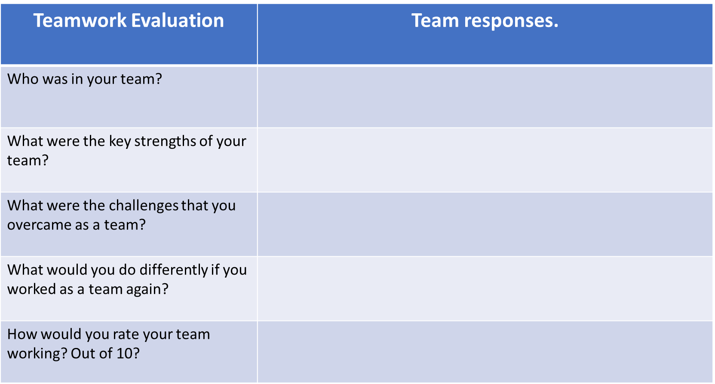
Elisabeta Tatulescu
Liviu Hadirca
Ani Dimova
Timekeepers, and quick lerners.
To trust others.
To communicate more.
6

