Slide 1
Programme: MSc Public Health and Social Care in Practice
Module: Community Care and Management of Longer-term Conditions
Module Code: LCHS7003
Ischemic Stroke: Diagnosis, Treatment, and Management
A Global and UK-Focused Approach
Presented by: MD Nasir Uddin Nahid
ID: 2432642

Slide 2
Definition & Scope
Definition: An ischemic stroke is a medical emergency caused by a blockage in an artery supplying the brain, which cuts off blood flow and oxygen to a part of the brain (NHS England, 2021). A blockage in a blood vessel supplying the brain, causing a loss of blood flow (Ben-Shlomo et al., 2024).
Symptoms: Sudden weakness or numbness, trouble speaking or understanding speech, and severe headache (Stroke.org.uk, 2023).
Aetiology:
  Thrombosis (blood clot forms in an artery).
  Embolism (clot from elsewhere blocks brain artery) (Marshall et al., 2022).

Slide 3
Prevalence of Ischemic Stroke
Global:
  15 million people suffer a stroke annually worldwide(King et al., 2020).
  30% of all strokes are ischemic(Stroke.org.uk, 2024).
UK:
  100,000 strokes occur annually in the UK; 1.3 million stroke survivors in the UK (Ben-Shlomo et al., 2024).
  85% of strokes in the UK are ischemic (Ferrari et al., 2024).
  Increasing incidence due to ageing population(Brain Research UK, 2021).

Slide 4
Economic and Social Burden
Economic Burden:
  Stroke-related healthcare costs in the UK amount to over £25 billion annually (Gormley et al., 2022).
  Over 50% of GP appointments in the UK are stroke-related (NHS England, 2024).
Social Burden:
  50% of stroke survivors have some disability (Bhf.org.uk, 2025)..
  Stroke is a major cause of long-term disability in the UK.
  Increased caregiver burden due to stroke survivors’ dependency (Huang, El-Serag and Loomba, 2020).

Slide 5
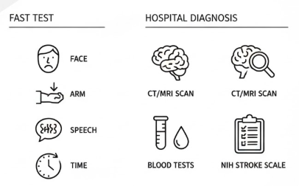
Diagnosis and Initial Assessment
FAST Test: Face, Arm, Speech, Time – for early identification in the community.
Hospital Diagnosis:
  CT Scan or MRI to differentiate from hemorrhagic stroke (NHS England, 2021).
  Blood Tests to assess clotting factors.
  NIH Stroke Scale to evaluate stroke severity.
UK Guidelines: Immediate assessment within 4.5 hours of symptom onset is critical (McInnes and Schett, 2017).
(Source: (Gormley et al., 2022)

Slide 6
UK Management of Ischemic Stroke
Acute Management:
  Thrombolysis: rtPA (clot-busting medication) within 4.5 hours.
  Mechanical Thrombectomy: For large vessel occlusions (NICE, 2024).
Patients receive care in stroke units with specialised teams under the UK Stroke Service Model.
Early supported discharge for home rehabilitation and hospital stay reduction (NHS England, 2021).
The House of Care model for person-centred, coordinated stroke care.

Slide 7
Treatment Options in the UK
Thrombolytic Therapy: rtPA within 4.5 hours if eligible (NHS England, 2018).
Antithrombotic Therapy:
  Aspirin 300 mg within 24 hours for ischemic stroke.
  Statins for cholesterol management post-stroke.
Anticoagulants: Used in atrial fibrillation to reduce stroke risk (Ball et al., 2020).
Surgical Treatment:
  Carotid Endarterectomy for carotid artery stenosis.
  Mechanical Thrombectomy for large clot removal (if eligible).

Slide 8
Comorbidities with Ischemic Stroke
Hypertension: Leading risk factor for stroke.
Atrial Fibrillation: Increases stroke risk 5x in the UK.
Diabetes: Stroke patients with diabetes have poorer outcomes (Lai and Szatmari, 2020).
Coronary Artery Disease: Frequently seen in stroke survivors.
Depression & Cognitive Decline: Post-stroke depression affects 40-50% of survivors (Ben-Shlomo et al., 2024).

Slide 9
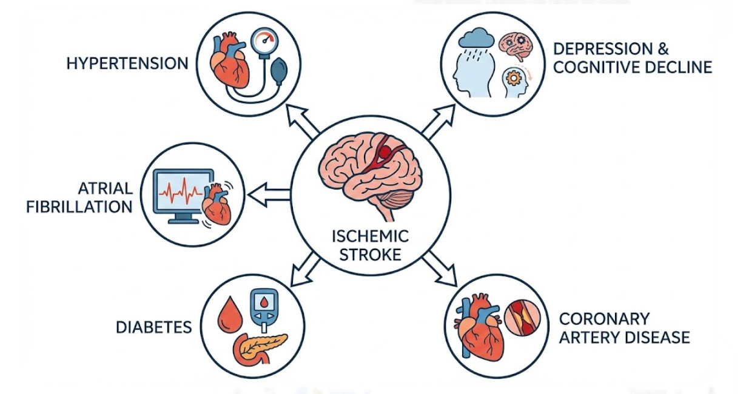
Prevention of Ischemic Stroke
Primary Prevention:
  Control BP through lifestyle and medication.
  Diet, exercise, smoking cessation (Johnston et al., 202).
  Regular screening for high cholesterol, diabetes, and atrial fibrillation.
Secondary Prevention:
  Antiplatelets (aspirin) and statins for post-stroke prevention (Chen et al., 2024).
  For atrial fibrillation patients to prevent further strokes.
  NHS Act FAST campaign to raise awareness (Morone et al., 2023).
(Source: (Marshall et al., 2022)

Slide 10
Co-productive Care for Ischemic Stroke Patients
Skills Required:
  Open, compassionate interaction with stroke patients.
  Collaboration across disciplines.
  Person-centred Care: Prioritise patient goals and preferences (Xie et al., 2022).
Values:
  Caring for autonomy, dignity, and decision-making.
  In distinct UK populations, stroke care involves cultural knowledge (Luo et al., 2022).
Behaviours:
  Patient concerns addressed with empathy and active listening.
  Promoting patient self-management (Lip et al., 2023).

Slide 11
Comprehensive Model of Personalized Care
Evidence-Based Components:
  1. For prevention and early intervention, consider regular screenings and lifestyle adjustments.
  2. Immediate thrombolysis and thrombectomy for prompt care and treatment(Ferrari et al., 2024).
  3. Multidisciplinary Rehabilitation: Physiotherapy, speech therapy, and occupational therapy.
  4. Secondary Prevention: Antithrombotic treatment and comorbidity management (Powell, 2025).
  5. Self-Management Support: Utilising information and resources to empower patients.
  6. Integrated Long-Term Care: Person-centred, GP-follow-up, and rehabilitation(Geerlings et al., 2023).
UK Example: These components are integrated across stroke care pathways in the House of Care paradigm.

Slide 12
Critical Evaluation of Care Models
The current challenges:
  Access to emergency care delayed treatment for some.
  Regional differences in mechanical thrombectomy availability (Marshall et al., 2022).
Improvement Opportunities:
  Public education about stroke symptoms and urgency can improve (Bhf.org.uk, 2025).
  Improved rehabilitation and post-stroke care in impoverished populations (Patel et al., 2018)..
Framework Application:
  Person-centred care improves stroke survivors' outcomes by personalising therapy.

Slide 13
Skills, Values, and Behaviours in Stroke Care
Essential Skills:
  Experience with thrombolysis and rehabilitation.
  Communicating with patients and families well (Heath-Kelly, 2013).
Values in Practice:
  Including stroke survivors in care decisions.
  Understanding stroke's mental and physical impacts.
Effective Care Behaviours:
  Teamwork with nurses, physiotherapists, and doctors.
  Action on comorbidities like hypertension and diabetes (Lowe, 2016).

Slide 14
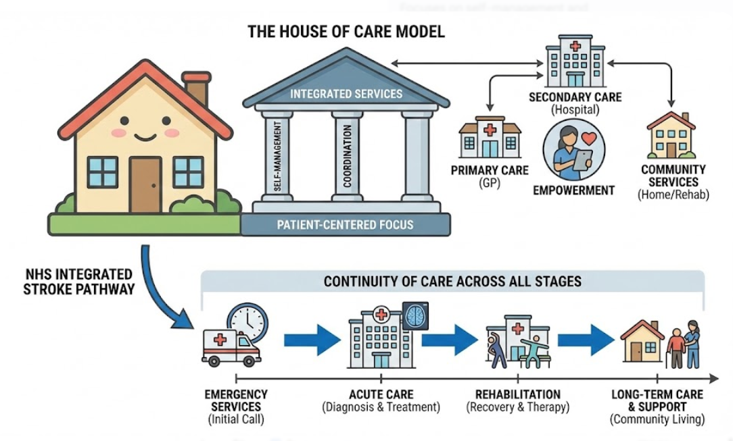
Models & Frameworks for Stroke Care
House of Care Model:
  Promotes self-management and primary-secondary-community service cooperation (Laws et al., 2025).
  NHS Integrated Stroke Pathway:
  Emergency, rehabilitation, and long-term care.
  Promotes stroke recovery continuity (Laws et al., 2025).
(Source: (NHS England, 2024)

Slide 15
Future Directions in Ischemic Stroke Management
Technological Advancements:
  Telemedicine and digital health for remote stroke rehabilitation.
  AI and machine learning for early detection and diagnosis (Ferrari et al., 2024).
Policy Focus:
  Focus on stroke prevention and early intervention.
  National lifestyle-related stroke prevention efforts for high-risk populations (Gormley et al., 2022).

Slide 16
Conclusion
Key Takeaways:
Ischaemic stroke remains a major UK and global health issue.
Stroke recovery requires prompt treatment, rehabilitation, and long-term care.
Person-centred care approaches like House of Care improve patient outcomes.
Recommendations:
Take stroke prevention seriously in high-risk groups (NICE, 2024) .
Increase UK acute stroke therapy access.
Improve post-stroke rehabilitation and self-management.

Slide 17
REFERENCES
Abbas, M., Malicke, D.T. and Schramski, J.T. (2023). Stroke Anticoagulation. [online] PubMed. Available at: https://pubmed.ncbi.nlm.nih.gov/31751016/ [Accessed 20 Nov. 2025].
Ball, H.A., McWhirter, L., Ballard, C., Bhome, R., Blackburn, D.J., Edwards, M.J., Fleming, S.M., Fox, N.C., Howard, R., Huntley, J., Isaacs, J.D., Larner, A.J., Nicholson, T.R., Pennington, C.M., Poole, N., Price, G., Price, J.P., Reuber, M., Ritchie, C. and Rossor, M.N. (2020). Functional cognitive disorder: dementia’s blind spot. Brain, 143(10). doi:https://doi.org/10.1093/brain/awaa224.
Ben-Shlomo, Y., Darweesh, S., Llibre-Guerra, J., Marras, C., San Luciano, M. and Tanner, C. (2024). The epidemiology of Parkinson’s disease. The Lancet, 403(10423), pp.283–292. doi:https://doi.org/10.1016/s0140-6736(23)01419-8.
Bhf.org.uk (2025). UK Factsheet. [online] British Heart Foundation. British Heart Foundation. Available at: https://www.bhf.org.uk/-/media/files/for-professionals/research/heart-statistics/bhf-cvd-statistics-uk-factsheet.pdf [Accessed 20 Nov. 2025].
Brain Research UK (2021). Stroke – Neurological condition. [online] Brain Research UK. Available at: https://www.brainresearchuk.org.uk/neurological-conditions/stroke [Accessed 20 Nov. 2025].
Chen, R., Guo, Y., Kuang, Y. and Zhang, Q. (2024). Effects of home-based exercise interventions on post-stroke depression: A systematic review and network meta-analysis. International Journal of Nursing Studies, 152, pp.104698–104698. doi:https://doi.org/10.1016/j.ijnurstu.2024.104698.
Ferrari, A.J., Santomauro, D.F., Aali, A., Abate, Y.H., Abbafati, C., Abbastabar, H., Abd ElHafeez, S., Abdelmasseh, M., Abd-Elsalam, S., Abdollahi, A., Abdullahi, A., Abegaz, K.H., Abeldaño Zuñiga, R.A., Aboagye, R.G., Abolhassani, H., Abreu, L.G., Abualruz, H., Abu-Gharbieh, E., Abu-Rmeileh, N.M. and Ackerman, I.N. (2024). Global incidence, prevalence, years lived with disability (YLDs), disability-adjusted life-years (DALYs), and healthy life expectancy (HALE) for 371 diseases and injuries in 204 countries and territories and 811 subnational locations, 1990–2021: a systematic analysis for the Global Burden of Disease Study 2021. Lancet, [online] 403(10440). doi:https://doi.org/10.1016/S0140-6736(24)00757-8.
Geerlings, A.D., Kapelle, W.M., Sederel, C.J., Tenison, E., Wijngaards-Berenbroek, H., Meinders, M.J., Munneke, M., Yoav Ben-Shlomo, Bloem, B. and Sirwan K. L. Darweesh (2023). Caregiver burden in Parkinson’s disease: a mixed-methods study. BMC Medicine, [online] 21(1). doi:https://doi.org/10.1186/s12916-023-02933-4.
Gormley, M., Creaney, G., Schache, A., Ingarfield, K. and Conway, D.I. (2022). Reviewing the epidemiology of head and neck cancer: definitions, trends and risk factors. British Dental Journal, [online] 233(9), pp.780–786. doi:https://doi.org/10.1038/s41415-022-5166-x.
Heath-Kelly, C. (2013). Counter-Terrorism and the Counterfactual: Producing the ‘Radicalisation’ Discourse and the UK PREVENT Strategy. The British Journal of Politics and International Relations, [online] 15(3), pp.394–415. Available at: https://journals.sagepub.com/doi/full/10.1111/j.1467-856X.2011.00489.x [Accessed 20 Nov. 2025].
Huang, D.Q., El-Serag, H.B. and Loomba, R. (2020). Global epidemiology of NAFLD-related HCC: trends, predictions, risk factors and prevention. Nature Reviews Gastroenterology & Hepatology, 18(4), pp.223–238. doi:https://doi.org/10.1038/s41575-020-00381-6.
Johnston, T.E., Keller, S., Denzer-Weiler, C. and Brown, L. (2021). A Clinical Practice Guideline for the Use of Ankle-Foot Orthoses and Functional Electrical Stimulation Post-Stroke. Journal of Neurologic Physical Therapy, 45(2), pp.112–196. doi:https://doi.org/10.1097/npt.0000000000000347.
Khan, I.I., Islam, Md.M., Ranjan, R., Islam, M.T. and Adhikary, A.B. (2021). A 60-year-old male presented with left-sided weakness and difficulty in speech. Bangabandhu Sheikh Mujib Medical University Journal, 14(1), pp.7–12. doi:https://doi.org/10.3329/bsmmuj.v14i1.50517.
King, D., Wittenberg, R., Patel, A., Quayyum, Z., Berdunov, V. and Knapp, M. (2020). The Future incidence, Prevalence and Costs of Stroke in the UK. Age and Ageing, 49(2), pp.277–282. doi:https://doi.org/10.1093/ageing/afz163.
Lai, M.-C. and Szatmari, P. (2020). Sex and gender impacts on the behavioural presentation and recognition of autism. Current Opinion in Psychiatry, 33(2), pp.117–123. doi:https://doi.org/10.1097/yco.0000000000000575.
Laws, A., Allen, M., Scott, J., Moseley, L., Pearn, K., Ford, G.A., Price, C., White, P., McClelland, G., Shaw, L., Phillips, D., Wilson, D., McMeekin, P. and James, M. (2025). Modelling the potential clinical benefit of mobile stroke units in England. BMC Emergency Medicine, 25(1). doi:https://doi.org/10.1186/s12873-025-01242-8.

Slide 18
REFERENCES
Lip, G.Y.H., Proietti, M., Potpara, T., Mansour, M., Savelieva, I., Tse, H.F., Goette, A., Camm, A.J., Blomstrom-Lundqvist, C., Gupta, D. and Boriani, G. (2023). Atrial fibrillation and stroke prevention: 25 years of research at EP Europace journal. Europace: European Pacing, Arrhythmias, and Cardiac Electrophysiology: Journal of the Working Groups on Cardiac Pacing, Arrhythmias, and Cardiac Cellular Electrophysiology of the European Society of Cardiology, [online] 25(9), p.euad226. doi:https://doi.org/10.1093/europace/euad226.
Lowe, D. (2016). Prevent Strategies: the Problems Associated in Defining Extremism: the Case of the United Kingdom. Studies in Conflict & Terrorism, [online] 40(11), pp.917–933. doi:https://doi.org/10.1080/1057610x.2016.1253941.
Luo, Y., He, L., Ma, T., Li, J., Bai, Y., Cheng, X. and Zhang, G. (2022). Associations between consumption of three types of beverages and risk of cardiometabolic multimorbidity in UK Biobank participants: a prospective cohort study. BMC medicine, [online] 20(1), p.273. doi:https://doi.org/10.1186/s12916-022-02456-4.
Marshall, I., McKevitt, C., Wang, Y., Wafa, H., Skolarus, L., Bhalla, A., Muruet-Gutierrez, W., Emmett, E., Sommerville, P., Birns, J., Sackley, C., Clarke, S., Hamidi, F., Stevens, E., Rudd, A.G., Rodgers, H. and Wolfe, C.D.A. (2022). Stroke Pathway — An Evidence Base for Commissioning — An Evidence Review for NHS England and NHS Improvement. NIHR Open Research, [online] 2(1), p.43. Available at: https://openresearch.nihr.ac.uk/articles/2-43.
McInnes, I.B. and Schett, G. (2017). Pathogenetic insights from the treatment of rheumatoid arthritis. The Lancet, [online] 389(10086), pp.2328–2337. doi:https://doi.org/10.1016/s0140-6736(17)31472-1.
Morone, G., Baricich, A., Paolucci, S., Bentivoglio, A.R., De Blasiis, P., Carlucci, M., Violi, F., Levato, G., Pani, M., Carpagnano, L.F., Spandonaro, F., Picelli, A. and Smania, N. (2023). Long-Term Spasticity Management in Post-Stroke Patients: Issues and Possible Actions—A Systematic Review with an Italian Expert Opinion. Healthcare, [online] 11(6), p.783. doi:https://doi.org/10.3390/healthcare11060783.
NHS England (2018). NHS England» Developing a national Genetic Diabetes Nurse educational initiative. [online] England.nhs.uk. Available at: https://www.england.nhs.uk/atlas_case_study/developing-a-national-genetic-diabetes-nurse-educational-initiative/ [Accessed 20 Nov. 2025].
NHS England (2021). National Stroke Service Model. [online] Available at: https://www.england.nhs.uk/wp-content/uploads/2021/05/stroke-service-model-may-2021.pdf [Accessed 20 Nov. 2025].
NHS England (2024). NHS England» Hospital admissions for strokes rise by 28% since 2004 – as NHS urges the public to ‘Act FAST’. [online] NHS England. Available at: https://www.england.nhs.uk/2024/11/hospital-admissions-for-strokes-rise-by-28-since-2004-as-nhs-urges-the-public-to-act-fast/ [Accessed 20 Nov. 2025].
NICE (2019). Recommendations | Stroke and Transient Ischaemic Attack in over 16s: Diagnosis and Initial Management | Guidance | NICE. [online] Nice.org.uk. Available at: https://www.nice.org.uk/guidance/ng128/chapter/Recommendations [Accessed 20 Nov. 2025].
NICE (2024). 1 Recommendations | Artificial intelligence (AI)-derived software to help clinical decision making in stroke | Guidance | NICE. [online] www.nice.org.uk. Available at: https://www.nice.org.uk/guidance/dg57/chapter/1-Recommendations [Accessed 20 Nov. 2025].
Patel, A., Berdunov, V., King, D., Quayyum, Z., Wittenberg, R. and Knapp, M. (2018). Economic case for wider implementation of interventions that work Current, future and avoidable costs of stroke in the UK. [online] Available at: https://www.stroke.org.uk/sites/default/files/costs_of_stroke_in_the_uk_economic_case_interventions_that_work.pdf [Accessed 20 Nov. 2025].
Powell, T. (2025). World Stroke Day. [online] House of Commons Library. Available at: https://commonslibrary.parliament.uk/research-briefings/cdp-2023-0204 [Accessed 20 Nov. 2025].
Stroke.org.uk (2023). Ischaemic stroke. [online] Stroke.org.uk. Available at: https://www.stroke.org.uk/stroke/types/ischaemic? [Accessed 20 Nov. 2025].
Stroke.org.uk (2024). Stroke Statistics. [online] Stroke Association. Available at: https://www.stroke.org.uk/stroke/statistics [Accessed 20 Nov. 2025].
sudani, B. (2017). National clinical guideline for stroke. [online] Academia.edu. Available at: https://www.academia.edu/download/53449840/2016-National-Clinical-Guideline-for-Stroke-5th-Edition.pdf [Accessed 20 Nov. 2025].
Xie, H., Li, J., Zhu, X., Li, J., Yin, J., Ma, T., Luo, Y., He, L., Bai, Y., Zhang, G., Cheng, X. and Li, C. (2022). Association between healthy lifestyle and the occurrence of cardiometabolic multimorbidity in hypertensive patients: a prospective cohort study of UK Biobank. Cardiovascular Diabetology, 21(1). doi:https://doi.org/10.1186/s12933-022-01632-3.

Slide 19


