Slide 1

SJED7040: Transforming Education
Session 1

Slide 2
Aim: To have critical understanding of management, leadership and change in the organisation of educational institutions.
Critically analyse the macro-contexts of change in education; models of change; nature and elements of change in educational institutions; leading and management of change.
Critically review some of the main theories of the management and leadership of change.
Analyse and evaluate the management and leadership of change in an educational institution with which they are familiar;
Critically reflect upon and challenge the relationship between theory and practice with educational leadership and management and transformation.
Formulate, analyse and solve contemporary problems within education in Wales and UK.

Slide 3
Schedule – Semester 1
18-Oct | Introduction to Module and Leadership
25-Oct | Dissertation Conference (27/10) – No lectures on Wednesday
08-Nov | Key Theories of Leadership and Management
15-Nov | Models of Change
22-Nov | Independent Study
29-Nov | Educational Changes in Wales
06-Dec | Educational Changes
13-Dec | Tutorials

Slide 4
Schedule – Semester 2
31-Jan | Becoming a Leader
07-Feb | Guest Speaker (TBC)
14-Feb | Presentation Workshop
21-Feb | Seminar Presentations

Slide 5
Assignment 1
COMPONENT WEIGHTING: 60%
WORD COUNT: 5000 WORDS
DUE: 3pm 29/01/2018
With careful reference to relevant theories of change, management and leadership, present a case study of one contemporary educational change initative which includes:
  A critical reflection on the case for change
  Critical analysis of the implementation and operation of the initative
  Evaluation of the leadership and management approaches used to initiate change
  Critical exploration of the different demands placed on educational leaders

Slide 6
Assignment 2
COMPONENT WEIGHTING: 40%
WORD COUNT: 15 MINUTES PER PERSON
21st February 2018
Individual Presentation
What makes an effective educational leader in times of change?

Slide 7

Operational Definitions
Leadership requires…
Management requires…

Slide 8
Questions for Reflection
Do you agree with making a distinction between the two terms?
Is it better to be a manager or a leader?
Can we measure the effectiveness of leaders?
Would you add or change anything when considering leadership and management in an educational context?
Are teachers leaders or managers?

Slide 9
“Always it seems the concept of leadership eludes us or turns up in another form to taunt us with its slipperiness and complexity. So we have invented an endless proliferation of terms to deal with it…and still the concept is not sufficiently defined.”
Bennis, 1959

Slide 10
Leadership as a Process
What can leaders influence?
  Choice of strategy/objectives
  Motivation of others to achieve objectives
  Mutual trust and cooperation of others
  Organisations and coordination of work activities
  Allocation of resources
  Development of member skills and confidence
  Learning and sharing of new knowledge
  Design of formal structures, programmes and systems
  Shared beliefs and values of members
  Leonard and Leggett, 2012

Slide 11
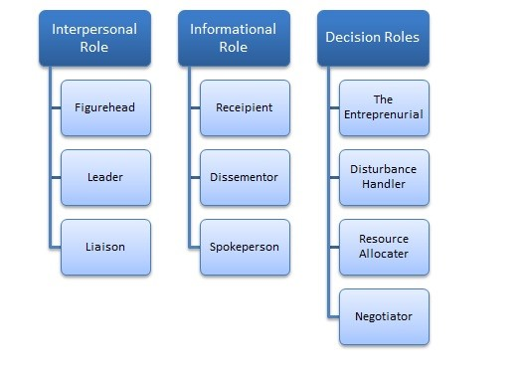
Mintzberg’s Managerial Roles (1973)

Slide 12
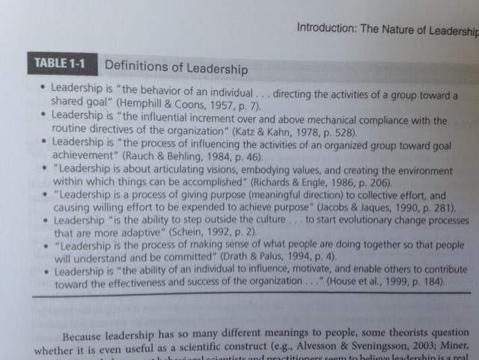
What makes a great leader?

Slide 13
  Leonard and Leggett, 2012

Slide 14
The most effective school systems emphasise the importance of good leadership at all levels and the best leaders have a very strong focus on leading improvements in learning and teaching and supporting their staff to improve their own skills.
Estyn, 2015

Slide 15
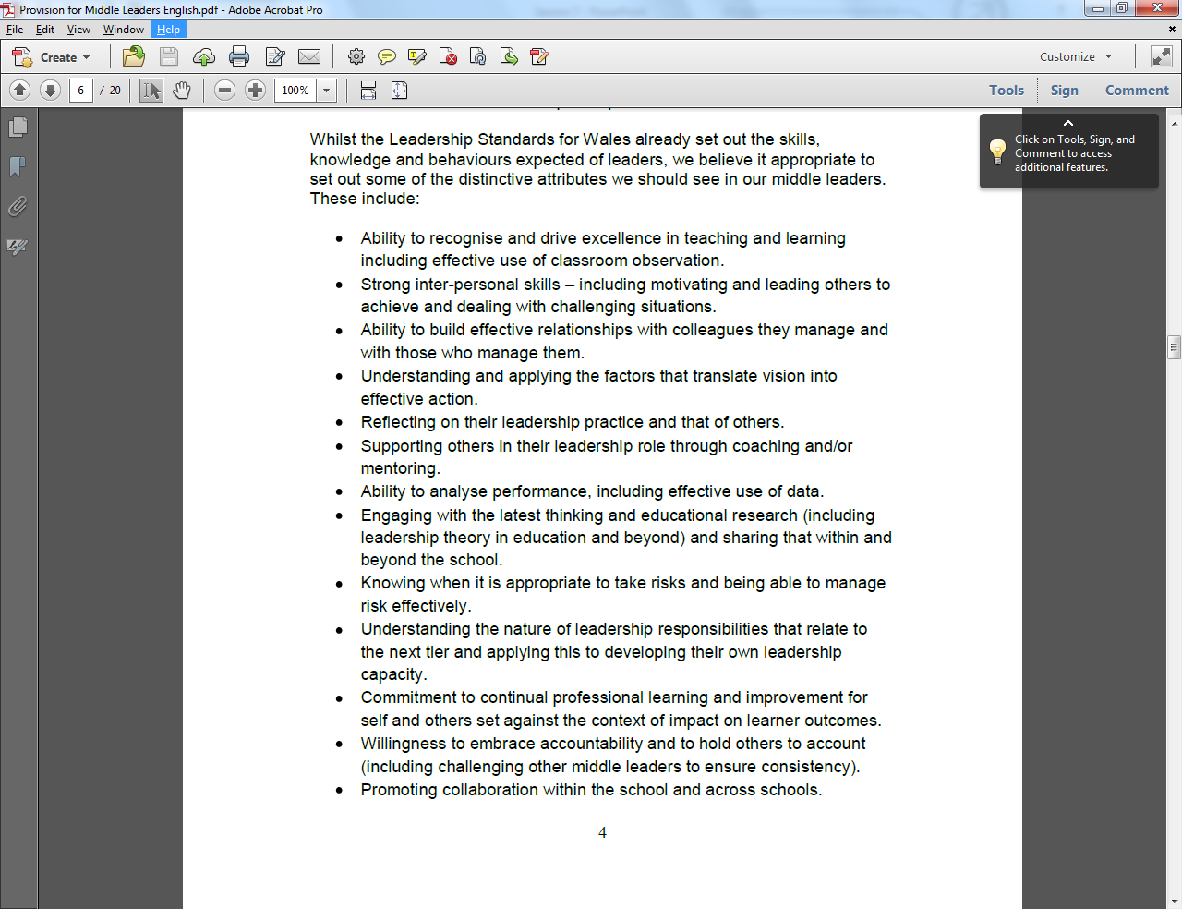
WG, 2014

Slide 16
WG, 2014

Slide 17
Estyn, 2015
Collaboration amongst professionals
Opportunities for sharing of best practice
Role of reflective practice leading to reflexive teaching
Good use of data (including research)
Models of distributed leadership
Underpins WG policy and practice (e.g. New Deal)

Slide 18

Professional Standards
Read the standards for leadership in schools.
With a partner, reflect on your key area.
To what extent do you believe this document sets out the qualities of a school leader?
What are the advantages of this approach to developing leadership in the sector?
What are the disadvantages?

Slide 19

What are you?
Roger McGough

Slide 20
Useful Follow Up Reading
Estyn (2015) Best practice in leadership development in schools, Cardiff: Estyn. Available at: https://www.estyn.gov.wales/sites/default/files/documents/Best%20practice%20in%20leadership%20development%20in%20schools.pdf
Chapter 1 – Gunter, H. (2001) Leaders and Leadership in Education, London: Paul Chapman Ltd.

Slide 21
Bibliography
Estyn (2015) Best practice in leadership development in schools, Cardiff: Estyn. Available at: https://www.estyn.gov.wales/sites/default/files/documents/Best%20practice%20in%20leadership%20development%20in%20schools.pdf
Leonard, L. & Leggett, R. (2012) Leadership, Essex: Perason Education Ltd.
Welsh Government (2014) Leadership development – provision for middle leaders, Cardiff: Welsh Government. Available at: http://learning.gov.wales/docs/learningwales/publications/150623-provision-for-middle-leaders-en.pdf

