Slide 1



Collaborative Learning
Collaborative learning is an educational approach where individuals collaborate to achieve shared learning goals.
It is based on socio-constructivist theory, which posits that knowledge is developed through interaction and dialogue.
The importance of collaborative learning is growing in modern education and professional settings due to globalisation, digital transformation, and interdisciplinary collaboration.

Slide 2

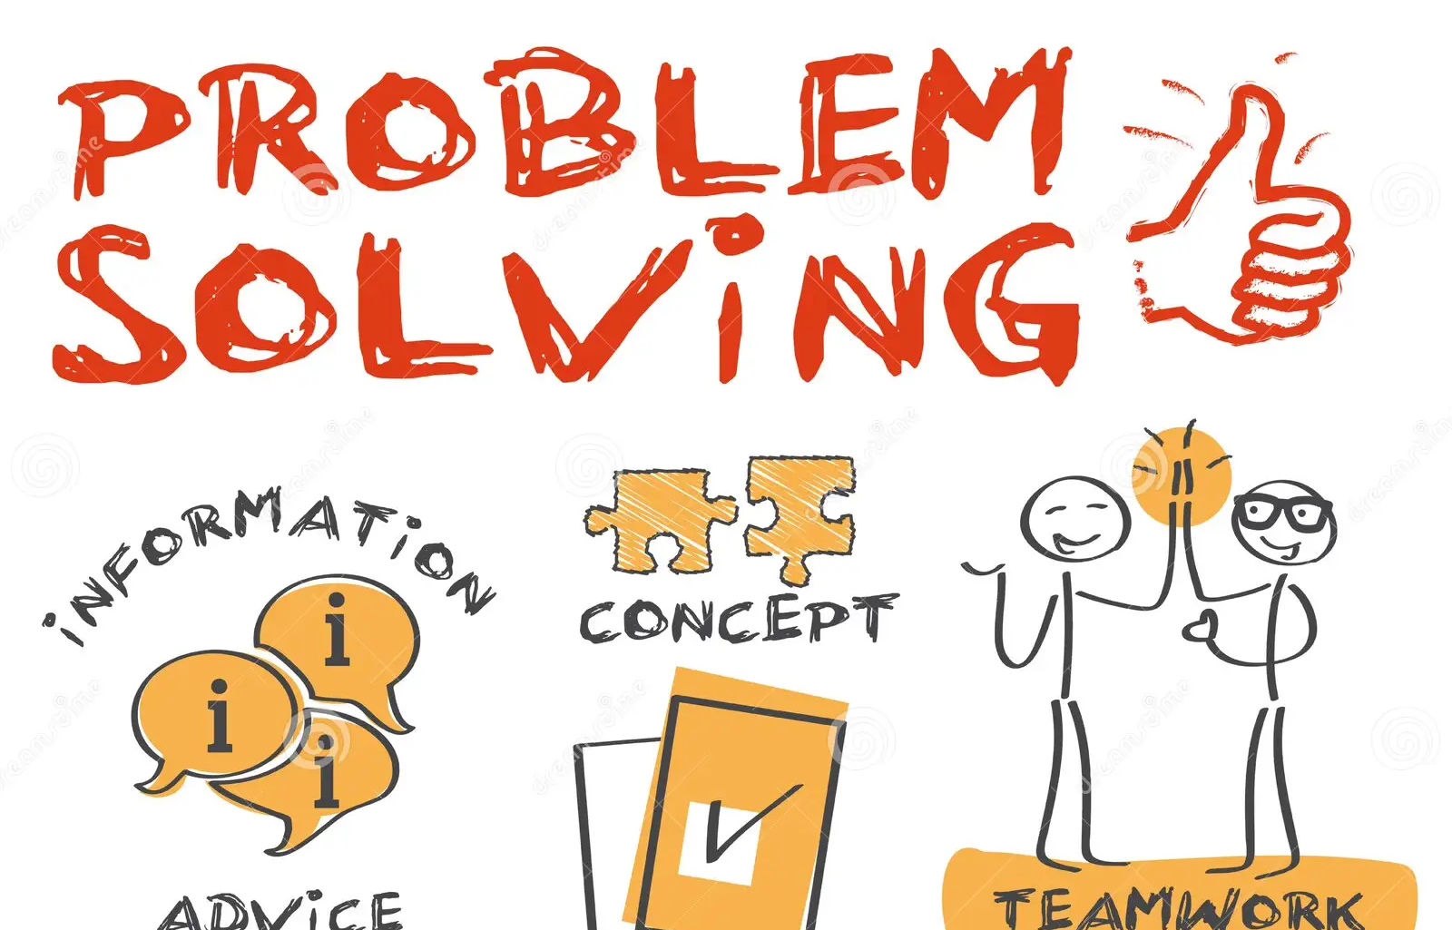
What are the benefits?
Collaborative learning enhances critical thinking, problem-solving, and knowledge construction.
Exposure to diverse perspectives deepens understanding and promotes higher-order thinking.
Research indicates that effective structuring of peer interaction improves student engagement and academic performance (Qureshi et al., 2023).
Collaborative environments also foster essential social and emotional skills for teamwork in professional settings (Huang & Lajoie, 2023).
In professional contexts, this learning approach reflects workplace practices, aiding the development of communication, leadership, and adaptability skills valued in global organisations.

Slide 3



Collaborative Learning in Global Business Contexts
Collaborative learning promotes intercultural competence and global citizenship by increasing awareness of cultural differences and communication styles.
Virtual collaboration tools enhance international teamwork and improve global competencies.
Collaboration fosters innovation through diverse knowledge and perspectives, essential for competitiveness in business environments.

Slide 4
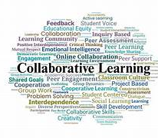
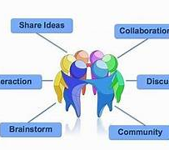
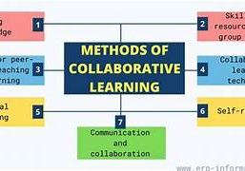
Role in Professional Practice
Collaborative learning is widely used in professional training fields, including healthcare, education, and technology.
It enhances interprofessional learning by promoting collaboration among individuals from different disciplines.
In clinical placements, supervision encourages patient-centred practice through teamwork (Buck Jensen et al., 2023).
In technology education, collaborative strategies prepare learners for real-world problem-solving in teams (Tverdokhlib et al., 2024).

Slide 5

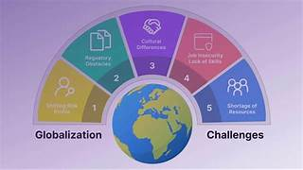

Challenges and limitations
Collaborative learning offers benefits but encounters challenges.
Unequal participation can result in imbalanced learning outcomes.
Technological barriers and resource limitations affect collaboration, particularly in low-resource or inclusive environments.
Group conflicts, communication issues, and cultural differences hinder effectiveness in global teams.
Data privacy and security concerns are significant in digital and AI-supported contexts.

Slide 6

Conclusion
Collaborative learning enhances critical thinking, engagement, and professional skills.
Particularly effective in global and interdisciplinary contexts.
Effectiveness relies on structured implementation, inclusivity, and technological support.

Slide 7
References
Buck Jensen, C., Norbye, B., Abrandt Dahlgren, M., Tornqvist, T., & Iversen, A. (2023). Students in interprofessional clinical placements: How supervision facilitates patient-centeredness in collaborative learning. The Clinical Supervisor, 42(2), 352–374.
Demetriou, K. (2023). Strengths and weaknesses of using educational technology in inclusive settings with limited available resources: Reflections on a classroom-based computer-mediated collaborative learning approach. International Journal of Learning Technology, 18(3), 279–303.
Huang, X., & Lajoie, S. P. (2023). Social emotional interaction in collaborative learning: Why it matters and how we can measure it? Social Sciences & Humanities Open, 7(1), 100447.
Jaswal, R., Panda, S. N., & Khullar, V. (2025). Federated learning: An approach for managing data privacy and security in collaborative learning. Recent Advances in Electrical & Electronic Engineering.
Qureshi, M. A., Khaskheli, A., Qureshi, J. A., Raza, S. A., & Yousufi, S. Q. (2023). Factors affecting students’ learning performance through collaborative learning and engagement. Interactive Learning Environments, 31(4), 2371–2391.
Tverdokhlib, I. A., Klochko, O. V., Sharyhin, O. A., & Fedorets, V. M. (2024). Collaborative learning in the system of training future information technologies specialists as an educational strategy for the fundamentalization of the sustainable development of education. In AREdu (pp. 206–225).
Van Rompay-Bartels, I., Watkins, C., Zijlstra, L., & Geessink, J. (2024). Assessing the impact of intercultural virtual collaboration on global citizenship education. In Belonging in culturally diverse societies: Official structures and personal customs. IntechOpen.
Zalli, E. (2024). Globalization and education: Exploring the exchange of ideas, values, and traditions in promoting cultural understanding and global citizenship. Interdisciplinary Journal of Research and Development, 11(1 S1), 55–55.

