Slide 1
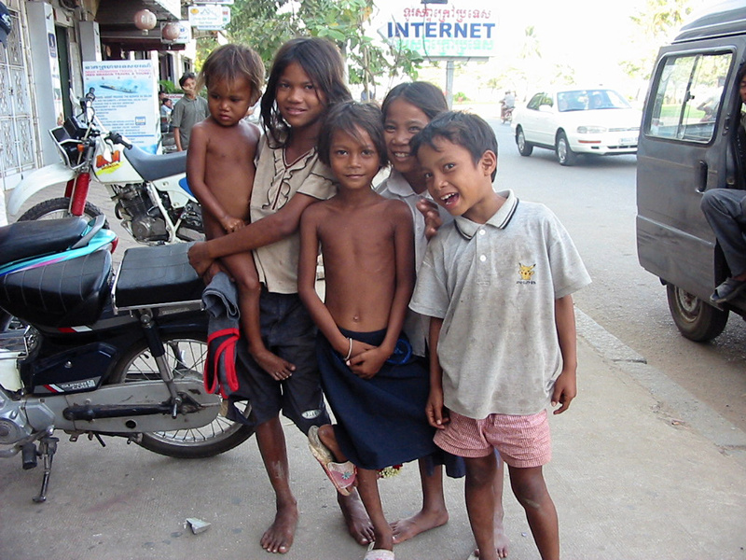
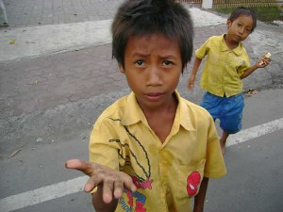
Street Children
Dr. Rachel Casiday
r.casiday@tsd.ac.uk

Slide 2
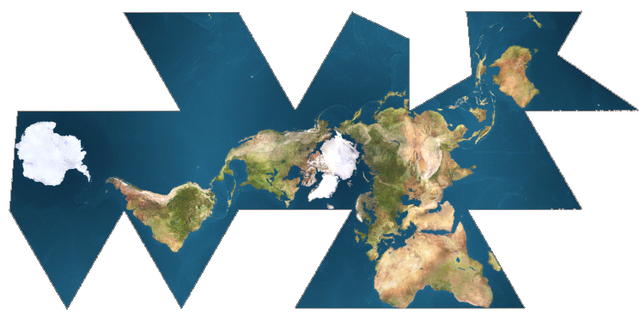
A Global Phenomenon
But we don’t actually know how many children live on the streets worldwide
(UNICEF has estimated 100 million but this figure has been questioned by anthropologists and others.)

Slide 3
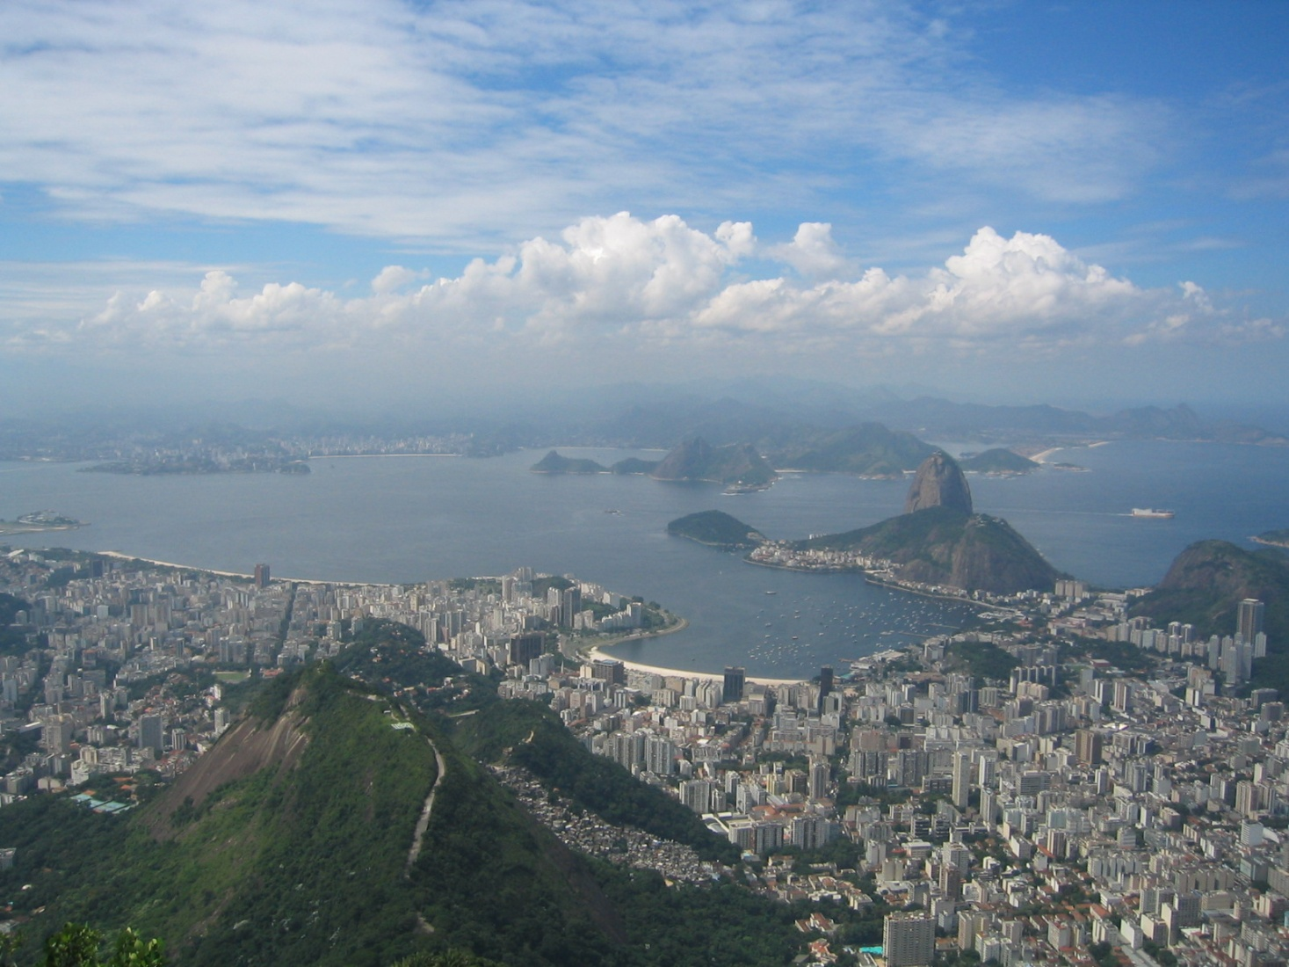
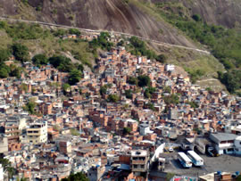
Urbanisation
Rocinha – Rio de Janiero’s largest favela

Slide 4
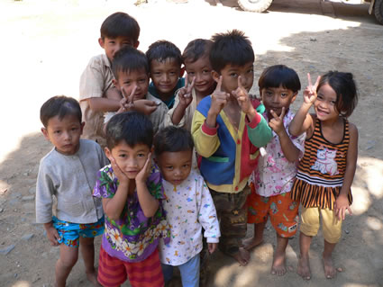
Small-Scale Societies?

Slide 5
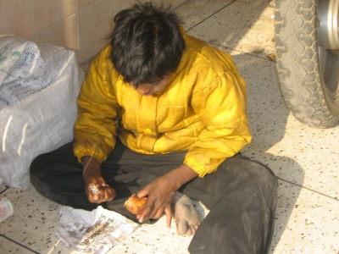
Where do street children come from?

Slide 6
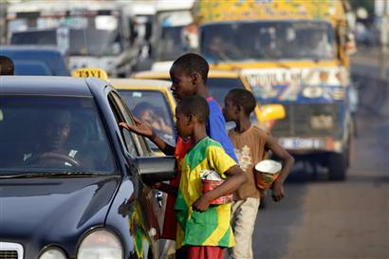
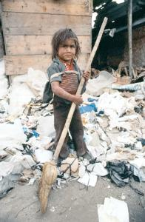
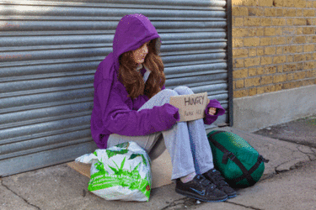
Subsistence

Slide 7
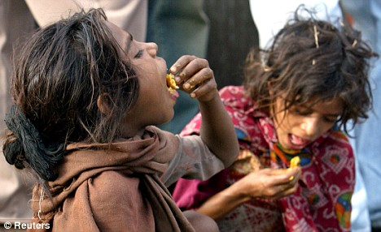
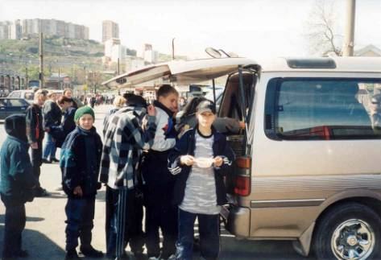
Subsistence

Slide 8
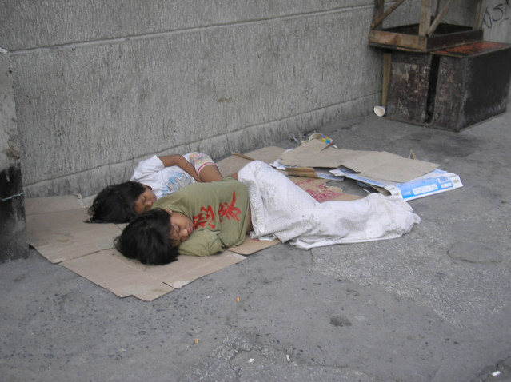
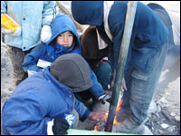
Making a home

Slide 9
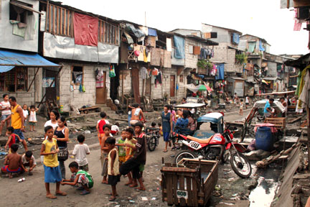
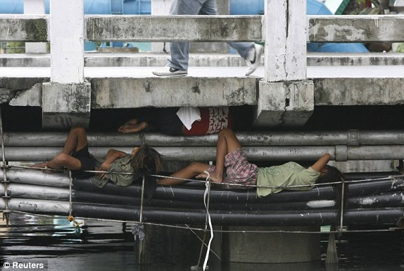
The ‘landscape’ of the street

Slide 10
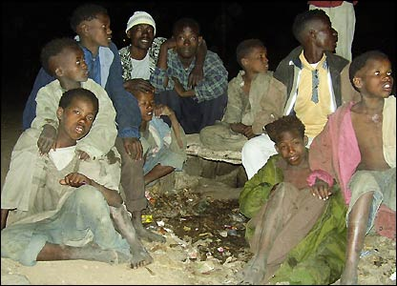
Family and community

Slide 11
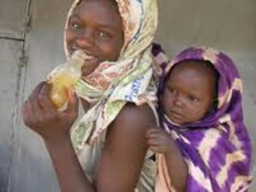
Glue and other drugs

Slide 12
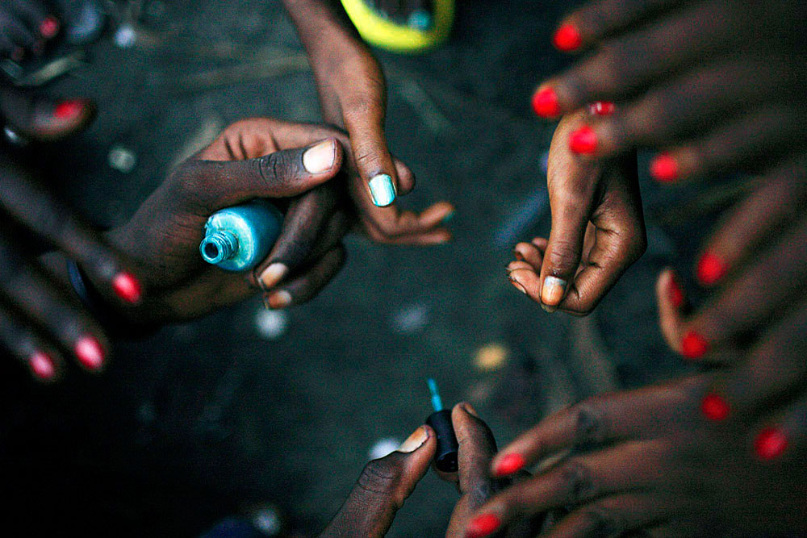
Gendered livelihoods

Slide 13
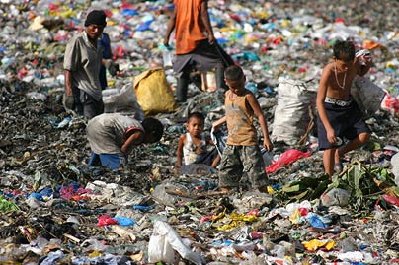
‘Street children’ don’t just live in streets...

Slide 14
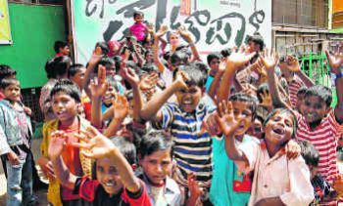
Life off the street?

Slide 15
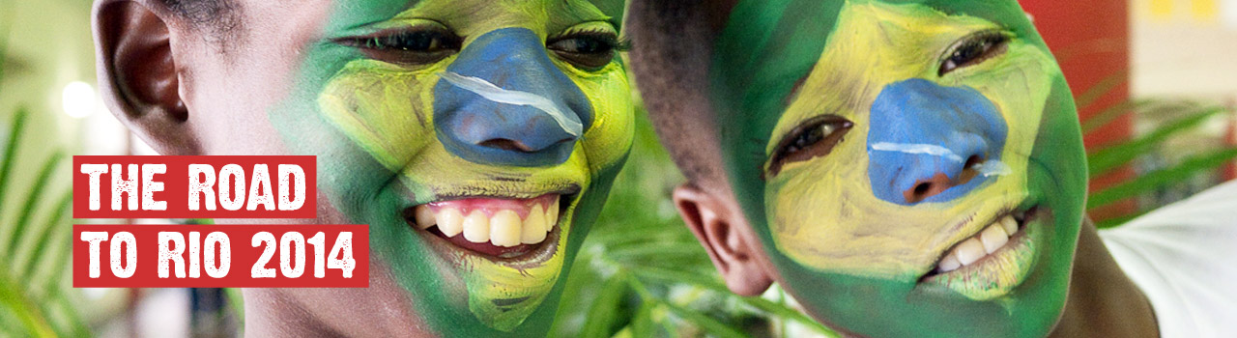
‘Don’t call me a street child.’
Notes:
In Georgia, the term “street children” is also charged
with negative connotations, often focusing more on the
harmful aspects of street life than on those who live such
a life. The children themselves do not want to be called
“street kids.” The research organized two focus groups
(in Tbilisi and Rustavi) with children known to Save the
Children’s project mobile teams from their street work.
When the facilitators asked what name the children
would use to describe themselves, they said “just kids.”
Prompted, they came up with other suggestions: “children who work,” “begging children,” or “cool boys.” The
stigma associated with the name and a trend to place such children into rigid categories is so strong that it
becomes easy to forget the most essential reality: that
a “street child” is simply a child with individually unique
talents and personal abilities. (Don’t Call Me a Street Child
Estimation and Characteristics
of Urban Street Children in Georgia: p. 113. Available at: http://www.unicef.org/georgia/Street_children_survey.eng(1).pdf)

Slide 16


