Slide 1
Strategies for Effective Communication in a Business Setting
Cristian Ioan Spridon 2118625
Marian Postolache 2119559
Iulian Neagu 2107401
Mirela Oprea 2107120
Elena-Catalina Calau 2117472

Slide 2

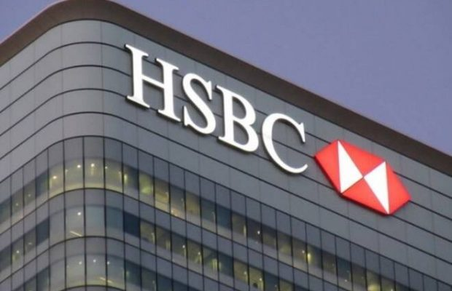

“Opening up a world of opportunity”
HSBC, 2022

Slide 3

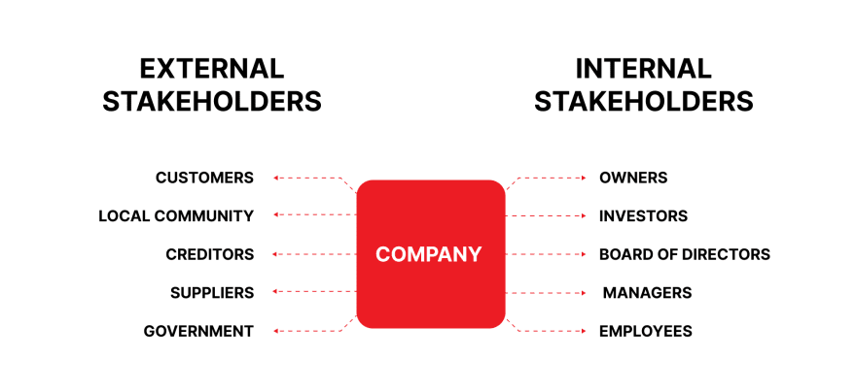

Slide 4
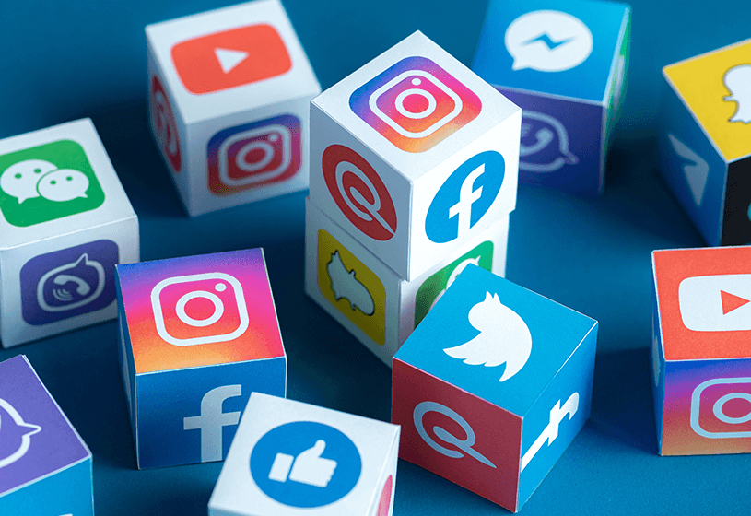
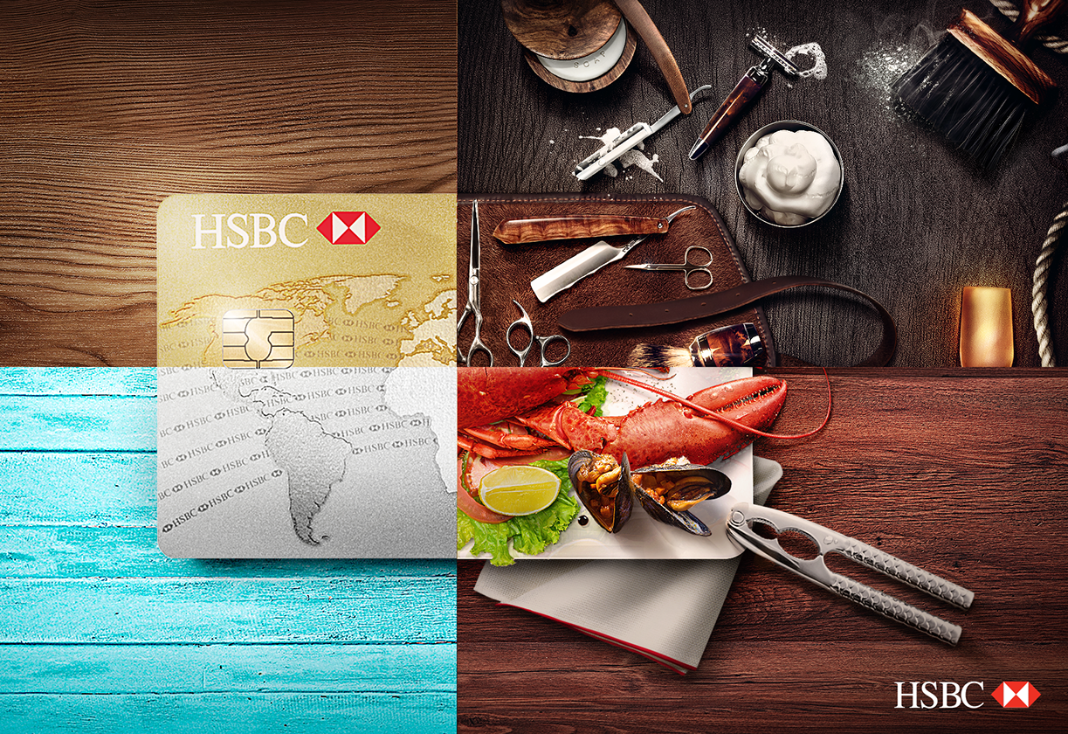
Facebook - @HSBC, with 3 million people following the page
Instagram - @HSBC with 50,000 followers on the main account
Twitter - @HSBC with 200,000 followers on the main account
YouTube with 36,000 subscribers and millions of views on the videos

Slide 5
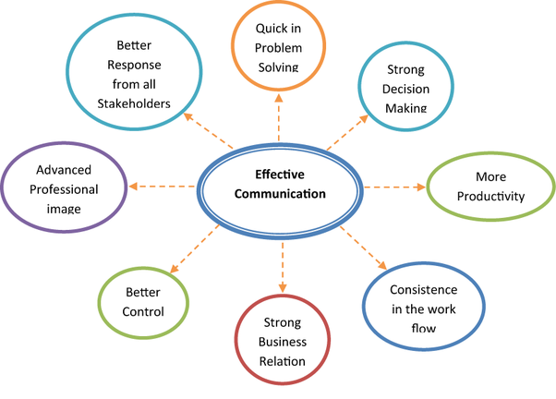
Benefits of effective communication in business

Slide 6
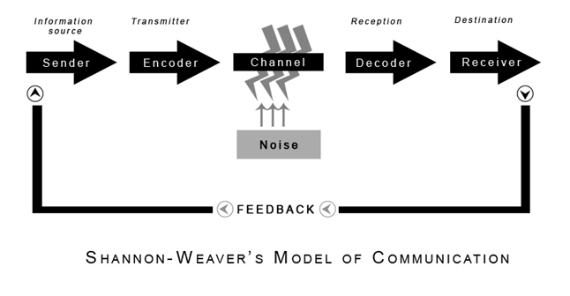
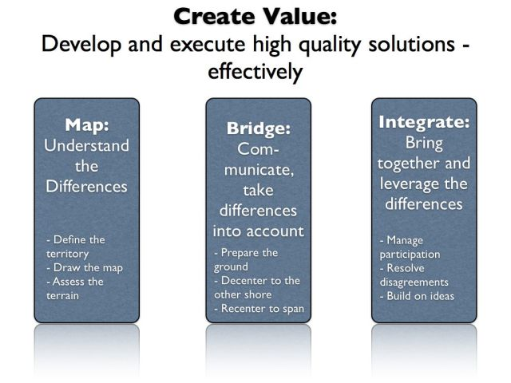
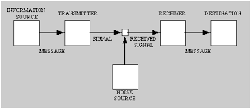
Theories and models of communication

Slide 7
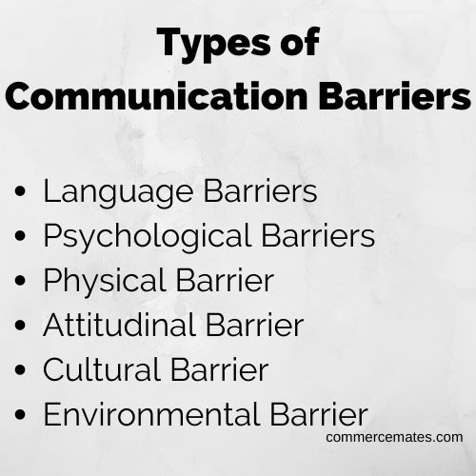

Slide 8

What channels to use to improve communication

Slide 9
References
Bennet, M. (2021) Models of effective communication in organisations, available at: https://dovney.com/models-of-effective-communication-in-organizations (Accessed at: 12 Jul 2022)
Facebook (2022) HSBC, available at: https://www.facebook.com/HSBC (Accessed at: 10 Jul 2022)
Grammarly (2022) Top 8 benefits of effective communication in the workplace, available at: https://www.grammarly.com/business/learn/benefits-of-effective-communication/ (Accessed at: 12 Jul 2022)
HSBC (2021) HSBC: An overview, available at: https://www.sec.gov/Archives/edgar/data/83246/000114420412052308/v744588-1_fwp.pdf (Accessed at: 10 Jul 2022)
Indeed (2022) 10 benefits of effective communication in the workplace, available at: https://www.indeed.com/career-advice/career-development/communication-benefits (Accessed at: 12 Jul 2022)
Instagram (2022) HSBC, available at: https://www.instagram.com/hsbc/ (Accessed at: 10 Jul 2022)
Martic, K. (2022) Top 13 communication barriers and to tackle them, available at: https://haiilo.com/blog/communication-barriers/ (Accessed at: 13 Jul 2022)
Pines, L. (2020) Top 3 shareholders of HSBC, available at: https://www.investopedia.com/articles/company-insights/082316/top-5-shareholders-hsbc.asp (Accessed at: 13 Jul 2022)
Skills you need (2022) Barriers to effective communication, available at: https://www.skillsyouneed.com/ips/barriers-communication.html (Accessed at: 12 Jul 2022)
Twitter (2022) HSBC, available at: https://twitter.com/HSBC?ref_src=twsrc%5Egoogle%7Ctwcamp%5Eserp%7Ctwgr%5Eauthor (Accessed at: 10 Jul 2022)
YouTube (2022) HSBC, available at: https://www.youtube.com/c/lionshsbc (Accessed at: 10 Jul 2022)

Slide 10


Slide 11
Teamwork Evaluation | Team responses.
Who was in your team? | Mirela Oprea, Iulian Neagu, Cristian Ioan Spridon, Elena-Catalina Calau and Marian Postolache.
What were the key strengths of your team? | We communicated very well and all of us been involved.
What were the challenges that you overcame as a team? | Because we have different work time we struggle to meet so often.
What would you do differently if you worked as a team again? | I don’t want to do any other changes because I like the team that we have been.
How would you rate your team working? Out of 10? | 9/10

