Slide 1
The Communications Mix
By Chloe and Daisy

Slide 2
An introduction to integrated marketing communications
https://thedma.org/membership/member-groups-communities/integrated-marketing-community/integrated-marketing-definitions/

Slide 3
Brief Summary of Itinerary
Booking a short stay holiday in Swansea bay and Gower. The target market for this product is for families with young children.
We are looking to do an itinerary for 3 – 5 days with costs of activities and accommodation. We will look to promote the itinerary for June and July.
The holiday package will be different to any other because you get the best of both worlds; you have the city centre and the beach in one holiday.

Slide 4
The most appropriate mix of marketing communications to reach the desired market segment is..
Organizations in the travel and tourism industry have a variety of communication methods to try with customers. They don't all have to be visible some in brochures or print items and direct marketing.
E – Marketing
This is the fastest growing part of travel and tourism and is very effective with fresh and new information. The internet is the best way for most people to get out quickly about sales and promotions and it's a better way to get things cheap.

Slide 5
What kind of advertisement works for our target market? And why? What didn’t?
Show that your aware of their different ways of getting the message across.. Through social media news papers and so on.
By using different advertisements.. They can reach out to different target markets for example the older generation – newspapers. Social media are from ages 16+ and TV adverting
We will use social networks and email to promote our offers and reach the desired target market which are families and young children.
We are on a budget, so by using newspapers and TV advertising would cost a lot. However, using the children channel on TV could gain more interest to more of our target audience as it engages the children.
Using social networking will engage the target market as it’s a quick convenient and cheap way of advertising and promoting.

Slide 6

What key messages do they have?
Mission statement – is a message that links with the business to make it sound more effective.
We will encourage people and engage families by making a slogan and a mission statement which we’ve decided would be
‘The future in Swansea is so bright you’d have to wear shades.’ SLOGAN
‘to encounter the culture and traditions that Swansea has to offer’. MISSION STATEMENT.

Slide 7




What brands are used? What makes branding so special?
What is branding? Branding is a way of Making more revenue for the company who make the product. All branding tend to be effective as people will talk about having a Hollister or Superdry jumper having the latest and expensive brands (Entrepreneur Staff, 2018).

Slide 8
What competition does the product have?
Bigger city's such as Cardiff due to it being a capital for Wales and more known for attractions and events being held in the city.
Pembrokeshire is another competitor as it has three well known attractions such as Oakwood, Blue Stone, and Folly Farm Adventure Zoo.

Slide 9
Cost? Return?
Merge our itinerary's together.
Both itinerary's are similar as they are designed for the summer and our target markets are families.

Slide 10
Compare our itinerary to someone else..
The first itinerary has a family of six with two young children and four adults.
The second itinerary has two adults and two children.
The second one looks more simple.
However, the first looks more advendurous.

Slide 11

How to market the product..
We will look to advertise on social networking as it doesn't cost and it’s a quick effective way to reach out to families.
We will make sure that we compromise on quality. Prices will be as low cost as possible.
Look for fun activities and events for the family to bond.

Slide 12

How will we sell our package?
Sold online via social media.
Pay pal
20 holiday packages during the summer

Slide 13
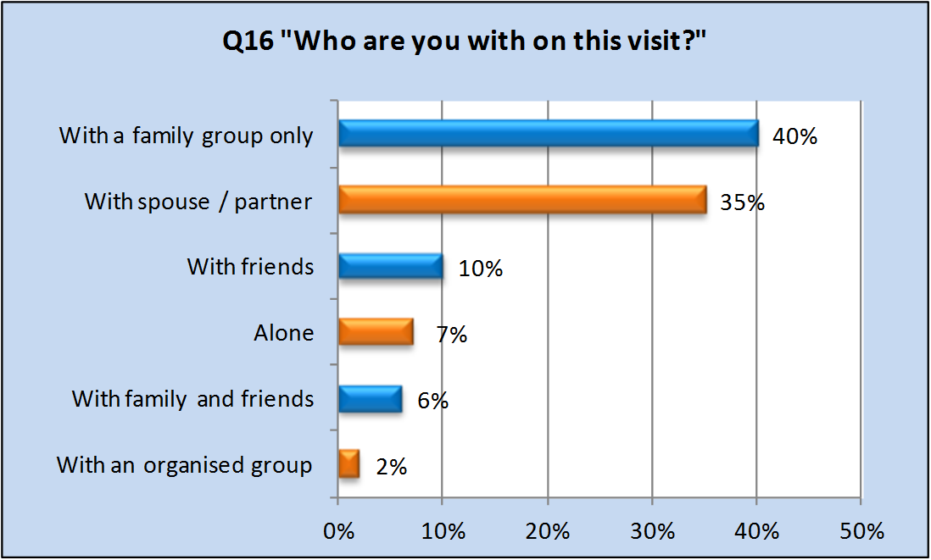
Statistics..
Looking at a power point done by
Lydall, Nesbitt, & Thorley (2015) to Swansea Bay visitors. This graph shows that there are more families attending Swansea Bay and Gower more than others. However, travelling as a couple is just as popular.

Slide 14
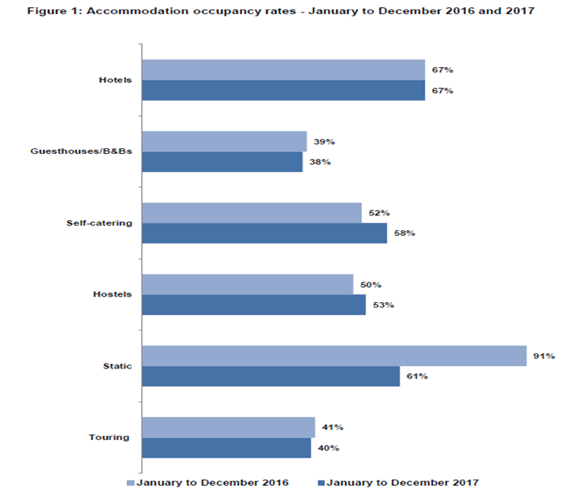
Statistics
Statics of Wales most popular accommodation choice Is shown in the graph beside this was a survey done by the Welsh Government (2017)

Slide 15
Reference List..
Entrepreneur Staff, 2018. Entrepreneur. [Online]
Available at: https://www.entrepreneur.com/encyclopedia/branding
Lydall, A., Nesbitt, L. & Thorley, D., 2015. Swansea Visitor Survey [Interview] (19th November 2015).
MMC Learning, 2018. Integrated Marketing Communication. [Online]
Available at: http://multimediamarketing.com/mkc/marketingcommunications/
PayPal, 2018. What is PayPal Buyer Protection and how am I covered?. [Online]
Available at: https://www.paypal.com/uk/selfhelp/article/what-is-paypal-buyer-protection-and-how-am-i-covered-faq645
Welsh Government, 2017. Wales Tourism Accommodation Occupancy Survey. Statistical First Release, pp. 1-16.

Slide 16
Thank You for listening.. Any Questions?

