Slide 1
Advanced Instrumentation Systems
M6X00942

Slide 2
Module Outcomes
Upon the successful completion of this module, the student should be able to:
  Demonstrate a sound understanding of the principles and methods used in tracking and surveillance of airborne targets.
  Select and critically evaluate appropriate methods and technologies used in the acquisition of telemetry data in Test Range trials.

Slide 3
Module Content
Tracking Radar and Surveillance Radar;
  Doppler tracking and mono pulse;
  Radar Cross Section - factors affecting RCS, Measurement and Calculation, RCS reduction
  Flight Termination Systems;
Telemetry;
Global Positioning System, Inertial Navigation Systems; GPS and Automatic Dependent Surveillance;
Spatial Coordinate Systems, Geodetics and Geocoding systems;

Slide 4
Assessment
1 Assignment (50%)
  2500 Word equivalent
1 Exam (50%)
  2 Hour exam
  Around the last week in June

Slide 5
Units
There are 7 SI Base units – All other units are derived from these
Symbol | Name | Quantity
m | metre | Length
kg | kilogram | Mass
s | second | Time
A | ampere | Electric current
K | kelvin | Temperature
mol | mole | Amount of substance
cd | candela | Luminous Intensity

Slide 6
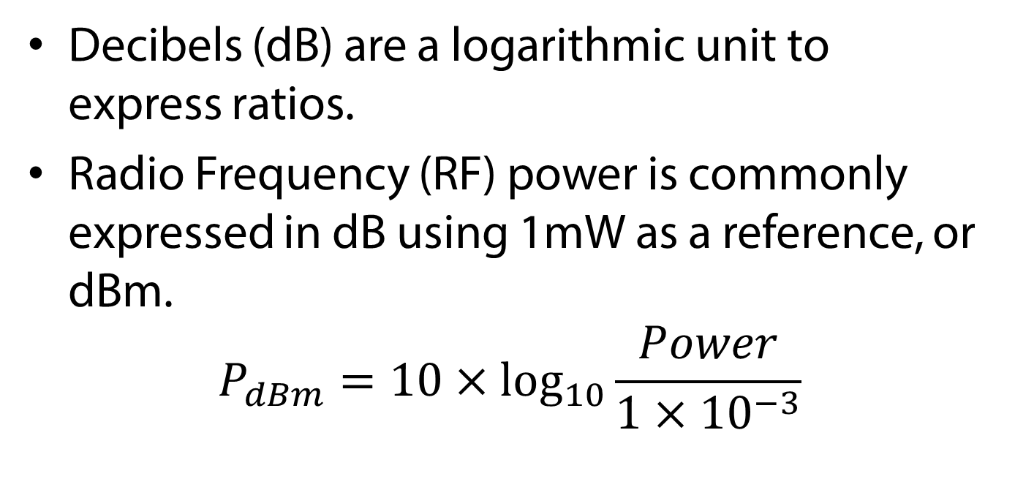
Decibels
Decibels (dB) are a logarithmic unit to express ratios.
Radio Frequency (RF) power is commonly expressed in dB using 1mW as a reference, or dBm.
$$P_{dBm}=10×\log_{10}{\frac{Power}{1×{10}^{−3}}}$$

Slide 7
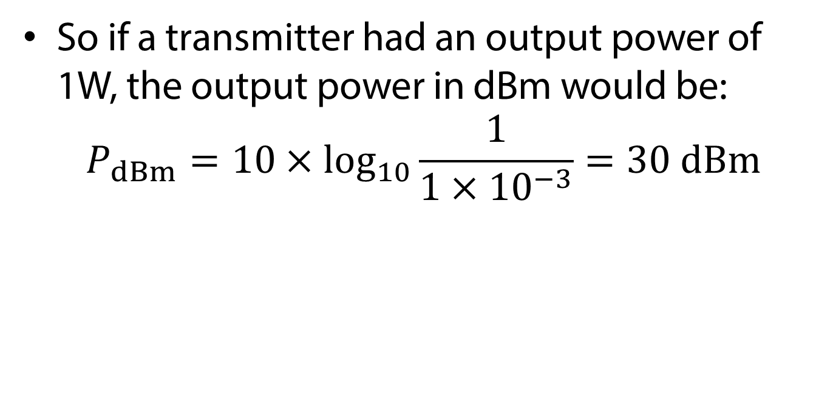
Decibels
So if a transmitter had an output power of 1W, the output power in dBm would be:
$$P_{dBm}=10×\log_{10}{\frac{1}{1×{10}^{−3}}}=30 dBm$$

Slide 8
RADAR
RAdio Detection And Ranging
Radio/microwaves are reflected and scattered in many directions by objects they hit
If a reflected wave is received it can tell us
  Range (derived from the time difference between transmitted and reflected wave)
  Direction (if the transmitter and receiver antennae are directional
  Speed (an approaching or retreating object introduces frequency shifting on the signal by the Doppler effect)

Slide 9
Radar Types
Primary Surveillance Radar (PSR)
  Limited
    Range Finding
    Angle
    Velocity (Doppler)
Secondary Surveillance Radar (SSR)
  More advanced but requires transponder on aircraft

Slide 10
Radar types
Identification of Friend or Foe (IFF)
  Extension of SSR
Multilateration – ADS-B
Semi-Active Radar Homing

Slide 11
The RADAR Equation
The scattering cross-section σ of a target is the imaginary area which intercepts a power S_{σ} from the plane wave incident upon it and scatters the power isotropically such that the power flux incident on the receiver is that observed
S (in W/m²)
O – the scattering object
r₁
S_{σ}
T
r₂
R

Slide 12
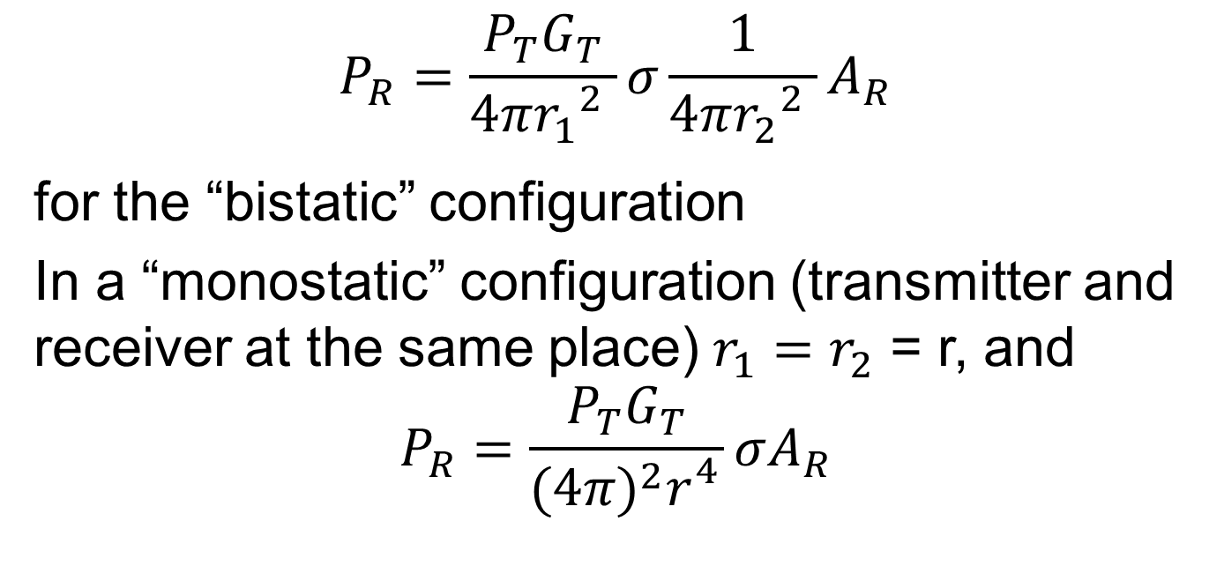
The Radar Equation
$$P_{R}=\frac{P_{T}G_{T}}{4π{r_{1}}_{}^{2}}σ\frac{1}{4π{r_{2}}_{}^{2}}A_{R}$$
for the “bistatic” configuration
In a “monostatic” configuration (transmitter and receiver at the same place) $r_{1}=r_{2}$ = r, and
$$P_{R}=\frac{P_{T}G_{T}}{{(4π)}^{2}r_{}^{4}}σA_{R}$$

Slide 13
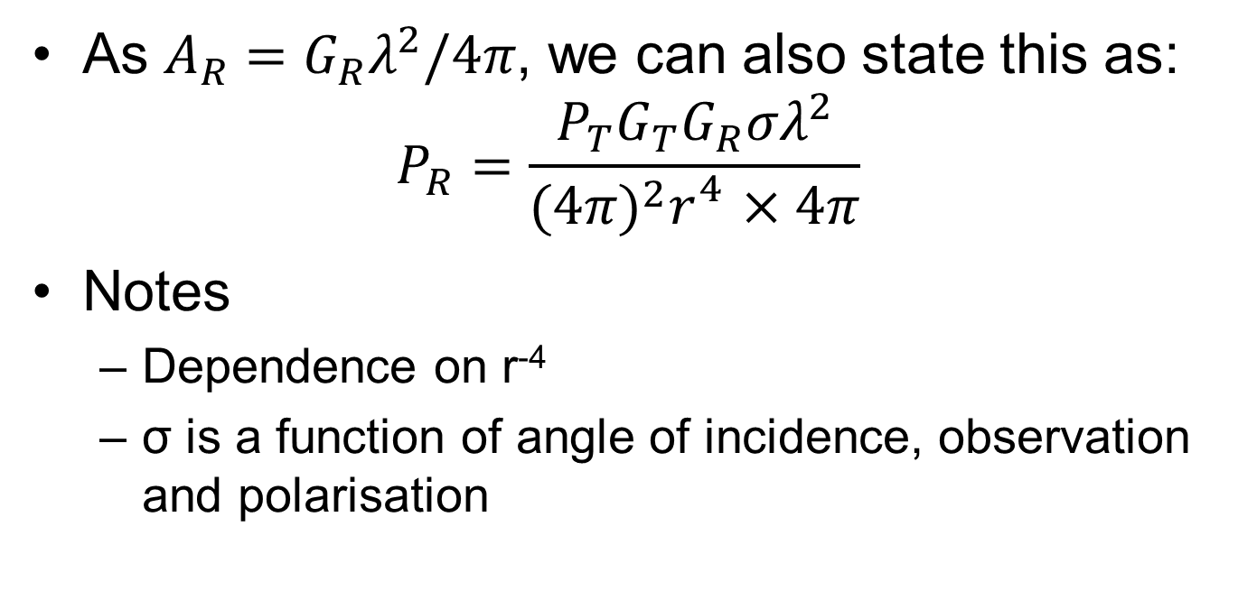
Radar Equation
As $A_{R}=G_{R}λ^{2}/4π$, we can also state this as:
$$P_{R}=\frac{P_{T}G_{T}G_{R}σλ^{2}}{{(4π)}^{2}r_{}^{4}×4π}$$
Notes
  Dependence on r⁻⁴
  σ is a function of angle of incidence, observation and polarisation

Slide 14
OK, But What About Radar Systems?
Objects scatter and reflect radio waves
Some of that energy reaches the receiver
  How much depends on the object’s radar cross-section, σ
If the signal is greater than the noise background, we can detect it
  Same problem as with communications systems in DSP & Comms last semester
  Signal-to-noise ratio (SNR) is usually stated in dBs
  Noise figures are usually given as noise temperatures (again, see DSP & Comms)

Slide 15
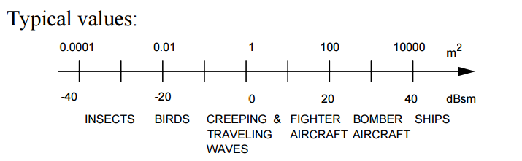
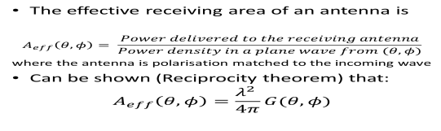
Radar Cross Section
$$σ≈4πA^{2}/λ^{2}$$
$$σ_{dBsm}=10\log_{10}(σ)$$
Courtesy of Prof. David Jenn, Navy Postgraduate School, available from:
http://faculty.nps.edu/jenn/Seminars/RadarFundamentals.pdf,
accessed 11.00, 04/03/16

Slide 16
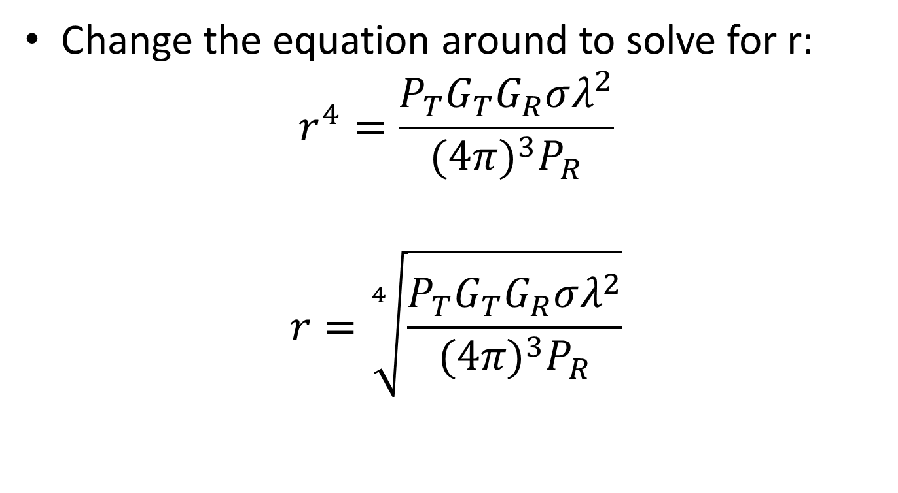
Radar Detection Range
Change the equation around to solve for r:
$$r_{}^{4}=\frac{P_{T}G_{T}G_{R}σλ^{2}}{{(4π)}^{3}P_{R}}$$
$$r=\sqrt[4]{\frac{P_{T}G_{T}G_{R}σλ^{2}}{{(4π)}^{3}P_{R}}}$$

Slide 17
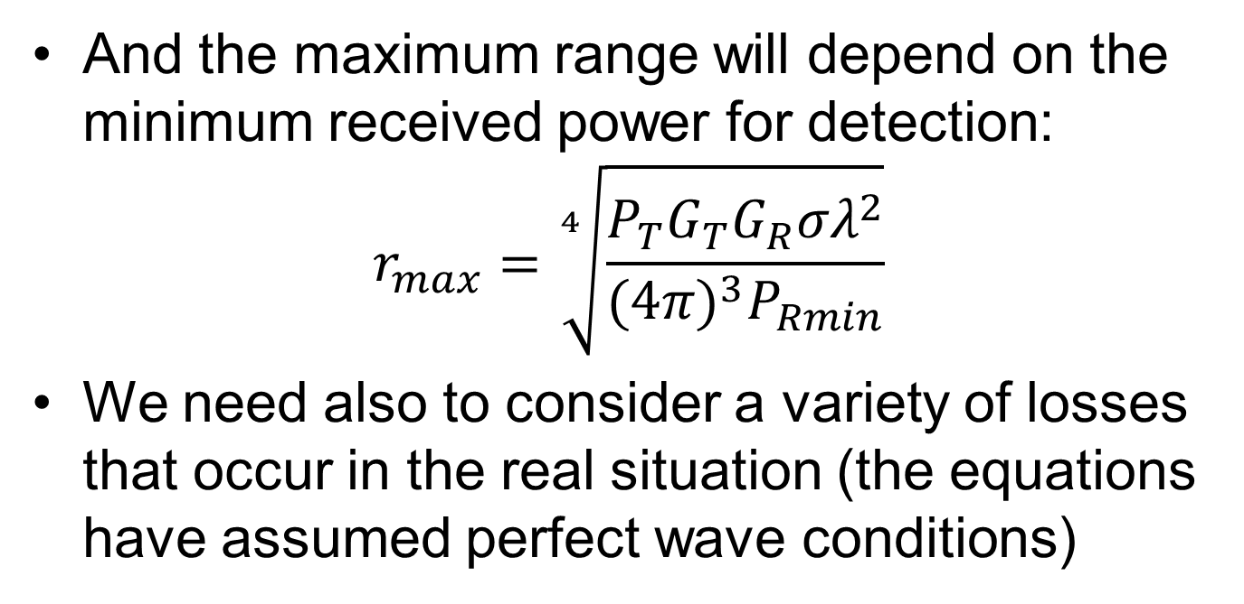
Radar Detection Range
And the maximum range will depend on the minimum received power for detection:
$$r_{max}=\sqrt[4]{\frac{P_{T}G_{T}G_{R}σλ^{2}}{{(4π)}^{3}P_{Rmin}}}$$
We need also to consider a variety of losses that occur in the real situation (the equations have assumed perfect wave conditions)

Slide 18
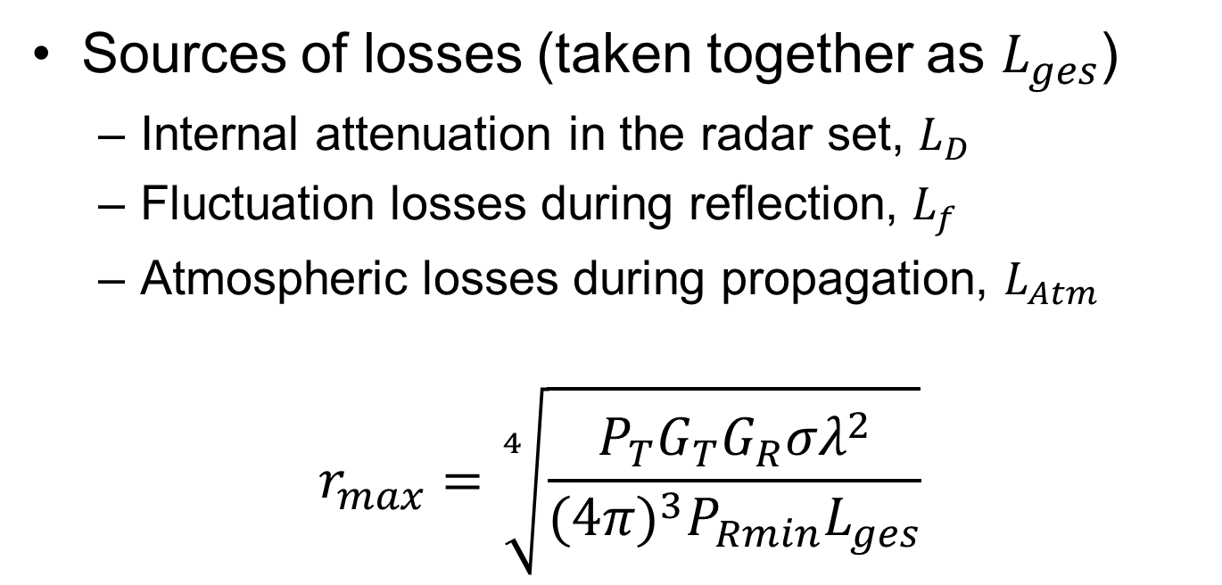
Detection Range with Losses
Sources of losses (taken together as $L_{ges}$)
  Internal attenuation in the radar set, $L_{D}$
  Fluctuation losses during reflection, $L_{f}$
  Atmospheric losses during propagation, $L_{Atm}$
$$r_{max}=\sqrt[4]{\frac{P_{T}G_{T}G_{R}σλ^{2}}{{(4π)}^{3}P_{Rmin}L_{ges}}}$$

Slide 19
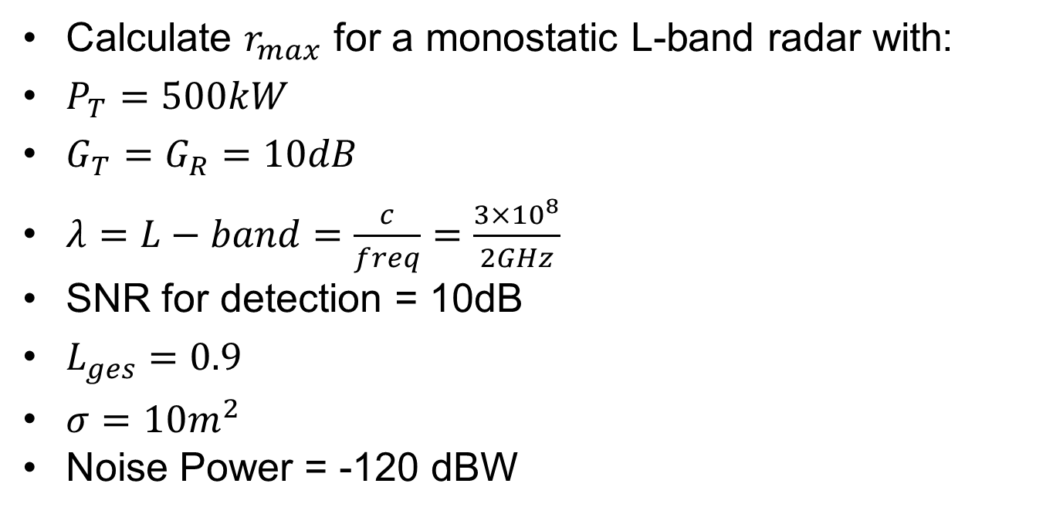
So?
Calculate $r_{max}$ for a monostatic L-band radar with:
$P_{T}=500kW$
$G_{T}=G_{R}=10dB$
$λ=L−band=\frac{c}{freq}=\frac{3×{10}^{8}}{2GHz}$
SNR for detection = 10dB
$L_{ges}=0.9$
$σ=10m^{2}$
Noise Power = -120 dBW

Slide 20
Detection Range Calculation
Noise power = -120dB; SNR = 10dB
∴Threshold signal level = -110dB
Frequency = L-band
Wavelength = 3x10⁸/2x10⁹ = 0.15m
10dB gain = signal x 10

Slide 21
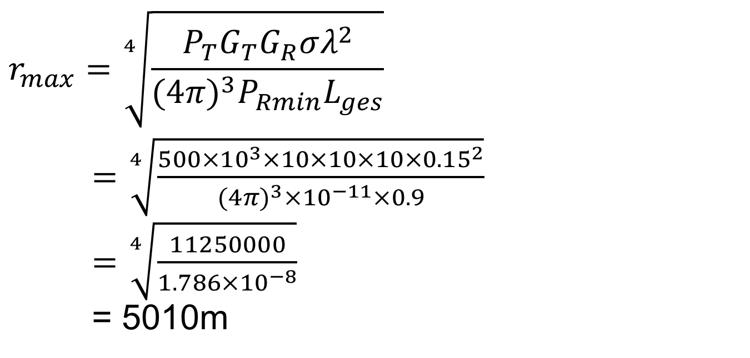
Detection Range Calculation
$$r_{max}=\sqrt[4]{\frac{P_{T}G_{T}G_{R}σλ^{2}}{{(4π)}^{3}P_{Rmin}L_{ges}}}$$
$=\sqrt[4]{\frac{500×{10}^{3}×10×10×10×{0.15}^{2}}{{(4π)}^{3}×{10}^{−11}×0.9}}$
$=\sqrt[4]{\frac{11250000}{1.786×{10}^{−8}}}$
= 5010m

Slide 22
Range Calculation
Change the power up to 2 MW. What is the new detection range?
Reduce the noise power to -140dBW. What is the new detection range?
Change the radar cross section to 200m². What is the new detection range?
Change the frequency down to 1GHz. What is the new detection range?

Slide 23
Answers
7085m
15842m
10594m
7085m

Slide 24
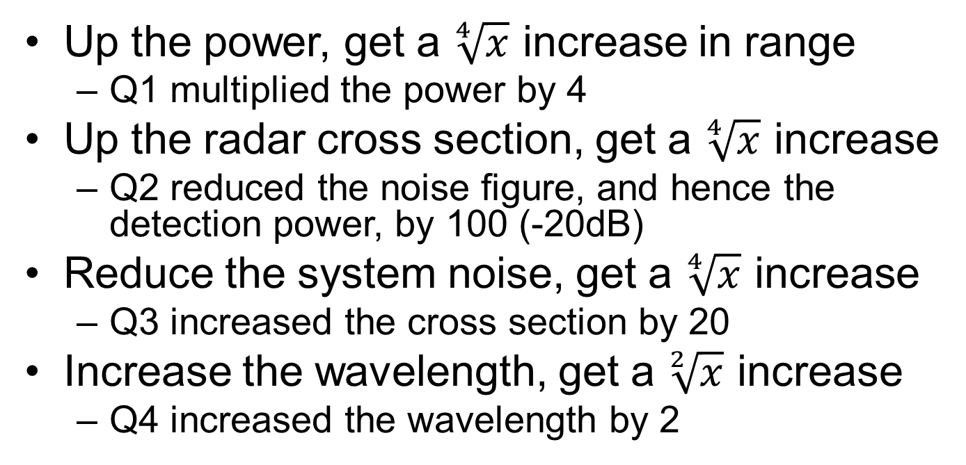
The Answers Tell Us?
Up the power, get a $\sqrt[4]{x}$ increase in range
  Q1 multiplied the power by 4
Up the radar cross section, get a $\sqrt[4]{x}$ increase
  Q2 reduced the noise figure, and hence the detection power, by 100 (-20dB)
Reduce the system noise, get a $\sqrt[4]{x}$ increase
  Q3 increased the cross section by 20
Increase the wavelength, get a $\sqrt[2]{x}$ increase
  Q4 increased the wavelength by 2

Slide 25
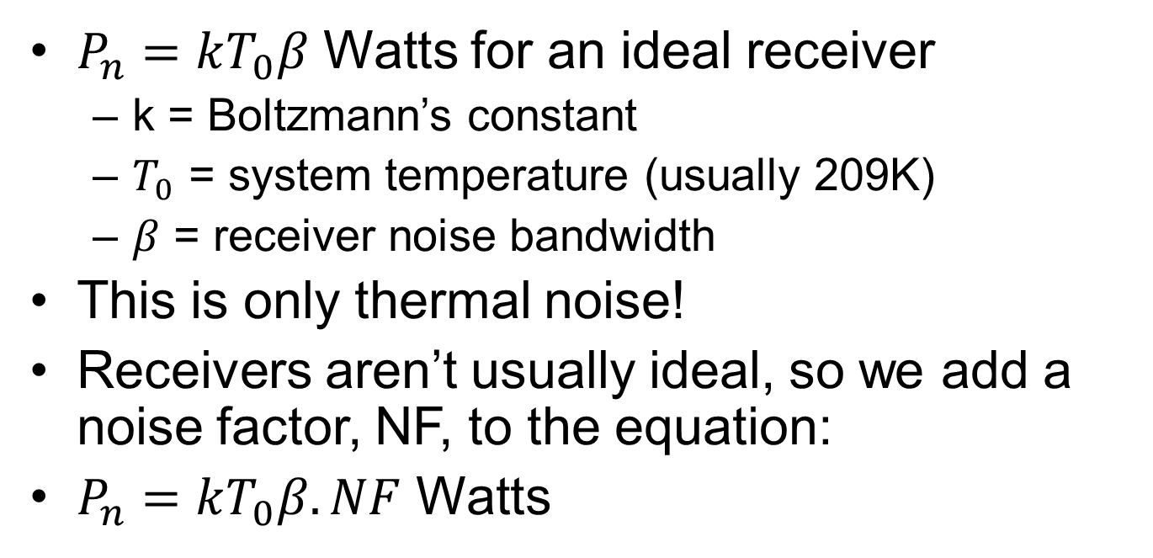
Noise Power?
$P_{n}=kT_{0}β$ Watts for an ideal receiver
  k = Boltzmann’s constant
  $T_{0}$ = system temperature (usually 209K)
  $β$ = receiver noise bandwidth
This is only thermal noise!
Receivers aren’t usually ideal, so we add a noise factor, NF, to the equation:
$P_{n}=kT_{0}β.NF$ Watts

Slide 26
Try One
The new Qinetiq stealth drone has a maximum radar equivalent reflecting area of 1m². What is the equivalent reflection gain if illuminated with an X-band (10GHz) radar? With an L-band (1GHz) radar?

Slide 27
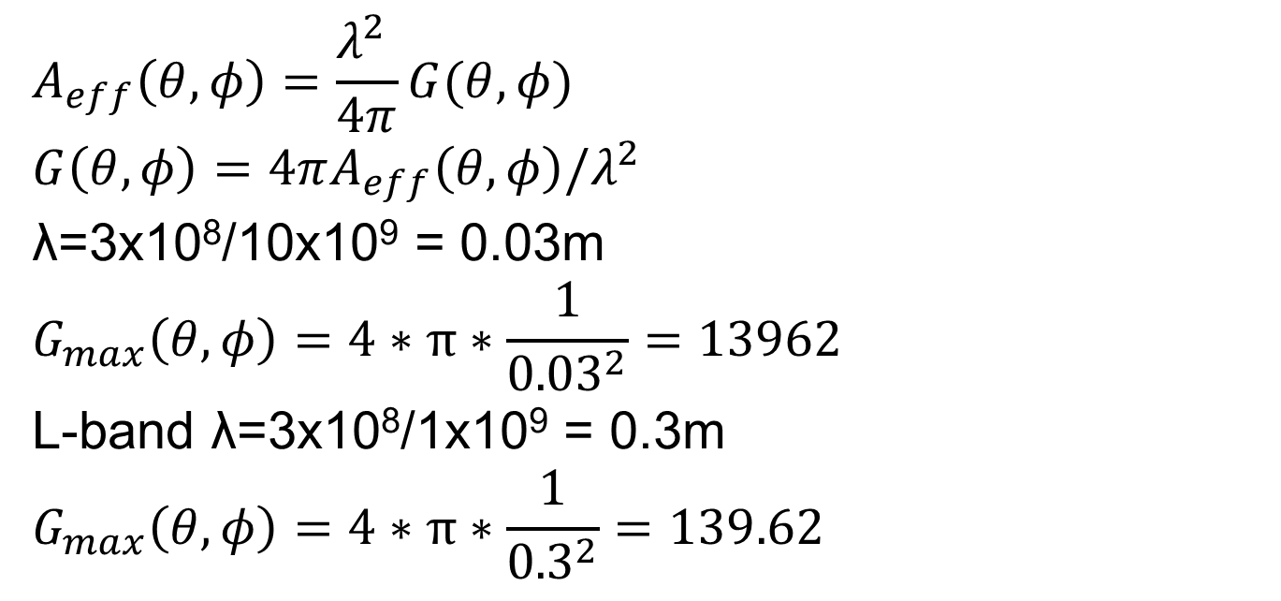
Answer
$$A_{eff}\left(θ,φ\right)=\frac{λ^{2} }{4π}G(θ,φ)$$
$$G\left(θ,φ\right)=4πA_{eff}\left(θ,φ\right)/λ^{2}$$
λ=3x10⁸/10x10⁹ = 0.03m
$$G_{max}\left(θ,φ\right)=4∗π∗\frac{1}{{0.03}^{2}}=13962$$
L-band λ=3x10⁸/1x10⁹ = 0.3m
$$G_{max}\left(θ,φ\right)=4∗π∗\frac{1}{{0.3}^{2}}=139.62$$

Slide 28
Using Radar

Slide 29
What Can We Measure?
Distance (via return signal delay estimation)
Speed (via the Doppler frequency shift in the returned signal)
Direction (because our antennae are generally directional, or by using multiple receivers)

Slide 30
Signature Analysis and Inverse Scattering
Target size (from magnitude of return)
Target shape and components (return as a function of direction)
Moving parts (modulation of the return)
Material composition
More functions, more complex radar
  Cost and size increases

Slide 31
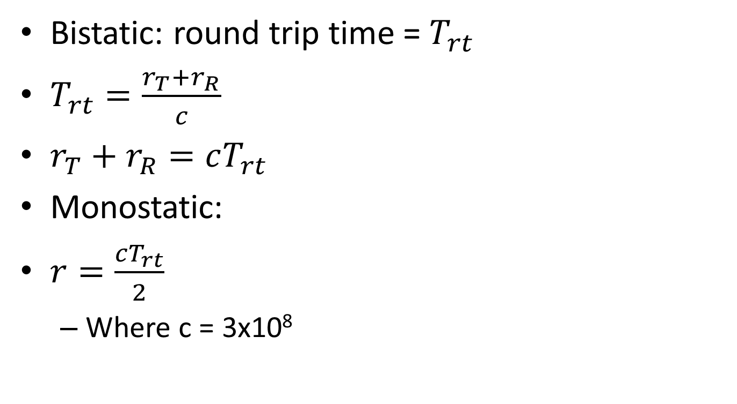
Time Delay Range Estimation
Bistatic: round trip time = $T_{rt}$
$T_{rt}=\frac{r_{T}+r_{R}}{c}$
$r_{T}+r_{R}=cT_{rt}$
Monostatic:
$r=\frac{cT_{rt}}{2}$
  Where c = 3x10⁸
r_{T}
Object (target)
T
r_{R}
R

Slide 32
Only One (Small?) Problem
Multipath reflections or multiple targets?
Scenario
  Multiple pulses transmitted
  Which one generated the return?
Pulse 1
Pulse 2
T_{R2}
T_{R1}

Slide 33
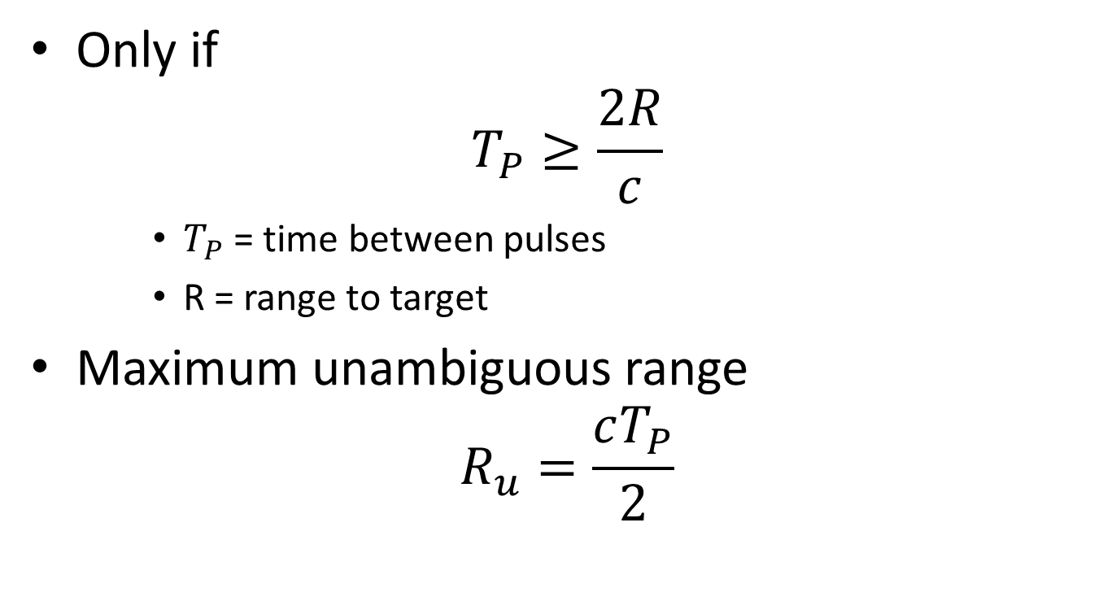
Unambiguous Range?
Only if
$$T_{P}≥\frac{2R}{c}$$
    $T_{P}$ = time between pulses
    R = range to target
Maximum unambiguous range
$$R_{u}=\frac{cT_{P}}{2}$$

Slide 34
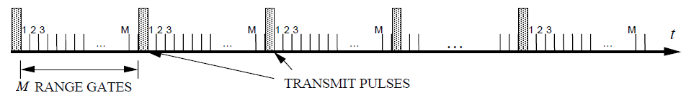
Range Gates
Use our knowledge of pulse propagation to create a set of sub-sets of time (gates)
Each gate is opened and closed
The time each gate is open is a range increment
Gates must include the ranges of interest, or cover interval between pulses
For tracking a target, we acquire it in one particular gate period
We can then follow it
We know which gate period it is going into next so can continue to track
Dwell time = N/f_{p}

Slide 35
Range Gates and Bins
The returned signal “gates” are imaginary, a way to describe dividing time into slots according to range
This is all handled by the signal processing at the receiver
  As DSP&Comms – timing of gate open, delay intervals based on time of transmission

Slide 36
Multipath Returns
Airborne radar
Aircraft
Target
H_{A}
Grazing angle, ψ
H_{T}
Ground

Slide 37
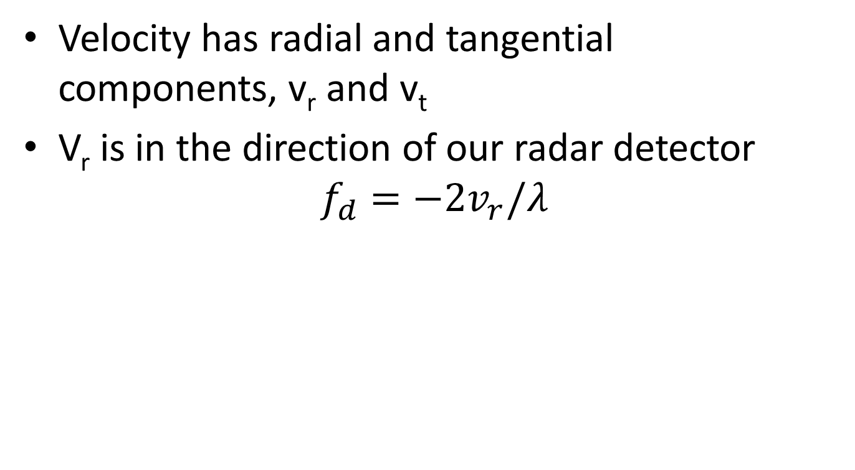
Doppler Frequency Shift
Velocity has radial and tangential components, v_{r} and v_{t}
V_{r} is in the direction of our radar detector
$$f_{d}=−2v_{r}/λ$$
v_{t}
v
Radar Set
v_{r}

Slide 38
Doppler Issues
Our transmitted signal isn’t spectrally “pure”
  Can we tell side bands from Doppler return?
  Only if sufficiently high pulse repetition frequency
  But high f_{P} = small T_{P} , which give us problems with range ambiguity (see earlier)

Slide 39
Radar Cross Section
Radar cross section is the measure of a target's ability to reflect radar signals in the direction of the radar receiver, i.e. It is a measure of the ratio of backscatter power per steradian (unit solid angle) in the direction of the radar (from the target) to the power density that is intercepted by the target.

Slide 40
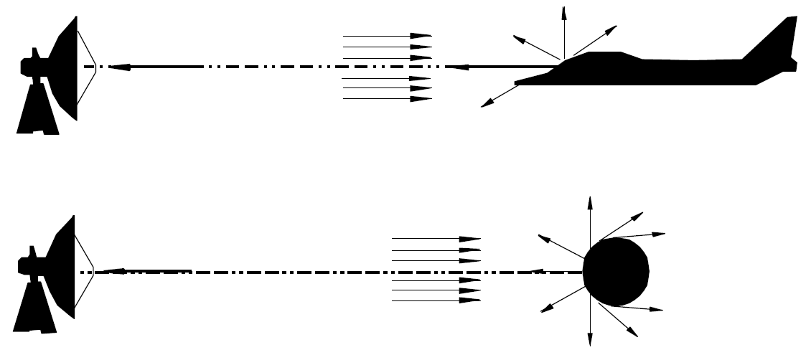
Radar Cross Section
The RCS of a target can be viewed as a comparison of the strength of the reflected signal from a target to the reflected signal from a perfectly smooth sphere of cross sectional area of 1 m²

Slide 41
Radar Cross Section
The conceptual definition of RCS includes the fact that not all of the radiated energy falls on the target.
A target’s RCS (F) is most easily visualized as the product of three factors:
F = Projected cross section x Reflectivity x Directivity .

Slide 42
Radar Cross Section
Reflectivity: The percent of intercepted power reradiated (scattered) by the target.
Directivity: The ratio of the power scattered back in the radar's direction to the power that would have been backscattered had the scattering been uniform in all directions (i.e. isotropically).

Slide 43
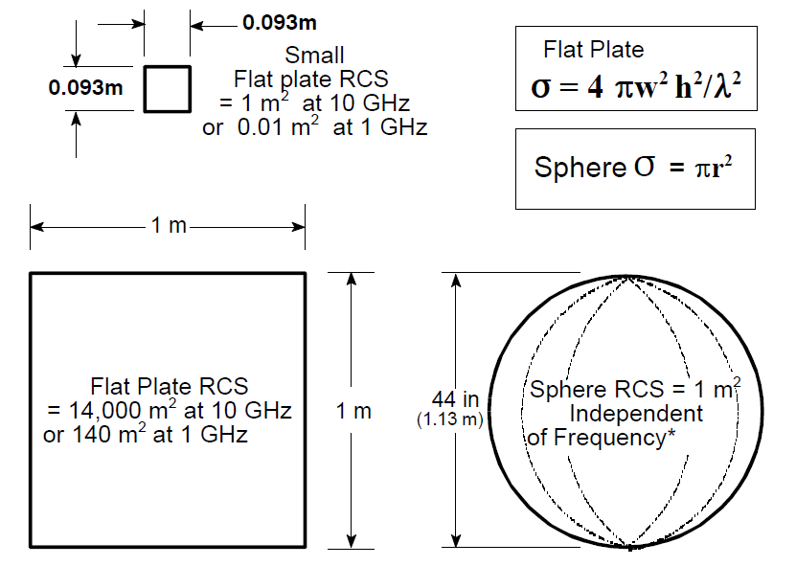
Radar Cross Section

Slide 44
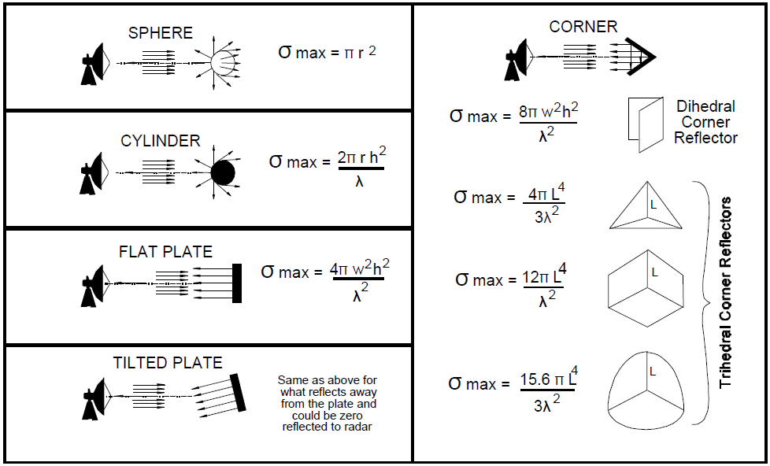
Radar Cross Section
RCS is dependant on shape of reflector

Slide 45
Radar Cross Section
RCS patterns are shown as objects are rotated about their vertical axes (the arrows indicate the direction of the radar reflections).
The sphere is essentially the same in all directions.
The flat plate has almost no RCS except when aligned directly toward the radar.
The corner reflector has an RCS almost as high as the flat plate but over a wider angle, i.e., over ±60E.
The return from a corner reflector is analogous to that of a flat plate always being perpendicular to your collocated transmitter and receiver.

Slide 46
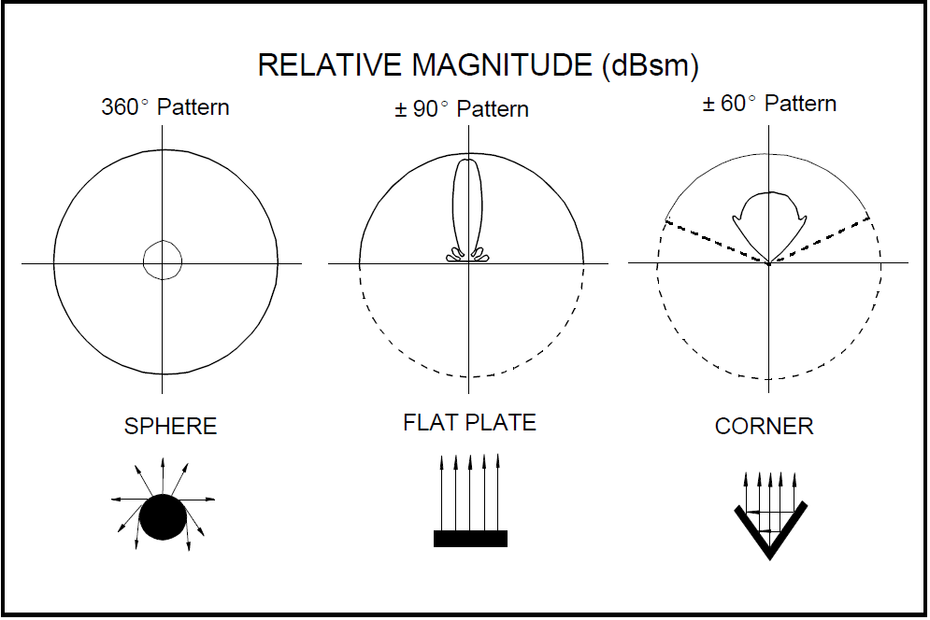
Radar Cross Section

Slide 47
Radar Cross Section
Targets such as ships and aircraft often have many effective corners.
Corners are sometimes used as calibration targets or as decoys, i.e. corner reflectors.
An aircraft target is very complex. It has a great many reflecting elements and shapes.
The RCS of real aircraft must be measured.
It varies significantly depending upon the direction of the illuminating radar

Slide 48
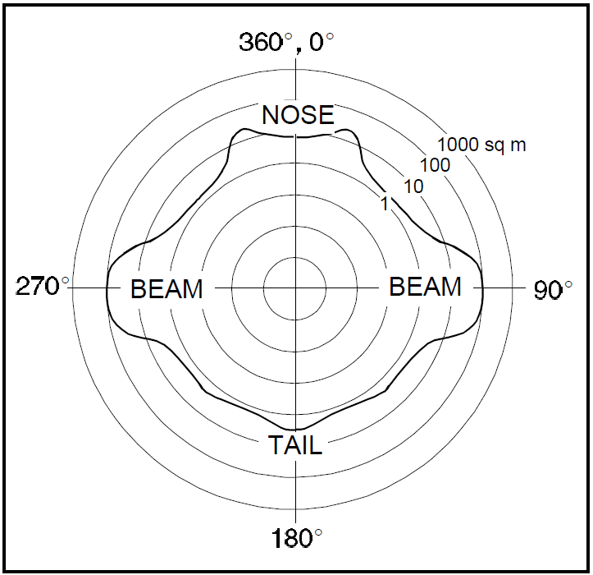
Radar Cross Section
Typical RCS of a jet aircraft

Slide 49
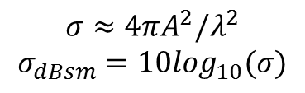
Radar Cross Section
$$σ≈4πA^{2}/λ^{2}$$
$$σ_{dBsm}=10\log_{10}(σ)$$
Courtesy of Prof. David Jenn, Navy Postgraduate School, available from:
http://faculty.nps.edu/jenn/Seminars/RadarFundamentals.pdf,
accessed 11.00, 04/03/16

Slide 50
Huygens Principle
The wavefront of a propagating wave of light at any instant conforms to the envelope of spherical wavelets emanating from every point on the wavefront at the prior instant (with the understanding that the wavelets have the same speed as the overall wave).
http://www.mathpages.com/home/kmath242/kmath242.htm

Slide 51
Huygens Principle
Allows a decent explanation of diffraction and reflection
Lots of debate about the scientific value of Huygens’ work
It gives the right answers to some early problems

Slide 52
Shape of the Plane Wave in the Far Field Case
Far field? Where
Consider a plane wave. All points on the wavefront propagate at the same speed.
Take three imaginary “rays”
As the waves propagate in the x-direction, over time the front curves as shown
r
r
r

Slide 53
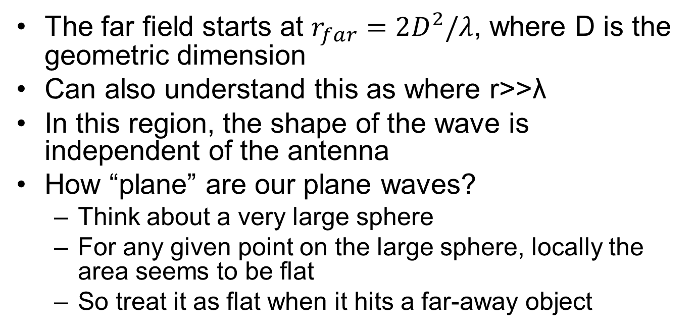
Far Field (Fraunhofer Region)
The far field starts at $r_{far}=2D^{2}/λ$, where D is the geometric dimension
Can also understand this as where r>>λ
In this region, the shape of the wave is independent of the antenna
How “plane” are our plane waves?
  Think about a very large sphere
  For any given point on the large sphere, locally the area seems to be flat
  So treat it as flat when it hits a far-away object

Slide 54
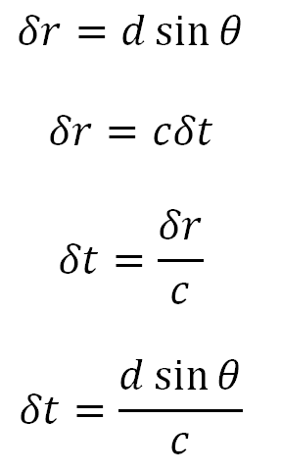
Let’s Look at Phased Arrays
Wavefront
δr
θ
θ
d
d
d
The phase difference between successive elements is how far additionally the wavefront has to travel to hit the next array element = δr
This is the equation for time delay beam steering: array separation is d,
pick your direction, θ, and calculate the time delay between elements δt

Slide 55
Phased Arrays – Phase Steering
A full cycle of wavelength λ = 2π radians of phase
δφ/2π = δr/λ
δφ = 2πδr/λ
= 2πdsinθ/λ
There’s no reason why δφ should not exceed 2π
  If so, simply subtract 2π to get the phase angle

Slide 56
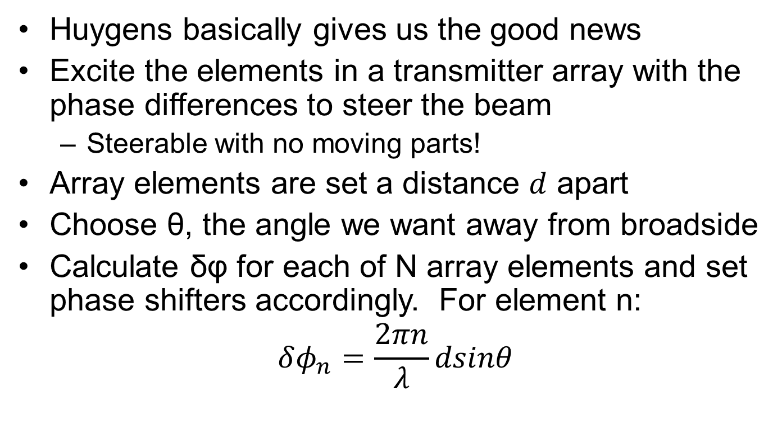
Phased Array Antennae
Huygens basically gives us the good news
Excite the elements in a transmitter array with the phase differences to steer the beam
  Steerable with no moving parts!
Array elements are set a distance $d$ apart
Choose θ, the angle we want away from broadside
Calculate δφ for each of N array elements and set phase shifters accordingly. For element n:
$$δφ_{n}=\frac{2πn}{λ}dsinθ$$

Slide 57
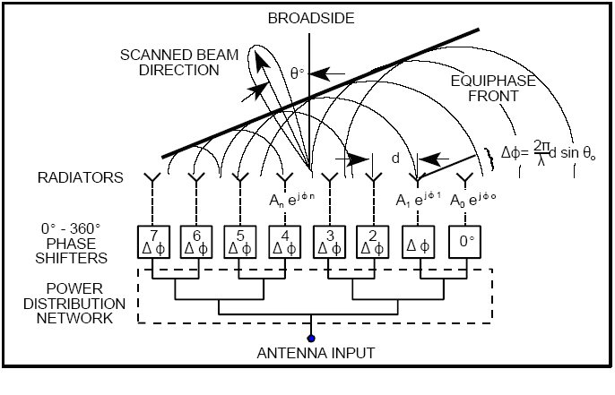
Corporate-fed Phased Array

Slide 58
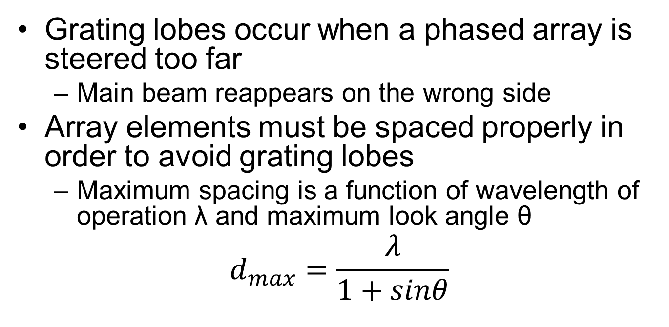
Grating Lobes
Grating lobes occur when a phased array is steered too far
  Main beam reappears on the wrong side
Array elements must be spaced properly in order to avoid grating lobes
  Maximum spacing is a function of wavelength of operation λ and maximum look angle θ
$$d_{max}=\frac{λ}{1+sinθ}$$

Slide 59
Questions
What are the maximum separations of array elements for an x-band (λ = 3cm) radar with a maximum steer angle of (a) 60 degrees; (b) 30 degrees?

Slide 60
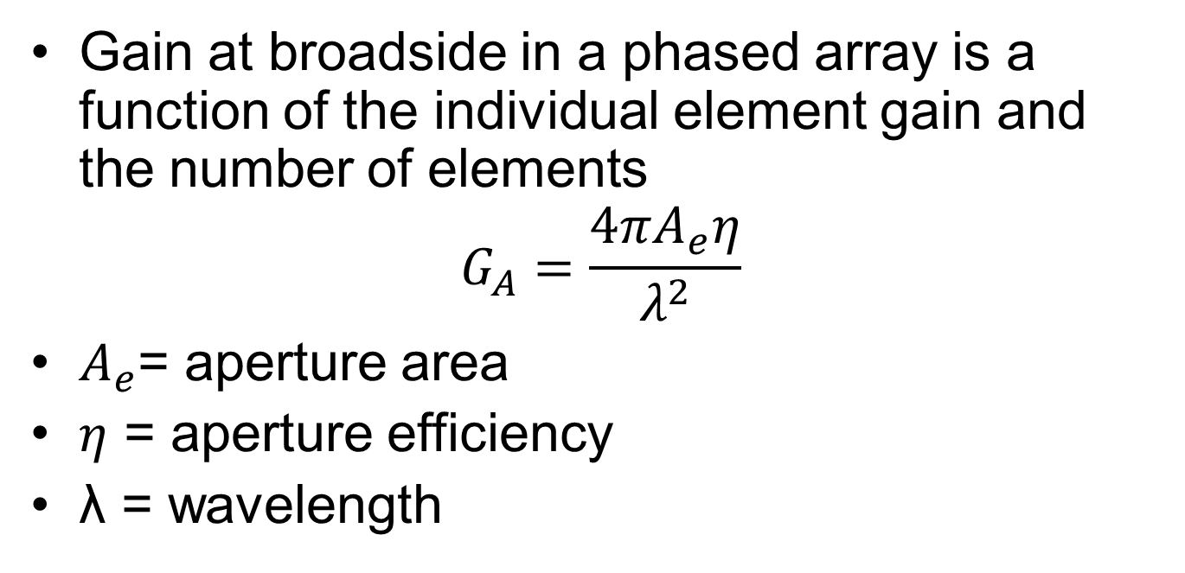
Phased Array Gain
Gain at broadside in a phased array is a function of the individual element gain and the number of elements
$$G_{A}=\frac{4πA_{e}η}{λ^{2}}$$
$A_{e}$= aperture area
$η$ = aperture efficiency
λ = wavelength

Slide 61
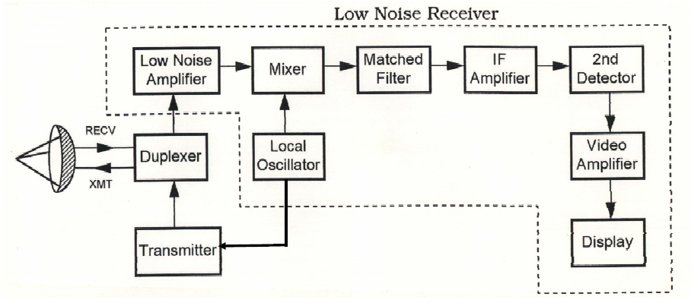
A Radar Block Diagram
Courtesy of Prof. David Jenn, Navy Postgraduate School, available from:
http://faculty.nps.edu/jenn/Seminars/RadarFundamentals.pdf,
accessed 11.00, 04/03/16

Slide 62
Radios

Slide 63
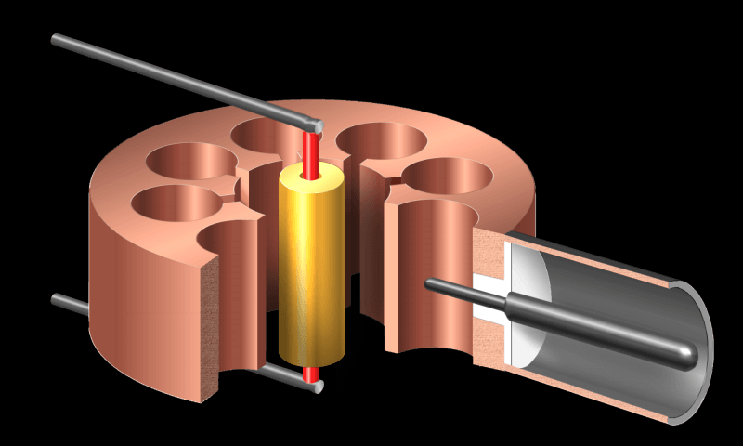
Microwave generation
Magnetron
http://www.radartutorial.eu/08.transmitters/Magnetron.en.html

Slide 64
Automatic Dependent Surveillance

Slide 65
Multilateration

Slide 66
Factors effecting Radar reception
RCS
Ghosting

Slide 67
RADAR Cross Section

Slide 68
Telemetry

Slide 69
Flight Termination Systems

Slide 70
Problem
We need to measure the distance from point A to point B along an the shortest path. How can we do this?
Where is point A?
How can we describe where points A and B are?
We need some kind of frame of reference

Slide 71
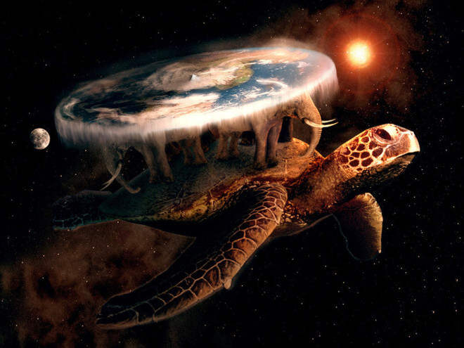
B
Assuming we have a frame of reference, can’t we just use Pythagoras?
Yes we can, so long as…
A

Slide 72
Geodetics and Geocoding systems
Geodetics is the science of measuring and representing the Earth

Slide 73
Coordinate Systems

Slide 74
Global Positioning System

Slide 75
Inertial Navigation Systems

