Slide 1


Community Sports Development
M5X02089
Mark
Napieralla

Slide 2
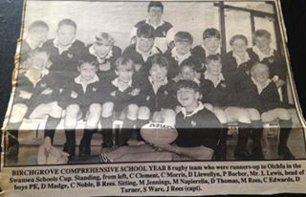
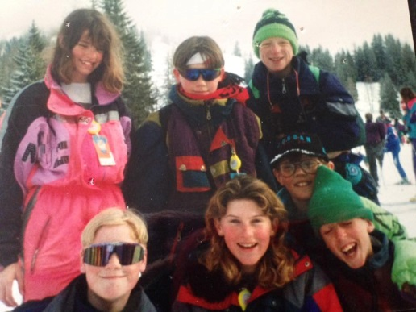
Community Sports Development
Who Am I? How did I get a job in the sports industry:
Brought up in Wales (Clydach) small village outside Swansea
Played Sport from a young age – Dad a huge influence sport / rugby mad
A Levels at Gorseinon College (football reasons)
Attended Plymouth College of St Mark and St John to study Sport and recreation, leisure and tourism
Year 1 ???? Year 2/3

Slide 3
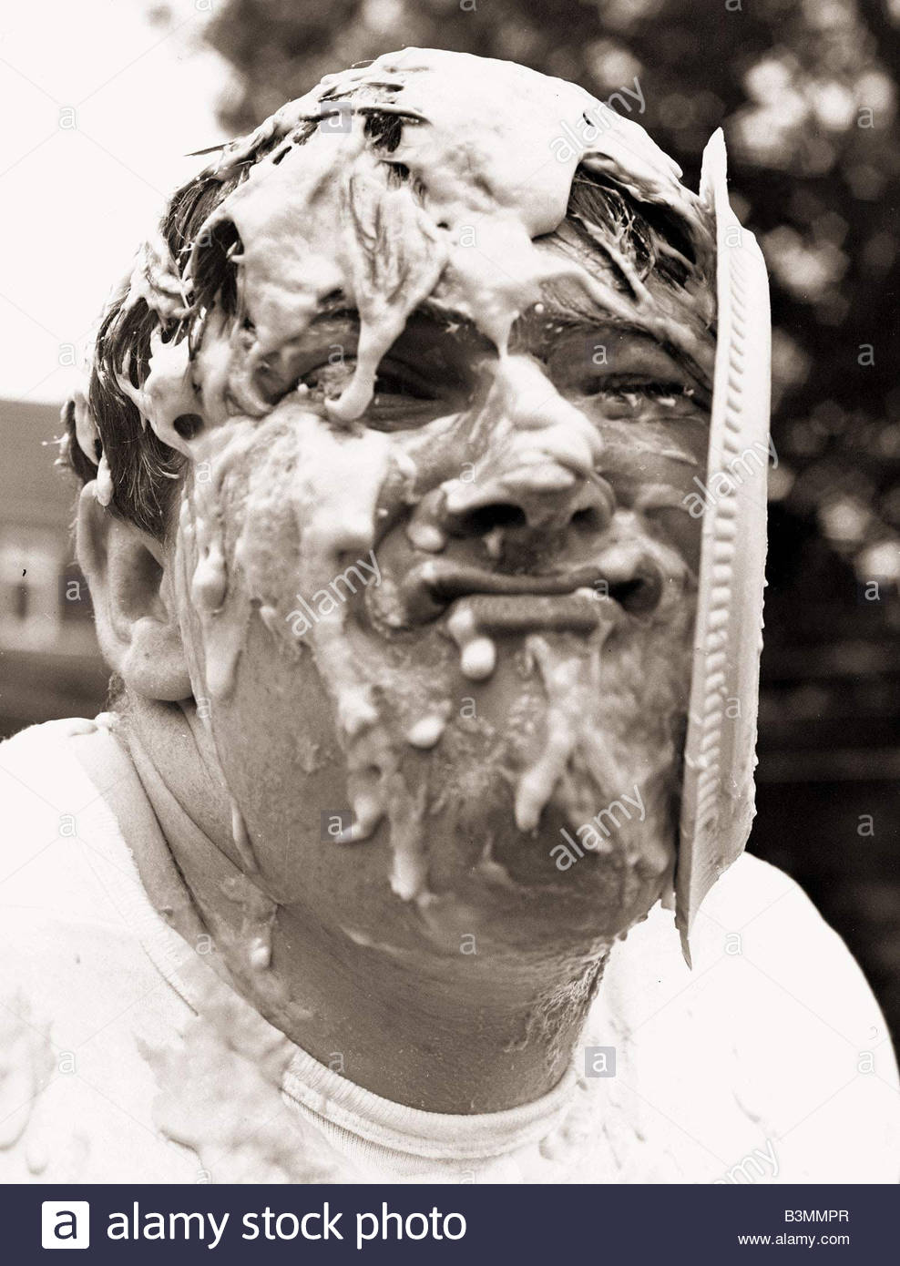
Community Sports Development
Who Am I / My Journey:
Wanted to work in Sports development
when leaving university.

Slide 4
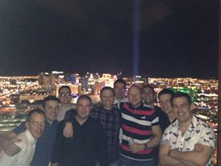

Community Sports Development

Slide 5


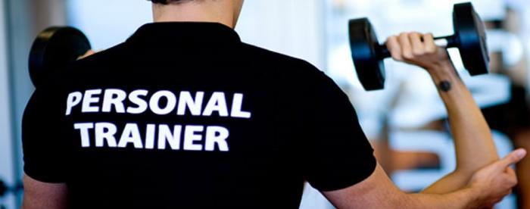
Community Sports Development

Slide 6
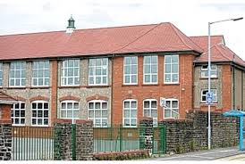
Community Sports Development

Slide 7


Community Sports Development

Slide 8
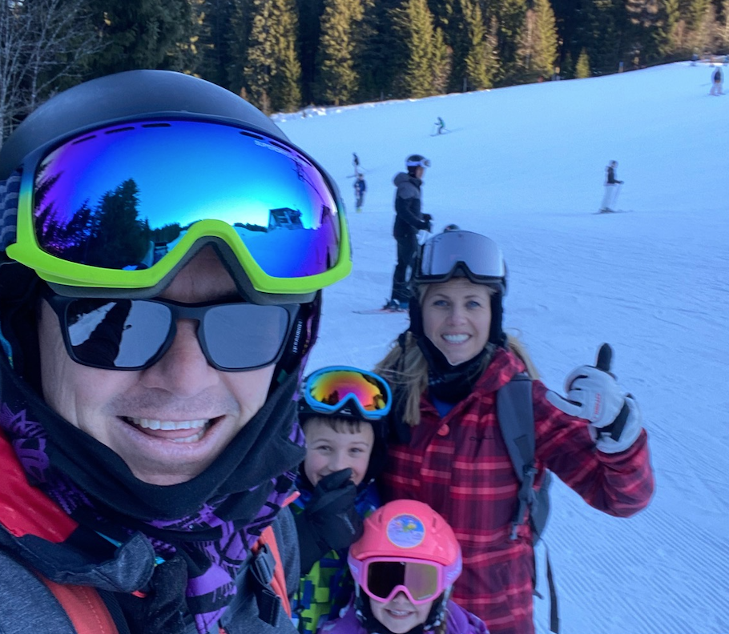
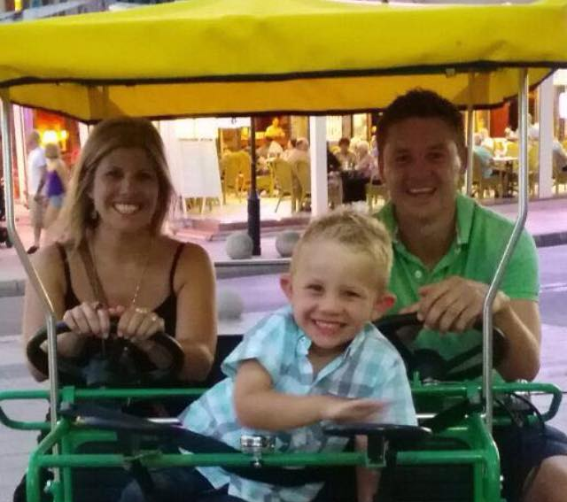

Outside Of Work

Slide 9
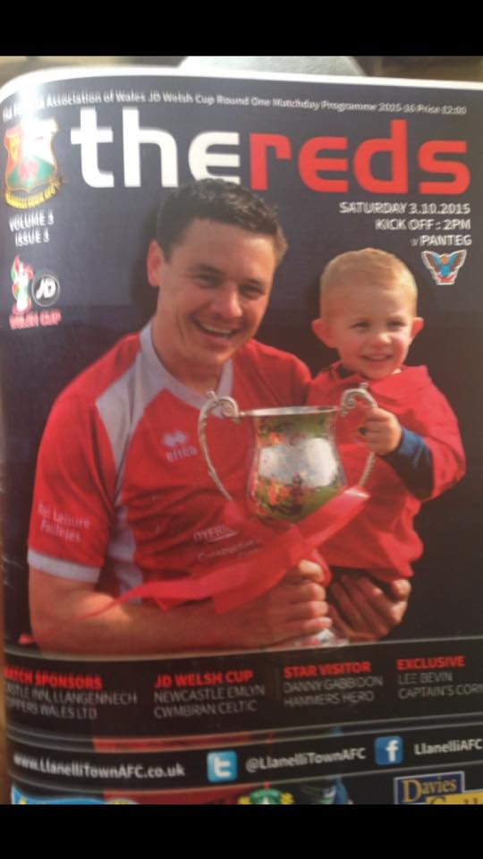
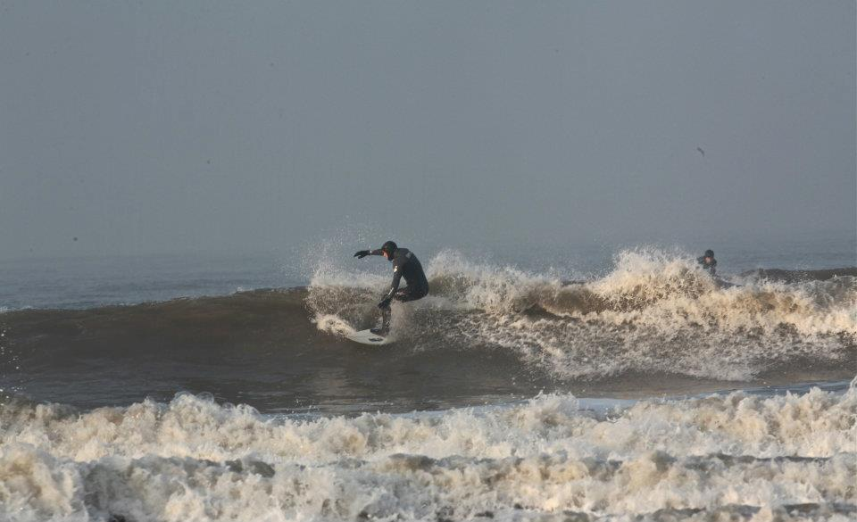
Outside Of Work

Slide 10
Community Sports Development
How well do you know each other?
Circle task- (speed discussions) / 3 rotation outside
Name
Your worst quality
Your best quality
Where you see yourself working in sport in the future
Where you work now
Your main interests
How you got to this point on your course (academically)
Feedback to group- present your friend

Slide 11
Community Sports Development
My expectations / standards:
Attendance- If you cant attend email me before the lecture starts
Professionalism / language
Mobile Phones- in bags not on the desk or in pockets
Hand in work on time
Value everyone's views, challenge, agree and disagree
My way of delivering:
Practical tasks
Use of technology
Real life experiences
Energisers / brain mash
Breaks-
Research / further reading

Slide 12
Community Sports Development
What you need to bring?
Pen
Notepad
Smart Phone- QR Code Reader
Drink / non fizzy
Energy
Concentration
Ideas / creativity / an open mind!
Timings
12- This room
1- Break
1:30- IT room/this room
Times may vary / we may be offsite at times

Slide 13

Community Sports Development
What do I expect from this module- Think, Pair, share
Post it note feedback

Slide 14
Monkey cucumber / grapes
Notes:
https://www.youtube.com/watch?v=gOtlN4pNArk

Slide 15
Community Sports Development
Aims of this module:
Develop an understanding of issues relevant to sports development, planning, managing sport infrastructures and key initiatives and programmes.
Evaluate arguments, assumptions and current strategies that are focused on creating pathways of opportunities for all individuals to achieve their potential through and in sport.

Slide 16
Community Sports Development
What will we be doing?
Presentations
Discussions / tasks / practical tasks in the classroom
Student research and presentation
Offsite visits to see sports development in practice
A real life practical task- your project could be brought to life
Use of technology where possible- You will need a QR code reader

Slide 17


Community Sports Development
Two
Parts
1- 4/3 +11/3
2- 13/5
How to get
Your grade?
Hand your work in on time!

Slide 18
Community Sports Development
Flip Chart Rotation Task- 3 groups
Think about Community Sports Development
1- Where does / should it happen
2- What does it look like
3- What are the day to day tasks of a sports development officer

Slide 19
Community Sports Development
BREAK

Slide 20
Community Sports Development
My department
My team
The projects / what we deliver
My budget- Just under £500000 per year for all projects
2/3 from Sport Wales
1/3 working in partnership and taking leads on projects

Slide 21
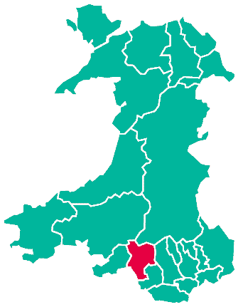

Neath Port Talbot

Slide 22
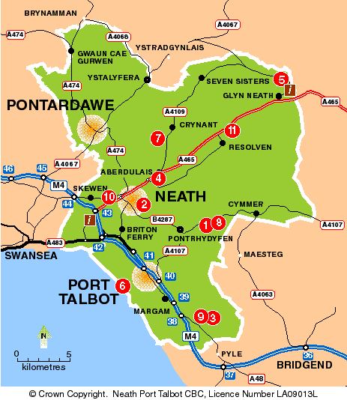
Neath Port Talbot

Slide 23
Staff Structure
Projects
Officers
Admin – Jess Davies / Alison Edwards
AYP CO-ORDINATORS
Mark Napieralla
Michelle Hall
MTB- Tom
Health- Rebecca P
Neath Valley AYP / Community 16 HOURS
Claire
Afan Valley
21 HOURS
Kyle Harkett
Bae Baglan Area- 21 HOURS
Claire
Neath Central- 15 hours Martin Kelly
Neath Cimla AYP- 21 HOURS
Stephanie
PT Central / West 37 HOURS
Sharon
Swansea Valley AYP- 37 HOURS
Carwyn
Inclusive Clubs
Development
Michelle Lewis
Volunteers
SG Offer
Students
Coaches
Coaches

Slide 24








Community
Sport
Pathway

Slide 25
LAPA-Community Clubs
Some of our focus for this year :
Netball – Swansea Bay Netball League
Badminton
Inclusive Sports Clubs
Early years / creche
Health intervention
Ambassadors, Improving delivery sport PA / training
MTB- 2 x community clubs, EMTB
Camps / holiday activities
Targeting areas that need it most
Sport Survey 2022
Afan Valley Active / Biking
Margam MTB Trail project / events / commonwealth games

Slide 26
Community Clubs
Student Research Task:
What new community sports sessions could be developed in the Swansea Bay region and why?
Research- growing trends, what is successful elsewhere (USA). What facilities could be used, is there evidence of a need? Why would you set up that session in that area?
Design a small PowerPoint presentation of 5 slides maximum

Slide 27



Task- Research the 3 pages below to find out information about the services of physical activity and sport Neath Port Talbot
@nptpass
Search NPT PASS
Search NPT PASS

Slide 28
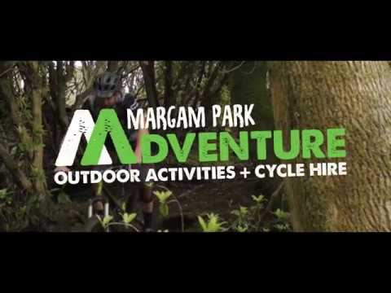
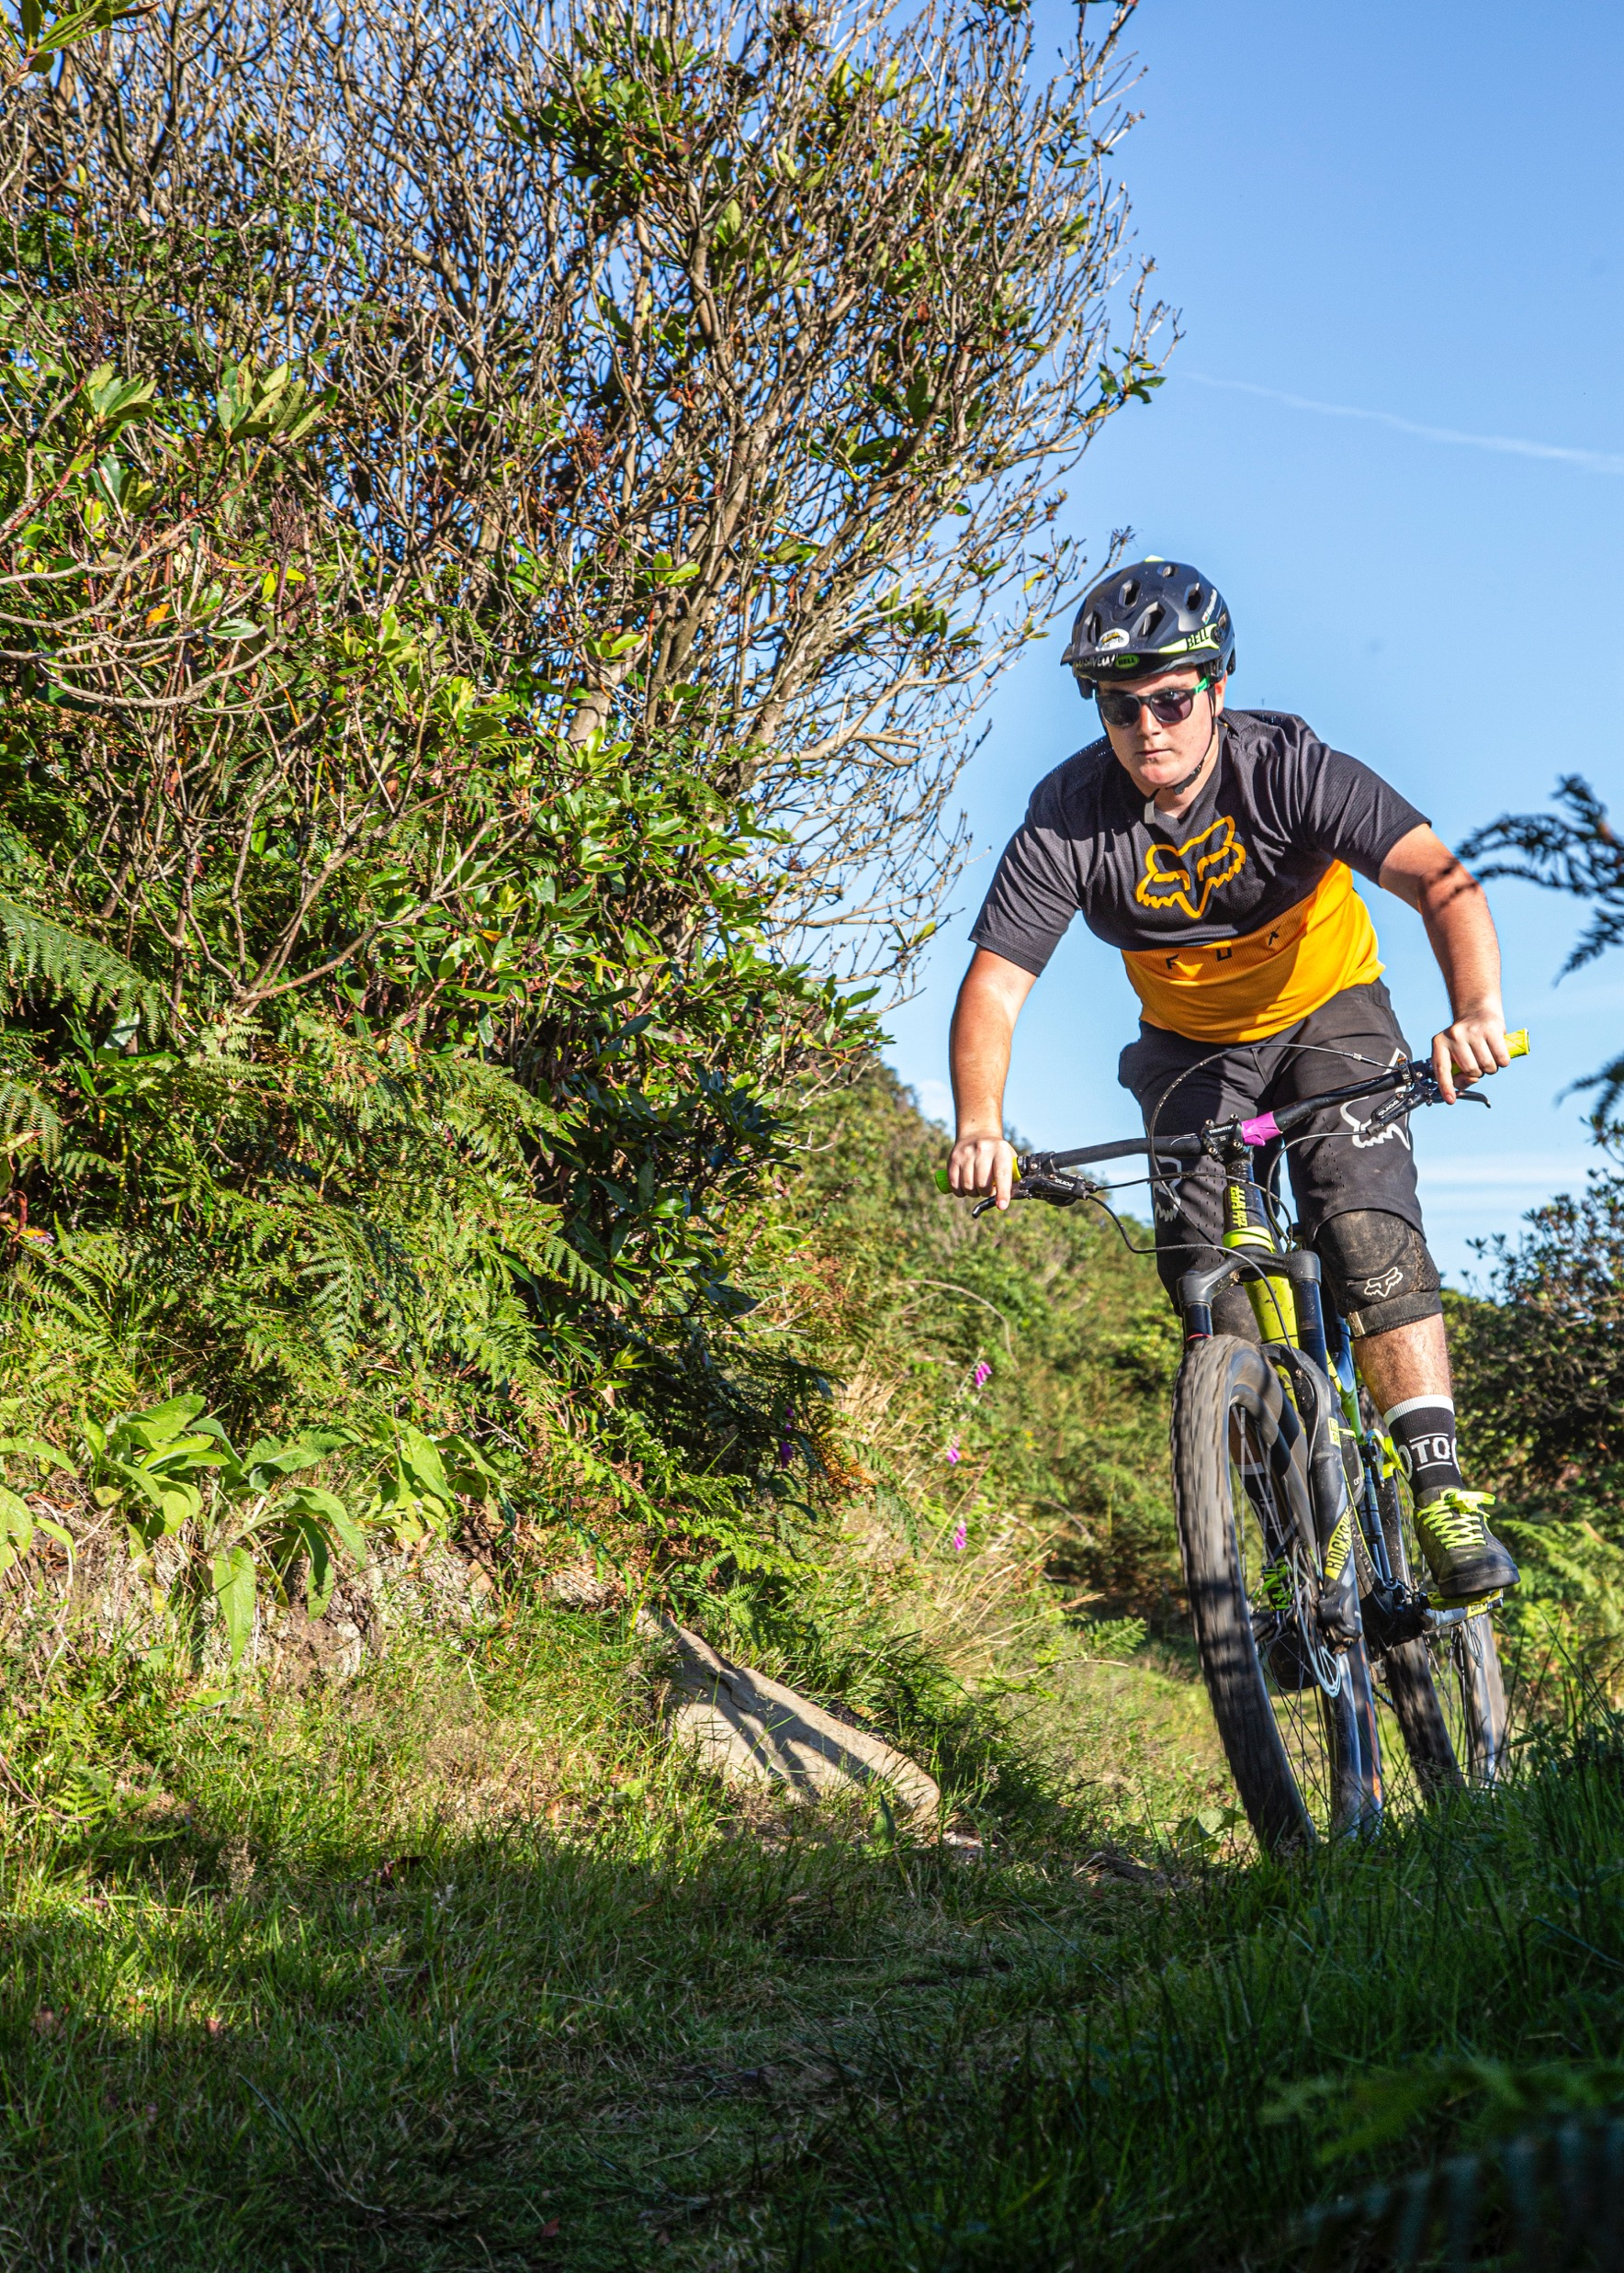
https://www.youtube.com/watch?v=xDb1JgCbibo
Trips- TBC

