Slide 1

EcoSip: Sustainable Café Startup
Module: Enterprise and Entrepreneurship (LCLM4006)
Student Name: Hammad Talib
Lecturer: Trinh Nguyen Thi Ngoc

Slide 2

Introduction
EcoSip is a London-based café combining premium coffee culture with environmental responsibility.
Operates under a zero single-use plastic policy, using bamboo cups and wheat straw plates
Aims to redefine the café experience by aligning with UK sustainability goals and eco-conscious lifestyles.
The concept merges quality, sustainability, and community engagement.

Slide 3
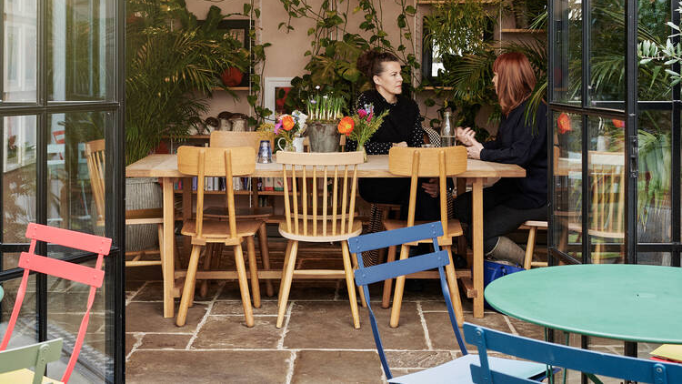
Business Overview
Products/Services: Coffee, teas, smoothies, and snacks, all served in biodegradable crockery (Nguyen, 2018).
Additional Revenue: Sale of branded eco-friendly tableware (cups, straws, plates) (George, 2023).
Legal Format: Private Limited Company, ensures limited liability and investor credibility.
Management Structure:
Founder/CEO – Strategy, Finance
Marketing Manager – Branding, Promotions
Operations Manager – Supply Chain, Compliance
Support Staff – Baristas & Customer Service

Slide 4
Unique Selling Proposition (USP)
Sustainability is not a feature, it’s EcoSip’s core identity.
Uses 100% biodegradable materials and offers rewards for reusable cups (Poortinga and Whitaker, 2018).
Goes beyond coffee, builds a green lifestyle brand.
Competitors like Starbucks or Costa have limited eco-initiatives; EcoSip leads from the start.

Slide 5
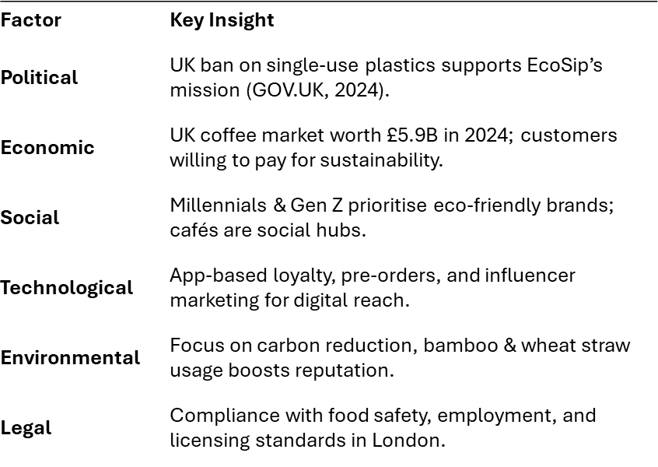
Pestel Analysis

Slide 6

Market & Competitor Snapshot
Target Market:
  Age: 20–35 years
  Students & professionals in London
  Value sustainability & convenience
Main Competitors:
  Starbucks, Costa, Pret A Manger, small eco cafés
  EcoSip’s Edge:Combines café culture with retail sustainability.
  Offers a lifestyle, not just coffee.
  Early adopter advantage in eco-space.

Slide 7
Marketing Strategy (STP + 4Ps)
Segmentation: Demographics (urban youth), psychographics (eco-conscious consumers).
Targeting: 20–35-year-old Londoners who pay more for sustainable brands.
Positioning: “Where Coffee Meets Sustainability.”
Marketing Mix (4Ps):Product: Coffee, snacks, and eco-tableware.
  Price: 10% premium over Costa & Pret.
  Place: Central London + online delivery (Uber Eats, Deliveroo).
  Promotion:
    Instagram & TikTok campaigns (Hou and Li,2025)
    Influencer collaborations
    Launch event with free reusable cups
    Loyalty rewards through app

Slide 8
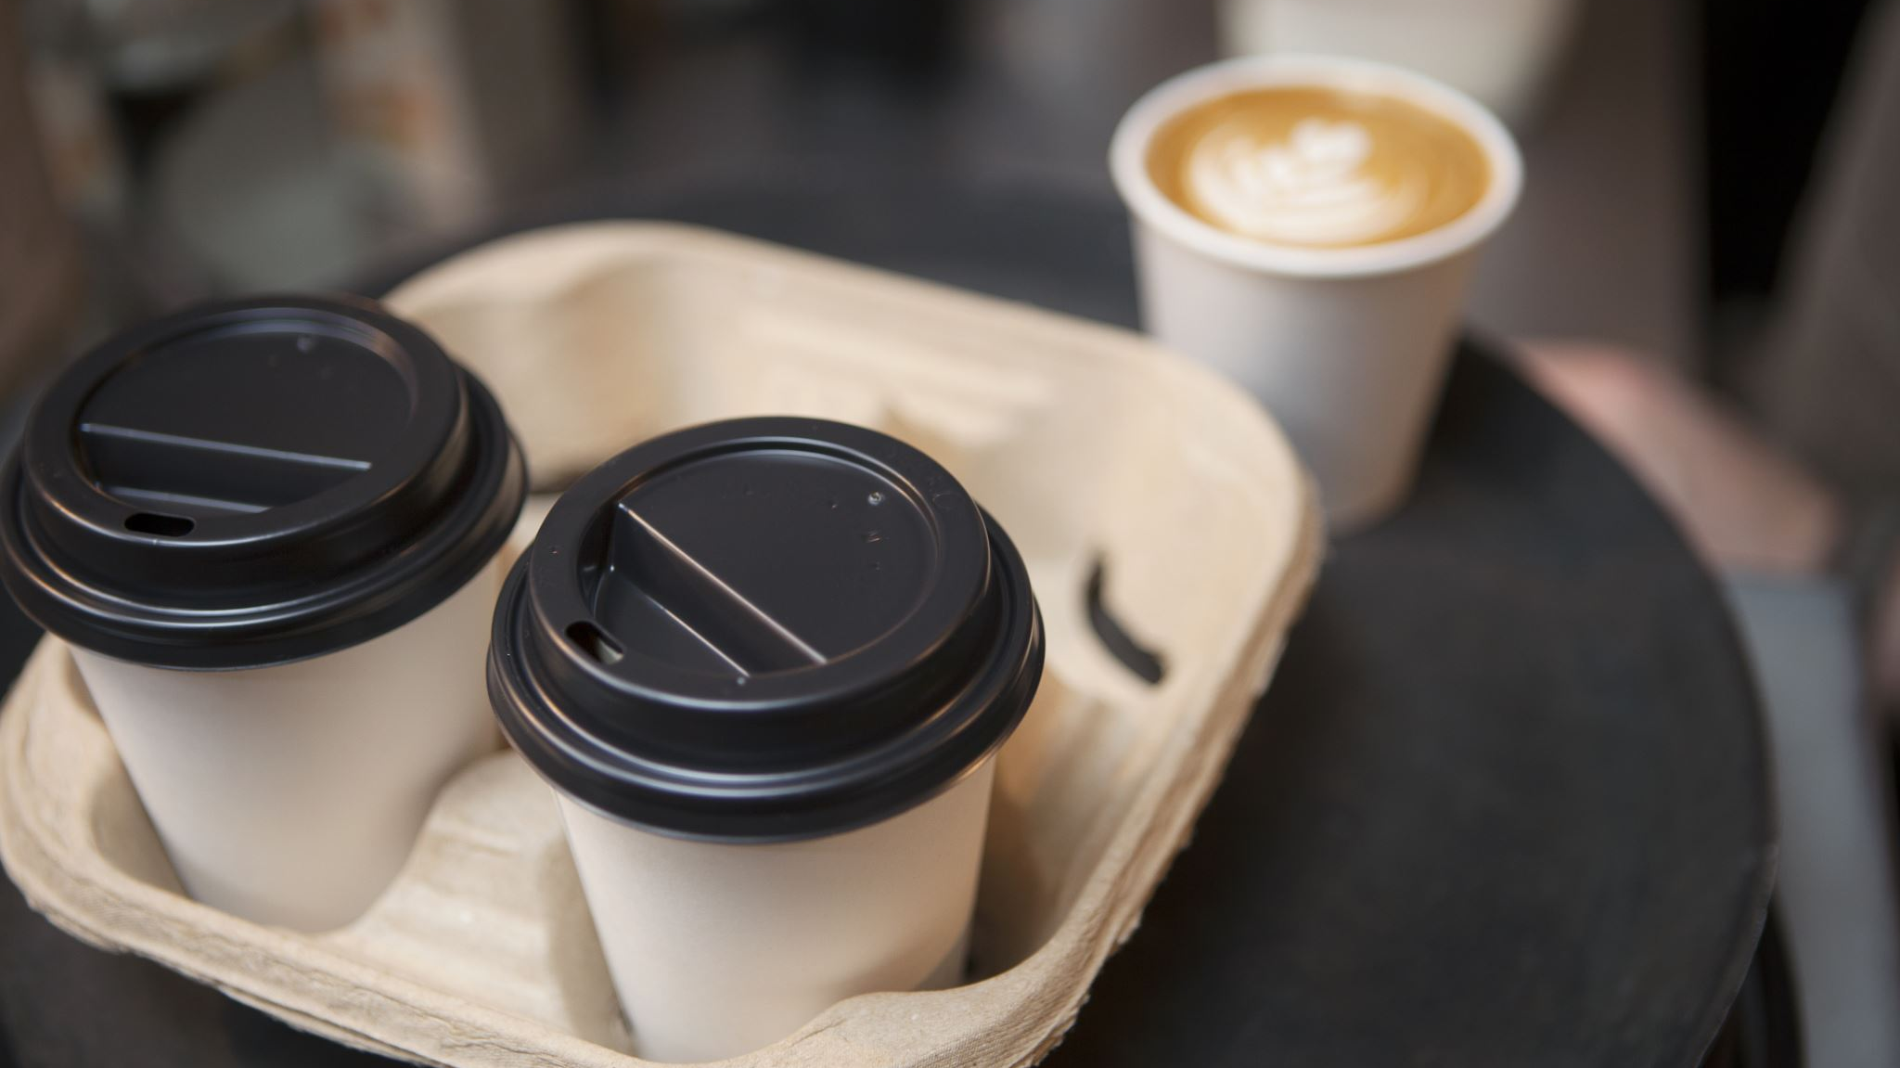
KPIs (Month 1 Goals)
500 customers served
200 reusable cups sold
1,500 Instagram followers
Customer satisfaction above 85%
Achieve brand awareness and break-even by Month 3

Slide 9
Funding & Financial Plan
Category | Cost (£)
Café Fit-Out | 12,000
Equipment | 8,000
Marketing | 5,000
Licences & Permits | 2,000
Working Capital | 7,000
Wages & Operations | 6,000
Total | 40,000
Total Startup Funding Needed: £40,000
  £15,000 Founder investment
  £25,000 UK Start-Up Loan
Fund Allocation
Expected Net Cash Flow (Month 1): £3,700

Slide 10
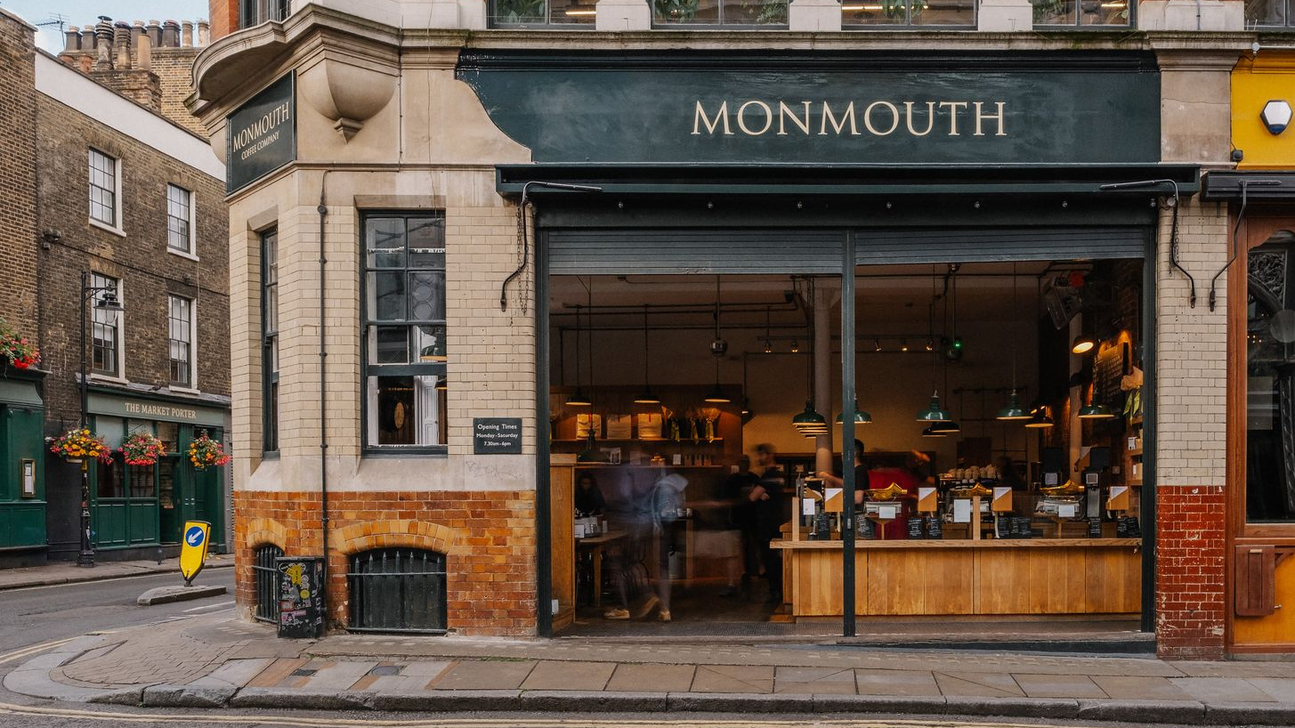
Risks, and Mitigation
Risks
Low initial footfall
Supplier cost fluctuations
Competitive imitation
Regulatory updates
Mitigation
Partner with Deliveroo & Uber Eats
Multi-supplier contracts
Loyalty programs for retention
Stay compliant via regular updates

Slide 11
Conclusion
EcoSip integrates sustainability and profitability, turning coffee drinking into an eco-conscious lifestyle choice. With clear strategy, strong brand identity, and scalable model, EcoSip is ready to become London’s leading eco-café.

Slide 12
References
Poortinga, W. and Whitaker, L., 2018. Promoting the use of reusable coffee cups through environmental messaging, the provision of alternatives and financial incentives. Sustainability, 10(3), p.873.
Nguyen, T., 2018. Establishing a Customer Approach and a Product Promotion Plan for a Start-up Busi-ness in Fruit and Tea Based Beverages.
George, A.S. and George, A.H., 2023. Biodegradable ecofriendly sustainable tableware and packaging: A comprehensive review of materials, manufacturing, and applications. Partners Universal International Research Journal, 2(2), pp.202-228.
Hou, J.Z. and Li, X., 2025. Promoting Social Marketing on Social Media: Using TikTok as an Engaging Platform to Reduce Food Waste. In Contemporary Issues in Social Media Marketing (pp. 72-85). Routledge.

