Slide 1

Analyzing Business Failure and Innovation: A Case Study of Blockbuster
Developing Innovation and Creativity for Business Advantage
(BMSW6102_BIRM)
Lecturer Name: Students Name and ID:
Abdi Rahman Natalia Rupet (2109475)
University of Wales Trinity Saint David Birmingham

Slide 2

Introduction
Why Blockbuster?
Who it is Blockbuster?
How its innovation has influenced the organisation positive and negative.
SCAMPER framework .
It’s biggest competitor.
Recommendations.
Procedure followed to complete the assignment.
Challenges faced and overcoming them.
Practical learning outcomes.
Future benefits.

Slide 3


WHY ?
Blockbuster is an excellent example of a business that failed to adapt to market innovation, ultimately becoming outdated.
This Photo by Unknown Author is licensed under CC BY

Slide 4
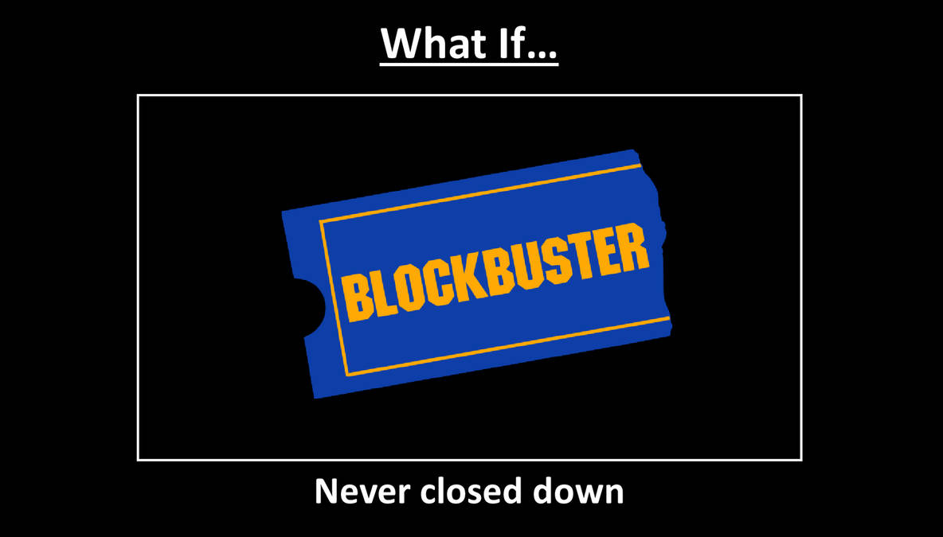
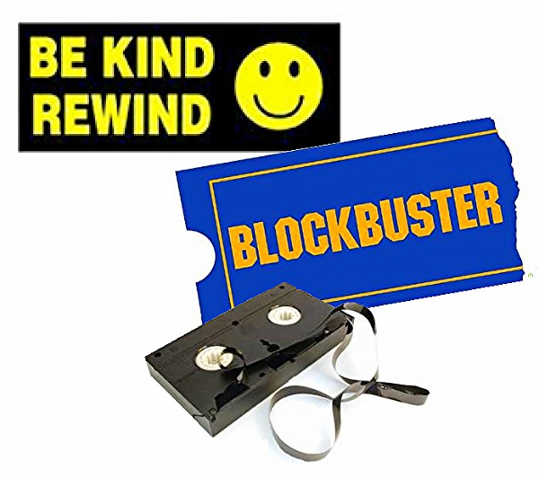

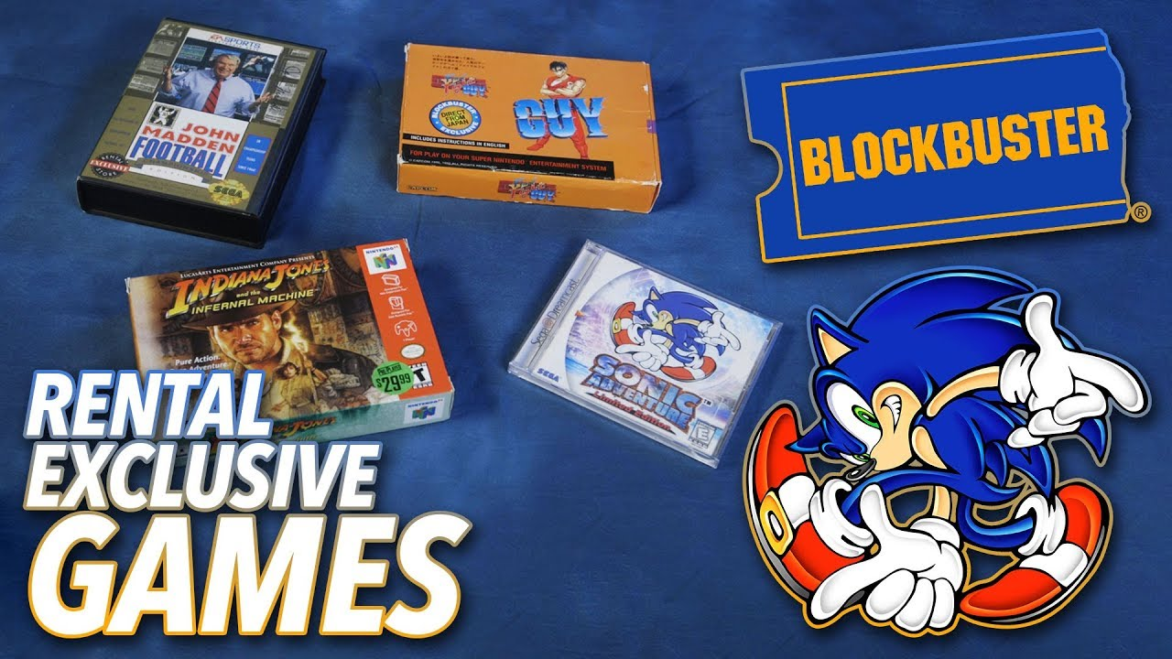
Video Home System videocassette
(VHS)
Digital Video Disc (DVD)
Video Game
PPT online pictures
PPT online pictures
PPT online pictures
This Photo by Unknown Author is licensed under CC BY
Notes:
https://www.geekwire.com/2018/blockbusters-last-stand-inside-one-iconic-video-rental-chains-final-u-s-stores/
https://www.ebay.com/itm/203186123184

Slide 5
How its innovation has influenced the organisation positive and negative
+ Blockbuster's decision to switch to the DVD format in the late '90s was a foresighted financial move. Blockbuster was able to provide its consumers with higher-quality, longer-lasting movie rentals once it made the switch from VHS tapes to DVDs.
By making this adjustment quickly, Blockbuster was able to maintain its competitive position and win back unhappy customers (Franco et al. 2023).
Blockbuster's membership programs, such as the Blockbuster Rewards Programme, were innovative ways to increase consumer retention.
- Lack of a solid retail strategy and poor management of the transition away from a high number of physical locations contributed to Blockbuster's financial troubles. Blockbuster’s meteoric rise is widely credited with sparking a retail renaissance, yet the company was slow to adopt online rental services. (Levine, 2022).

Slide 6
The Consumer
Adapt to trends
All Ages
Adoption to technology
Looking for entertainment
Current
Value Experience
Blockbuster did not adapt to the customers changing needs and eventually went bankrupt!

Slide 7
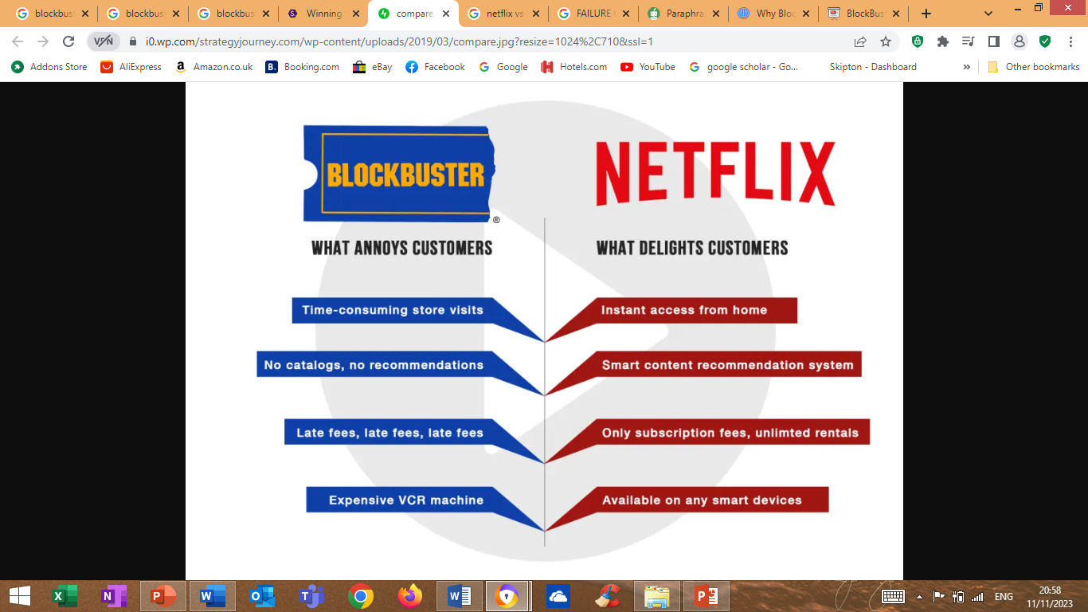
Stratability Academy(2019)

Slide 8
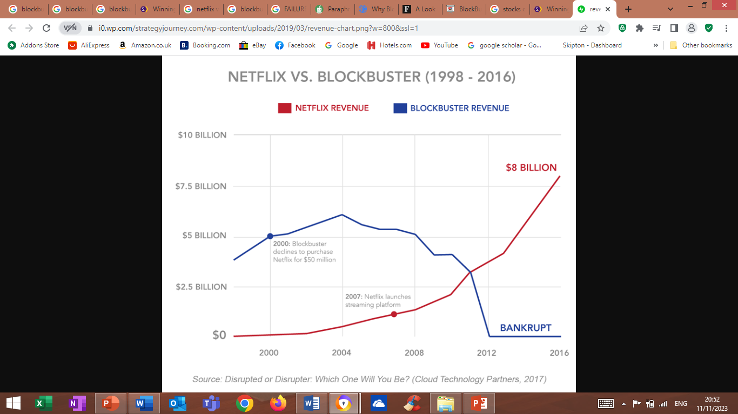
It’s biggest competitor
“Netflix might not have been if Blockbuster had launched their own streaming service two years sooner.” (Reed Hastings)
Notes:
Netflix won for the simple reason that they offered a better service. No late fees. No trudging out to the local store with it's limited selection to return movies. No limited time period for watching the movie you just rented.
http://d-edreckoning.blogspot.com/2010/10/tale-of-blockbuster-important-lesson.html
https://strategyjourney.com/winning-the-customer-journey-battle-netflix-vs-blockbuster-case-study/

Slide 9
SCAMPER framework
S Substitute | C Combine | A Adapt | M Modify | P Put to Another Use | E Eliminate | R Reverse
switched from renting movies in stores to renting them online | regular renters and internet fans by using its huge store network to create a unique, mixed approach | to adapt to the changing rental industry | had shifted its focus on material production and distribution, the company might have survived the digital era | Instead of only renting DVDs and video games from their locations, Blockbuster could have tried new approaches | for increased productivity may have been realised by the elimination of this division, | may have potentially reversed its financial situation via the establishment of strategic alliances with internet streaming platforms
Using the SCAMPER framework, we can estimate how many opportunities Blockbuster passed up that could have altered its future.
Notes:
Using the SCAMPER framework, we can estimate how many opportunities Blockbuster passed up that could have altered its future.

Slide 10

Holding events, and being active in the community.
Open online as well as in stores.
Recommendations
Keep up with the subscription plan.
Keep prices low and movie stocks high.
Customer oriented.

Slide 11

CONCLUSION
The unexpected demise of Blockbuster is a reminder of how crucial it is to be inventive and flexible in today's fast-paced economy.
It's possible that a strategy combining online and offline elements would be optimal.
Cooperation and licensing could help businesses increase sales and access to new resources.
Notes:
The unexpected demise of Blockbuster as a once-dominant force in the video rental market is a dismal reminder of how crucial it is to be inventive and flexible in today's fast-paced economy. Using the SCAMPER framework, we can estimate how many opportunities Blockbuster passed up that could have altered its future.In today's fast-paced world, businesses that wish to succeed must be vigilant, adaptable, and innovative. The failure of Blockbuster to do so ultimately led to the company's demise. They lagged behind the rest of the digital revolution because their leaders undervalued the significance of moving to digital broadcasting platforms online. Because of its resistance to digital innovation and inflexibility in responding to shifting consumer preferences, the company's potential for success was severely constrained.There were some missteps that Blockbuster committed that could serve as examples for startups to avoid. They must be proficient in digital tools and responsive to shifting consumer preferences. It's possible that a strategy combining online and offline elements would be optimal. Cooperation, cooperation, and licensing could help businesses increase sales and access to new resources.

Slide 12
Procedure followed to complete the assignment
Gather ideas and decide what to write about
Research information and take notes
Write a draft
Understand the assignment
Submit
Proof read/ Edit final draft
Revision
Receive feedback

Slide 13
Challenges faced and overcoming them
1. I had a hard time making sure the sources I used for my study were up to date.
Through the use of modern tools and academic writing, I was able to overcome this challenge.
2. Because I work a 12-hour shift, it was challenging to devote enough time to writing the paper.
By requesting an earlier end time at work, I was able to have more precious time to research and write on my homework.
3. It was difficult to stay up late reading and conducting research, but I was able to finish my project on time by forcing myself to finish it sooner so that I could turn it in on time for credit.

Slide 14
Practical learning outcomes
This assignment improved my research skills, namely in finding relevant data and citing scholarly sources. These are the kinds of abilities that will help me in my future academic and professional endeavours.
I was able to show my analytical and critical thinking skills in this project by evaluating a business case, evaluating the effect of an invention, and suggesting possible fixes for the issue.
Making wise choices in challenging real-world business scenarios requires these abilities. My writing and presenting skills have improved as a consequence of this training, and I can now communicate clearly in a variety of work-related contexts through reports, presentations, and discussions.

Slide 15
Future benefits
A vital part of our work was discussing conclusions and suggestions. My writing and presenting abilities have improved, and I can now effectively express my expertise in a variety of professional settings, such as speeches, presentations, and reports.
The programme placed a strong emphasis on the value of creativity and flexibility in the face of an evolving corporate landscape. This teaches upcoming business executives the value of flexibility and creativity.
One of my education's main advantages is that I have an interdisciplinary viewpoint. In the end, I will gain a great deal from the knowledge and skills I have gained from this assignment, which will help me in both my academic and professional goals.
This emphasises how crucial knowledge, adaptability, and innovation are in the modern, quickly evolving business environment.

Slide 16
REFERENCES
Franco, M., Minatogawa, V. and Quadros, R., 2023. How Transformative Business Model Renewal Leads to Sustained Exploratory Business Model Innovation in Incumbents: Insights from a System Dynamics Analysis of Case Studies. Systems, 11(2), p.60
Levine, D.S., 2022. From breakthrough to blockbuster: a conversation with Donald Drakeman. Journal of Commercial Biotechnology, 27(2), pp.1-4.
Stratability Academy(2019) Available at: https://www.google.com/imgres?imgurl=https%3A%2F%2Fi0.wp.com%2Fstrategyjourney.com%2Fwp-content%2Fuploads%2F2019%2F03%2Fcompare.jpg%3Fresize%3D1024%252C710%26ssl%3D1&tbnid=xP9XXGMrnZFsGM&vet=12ahUKEwiV1-7muryCAxWqYKQEHfPpDXYQMygqegUIARCgAQ..i&imgrefurl=https%3A%2F%2Fstrategyjourney.com%2Fwinning-the-customer-journey-battle-netflix-vs-blockbuster-case-study%2F&docid=2Ym-FG5VPw43xM&w=1024&h=710&q=blockbuster%20product%20and%20service%20diagram&hl=en&client=avast-a-1&ved=2ahUKEwiV1-7muryCAxWqYKQEHfPpDXYQMygqegUIARCgAQ (Accessed: 11 November 2023)
Tayler, 2017 Available at: http://d-edreckoning.blogspot.com/2010/10/tale-of-blockbuster-important-lesson.html (Accessed 11 November , 2023)
Taylor , 2017 Available at: https://strategyjourney.com/winning-the-customer-journey-battle-netflix-vs-blockbuster-case-study/ Accessed : 11 November, 2023)

Slide 17


