Slide 1
Prevalence of Outdoors in Health and Physical Activity
Are the outdoors being used to their full potential?

Slide 2
Outdoor Learning in Primary Schools
92%
78%
“The majority of research into the educational benefits that contact with nature has on children is related to the practice of learning outside the classroom – ranging from the use of school grounds to residential fieldwork.” (RSPB,2019)

Slide 3
Welsh National Curriculum
“The outdoors is the ideal environment for experiential learning, because it offers unique opportunities to be creative, to move around, to be noisy and to take risks. The outdoors is full of special stimuli such as weather, sounds, smells and textures which can enrich and enhance a child’s learning environment.” (Learning.gov.wales, 2009)
“The Foundation Phase environment should promote discovery and independence and a greater emphasis on using the outdoor environment as a resource for children’s learning”
(Welsh National Curriculum, 2015)
“Indoor and outdoor environments that are fun, exciting, stimulating and safe promote children’s development and natural curiosity to explore and learn through first-hand experiences.”
(Welsh National Curriculum, 2015)

Slide 4
Forest Schools
“A Forest School is an innovative educational approach to outdoor play and learning.” (Forest Schools Education, 2019)
Forest School Aims to Develop
Essential Elements
Self Awareness
Self Regulation
Intrinsic motivation
Empathy
Good social communication skills
Independence
A positive mental attitude, self-esteem and confidence
Use of a local wood land, or wooded setting
A Level 3 Forest School leader qulification
Regular visits to the same woodland over an extended period

Slide 5
Benefits of Outdoor Learning
Education
“Most practitioners report that learning outdoors promotes children’s engagement and enjoyment in learning. This in turn impacts positively on children’s personal and social development, general behaviour and wellbeing” (Estyn, 2016)
“Outdoor natural space provides additional opportunities for critical thinking, creative inquiry and problem solving; fundamental life skills permitting students to ‘think critically about issues pertinent to their lives and the world outside the classroom’” (Pretty et al, 2009).

Slide 6
Health and Well-being
Improves Vision
Reduces Stress
Increases Attention Span
Increases Vitamin D levels
Stronger Immune System
Contributes to bone development
“Across the UK, it is estimated that one in four children will show some evidence of mental ill health, and three children in an average size classroom will have a mental health problem.” (Assembly. Wales, 2018)

Slide 7
Physical Activity
* Large Muscle Development – gross motor and locomotor skills
* Fine Motor Skills
* Eye – Hand & Eye – Foot Coordination Skills
“Children acquired better physical skills because they had more opportunities for outdoor play on equipment that was physically challenging, such as climbing trees.” (Estyn, 2016)
Nature is a major motivating factor for exercise. There is very strong evidence that being outdoors is the most powerful correlate of physical activity, particularly in pre-school children. (RSPB2019)

Slide 8
Affordances Theory
An affordance can be something in the environment that offers a person different meaning, or that reveals a possible function. The perception of the environment should lead to an action or a possibility for different use.
“Intuitively children use their environment for physical challenges and play; they perceive the functions of the landscape and use them for play.” (Fjortoft, 2001).
Examples of such could be a large rock, which to one person could be a seat while to another something to climb on. A tree could be viewed as shelter to one person or something to swing from to another.

Slide 9
Nature Deficit
“Nature-deficit disorder describes the human costs of alienation from nature, among them: diminished use of the senses, attention difficulties, and higher rates of emotional and physical illnesses. The disorder can be detected in individuals, families, and communities.” (Louv 2005)
Louv, writes how children discover less, explore less and are losing some vital connections to nature and place.

Slide 10
Limitations to Outdoor Learning
Health and Safety * Cost * Weather * Centres and Operators

Slide 11
Teachers
“To encourage and facilitate teaching and learning outdoors, certain standards have been applied on a mandatory basis under the Qualified Teacher Status Standards Wales 2009, No. 25. Trainee teachers are required to demonstrate, as relevant to the age range they are trained to teach, that they are able to plan opportunities for schoolchildren to learn in out-of-school contexts”
(Welsh Assembly Government, 2009).
Knowledge and Ability
Changeable Nature of Guidance and Policy
Curriculum Pressures
Pedagogy change is seen more receptive to teachers when they are displeased with certain areas of their teaching
97%
12%
82%

Slide 12
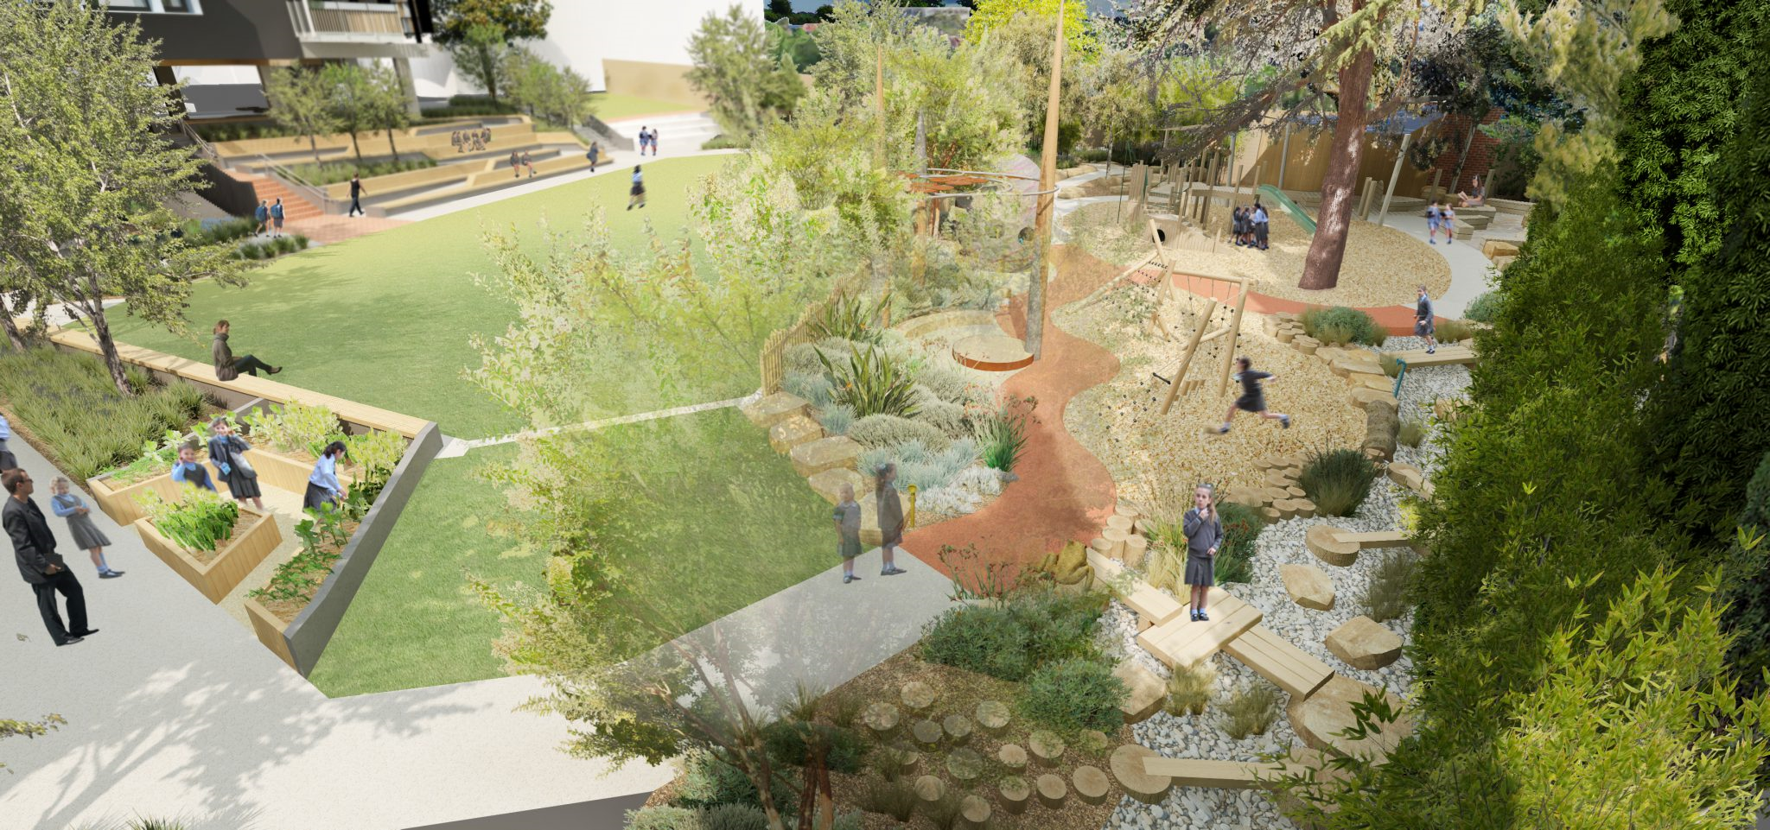
School Design
School environments are commonly designed to accommodate adult and professional demands of economy and efficiency over children’s preferences
“The School I’d Like”
“It is essential that innovative school designs offer all young children opportunities for affordances in nature.”
(Sharma-Brymer and Bland, 2016)

Slide 13
Socio-economic Differences
A survey conducted by Natural England established that 1 in 9 children hadn’t entered a forest, park or alternative natural settings over the last year. The children from minority ethnic, Asian, black and low income families were most affected.
(Natual England, 2019)
“Children’s experience of the natural world is significant in their socio-emotional health. Thus, schools are potentially ideal places to encourage children’s experience of the green space and their outdoor PA.” (Sharma-Brymer and Bland, 2016)
56%
74%

Slide 14
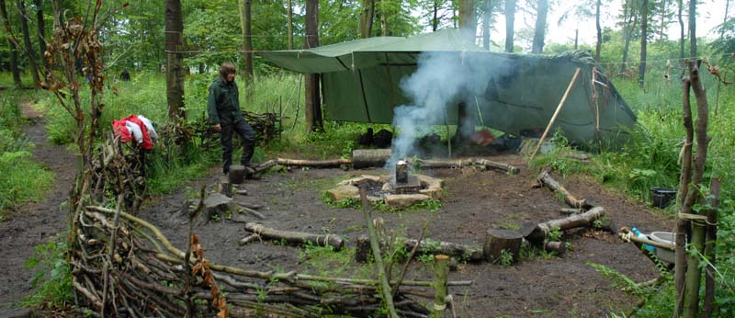
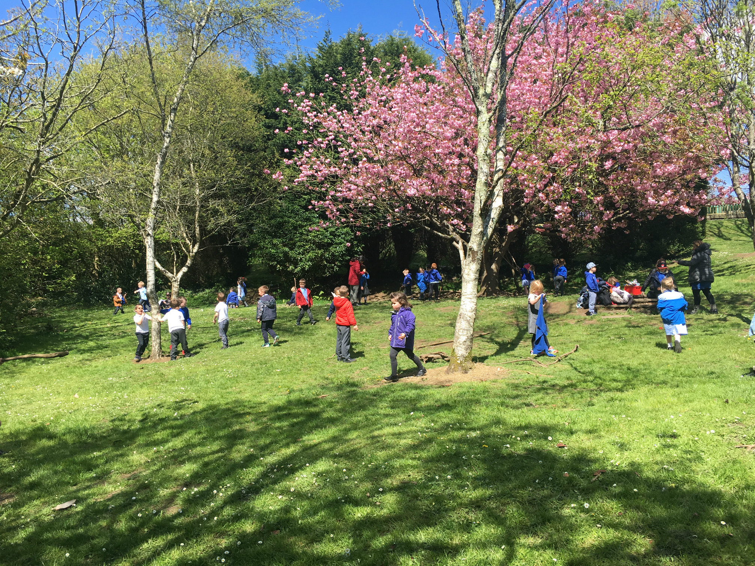
Rural School

Slide 15
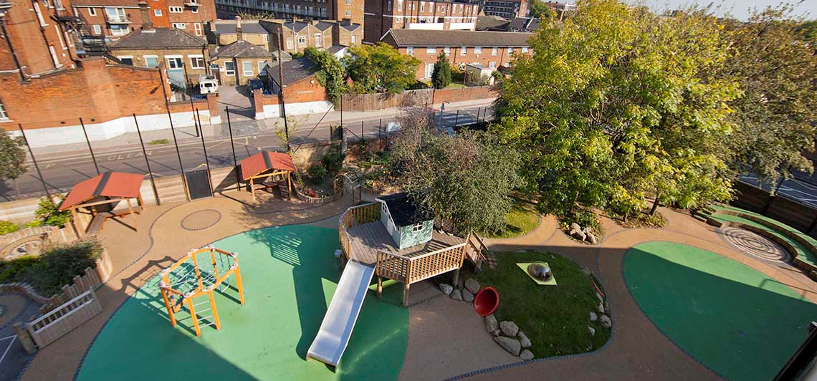
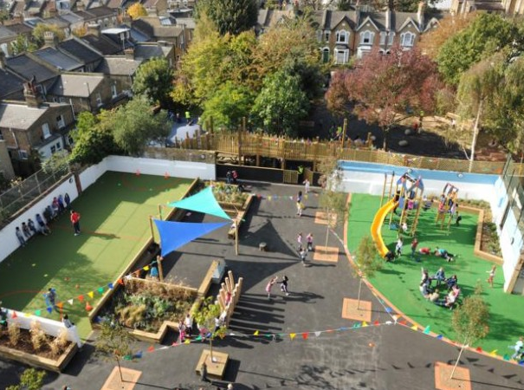
Inner City School

Slide 16
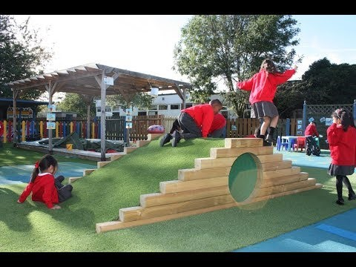
VIDEO SLIDE

Slide 17
THANK YOU!
Alister Tipuric
1600698

Slide 18
Personal Evaluation – to support your academic progress please complete the section below BEFORE submitting your work.
What do you consider to be the best aspects of this work?
Which aspects do you consider could have been improved in this piece of work?
What have you found most satisfying whilst undertaking this submission?
ASSESSMENT CRITERIA | Learning Outcomes | GRADE
 |  | Poor < 20% | Weak 20-29% | Unsatisfactory 30-39% | Satisfactory 40 – 49% | Good 50 – 59% | Very Good 60 – 69% | Excellent 70 – 84% | Exceptional 85– 100% | %
Presentation skills and communication of ideas. (including use of visual aids and interaction with the audience) | 4 |  |  |  |  |  |  |  |  | 20%
Depth of understanding of chosen topic | 1,2,3,4 |  |  |  |  |  |  |  |  | 35%
Quality of, and the appropriate use of research within the presentation | 1,3 |  |  |  |  |  |  |  |  | 20%
Response to questioning | 1,2,3,4 |  |  |  |  |  |  |  |  | 10%
Contribution to tutorial sessions / group meetings – evidenced via attendance and minutes | 5 |  |  |  |  |  |  |  |  | 15%
. It is expected that students will present work that is proof read, correctly referenced and adheres to the Assessment Checklist. Therefore a range of 0 – 10 marks will be deducted for non-completion of any of the points on the checklist below.

Slide 19
References
-Assembly.wales. (2019). Mind Over Matter. [online] Available at: https://www.assembly.wales/laid%20documents/cr-ld11522/cr-ld11522-e.pdf [Accessed 3 Jan. 2019].
-Bento, G. and Dias, G. (2017). The importance of outdoor play for young childrenʼs healthy development. Porto Biomedical Journal, 2(5), pp.157-160.
-Estyn. (2016). Annual Report | Estyn. [online] Available at: https://www.estyn.gov.wales/annual-report [Accessed 4 Jan. 2019].
-Fjortoft, I. (2001). The Natural Environment as a Playground for Children: The Impact of Outdoor Play Activities in Pre-Primary School Children. Early childhood educational journal, [online] 29(2), p.111. Available at: https://link.springer.com/content/pdf/10.1023/A:1012576913074.pdf [Accessed 29 Mar. 2018]. References
-Forest Schools Education. (2019). What Are Forest Schools? – Forest Schools Education. [online] Available at: http://forestschools.com/what-are-forest-schools/ [Accessed 5 Jan. 2019].
-Freidli and Parsonage (2009) Promoting mental health and preventing mental illness: the economic case for investment in Wales. Cardiff: All Wales Mental Health Promotion Network.
-Learning.gov.wales. (2009). Foundation phase outdoor learning handbook. [online] Available at: http://learning.gov.wales/docs/learningwales/publications/140828-foundation-phase-outdoor-learning-handbook-en.pdf [Accessed 3 Jan. 2019].
-Louv, R. (2005). Last child in the woods. Chapel Hill, NC: Algonquin Books of Chapel Hill.
-Natual England. (2019). Monitor of Engagement with the Natural Environment: survey purpose and results. [online] Available at: https://www.gov.uk/government/collections/monitor-of-engagement-with-the-natural-environment-survey-purpose-and-results [Accessed 8 Jan. 2019].
-Pretty et al (2009) Nature, childhood, health and life pathways. Interdisciplinary Centre for Environment and Society Occasional Paper 2009-02: University of Essex.
-Rspb. (2019). [online] Available at: https://www.rspb.org.uk/globalassets/downloads/documents/positions/education/every-child-outdoors---wales.pdf [Accessed 2 Jan. 2019].
-Sharma-Brymer, V. and Bland, D. (2016). Bringing Nature to Schools to Promote Children’s Physical Activity. Sports Medicine, 46(7), pp.955-962.
-WAG (2009) Education, Wales 2009 (No.25) – Qualified teacher status standards Wales 2009. Cardiff: Welsh Assembly Government.
-Welsh National Curriculum. (2015). [online] Available at: http://learning.gov.wales/docs/learningwales/publications/150803-fp-framework-en.pdf [Accessed 3 Jan. 2019].

