Slide 1

Regaining Paradise
Sustainability in the early Years
Student No: 2306989

Slide 2
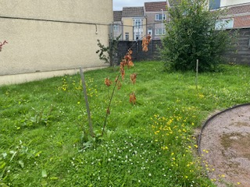
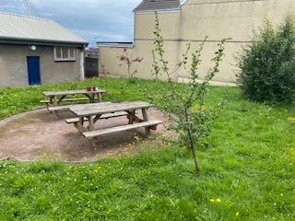
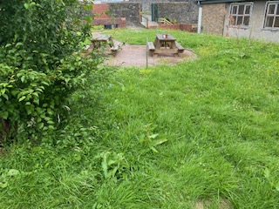
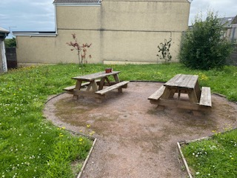
Discovering what we already have!
I have chosen this area, as the only "green" area within the school grounds.
This space was created to allow the children the opportunity to sit and relax quietly, listening to nature, reading a book, drawing, or simply sitting, watching and enjoying their surroundings.
On first glance, it seems quite basic and unkept, however it is actually teaming with wildlife.
Untidy spaces are ecological gold!
What made me interested in this little piece of gold is the possibility of what it could become, with a few little tweaks and careful consideration to existing wildlife and the benefits they already bring.

Slide 3
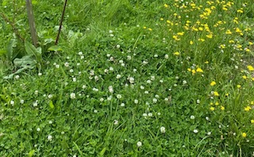
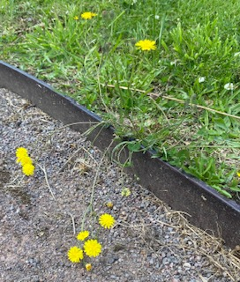
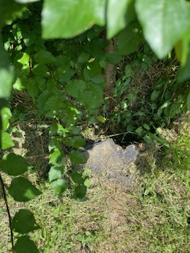

Exploring . . . .
Bees and other pollinators love the daisies and dandelions and drink their nectar and collect their pollen. Although dandelions are thought of as weeds, they actually provide early season food for pollinators.
The uncut grass creates its own microclimate where moisture is retained and temperatures buffered, creating a perfect environment for invertebrates and insects. Beetles and ants' nest in the soil among the long grass. Grasshoppers lay eggs in the soil and the long grass helps to provide warmth and vegetation for the young when they emerge.
Birds are attracted to the area to feed on insects and worms.
Small mammals like field mice and hedgehogs may nest under the bushes and feed on slugs, beetles and other insects.
That little edge between gravel and grass is like a miniature wildlife corridor! It's a transitional zone with warmth, shelter, moisture, and plenty of food sources. Robins and Blackbirds enjoy picking through the gravel edges looking for bugs.
A little hole tucked underneath the bush could be a doorway tp secret life! A number of animals, such as voles, mice, rabbits or foxes may have set up home here.

Slide 4
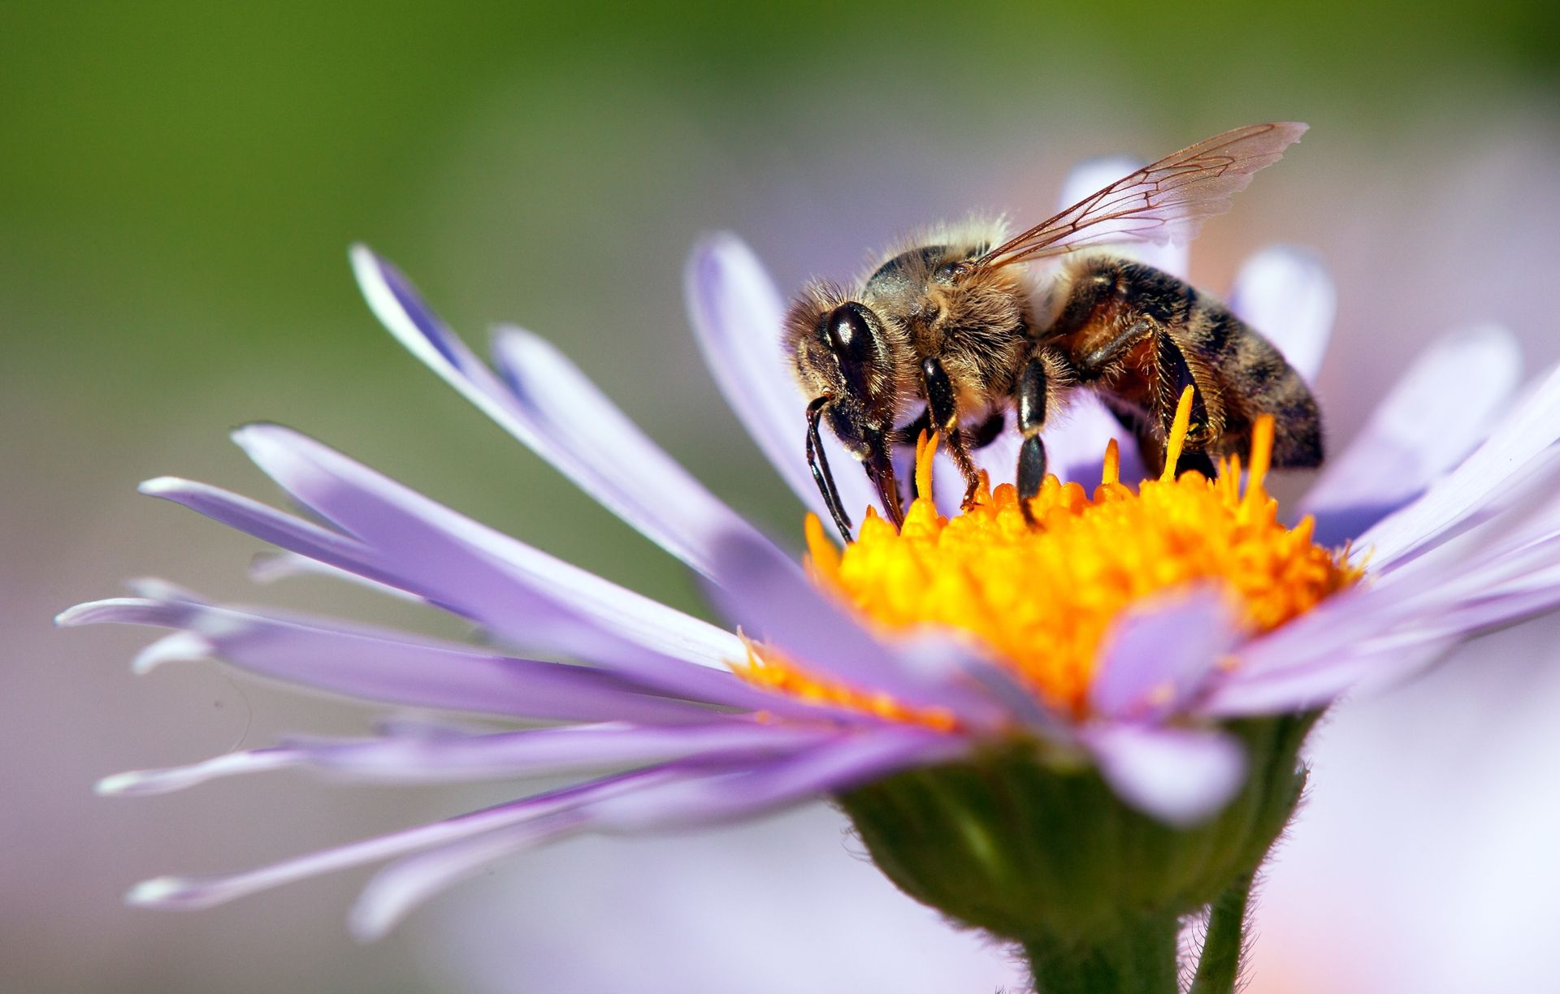
Why are Pollinators so important?
Pollinators such as bees, butterflies, moths, hoverflies, beetles, and wasps play a crucial role in both natural ecosystems and agriculture. By transferring pollen from one flower to another, they help flowering plants reproduce, which results in seeds, fruits, and vegetables. This process is essential not only for maintaining biodiversity but also for supporting a stable global food supply. Unfortunately, pollinators haven’t always been prioritised in conservation efforts. However, growing threats like habitat destruction, heavy pesticide use, and climate change are causing alarming declines in insect populations, making it clear that protecting these creatures is critical for sustaining life and meeting agricultural demands.
My small green space, complete with uncut grass, daisies, dandelions, and a bush, already provides a safe and nourishing haven for pollinators. The uncut grass offers shelter and nesting spots, while daisies and dandelions serve as accessible sources of nectar and pollen, especially during early seasons when food is scarce. The bush adds another layer of support, offering protection and a potential nesting area. Even small patches like this can contribute meaningfully by creating resting and feeding stations within an increasingly urban landscape. It’s a quiet but powerful way to support the health of pollinators and the broader environment.

Slide 5
Butterflies
Visit flowers and use their long tongue for nectar.
Prefer sunny spots and brightly coloured blooms. They pollinate during the daytime.
Bees
Collect nectar and pollen to feed their colonies and pollinate flowers as they go.
Different bees include honeybees, bumblebees, and solitary bees. The love blue, purple, and yellow flowers.
Moths
Like pale and fragrant flowers. Pollinate at night.
Bats
Key pollinators in tropical regions, they use smell to find flowers.
Different Pollinators
Hoverflies
Mimic bees and wasps. They feed on nectar and their larvae eat garden pests which is great for pest control!
Birds
Especially hummingbirds, sip nectar and transfer pollen via their feathers.
Beetles
Believed to be the oldest pollinators, dating back to dinosaur times!
They feed on pollen and floral parts, often in large, open blooms.
Wind!
Moves pollen without animal or human help, especially in grasses and trees.
Wasps
Occasionally drink nectar, so pollinate in the process. Although as they are less hairy, they are less efficient, but do still contribute.

Slide 6
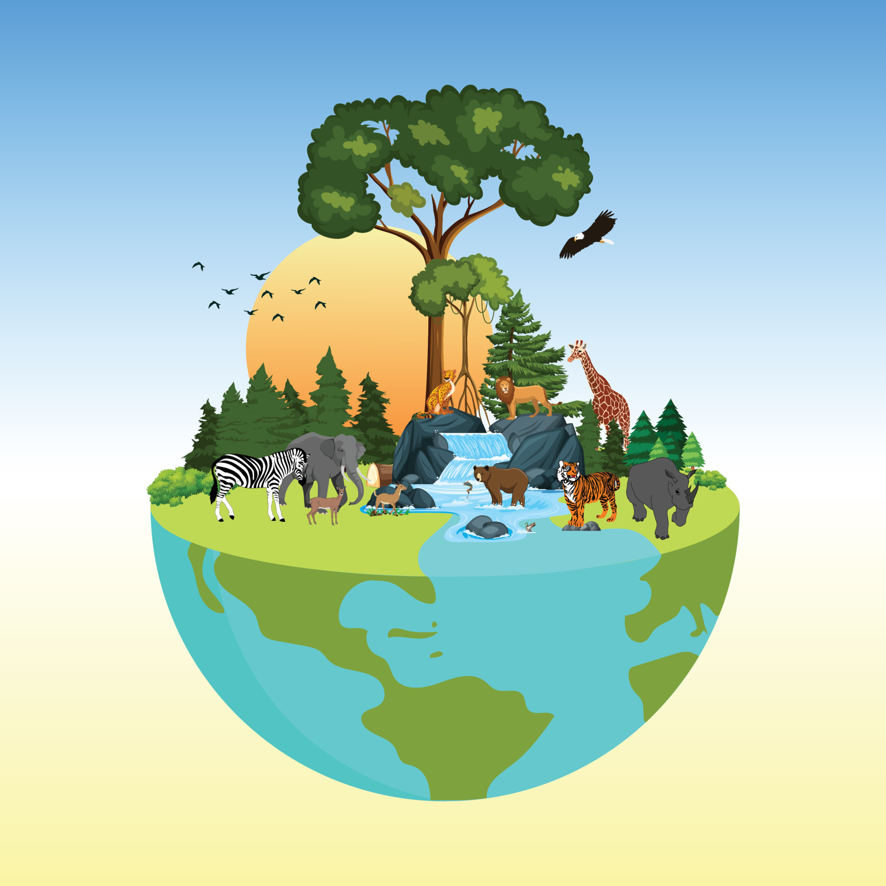
Biodiversity
Biodiversity is the vast variety of life found all around us, from microscopic organisms to towering trees, from insects and wildflowers to birds and mammals. It exists not only in the wilderness but also in farmland, towns, cities, and even our back gardens. This rich diversity of life is essential to the natural systems we rely on every day. It helps clean our air and water, grow food, build healthy, nourishing soil, and shield us from floods and climate extremes. We are part of this web of life, and its health is closely tied to our own well-being.
Even the small green space as shown in the photograph from my school can play a meaningful role in supporting biodiversity. The area of uncut grass, dotted with daisies and dandelions, and the bush, provides habitat and food for countless insects like bees, hoverflies, and beetles. These plants offer nectar and pollen, especially during seasons when other flowers are scarce. The untrimmed grass gives shelter and breeding grounds for small creatures, while the bush may offer nesting spots for birds or shade for insects. By simply allowing nature to flourish without interference, this green space becomes a quiet refuge, contributing to the survival of local wildlife and helping maintain the balance of life that sustains us all.

Slide 7
Wildlife Gardening
Wildlife gardening is a great way to help nature, even in small outdoor spaces. By planting wildflowers, growing areas of long grass, building log piles, and leaving parts of the garden a little messy, we can create homes and food for many types of wildlife. Bees, butterflies, birds, frogs, and insects all benefit from these safe, welcoming spaces, especially as their natural habitats are disappearing. Unlike tidy gardens that focus on looks, wildlife gardens focus on supporting life. They give people a chance to connect with nature, watch wildlife up close, and learn about the plants and animals that live around them. Even simple changes can make a big difference for biodiversity and help protect the natural world we all depend on.
So the Challenge begins!

Slide 8
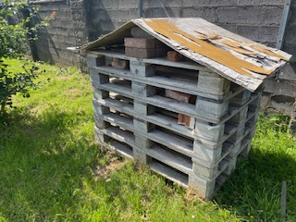
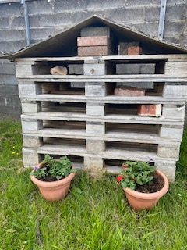
The Challenge!
To conserve and improve this little bit of wild within the concrete jungle of our school grounds, I have created a bug hotel from old pallets and wood, already filled with their own little bit of life! I weighed the pallets down with some old bricks and stones found around the grounds.
I also hope to attract woodlice to the area. In contrast to ladybirds, these little bugs, love damp, dark shelter and thrive when eating a diet of fungi, leaf litter and decaying matter. This supports a healthy environment by creating better conditions for plant roots and microorganisms. They also provide a food source for spiders, beetles, and birds.
Bug Hotel
I hope that the bug hotel will attract and provide shelter for wildlife which is beneficial to our space, such as insects that help to pollinate plants, control pests and boost biodiversity.
A variety of species of beetles can be attracted to bug hotels and provide a treasure trove of ecological services! Some beetles like a diet of slugs and caterpillars, which help protect plants for pollinators, whilst others prefer organic waste which in turn, enriches the soil to benefit healthy plant growth.
One of the insects I hope the bug hotel will attract is ladybirds, who love to hide in dry areas with twigs and leaves. The enjoy a diet of pests that can damage plants, so indirectly helping pollinators such as bees and butterflies by removing pests and helping to maintain the health of the plants. Ladybirds are also an important food source for birds, spiders and frogs.
Centipedes and Millipedes both enjoy damp shaded environments offered by bug hotels, although they prefer very different food sources! Centipedes hunt insects, spiders and other arthropods, indirectly supporting plant life, while Millipedes prefer decaying plant matter, enriching the soil to support plant growth.

Slide 9
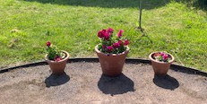
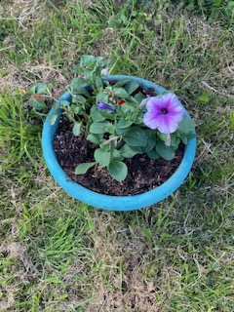
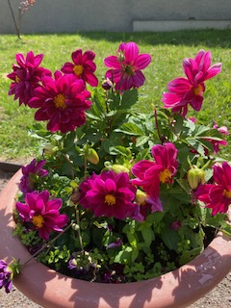
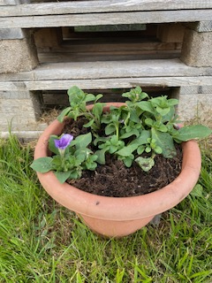
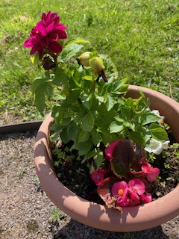
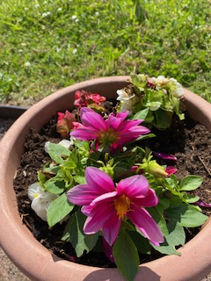
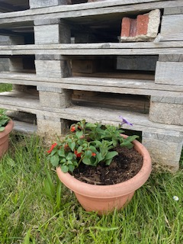
The Challenge!
Introducing potted flowers in a range of colours and shapes helps to attract a wider range of species with different feeding and nesting preferences.
Positioning some near the bug hotel provides shelter and food, creating a full-service ecosystem.
Variety in plant life = Variety in wildlife!
Positioning in grassy areas add cover and nesting materials for beetles, centipedes and millipedes, enhancing microhabitat diversity.
Decomposing petals and leaves add organic matter for hungry woodlice, beetles, and millipedes.

Slide 10
Sharing with Future Generations!
I intend to bring the children to the area to allow them to explore for themselves the diverse habitats that can be created by adding simple things like flowers, twigs, and stones. This hands-on exploration will be the foundation for a series of outdoor learning experiences where children could observe, question, and document the changes they see over time.
We will work together to design and build more mini-habitats such as log piles, wildflower patches, and a small pond to attract a variety of wildlife. Each addition could be linked to a learning theme; pollination, food chains, shelter, and seasonal changes, helping children understand the role each element plays in supporting biodiversity.
To deepen their understanding of sustainability, we could incorporate recycled materials into our projects and discuss the impact of human activity on the environment. Children will be encouraged to reflect on how their actions, like planting native species or reducing waste, can contribute to a healthier planet and how they can relay their learning at home with parents and siblings.
By developing this green space in a hands-on, child-led environment, it will also become a living classroom for cross-curricular learning: writing nature stories and poems, creating art inspired by the environment, conducting simple science experiments, and even using maths to measure plant growth or map the area.
Most importantly, the children will take ownership of the space. Their ideas will shape its development, fostering a sense of responsibility and pride. By nurturing this connection to nature, we aim to instill lifelong values of care, curiosity, and respect for the natural world.

