Slide 1

Attitudes and Attribution Theories
Week 7 – BMHP4003
Psychology in Health and Social care.

Slide 2
Previously we have…
Discussed theories of cognitive development
Discussed the Psychodynamic theories
Discussed behaviourist theories
Introduced Self concept and Social identity theory.

Slide 3



During today’s session.
We will explore what attitudes are.
Discuss how attitudes are formed and how attitudes link to behaviour.
We will discuss attribution theories and their revelance to Health and social care.

Slide 4
Attitudes
What does the word attitude mean to us?
“The word ‘attitude’ is derived from the Latin aptus, which means ‘fit and ready for action’” (Hogg & Vaughan, 2018, p154)
Attitudes are neurologically stored concepts, developed by means of experience, our preconceived ideas and beliefs towards objects, people, groups or activities influence how we view and approach situations. Our attitudes direct and affect many aspects of our everyday life.

Slide 5
How attitudes have been studied.
Attitudes are a key focus of social psychology.
1920’s and 1930’s
  Research and discussion focused on measuring attitudes and relating to behaviours
1950’s and 1960’s
  Research and discussion centred on how attitudes could be changed.
1980’s and 1990’s
  Research and discussion focuses on the function of attitudes on a social level.

Slide 6
How many components are there in an attitude?
Is an attitude a single belief and For many this may make sense but it underplays the complexity of attitudes. response? Or are there more components to an attitude?
The first model, proposed by Thurstone (1928) was a one-component model – this model simply put forward that a person either feels positive or negative about a object/person/activity/situation.
The next model was a two-component model – put forward by Allport (1935), he suggested that ‘mental readiness’ must also be considered – our knowledge, experience and thought processes influence whether we have positive or negative response to a object/person/activity/situation.

Slide 7
The three-component model of attitude.
Affective
However, the Three component model became popular in the mid 20th century and actually comes from ancient philosophy. The three components of an attitude being: Thought (cognitive), Feeling (Affective) and Action (behavioural).
cognitive
behavioural
Attitude

Slide 8
Example of the - 3 component model.
Component | Definition | Positive valence | Neutral valence | Negative Valence
Cognitive | Our beliefs about the object. Based on perceptions of the facts. | Maisie believes chocolate has high nutritional value. | Maisie believes that chocolate has some nutritional value, | Maisie believes that chocolate is an unhealthy food.
Affective | Our feelings linked to ay object dependant on values. | Maisie links chocolate with pleasurable feelings. | Maisie has no emotional responses related to chocolate. | Maisie links chocolate with feelings of guilt.
Behavioural | Our past behaviours towards an object stems from our own observation of the way we behave. | Maisie has eaten chocolate everyday for the past year. | Maisie occasionally eats chocolates if offered. | Maisie has completed a diet plan which states that she will not eat chocolate.
Mercer & Clayton (2012, p4)
Notes:
Make it clear to the students that they will be completing this table for a different example in the activity. Students will need some explanation about the term ‘Valence’ – if you like you can defer this by saying that the examples will aid you to demonstrate the meaning of each of these term.

Slide 9
Activity – 25mins
Three component Model
Complete the ‘Attitude Task’ activity (available on Moodle week)
This task considers the different attitudes a person could have towards visiting the dentist.
Complete on Moodle.
Notes:
The activity focuses on attitudes towards visiting the dentist.

Slide 10
Are all attitudes the same?
Katz (1960) proposed that there are multiple types of attitudes, each serving a different function, for example:
      Knowledge;
      Instrumentality (means to an ends or goal)
      Ego defensive (protecting a person’s self esteem)
      Value-expressiveness (allowing people to display values that uniquely identify and define them).
      Does social-context affect our attitudes towards an things?

Slide 11
How are attitudes formed?
Direct experience
Classic conditioning
Observational learning

Slide 12




Attitudes formed via Direct experience
Attitudes can be developed by means of direct experience. For example, if you had a bad experience with a dog, this may lead to a negative valence of attitude towards dogs.
Conversely, a positive experience with a particular group of people, for example, being helped with heavy bags on to a train by a Manchester United supporter may lead to a positive attitude towards all Manchester United supporters.
What kind of direct experience could lead individuals developing a positive or negative attitude towards seeking medical help/support? Discuss as a group.

Slide 13





Attitudes formed via Classic conditioning
We learned about conditioning when discussing the behaviourist approach in week 4.
Conditioning has repeatedly been explored as a means of manipulating attitude formation
Does this kind of conditioning occur in our everyday lives?
One such investigation was conducted by Krosnick et al (1992) which involved showing participants a series of images of an unfamiliar person. Before each image of the person, the participants when shown an image which was either happy or upsetting (a pair of kitten or a bloody shark), this image was shown so fast that the participants were unaware of it (subliminal).
Participants then gave an evaluation of the unfamiliar person, typically, those that were shown the positive images expressed a liking for the unfamiliar person, and the majority of those that had been shown the unsettling image expressed a dislike.
Consider how some people of different ethnicity or nationality are depicted in films or in the news.
Consider how a friend or family member’s opinion about a topic/issue or service might influence our attitudes?

Slide 14
Attitudes formed via Observational learning
We have briefly discussed observational learning during our week 4 session.
Let’s now consider how this observational learning can impact and influence our attitudes.
Observation learning (or vicarious conditioning) happens when a person watches and/or empathises with the emotional response of another person to a stimuli. (Bandura et al, 1969)
Gerull and Rapee (2002) conducted an investigation which involved a parents reacting to different toys infront of their toddler (child). For example, a mother showing fear or joy in response to a snake lead to the toddler later showing the same emotional response when presented with the same snake.
Have you ever had your attitudes influenced by observational learning? E.g towards foods, people, places or activities.
Could observational learning influence the attitude of a member of health and social care staff has towards service users?

Slide 15
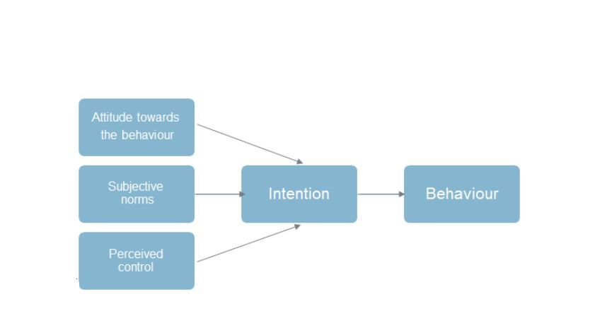
Do attitudes link to behaviour?
Probably the best-known theory that examines our attitudes and behaviour is Ajzen' s (1991) theory of planned behaviour.
This theory suggests that there are a number of different factors that shape whether our attitudes are reflected in our behaviour.
The first factor that we need to consider is the actual attitude that we hold towards the behaviour, and it is important to note that it is the attitude towards the behaviour that is crucial,
Next, we have subjective norms, which are basically the beliefs of the people who matter to us, so, perhaps, our family and our friends, and whether they have a favourable attitude towards the behaviour.
Following this, we have perceived control, and this relates to whether the person believes they have the resources and opportunity to engage in the behaviour.
Each one of these three factors feeds into the intention, and this should be specific to one particular behaviour in order for it to carry through.
Finally, we have the actual behaviour itself.
Notes:
The first three components influence the strength of intention. The strength of intention indicates the probability of a behaviour occurring.
Apply to the case study.

Slide 16


Theory of Planned behaviour
Let’s apply this theory to the example of a smoker who is thinking about whether or not they should stop smoking.
If we firstly look at their attitude towards their behaviour, it could be that the person has developed a negative attitude towards smoking. They may feel that smoking makes them unhealthy, that it makes them smell bad, and that it is expensive, for instance.
If we look at the subjective norms surrounding the behaviour, it could be that their family and friends are encouraging them to stop smoking because they want them to be healthy, and it could be that they have recently visited the doctors and been told that they need to stop smoking based on health grounds. Here, the subjective norms are also increasing the chances of the person giving up smoking.
Finally, if we look at perceived control, the person could think that they've got access to nicotine patches, or that they could go to counselling sessions, etc. In this case, they have a good level of perceived control. All of these factors feed into the person's specific intention that they are actually going to stop smoking and, because each one of these factors is positive, and they are all directed towards a very specific behaviour, the chances are that this person will stop smoking

Slide 17
Break
After the break we will learn about attribution theories.

Slide 18
References
Allport, F.H. (1935). Attitudes. In C.M. Murchison (Ed.), Handbook of social psychology, pp. 798-844). Worcester: Clark University Press.
Ajzen, I. (1991). The theory of planned behaviour, Organizational Behaviour and Human Decision Processes, 50(2), 179-211.
Bandura, A., Blanchard, E.,B., & Ritter, B., (1969), Relative efficacy of desensitization and modelling approaches for inducing behavioural, affective, and attitudinal changes, Journal of Personality and Social Psychology, 13, 173-199.
Gerull, F.,C., & Rapee, R.,M. (2002), Mother knows best: Effects of maternal modelling on the acquisition of fear and avoidance behaviour in toddlers, Behaviour Research and Therapy, 40, 279-287.
Hogg, M. A. and Vaughan, G. M. (2018) Social psychology. [electronic resource]. Eighth edition. Harlow: Pearson.
Katz, D. (1960). The functional approach to the study of attitudes. Public Opinion Quarterly, 24,163–204
Krosnick,J.A., Betz, A.Ll, Jussim, L.,J., & Lynn, A.,R., (1992), Subliminal conditioning of attitudes, Personality and Social Psychology Bulletin, 18, 152-162
Mercer, J., & Clayton, D., (2012), Social Psychology, Harlow: Pearson Education.
Thurstone, L. L. (1928). Attitudes can be measured. American Journal of Sociology,83, 529–554

