Slide 1
Jayla Imarni Russell
Student ID number: 2518864
Module code: LCHS4010
Lecturer: Prabjot Kaur Sahota
Component 1 – Presentation

Slide 2

Introduction
When psychology began, researchers were able to apply systematic and empirical scientific methods which produced reliable theories and data. Today there are many theories that can explain behaviour, cognitive and language development. Today we will be discussing 3-year-old Shona who has been introduced into early years education and has been showing signs of anxiety and limited interaction with her peers. We will be applying one of psychology’s most influential attachment theories to Shona and how it is affecting her interactions in society.

Slide 3
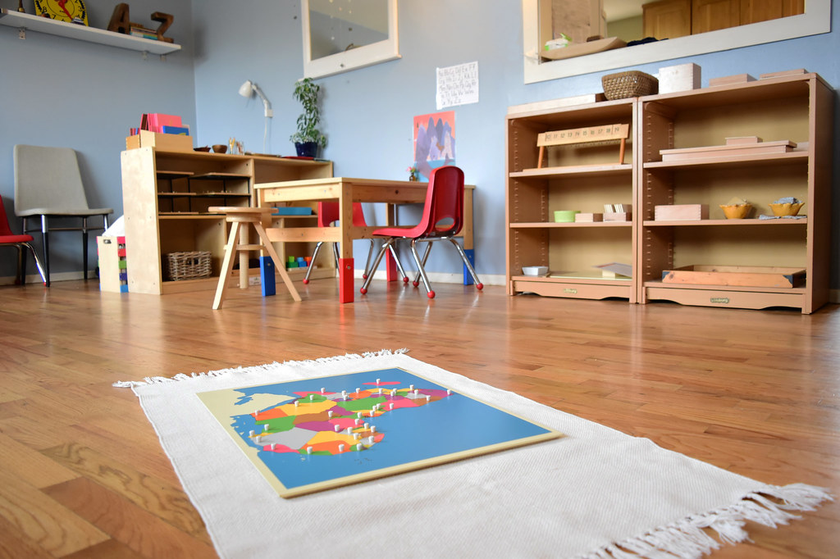
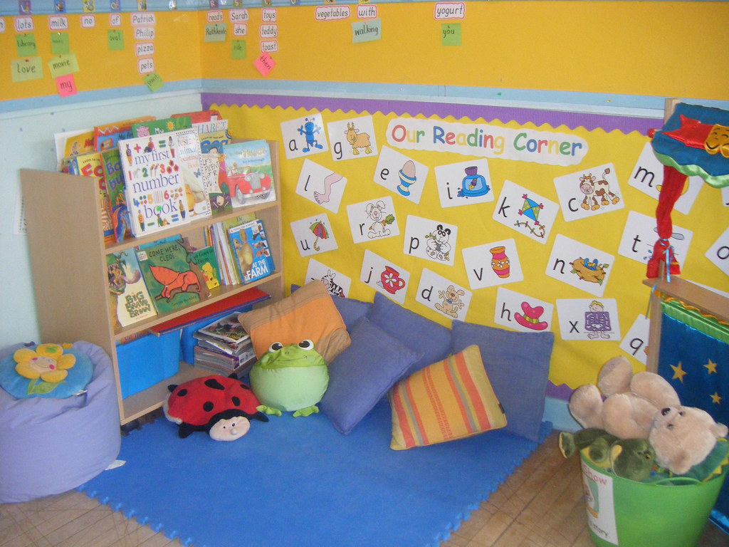
Piaget’s theory of cognitive development
Jean Piaget (1972) has played a crucial role in psychology and childhood development. He theorised that children themselves are active in their own learning process, (The Voice of Early Childhood, 2026). He believed that cognitive development occurs through a series of successful changes in cognitive structures. This means that older children are able to have thoughts that are simply beyond younger children.
The basis of Piaget’s theory is that we learn as a direct result of our experiences. For example, young children interact with objects to build their understanding of shapes and colours rather than just being taught them. However, our age can reflect how we make sense of those shapes and colours and we all make sense of different experiences at different stages of our lives.
There are 3 components to Piaget’s theory that we will briefly discuss.
Schemas
Adaptation
4 stages of development
Schemas
This is the mental framework used to organise and interpret information. It is what the individual groups in their mental understanding. Our schemata will grow through assimilation, accommodation and equilibration.
Schemas are based on the understanding and interactions of the individuals with their environment.
Adaptation
There are 2 processes within adaptation, and they are assimilation and accommodation.
Assimilation is where the child will process new objects, ideas or situations they have based in the information they have been given and retained
Accommodation is where the child then modifies their existing schemata to accommodate the new situations, objects and information
Now the equilibration is the child's internal motivation to maintain a balance between what they know and what they experience.

Slide 4
The 4 stages of development
According to McLeod, S (2026)
Sensorimotor stage (birth to 2 years)
This is the stage that the individual will learn through their senses and physical actions. By coordinating their sensory and motor experiences, they then begin to construct their basic knowledge. During this stage, the individual develops key concepts of object permeance; understanding that the object still exists even if its not currently in their view.
Preoperational stage (2 to 7 years)
In this stage the child then starts using language and symbols to communicate however they will struggle with ‘logical’ thinking.
At this stage they are seen as egocentric as they cannot see from other perspectives but their own.
They do not understand conservation, so for example they will see a tall, thin glass and believe it holds more water than a short, wider glass.
Concrete operational stage (7 to 11 years)
This is the stage where children can start to have more ‘logical’ thinking; they can begin to understand conservation.
This then allows them to mentally sort things into groups and mentally reverse actions.
They can also start to think about others’ thoughts and feelings a nit more realistically.
Formal operational stage (11+ years)
The adolescents develop the ability to think more abstractly and solve hypothetical situations
They can now begin to think systematically and form hypotheses
They should now understand concepts that aren’t tied to physical reality and can reason complex concepts like ethics, mathematics and science.

Slide 5
Why is Piaget’s theory important in early years?
Piaget’s theory is important in early childhood as it portray that children will learn based on hands-on experiences rather than just being taught.
According to Britannia School of Academics, (2026), it can encourage carers and adults to push children into active learning allowing the child to express their own ideas and ask questions. They can also make sense of their environments by actually interacting with it and learning with trial and era.
Furthermore, according to London School of Childcare Studies, (2026), Piaget’s explanation of the sensorimotor stage covers the birth to the age of 2 which are the vital ages for object permeance where something can still exist without it being seen.
Kholic, A (2020), suggested that during the preoperational stage (2-7 years) children start to represent their world with words, images, etc. which the University of Indonesia conducted a study for in elementary/primary schools for. They also stated that symbolic thoughts are beyond simple connection of physical actions and sensory information for the children.
Now these articles and studies back up Piaget’s Theory of the stages of cognitive development. Meaning that it is somewhat relevant to cognitive development of children, in psychology.
.

Slide 6

How does Piaget’s Theory apply to Shona ?
This could mean that Shona may not have yet experienced the concept of adaptation as she is relatively new to the nursery setting. Moreover, this is the perfect time for Shona to interact with her environment and peers to start to process information, with enough time she will then be able to accommodate new information, ideas or relationships. According to Therapy Trainings (2024), during the preoperational stage Shona should be expressing the use of magical thinking, and they are usually egocentric during this time; this has been described as the usual behavior for individuals ages 2-7. Furthermore, as stated before this is a new environment to Shona, therefore once she has familiarised her setting and the routine of consistently attending nursery and not seeing her carers, her schemata will group these things together and hopefully her anxiety will decrease, and she will learn how to engage in group play.
Now if we were to apply Piaget’s Theory to Shona, we would find that as she is showing signs of anxiety, during the sensorimotor stage, maybe she had rarely been separated from her carers for long periods at a time. Therefore, she may not have went through the stage of object permeance; she has not had the opportunity to understand her carers still exist even when not in her sight. Hence why she isn’t comfortable and has anxiety once her carers leave.
Additionally, Piaget’s Theory also explains children interacting with their environment; including peers, will help with their cognitive development. Now let’s think back to the second component to the theory; adaptation. The process of assimilation is where the child starts to learn how to process new situations, objects, etc. and accommodation is where they start to modify the existing information they have and can accommodate new situations and ideas. Finally, the equilibration process has to come form the child themselves; they have to wants to process information and modify their schemata and accommodate new information.

Slide 7

Strategies and Interventions
According to My Teaching Cupboard (2021), when Piaget observed children during the preoperational stage, he had found that they learned best with hands on activities. Therefore, there are many ways that Shonas early years educators can encourage Shona to become more interactive during group play and hopefully evoke her to build the equilibration to learn more vocabulary.
Things that they can do:
They can get Shona to interact with her environment by putting things out that could pique her interest; this could also take her mind off the fact that her carers are not there but the things around her are
As they are egocentric during this stage, they can do dress up activities and encourage dramatic play allowing the children to swap roles and start to begin thinking about others’ perspective
For her speech they can explicitly tech new vocabulary and the meaning of word as during this stage children expect others to understand language that they have created – in Shonas case she may expect other understand her needs even though she is silent.
Leatherbarrow, K, (2026), suggests that early years educators should place themselves at eye level with the child, this could make them less intimidating to Shona, and they can have a more softer approach, using softer tones

Slide 8

Is it nature or nurture?
The argument of nature vs nurture is one of psychology’s oldest debates but still a very popular topic of discussion even today. Baker, K (2021), suggests that philosophers like Plato believe that certain kinds of knowledge are innate. However, philosophers like Locke (1690) and Aristsotle believed that all knowledge was acquired through experience. Rather than certain knowledge being present, all individuals are born with a clean slate, empty brain and no experience.
In Shona’s case, she is new into the nursery environment, therefore that will show how she is nurtured as these are the non-biological factors. Her not interacting during group play could be nurture as this may not be a common thing that Shona regularly does. Additionally, Shona not being very vocal during her age could be due to nature. Maybe it could be something genetic. Maybe her biological parents were the same way. In opinion, it could be either or it could be both. I believe that both nature and nurture can both influence how a individual is and how they develop.

Slide 9
Usefulness and limitations to Piaget’s Theory
With Piaget’s theory, it explains a lot about cognitive development and how children are active participants in their own learning and interact with their environment for their own mental understanding. There are many positives to his theory that can help with the understanding of individual’s development from birth. On the other hand, there are many limitations to Piaget’s theory that cannot be accurately applied to individuals today.

Slide 10
Usefulness | Limitations
Stated by Nicola, (2016), Piaget’s theory influence the crucial role that individuals play within their own learning and development; through spontaneous interactions rather than knowledge presented to them | According to Jakobsen, K et al (2025), Piaget’s theory of stages suggest that all children reach the same level of cognitive development at the same time
Piaget’s theory allows adults, carers and educators to look into the individuals thinking. Rather than just checking that they got an answer correct they see how the child’s thought process brought them to that answer. They can then build on the child’s level of cognitive functioning. | As stated by Babakr, Z et al (2019), Piaget claims that individuals are egocentric during the preoperational stage. However, researchers have found that individuals experience egocentrism from an earlier stage.

Slide 11
Reference list
Abdul Kholic, (2020). How is Piaget’s Theory Used to Test the Cognitive Readiness of Early Childhood in School? Indonesian Journal of Early Childhood Education Studies: Vol 9 NO 1 – Accessed: October 3rd 2026
Babakr, Z, Mohamedin, P, Kakamad, K, (2019). Piagets Cognitive Developmental Theory: Critical Review in Education: Vol 2, no 3. – Accessed: October 3^{rd,} 2026
Baker, K, (2021). History of Psychology: Nature vs Nurture. Accessed: October 4, 2026
Brittania School of Academics, (2026). How Piaget’s Theory of Cognitive Development Shapes Early Years Learning? Available at: https://schoolofacademics.co.uk/how-piaget-theory-of-cognitive-development-shapes-early-years-learning?srsltid=AU7gw4UORFeYysF0YF5mto8teue_VI4FzL1MibEOSnKQLl3kEOzH_c2t Accessed: October 7, 2026
Jakobsen, K and Fischer, P, (2025). Child an Adolescent Development: A Topic Discussion (2nd edition). - Accessed October 5th
Leatherbarrow, K, (2026). Understanding Jean Piaget in the Early Years: A Practical Guide for Practitioners – Accessed October 5, 2026
London School of Childcare Studies, (2026). Jean Piaget: A Pioneer in Early Years Education. Available at: https://childcarestudies.co.uk/blog/jean-piaget/ Accessed: October 3rd (2026)
McLeod, S, (2026). Piaget’s Theory and Stages of Cognitive Development. Available at: https://www.simplypsychology.org/piaget.html Accessed: September 29th 2026
My Teaching Cupboard, (2021). Piaget and Play Based Learning. Available at: https://www.myteachingcupboard.com/blog/piaget-and-play-based-learning-1 Accessed: October 4, (2026).
Nicola, (2016). Piaget’s Influence on Educational Practices. Available at: https://mindsofwonder.com/2016/11/24/piagets-influence-educational-practices/ Accessed: October 9, 2026
Therapy Training, (2024). Piaget’s Stages of Cognitive Development: Implications for Child Therapy. Available at: https://www.therapytrainings.com/pages/blog/piagets-stages-of-cognitive-development-implications-for-child-therapy .Accessed September 22^{nd,} 2026
The Voice of Early Childhood, (2026). An Introduction to Jean Piaget. Available at: https://thevoiceofearlychildhood.com/introduction-jean-piaget/ Accessed: October 3, 2026

