Slide 1
EAEC6001
The Reflective Adult
1501619

Slide 2
Contents Page
Slide 1 – Front cover
Slide 2 – Contents page
Slide 3 – Introduction
Slide 4 – What is reflection and why is it important?
Slide 5 – What is good professional practice when it comes to reflection?
Slide 6 – Gibbs’s model of reflection
Slide 7/9 – Activity one
Slide 10 – Kolbs’s model of reflection
Slide 11/12 – Activity two
Slide 13 – Conclusion
Slide 14/18 - References

Slide 3
Introduction - Reflection
Reflection overview
Knowledge, values and skills
My personal experience and professional development

Slide 4
What is Reflection and why is it important?
Enhance professional development skills
Analyse previous activities/experiences
(Smith and Craft, 2011)
Looking at what did not go well
Improve in the future
(Envy and Walters, 2013)
Think about decisions we make and why we acted in that way
(The British Association for Early Childhood Education, 2016)

Slide 5
What is good professional practice when it comes to reflection?
Evaluates own performance against current practice (Tassoni, 2008)
Practitioner values (Brock, 2014)
Reflecting before, during or after the activity
Too controlled by others, for example management
(Rawlings, 2008)
Reflective practice is a cycle that has steps to follow
(McFarland et al., 2009)

Slide 6
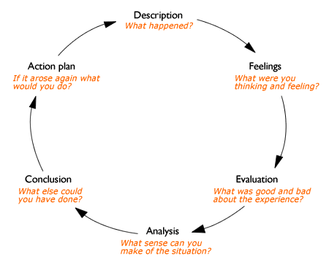
Gibb’s Model of Reflection
(Source: Oxford Brookes University, 2017)

Slide 7
My own personal reflection
Activity one (Negative experience)
Activity:
Three different activities used in the theme of farm animals.
What was I thinking and feeling?
Mixed emotions
Activity not going as I had planned

Slide 8
What were the good and bad points?
Children were all developing positive relationships with each other
Negative point - Children all went around the messy play activity
Children did not understand the concept of moving around the activities
What sense can I make of the situation?
Noise level was high
Children did not want to put activity away

Slide 9
What else I could have done?
Set the one activity out being the messy play
Sat with the children to encourage them
If it arose again what would I do?
Confidence decreased then increased
Another member of staff
Children should have had change of clothes – communication
Children Act 1989
Research has been carried out which shows that practitioners are developing positive relationships with parents (Estyn, 2013)

Slide 10
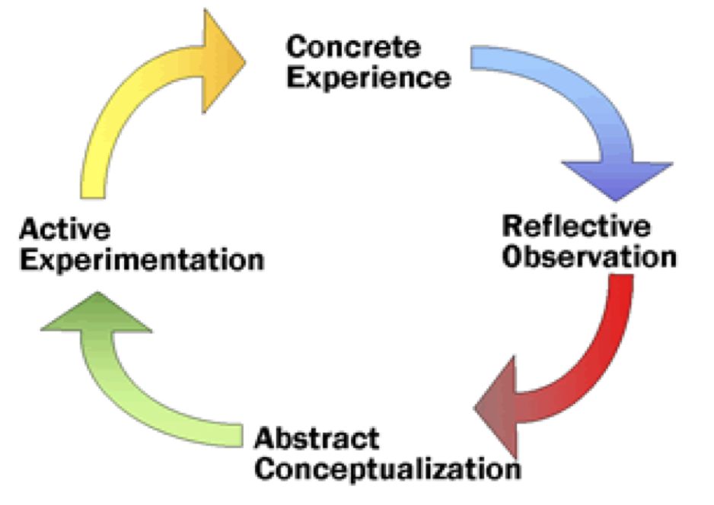
Kolbs Model of Reflection
(Source: NSDL, 2016)

Slide 11
My own personal reflection
Activity two:
Concrete experience (doing/having an experience)
Took the children on a teddy bear picnic
Reflective Observation (Reviewing/reflecting on the experience
Children apart from one child all brought their own teddies, correct clothing and a picnic
Lack of parent involvement
practitioners should have a positive relationship with parents
New environment
Values - acknowledge each individuals values and beliefs, not to be judgemental and positive power sharing

Slide 12
Abstract Conceptualisation (Concluding/learning from the experience)
Children are more engaged outdoors
More focused when there is one activity going on
Sending letters home enables good communication
Active Experimentation (Planning/trying out what you have learned)
Include songs
Develop my skills further - forest School training
Good management
Donaldson report

Slide 13
conclusion
Reflection is important to enhance professional skills
Complete further training (Tassoni, 2008)
Using models of reflection is beneficial
Gained understanding of knowledge, values and skills

Slide 14
Reference list
Blatchford, I., Taggart, B., Sylva, B., Sammons, P. and Melhuish, E. (2009) ‘Towards the Transformation of practice in Early Childhood Education: the effective provision of Pre-School Education’, Cambridge Journal of Education, Volume 38, Issue 1, pp.23-36.
Boyd, D. and Hirst, N. (2015) Understanding Early Years Education across the UK. England: Routledge.
Brock, A. (2014) The Early Years Reflective Practice Handbook. England: Routledge.
Cohen, D., Stern, V., Balaban, N. and Gropper, N. (2015) Observing and Recording the behaviour of young children. England: Teachers College Press. [e-book]. Available at: https://books.google.co.uk/books?id=P83fCgAAQBAJ&source=gbs_book_other_versions [Accessed: 10th October 2017].
Cole, R. (2008) Educating Everybody’s Children. England: Association for Supervision and Curriculum Development.
Couchenour, D. (2013) Families, Schools and Communities. England: Wadsworth Publishing.

Slide 15
Daly, M. and Byres, E. (2008) Early Years Management in Practice. England: Heinemann.
Deiner, P. (2012) Inclusive Early Childhood Education: Development, Resources and Practice. England: Cengage Learning.
Department for Education and Skills. (2004) Creating opportunity, releasing potential and achieving excellence. London: HMSO.
Department for Education. (2008) The Impact of Parental Involvement on Children’s Education. London. HMSO.
Donaldson, G. (2015) ‘Successful Futures’ file:///C:/Users/Invate/Downloads/Donaldson%20Report%20-%20Successful%20Futures%20-%20Independent%20Review%20of%20Curriculum%20and%20Assessment%20Arrangements%20in%20Wales.pdf [Accessed: 6th October 2017].
Envy, R. and Walters, R. (2013) Becoming a Practitioner in the Early Years. England: Sage Publications Ltd.

Slide 16
Essa, E. (2013) Introduction to Early Childhood Education. England: Wadsworth Publishing Company.
Estyn. (2013) ‘Partnership with Parents’ https://www.estyn.gov.wales/effective-practice/partnership-parents [Accessed: 3rd October 2017].
Family Action. (2014) ‘Our work with Schools and Education’ https://www.family-action.org.uk/schools-education/ [Accessed: 5th October 2017].
Fitzgerald, D. (2008) Parent Partnership in the Early Years. England: Continuum.
Gouldsboro, J. (2017) Promoting British Values in the Early Years: How To Foster a sense of belonging. England: Routledge.
Hughes, L. (2009) Good Practice in Safeguarding Children: Working effectively in Child Protection. England: Jessica Kingsley Publishers Ltd.
Jasper, M. (2003) Beginning Reflective Practice. England: Cengage Learning.
Kay, J. (2012) Good Practice in the Early Years. England: Bloomsbury Publishers. [e-book]. Available at: https://books.google.co.uk/books?id=Q5b2brjdvWAC&printsec=frontcover&dq=Kay,+J.+(2012)+Good+Practice+in+the+Early+Years.+England:+Bloomsbury+Publishers.+ebook&hl=en&sa=X&ved=0ahUKEwiViub-u-jWAhXKDxoKHZLJBlMQ6AEILTAB#v=onepage&q&f=false [Accessed: 8th October 2017].

Slide 17
Kingdon, Z. and Gourd, J. (2019) Early Years Policy: The Impact on Practice. England: Routledge.
McFarland, L., Saunders, R. and Allen, S. (2009) ‘Reflective Practice and Self-Evaluation in Learning Positive Guidance Experiences of Early Childhood Practicum Students’, Early Childhood Education, Issue 36, April, pp.505-511.
Moon, J. (2004) A Handbook of Reflective and Experiential Learning: Theory and Practice. England: Routledge.
NSDL. (2016) ‘Service Learning and Experiential Education’ https://serc.carleton.edu/introgeo/service/experiential.html [Accessed: 6th October 2017].
Oxford Brookes University. (2017) ‘Reflective Writing: About Gibbs Reflective Cycle’ https://www.brookes.ac.uk/students/upgrade/study-skills/reflective-writing-gibbs/ [Accessed: 8th October 2017].
Paige-Smith, A. and Craft, A. (eds) (2011) Developing Reflective Practice in the Early Years, Second Edition. Maidenhead: Open University Press.
Powell, J. and Uppal, E. (2012) Safeguarding Babies and Young Children: A Guide for Early Years Professionals. England: Open University Press.

Slide 18
Rawlings, A. (2008) Studying Early Years: A Guide to work based learning. England: Open University Press.
Sargent, M. (2011) The Project Approach in Early Years Provision. England: Practical Pre-School Books.
Tassoni, P. (2008) Children’s Care, Learning and Development. England: Heinmann.
The British Association for Early Childhood Education. (2016) ‘Interacting, Intervening or Interfering’ https://www.early-education.org.uk/news/blog-interacting-intervening-or-interfering [Accessed: 7th October 2017].
The Children’s Workforce Development Council. (2010) ‘The Common Core of Skills and Knowledge for the Children and Young People’s Workforce’ file:///C:/Users/Invate/AppData/Local/Microsoft/Windows/INetCache/IE/HYBTI7A7/common_core_skills_factsheet.pdf [Accessed: 11th October 2017].

