Slide 1
Changemakers: Building your Personal Brand for Sustainable Employment
Assignment 1
Curriculum Vitae

Slide 2

What is a CV?
CV is short for Curriculum Vitae, which is a Latin phrase which loosely translated means ‘the course of my life’.
A CV outlines a person’s academic and professional history which is usually used for applying for jobs.

Slide 3
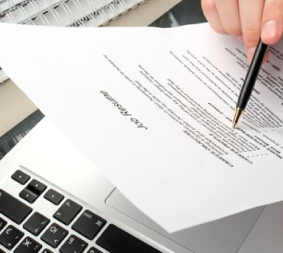
Why Is It Important To Have a Good CV?
Sometimes a CV is the first contact you have with a prospective employer, and it is your chance to make a good first impression.
You use it to show your prospective employer why they should hire you and what the benefits of having you on their team will be. It is ultimately a marketing tool – your shop window! It is far more than just a run-down of your career history, it is your passport to a new job.

Slide 4

How Do I Create a Good CV?
There are no hard and fast rules for creating a winning CV as each job is different and each employer will be looking for different things.
CV writing etiquette also changes over time, so it’s advisable to keep your CV updated and tailor it to each job that you apply for.

Slide 5
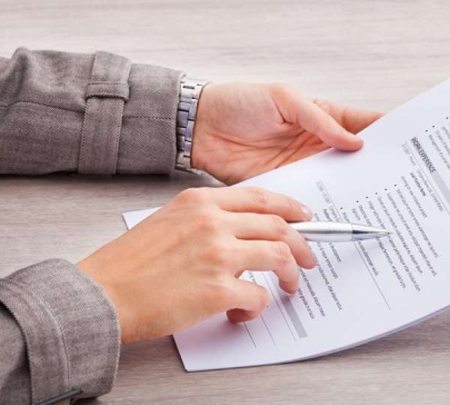
What To Remember…
Don’t lie – employers often run background checks and false claims will be uncovered
Sell yourself – what are your unique qualities, personality traits, skills and experience that make you stand out from the crowd
Personal statement first – put your academic qualifications at the back, if you’re buying a new car would you want to see the technical spec or the glossy picture first?
Don’t leave unexplained gaps – if you had a career break to travel or raise a family, explain what skills or experience you gained from this
Be clear and concise – CVs should be a maximum of three pages long and should be easy to read
Don’t make mistakes – check your spelling and grammar meticulously.

Slide 6
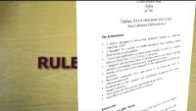
How to Write a Good CV

Slide 7
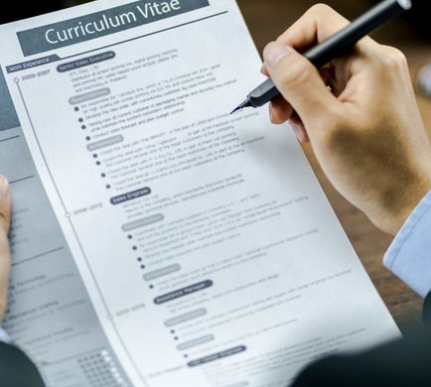
What To Include
Name / Contact Details
Key Achievements
Employment History
Education & Qualifications
Training
Interests & Hobbies
References – x2

Slide 8
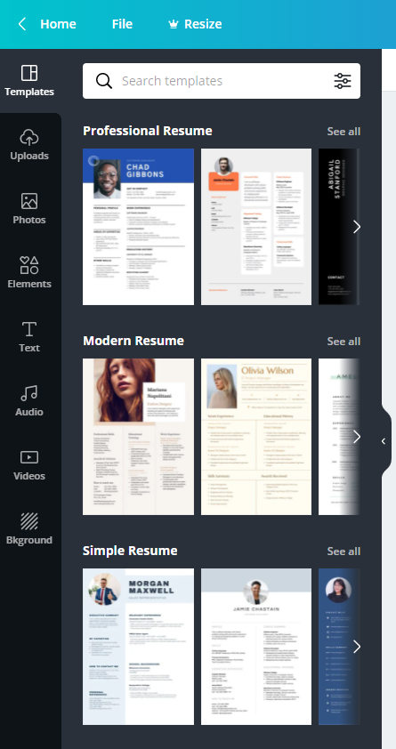

What Does a CV Look Like?

Slide 9
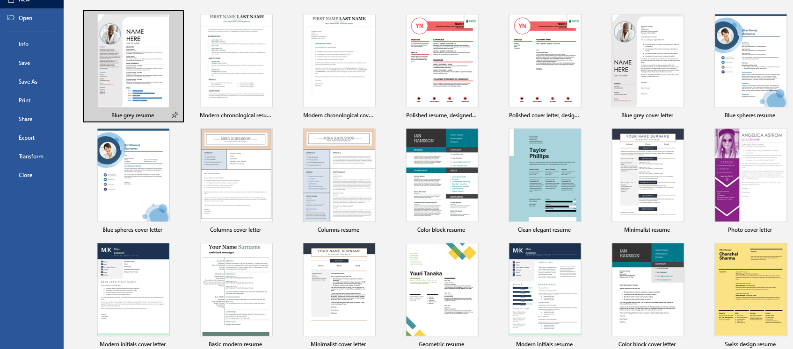
MS Word

