Slide 1

Revisiting Pedagogies in SciTech
ECAD6008

Slide 2

Session’s aims
Reinforce knowledge and understanding
Apply your understanding to your professional practice
Critically evaluate your practice
Create a purposeful way forward for your practice

Slide 3
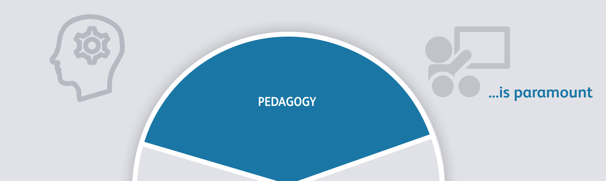
Professional Standards
Notes:
Link to professional standards

Slide 4

Activating prior knowledge about pedagogy
Pedagogy shapes all the decisions you make about your lessons in order to ensure inclusion, accessibility and progress for all your learners.
It’s therefore essential that you make the best possible pedagogical choices.
Notes:
Set 3rd point as task

Slide 5

Think, Pair, Share, Question
Think time – 5 minutes:
What are the sources you refer to to inform your pedagogy when planning – think broader than just documentation
Pair time – 10 minutes
Discuss and compare notes on the sources you may have used
Share time - 10 minutes
Share your discussion’s main points
Notes:
25 mins APK

Slide 6

Self Assessment Activity
1)Use the document to put a mark in the box that applies for each of the
2) In groups consider any recurring themes, and why this may be
3) Feedback

Slide 7
Planning ahead
1) Back in your groups, consider how you can develop 3 areas moving forward
2) Consider how you will evidence this? What will it look like in practice? What will the impact be on your learners?
Discuss in groups if your answers could be related to the nature of the subjects in your AoLE

Slide 8

The Pedagogical Principles
In groups, discuss and use the task sheet and note how your knowledge and understanding of these pedagogical principles has developed over the course of PTE
Can you give examples of where you have considered these in your practice?

Slide 9
The AoLE Lens
Considering moving forward reflect on:
What practice you have observed or taken part in in practice that shows an approach to AoLE planning?
Where are there opportunities going back to PTE to plan as an AoLE?
What are some of the barriers to this?
What steps can you take to overcome them?

