Slide 1
Ethical Hacking
Lecture 11-12
Lecturer: Assoc. Professor Carlene Campbell
Email: carlene.campbell@uwtsd.ac.uk
Website: https://www.knowledgewithprofit.com

Slide 2
This lecture will look at:
Cloud, Mobile, IoT & OT Hacking
And
Cryptography

Slide 3
Researching Attack Vectors and Performing Attacks on Cloud Technologies
Overview
Another trend that poses new security challenges is the migration of computing resources, data, and software to the cloud.
The cloud presents a network without a perimeter, there is no border between a traditional internal network and external users as there is when resources are housed on-site.
This lack of perimeter increases reliance on access control, cloud configuration, and network architecture for security. In addition, cloud applications and data are exposed to the internet via application programming interfaces (API).
Mobile and IoT devices often communicate with applications hosted in the cloud. All these technologies and architectures increase the attack surface and introduce a variety of cybersecurity risks.
Cloud computing security includes many of the same functionalities as traditional IT security, including protecting critical information from theft, data exfiltration, and deletion, as well as privacy.
The National Institute of Standards and Technology (NIST) authored Special Publication (SP) 800-145, “The NIST Definition of Cloud Computing,” to provide a standard set of definitions for the different aspects of cloud computing.
Cloud computing can be broken into the following three basic models:
  Infrastructure as a Service (IaaS)
  Platform as a Service (PaaS)
  Software as a Service (SaaS)

Slide 4
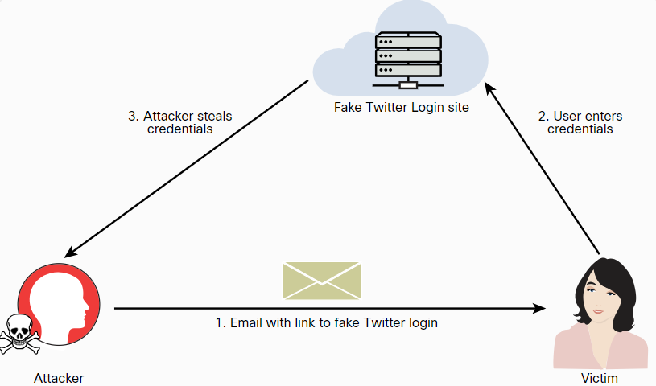
Researching Attack Vectors and Performing Attacks on Cloud Technologies
Credential Harvesting
Credential harvesting (or password harvesting) is the act of gathering and stealing valid usernames, passwords, tokens, PINs, and any other types of credentials through infrastructure breaches.
One of the most common ways that attackers perform credential harvesting is by using phishing and spear phishing emails with links that could redirect a user to a bogus site.

Slide 5
Researching Attack Vectors and Performing Attacks on Cloud Technologies
Credential Harvesting (Cont.)
These steps show how easy it is to perform a social engineering attack and instantiate a fake website (in this case, a fake Twitter login site) to perform a credential harvesting attack.
  Step 1. Launch SET by entering the setoolkit command.
  Step 2. Select 1) Social-Engineering Attacks from the main menu.
  Step 3. In the menu that appears, select 2) Website Attack Vectors.
  Step 4. In the menu and explanation that appear next, select 3) Credential Harvester Attack Method.
  Step 5. In the menu that appears next select 1) Web Templates to use a predefined web template (Twitter).
  Step 6. In the menu, enter the IP address of the host that you would like to use to harvest the user credentials (in this case, 192.168.88.225).
  Step 7. Select 3. Twitter

Slide 6
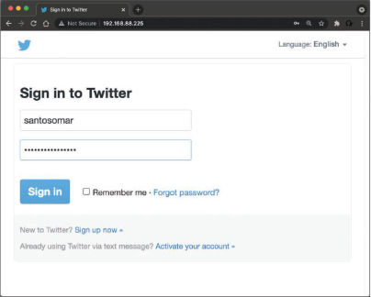
Researching Attack Vectors and Performing Attacks on Cloud Technologies
Credential Harvesting (Cont.)
You can then redirect users to this fake Twitter site by sending a spear phishing email or taking advantage of web vulnerabilities such as cross-site scripting (XSS) and cross-site request forgery (CSRF).
Attackers have been known to harvest cloud service provider credentials once they get into their victims’ systems. Different threat actors have extended their credential harvesting capabilities to target multiple cloud and non-cloud services in victims’ internal networks and systems after the exploitation of other vulnerabilities.

Slide 7
Researching Attack Vectors and Performing Attacks on Cloud Technologies
Cloud Malware Injection Attacks
Cloud deployments are susceptible to malware injection attacks.
In a cloud malware injection attack, the attacker creates a malicious application and injects it into a SaaS, PaaS, or IaaS environment.
Once the malware injection is completed, the malware is executed as one of the valid instances running in the cloud infrastructure.
Subsequently, the attacker can leverage this foothold to launch additional attacks, such as covert channels, backdoors, eavesdropping, data manipulation, and data theft.

Slide 8
Researching Attack Vectors and Performing Attacks on Cloud Technologies
Side-Channel Attacks
Side-channel attacks are often based on information gained from the implementation of the underlying computer system (or cloud environment) instead of a specific weakness in the implemented technology or algorithm.
The attacker aims to gather information from or influence an application or a system by measuring or exploiting indirect effects of the system or its hardware.
Most side-channel attacks are used to exfiltrate credentials, cryptographic keys, and other sensitive information by measuring coincidental hardware emissions.
Side-channel attacks can be used against VMs and in cloud computing environments where a compromised system controlled by the attacker and target share the same physical hardware.

Slide 9
Researching Attack Vectors and Performing Attacks on Cloud Technologies
Tools and Software Development Kits (SDKs)
Documents such as Swagger and the OpenAPI Specification documents can help you greatly when you are assessing API implementations.
Software development kits (SDKs) and cloud development kits (CDKs) can provide great insights about cloud-hosted applications, as well as the underlying infrastructure.
An SDK is a collection of tools and resources to help with the creation of applications (on premises or in the cloud).
CDKs, on the other hand, help software developers and cloud consumers deploy applications in the cloud and use the resources that the cloud provider offers.

Slide 10
Explaining Common Attacks and Vulnerabilities Against Specialized Systems
Attacking Mobile Devices
Attackers use various techniques to compromise mobile devices:
  Reverse Engineering - The process of analyzing the compiled mobile app to extract information about its source code could be used to understand the underlying architecture of a mobile application and potentially manipulate the mobile device.
  Sandbox Analysis - iOS and Android apps are isolated from each other via sandbox environments. Sandboxes in mobile devices are a mandatory access control mechanism describing the resources that a mobile app can and can’t access. An attacker could perform detailed analysis of the sandbox implementation in a mobile device to potentially bypass the access control mechanisms.
  Spamming – SMS attacks continue to be some of the most common attacks against mobile users. In such an attack, a user may be presented with links that could redirect to malicious sites to steal sensitive information or install malware.

Slide 11
Explaining Common Attacks and Vulnerabilities Against Specialized Systems
Attacking Mobile Devices (Cont.)
The following are some of the most prevalent vulnerabilities affecting mobile devices:
  Insecure storage - Mobile app developers often do not use these secure storage APIs successfully, and an attacker could leverage these vulnerabilities.
  Passcode vulnerabilities and biometrics integrations - Vulnerabilities in these integrations could lead to sensitive data exposure and full compromise of the mobile device.
  Certificate pinning - The idea is to force the mobile app to store the server certificate or public key and subsequently establish connections only to the trusted/known server (referred to as “pinning” the server). The goal of certificate pinning is to reduce the attack surface by removing the trust in external CAs.
  Using known vulnerable components - Attackers may leverage known vulnerabilities against the underlying mobile operating system, or dependency vulnerabilities (that is, vulnerabilities in dependencies of a mobile application).
  Execution of activities using root and over-reach of permissions - Application developers must practice the least privilege concept.
  Business logic vulnerabilities - An attacker can use legitimate transactions and flows of an application in a way that results in a negative behavior or outcome.

Slide 12
Explaining Common Attacks and Vulnerabilities Against Specialized Systems
Attacking Mobile Devices (Cont.)
These are some of the tools most commonly used to perform security research and test the security posture of mobile devices:
  Burp Suite
  Drozer
  needle
  Mobile Security Framework (MobSF)
  Postman
  Ettercap
  Frida
  Objection
  Android SDK tools
  ApkX
  APK Studio

Slide 13
Explaining Common Attacks and Vulnerabilities Against Specialized Systems
Attacking Internet of Things (IoT) Devices
IoT is an incredibly broad term that can be applied across personal devices, industrial control systems (ICS), transportation, and many other businesses and industries.
Managing and orchestrating IoT systems introduces additional complexity due to disparate hardware and software, the use of legacy technologies, and, often, multiple vendors and integrators.
IoT platforms must integrate a wide range of IoT edge devices with varying device constraints and must be integrated to back-end business applications.
IoT environments span a range of components that include sensors, gateways, network connectivity, applications, and cloud infrastructure.
The unfortunate reality is that most IoT security efforts today focus on only a few elements of the entire system. A secure IoT platform should provide the complete end-to-end infrastructure to build an IoT solution, including the software, management, and security to effectively collect, transform, transport, and deliver data to provide business value.

Slide 14
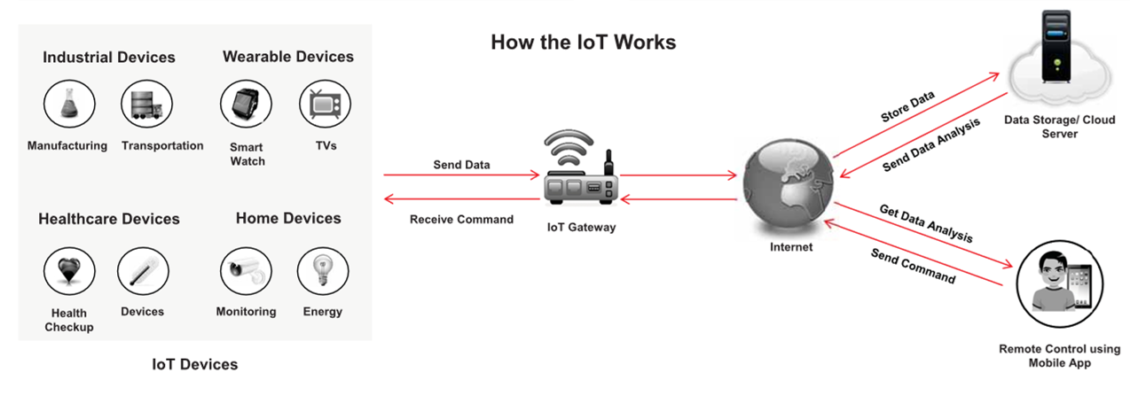
IoT
Internet of Things (IoT), also known as Internet of Everything (IoE), refers to the network of devices having IP addresses and the capability to sense, collect, and send data using embedded sensors, communication hardware and processors
In IoT, the term thing is used to refer to a device that is implanted on natural, human-made, or machine-made objects and has the functionality of communicating over the network

Slide 15
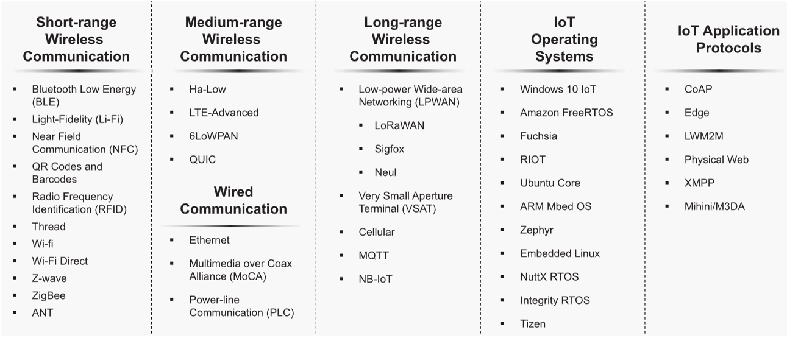
IoT Technologies and Protocols
Notes:
Some of the most common network protocols for IoT implementations include the following:
Wi-Fi
Bluetooth and Bluetooth Low Energy (BLE)
Zigbee
Z-Wave
LoraWAN
Insteon
Modbus
Siemens S7comm (S7 Communication)

Slide 16
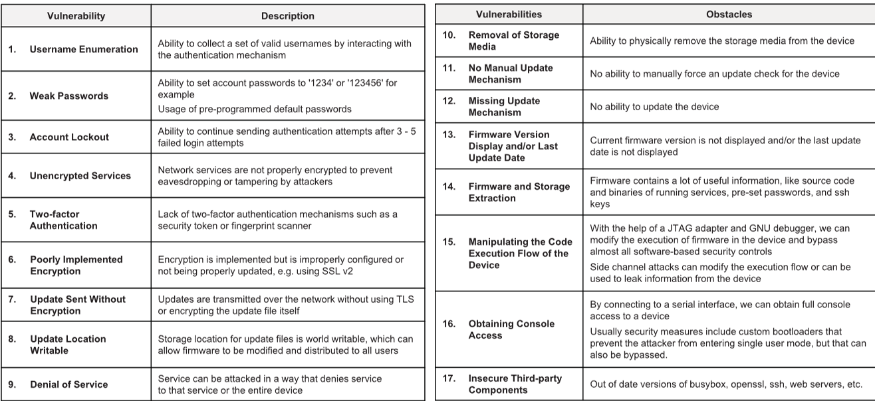
IoT Vulnerabilities
https://owasp.org
Notes:
These are some of the most common security vulnerabilities affecting IoT implementations:
Insecure defaults - Default credentials and insecure default configurations are often concerns with IoT devices. You will find hundreds of IoT devices with default credentials and insecure configurations exposed on the Internet.
Plaintext communication and data leakage - Even if encryption is supported, many IoT devices fail to implement encrypted communications, and an attacker could easily steal sensitive information.
Hard-coded configurations - Often IoT vendors sell their products with hard-coded insecure configurations or credentials.
Outdated firmware/hardware and the use of insecure or outdated components - Many organizations continue to run outdated software and hardware in their IoT devices. In some cases, some of these devices are never updated!

Slide 17
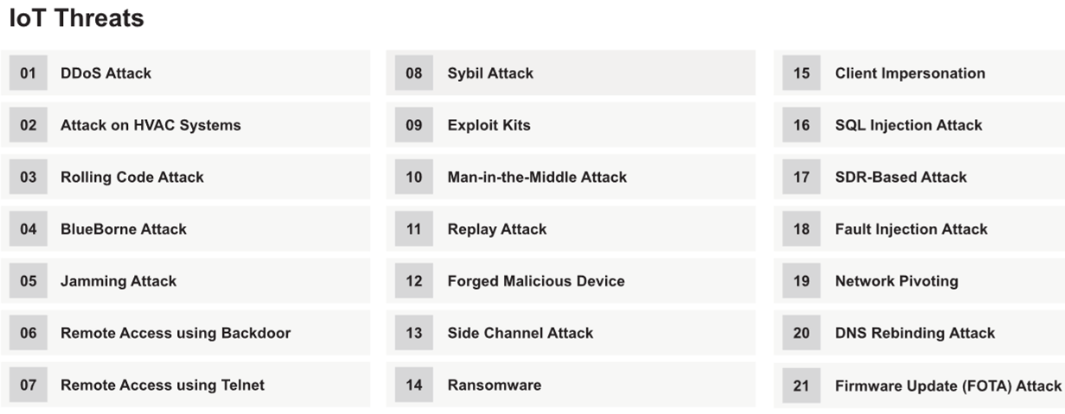
IoT Threats
IoT devices on the Internet have very few security protection mechanisms against various emerging threats
Attackers often exploit these poorly protected devices on the Internet to cause physical damage to the network, to wiretap the communication, and to launch disruptive attacks such as DDoS

Slide 18
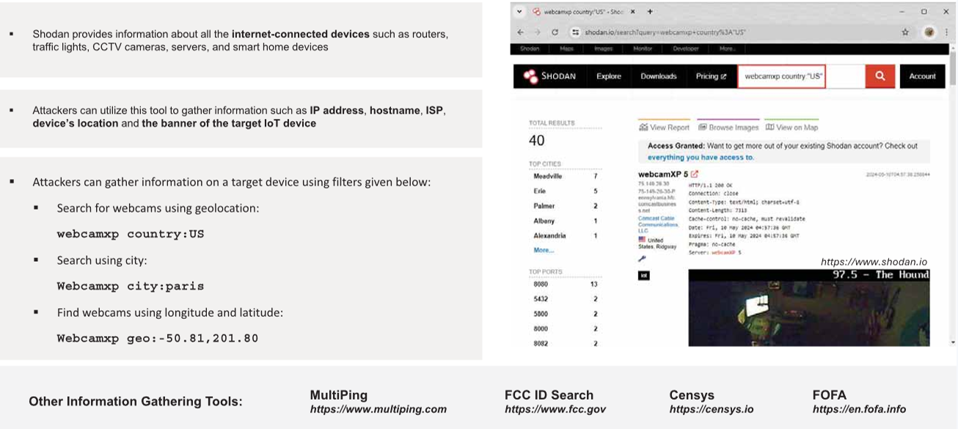
Information Gathering using Shodan

Slide 19
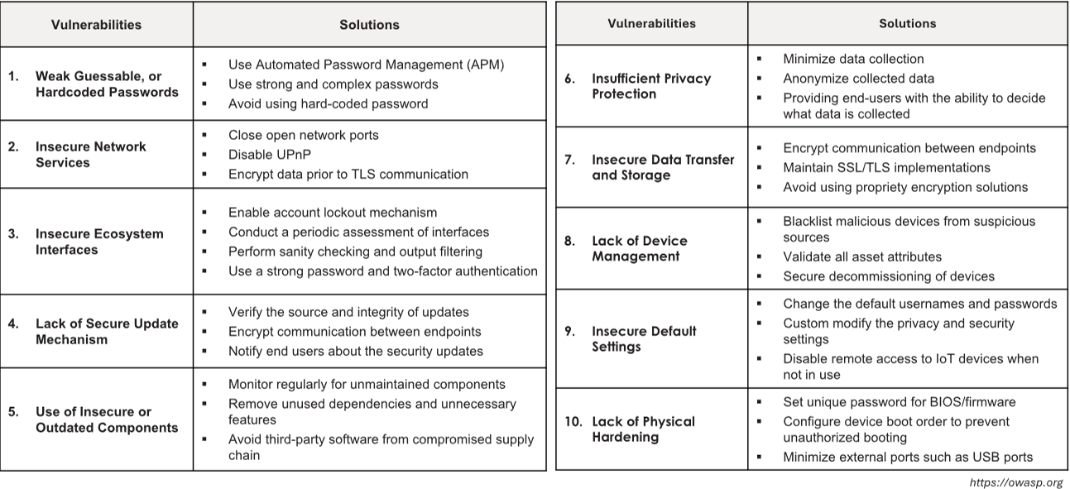
OWASP Top 10 IoT Vulnerabilities Solutions

Slide 20
Explaining Common Attacks and Vulnerabilities Against Specialized Systems
IoT Security Special Considerations
These are a few special considerations to keep in mind when trying to secure IoT implementations:
  Fragile Environment - Many IoT devices (including sensors and gateways) have limited compute resources. Because of this lack of resources, some security features, including encryption, may not even be supported in IoT devices.
  Availability Concerns - DoS attacks against IoT systems are a major concern.
  Data Corruption - IoT protocols are often susceptible to input validation vulnerabilities, as well as data corruption issues.
  Data Exfiltration - IoT devices could be manipulated by an attacker and used for sensitive data exfiltration.

Slide 21
Take a break
We’ll rejoin in 10 minutes

Slide 22
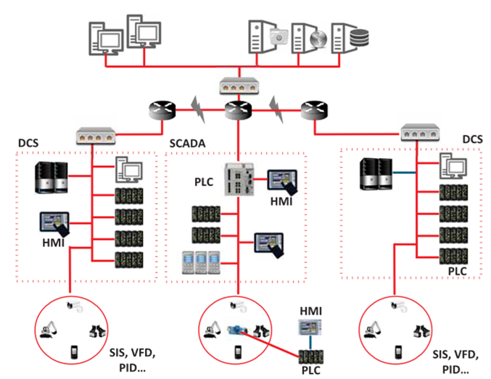
Operational Technology (OT)
Operational Technology (OT) is the software and hardware designed to detect or cause changes in industrial operations through direct monitoring and/or controlling of industrial physical devices
OT consists of Industrial Control Systems (ICS) that include Supervisory Control and Data Acquisition (SCADA), Remote Terminal Units (RTU), Programmable Logic Controllers (PLC), Distributed Control System (DCS), etc., to monitor and control the industrial operations
ICS is often referred to as a collection of different types of control systems and their associated equipment such as systems, devices, networks, and controls used to operate and automate several industrial processes
An ICS consists of several types of control systems like SCADA, DCS, BPCS, SIS, HMI, PLCs, RTU, IED, etc.

Slide 23
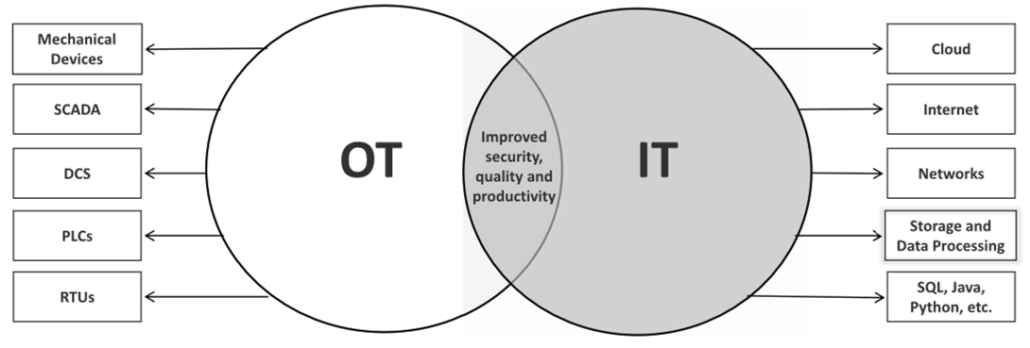
IT/OT Convergence (IIOT)
IT/OT convergence is the integration of IT computing systems and OT operation monitoring systems to bridge the gap between IT/OT technologies for improving overall security, efficiency, and productivity
The IT/OT convergence can enable smart manufacturing known as industry 4.0, where IoT applications are used in industrial operations
Using this Internet of Things (IoT) for industrial operations such as monitoring supply chains, manufacturing and management systems is referred to as Industrial Internet of Things (IIoT)

Slide 24
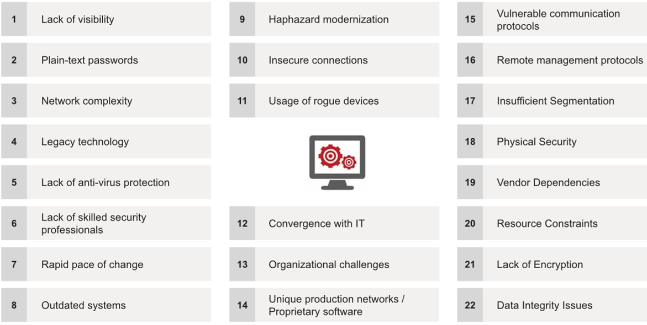
Challenges of OT

Slide 25
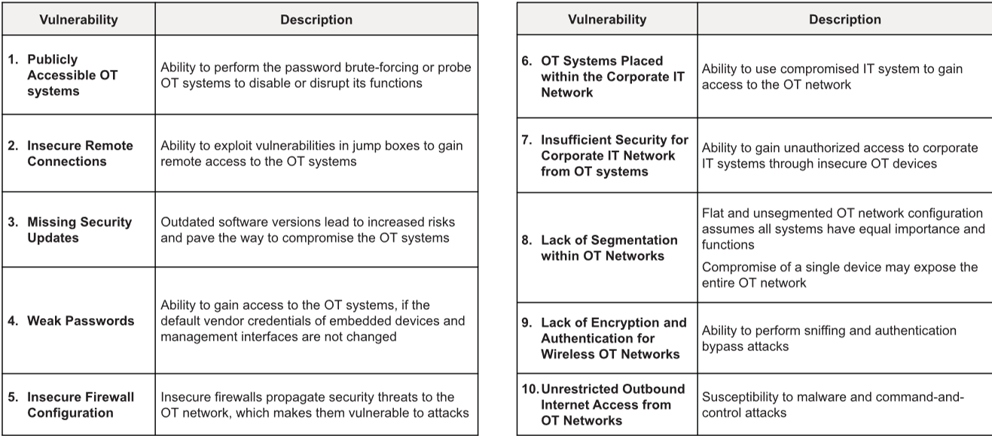
OT Vulnerabilities

Slide 26
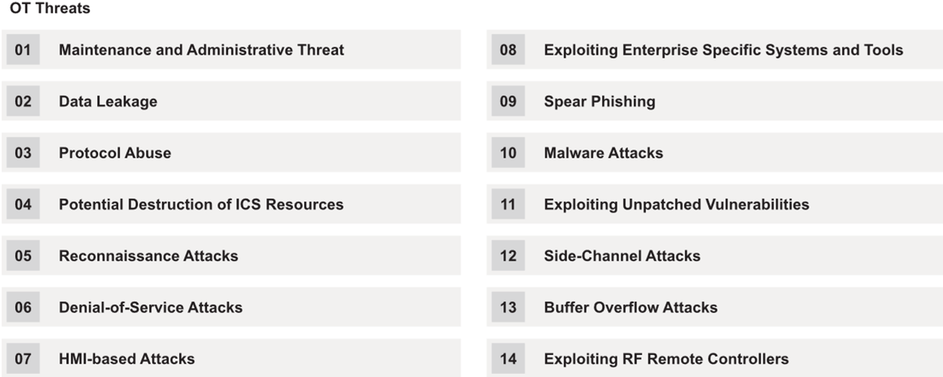
OT Threats
Most OT systems use legacy and outdated software with no security protection, leaving a potential gateway for cyber criminals to gain access to the corporate IT network and OT infrastructure

Slide 27
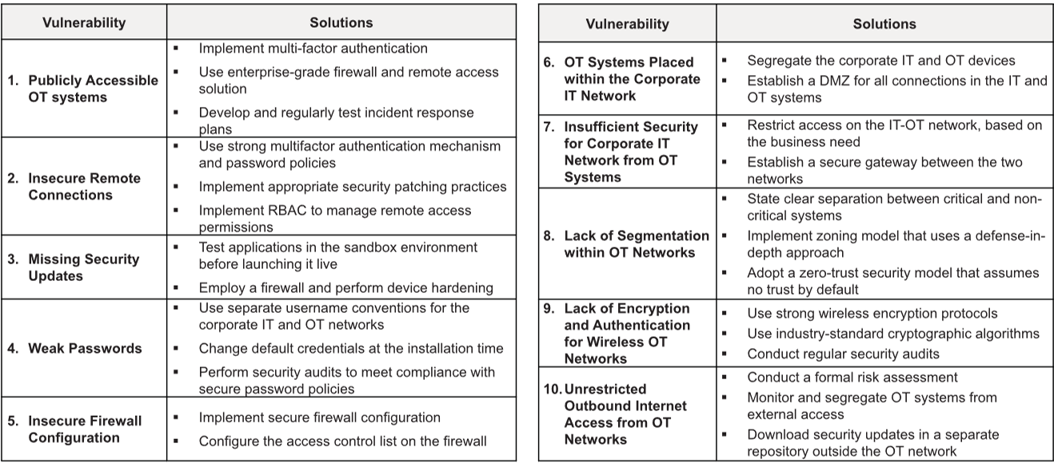
OT Vulnerabilities and Solutions

Slide 28
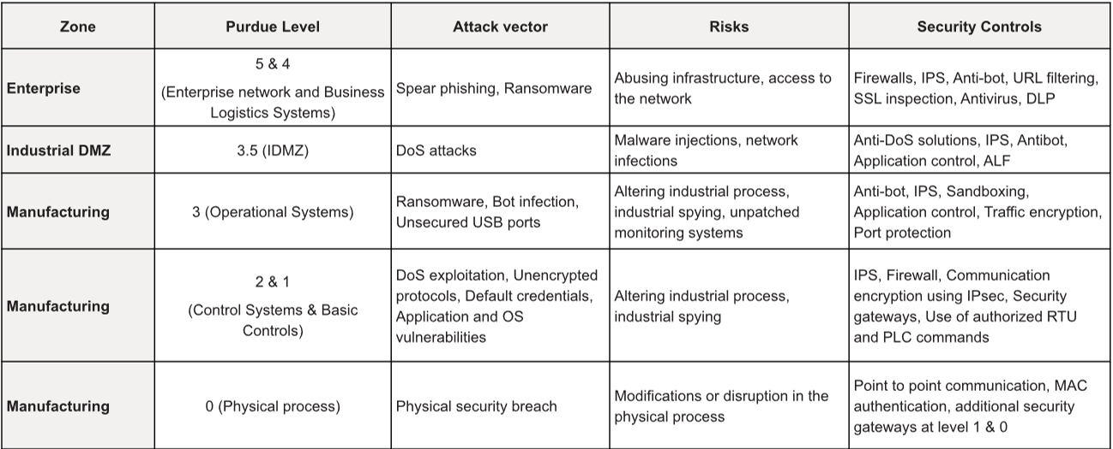
How to Secure an IT/OT Environment
Security Controls based on Purdue Model

Slide 29
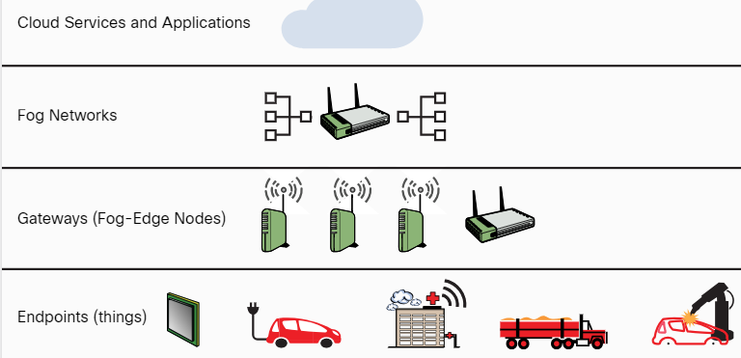
Explaining Common Attacks and Vulnerabilities Against Specialized Systems
Data Storage System Vulnerabilities
IoT architectures extend from IoT endpoint devices (things) to intermediary “fog” networks and cloud computing.
Gateways and edge nodes are devices such as switches, routers, and computing platforms that act as intermediaries (“the fog layer”) between the endpoints and the higher layers of the IoT system.
The IoT architectural hierarchy high-level layers:
IoT Architecture Layers

Slide 30
Explaining Common Attacks and Vulnerabilities Against Specialized Systems
Data Storage System Vulnerabilities (Cont.)
The following are some of the most common misconfigurations of IoT devices and cloud-based solutions:
  Default/blank username/password – Hardcoded or default credentials are often left in place by administrators and in some cases by software developers, exposing devices or the cloud environment to different attacks.
  Network exposure – Many IoT, ICS, and SCADA systems should never be exposed to the Internet.
  Lack of user input sanitization - Input validation vulnerabilities in protocols such as Modbus, S7 Communication, DNP3, and Zigbee could lead to DoS and code execution.
  Underlying software vulnerabilities and injection vulnerabilities – Attackers can inject malicious SQL statements after “escaping input” by using the single quote method. IoT systems can be susceptible to similar vulnerabilities.
  Error messages and debug handling - Many IoT systems include details in error messages and debugging output that can allow an attacker to obtain sensitive information from the system and underlying network.

Slide 31
Explaining Common Attacks and Vulnerabilities Against Specialized Systems
Management Interface Vulnerabilities
The Intelligent Platform Management Interface (IPMI) is a collection of compute interface specifications (often used by IoT systems) designed to offer management and monitoring capabilities independently of the host system’s CPU, firmware, and operating system.
System administrators can use IPMI to enable out-of-band management of computer systems (including IoT systems) and to monitor their operation.
An IPMI subsystem includes a main controller, called a baseboard management controller (BMC), and other management controllers, called satellite controllers.
The satellite controllers within the same physical device connect to the BMC via the system interface called Intelligent Platform Management Bus/Bridge (IPMB).
The BMC, which has direct access to the system’s motherboard and other hardware, may be leveraged to compromise the system.
If you compromise the BMC, it will provide you with the ability to monitor, reboot, and even potentially install implants (or any other software) in the system.

Slide 32
Explaining Common Attacks and Vulnerabilities Against Specialized Systems
Exploiting Virtual Machines
A VM is supposed to be a completely isolated system. One VM should not have access to resources and data from another VM unless that is strictly allowed and configured.
The hypervisor is the entity that controls and manages the VMs. There are two types of hypervisors:
  Type 1 hypervisors (also known as native or bare-metal hypervisors) run directly on the physical (bare-metal) system. Type 2, or hosted, hypervisors run on top of other operating systems. These virtual systems have been susceptible to many vulnerabilities, including the following:
  VM escape vulnerabilities: These vulnerabilities allow an attacker to “escape” the VM and obtain access to other virtual machines on the system or access to the hypervisor.
  Hypervisor vulnerabilities such as hyperjacking: Hyperjacking is a vulnerability that could allow an attacker to control the hypervisor. Hyperjacking attacks often require the installation of a malicious (or “fake”) hypervisor that can manage the entire virtual environment.
  VM repository vulnerabilities: Attackers can leverage these vulnerabilities to compromise many systems and applications. There are many public and private VM repositories that users can leverage to deploy VMs. Attackers have found ways to upload fake or impersonated VMs with malicious software and backdoors.

Slide 33
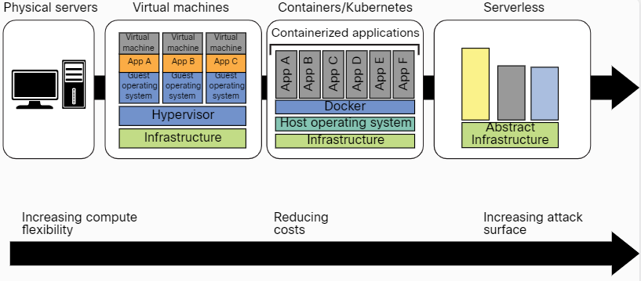
Explaining Common Attacks and Vulnerabilities Against Specialized Systems
Vulnerabilities Related to Containerized Workloads
Computing has evolved from traditional physical (bare-metal) servers to VMs, containers, and serverless architectures.
The Evolution of Computing

Slide 34
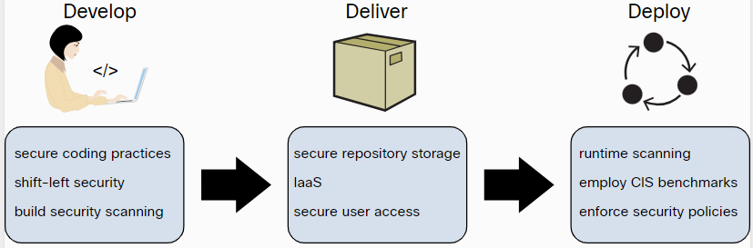
Explaining Common Attacks and Vulnerabilities Against Specialized Systems
Vulnerabilities Related to Containerized Workloads (Cont.)
Vulnerabilities in applications and in open-source software running in containers such as Docker, Rocket, and containerd are often overlooked by developers and IT staff. Attackers may take advantage of these vulnerabilities to compromise applications and data.
Three key security best practices that organizations should use to create a secure container image:
Securing Container Images

Slide 35
Explaining Common Attacks and Vulnerabilities Against Specialized Systems
Vulnerabilities Related to Containerized Workloads (Cont.)
Many tools allow you to scan Docker images for vulnerabilities and assess Kubernetes deployments. The following are a few examples of these tools:
  Anchore’s Grype - Grype is an open-source container vulnerability scanner
  Clair – Another open-source container vulnerability scanner
  Dagda - This set of open-source static analysis tools can help detect vulnerabilities, Trojans, backdoors, and malware in Docker images and containers
  kube-bench - This open-source tool performs a security assessment of Kubernetes clusters based on the CIS Kubernetes Benchmark.
  kube-hunter - This open-source tool is designed to check the security posture of Kubernetes clusters.
  Falco – A threat detection engine for Kubernetes
Another strategy that threat actors have used for years is to insert malicious code into Docker images on Docker Hub

Slide 36
Cryptography

Slide 37
Learning Outcome
Upon completion of this material, you should be able to:
  Understanding Cryptography concepts
  Understand Public Key Infrastructure (PKI)
  Understand Email and Disk encryption
  Understand Cryptography Attacks
  Know the tools
  Know about the countermeasures
Notes:
Cloud computing is an emerging technology that delivers computing services such as online business applications, online data storage, and webmail over the Internet. Cloud implementation enables a distributed workforce, reduces organization expenses, and provides data security, and so on. As many enterprises are adopting the cloud, attackers make cloud as their target of an exploit to gain unauthorized access to the valuable data stored in it. Therefore, one should perform cloud pen testing regularly to monitor its security posture.

Slide 38
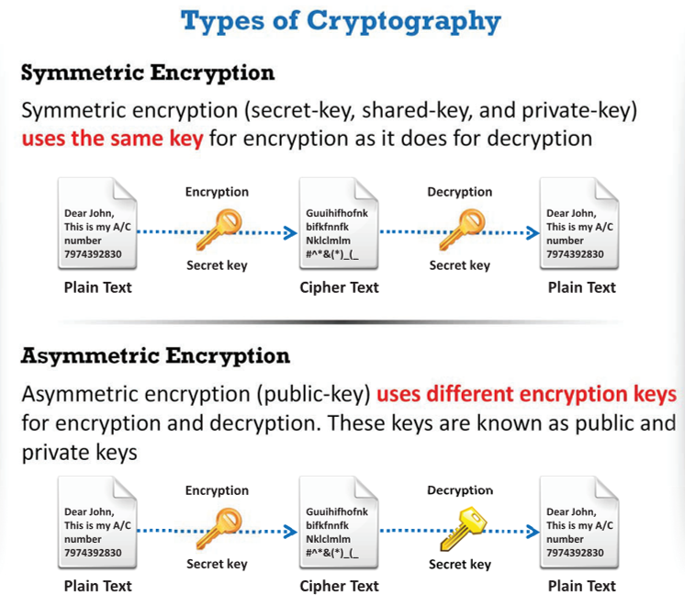
Cryptography concepts
Cryptography is the conversion of data into a scrambled code that is encrypted and sent across a private or public network
Cryptography is used to protect confidential data such as email messages, chat sessions, web transactions, personal data, corporate data, e-commerce applications, etc.
Objectives of Cryptography
Confidentiality - Assurance that the information is accessible only to those authorized to have access.
Integrity - The trustworthiness of data or resources in terms of preventing improper and unauthorized changes.
Authentication - Refers to the characteristic of a communication, document, or any data that ensures the quality of being genuine.
Nonrepudiation - Guarantee that the sender of a message cannot later deny having sent the message, and that the recipient cannot deny having received the message.
Notes:
Cryptography
“Cryptography” comes from the Greek words kryptos, meaning “concealed, hidden, veiled, secret, or mysterious,” and graphia, “writing”; thus, cryptography is “the art of secret writing.”
Cryptography is the practice of concealing information by converting plain text (readable format) into cipher text (unreadable format) using a key or encryption scheme. It is the process of conversion of data into a scrambled code that is encrypted and sent across a private or public network. Cryptography protects confidential data such as email messages, chat sessions, web transactions, personal data, corporate data, e-commerce applications, and many other kinds of communication. Encrypted messages can at times be decrypted by cryptanalysis (code breaking), even though modern encryption techniques are virtually unbreakable.
Objectives of Cryptography
▪ Confidentiality - Assurance that the information is accessible only to those authorized to have access.
▪ Integrity - The trustworthiness of data or resources in terms of preventing improper and unauthorized changes.
▪ Authentication - Refers to the characteristic of a communication, document, or any data that ensures the quality of being genuine.
▪ Nonrepudiation - Guarantee that the sender of a message cannot later deny having sent the message, and that the recipient cannot deny having received the message.

Slide 39
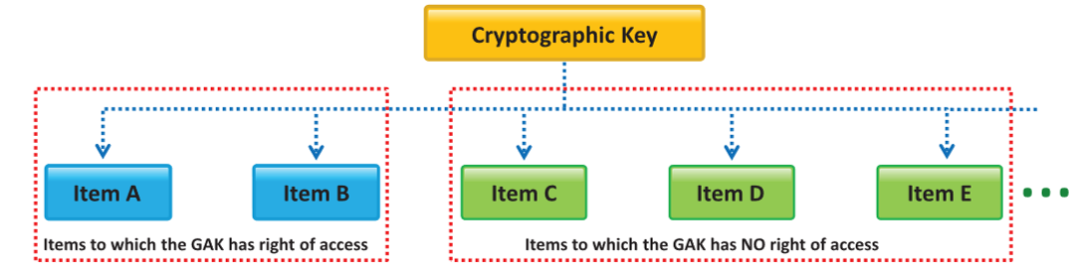
Government Access to Keys (GAK)
GAK means that software companies will give copies of all keys (or at least enough of the key that the remainder could be cracked) to the government
The government promises that they would hold on to the keys in a secure manner and will only use them when a court issues a warrant to do so
To the government, the issue is similar to the ability to wiretap phone.
Notes:
Government Access to Keys (GAK) refers to statutory obligation of individuals and organizations to disclose their cryptographic keys to government agencies. It means that software companies will give copies of all keys, (or at least enough of the key that the remainder could be cracked) to the government. Law enforcement agencies around the world acquire and use these cryptographic keys to monitor suspicious communication, and collect evidence of cybercrimes in the interest of national security. The government promises that they will hold on to the keys in a secure way, and will only use them when a court issues a warrant to do so. To the government, this issue is similar to the ability to wiretap phones.
Government agencies often use key escrow to have uninterrupted access to keys. Key escrow is a key exchange arrangement in which essential cryptographic keys are stored with a third party in escrow. The third party can use or allow others to use the encryption keys under certain predefined circumstances. The third party, with reference to GAK, is generally a government agency that may use the encryption keys to decipher digital evidence using authorization or a warrant from a court of law. However, there is a growing concern about privacy and security of cryptographic keys and information. Government agencies are responsible for protecting the keys.
These agencies generally use a single key to protect other keys, which is not a good idea, as revealing a single key could cause exposure of other keys. These agencies are not aware just how confidential the information protected by the keys is, which makes it difficult to judge how much protection is required. In cases where seized keys also protect other information to which these agencies do not have the right to access, consequences of key revelation cannot be determined, because government agencies are not aware of the information the keys protect. In such cases, the key owner is liable for the consequences of key revelation. Before owner’s hand over their keys to government agencies, they need to be assured that government agencies will protect these keys according to a standard that is sufficient to protect their interests.

Slide 40
Encryption Algorithm
Ciphers – an algorithm for preforming encryption and decryption.
Data Encryption Standard (DES) - a standard for data encryption that uses a secret key for both encryption and decryption (symmetric cryptosystem).
Advanced Encryption Standard (AES) is a National Institute of Standards and Technology (NIST) specification for the encryption of electronic data.
RC4, RC5, RC6 Algorithms are symmetric encryption algorithms, developed by RSA Security
Twofish algorithm was one of the five finalists to replace DES for the U.S. Government, but was not chosen.
The Digital Signature Algorithm (DSA) is a Federal Information Processing Standard for digital signatures.
Ron Rivest, Adi Shamir, and Leonard Adleman formulated RSA, a public-key cryptosystem for Internet encryption and authentication.
Diffie-Hellman - A cryptographic protocol that allows two parties to establish a shared key over an insecure channel.
Message Digest (One-way Hash) Functions calculate a unique fixed-size bit string representation called a message digest of any arbitrary block of information.
Notes:
Ciphers
In cryptography, a cipher is an algorithm (a series of well-defined steps) for performing encryption and decryption. Encipherment is the process of converting plain text into a cipher or code; the reverse process is called decipherment. A message is encrypted using a cipher is rendered unreadable, unless its recipient knows the secret key required to decrypt it. Communication technologies (e.g., Internet, cell phones) rely on ciphers to maintain both security and privacy. The cipher algorithms may be open sourced (the algorithmic process is in public domain while key is selected by a user and is private) or close sourced (the process is developed for use in specific domain like military and the algorithm itself is not in public domain). Further, the ciphers could be either free for public use or licensed.
DES is a standard for data encryption that uses a secret key for both encryption and decryption (symmetric cryptosystem). DES uses a 64-bit secret key of which 56 bits are generated randomly and other 8 bits help in error detection. It uses the Data Encryption Algorithm (DEA), a secret key block-cipher employing a 56-bit key operating on 64-bit blocks. DES is the archetypal block cipher — an algorithm that takes a fixed-length string of plaintext bits and transforms it into a ciphertext bit string of the same length. DES’s design allows users to implement it in hardware and use for single-user encryption, such as to store files on a hard disk in encrypted form. DES provides 72 quadrillion or more possible encryption keys and chooses a random key for encryption of each message. Because of the inherent weakness of DES vis-à-vis today's technologies, some organizations use triple DES, in which they repeat the process three times (3DES) for added strength. Triple Data Encryption Standard (3DES) Eventually it became obvious that DES would no longer be secure. The U.S. federal government began a contest seeking a replacement cryptography algorithm. However, in the meantime, 3DES was created as an interim solution. Essentially, it does DES three times with three different keys. 3DES uses a “key bundle” which comprises three DES keys, K1, K2, and K3. Each key is standard 56-bit DES key. It will then apply the following process: DES encrypt with K1, DES decrypt with K2, then DES encrypt with K3. There are three options for the keys. In the first option, all three keys are independent and different. In the second option, K1 and K3 are identical. In the third option, all three keys are the same. Therefore, you are literally applying the exact same DES algorithm three times with the same key. Option 1 is the most secure, with option 3 being the least secure.
▪ RC4
RC4 is a variable key-size symmetric-key stream cipher with byte-oriented operations that depends on the use of a random permutation. According to some analyses, the period of the cipher is likely to be greater than 10,100. Each output byte uses eight to sixteen system operations, meaning the cipher has the ability to run fast when used in software. Products like RSA SecurPC use this algorithm for file encryption. RC4 enables safe communications such as traffic encryption (which secures Web sites) and for Web sites that use the SSL protocol.
▪ RC5
RC5 is a fast symmetric-key block cipher designed by Ronald Rivest for RSA Data Security (now RSA security). The algorithm is a parameterized algorithm with a variable block size, variable key size, and a variable number of rounds. The block sizes can be 32, 64, or 128 bits. The range of the rounds can vary from 0 to 255, and the size of the key can vary from 0 to 2,040 bits. This built in variability can offer flexibility at all levels of security. Routines used in RC5 are key expansion, encryption, and decryption. In the key expansion routine, the secret key that a user provides is expanded to fill the key table (the size of which depends on the number of rounds). The RC5 uses key table for both encryption and decryption. The encryption routine has three fundamental operations: integer addition, bitwise XOR, and variable rotation. The intense use of data-dependent rotation, plus the combination of different operations, makes RC5 a secure encryption algorithm.
▪ RC6
RC6 is a symmetric key block cipher derived from RC5.It is a parameterized algorithm with a variable block size, key size, and number of rounds. Two features that differentiate the RC6 algorithm from RC5 are integer multiplication (which is used to increase the diffusion achieved in fewer rounds and increased speed of the cipher), and the use of four 4-bit working registers rather than two 2-bit registers. The RC6 algorithm uses Four 4-bit registers in place of the two 2-bit registers because the block size of the AES is 128 bits.
Blowfish
Blowfish is a type of symmetric block cipher algorithm, designed to replace DES or IDEA
algorithms. It uses a same secret key to encrypt and decrypt data. This algorithm splits the data into a block length of 64-bit size and produces a key ranging from length 32 bits to 448 bits. Due to the high speed and overall efficiency, blowfish is used in software ranging from categories such as password protection tools to e-commerce websites for securing payments. It is a 16-round Feistel cipher working on 64-bit blocks. However, unlike DES, it can have varying key sizes ranging from 32 bits to 448 bits. There are really two parts to this algorithm. The first part handles the expansion of the key. The second part actually encrypts the data. The key expansion is handled in several steps. The first step is to break the original key into a set of subkeys. Specifically, a key of no more than 448 bits is separated into 4,168 bytes. There is a P-array and four 32-bit S-boxes. The P-array contains 18 32-bit subkeys, while each S-box contains 256 entries.
Key expansion is done as follows:
1. The first step in the key expansion phase is to initialize the P-array and S-boxes.
2. Then, XOR P-array with the key bits. For example, P1 XOR (first 32 bits of the key), P2XOR (second 32 bits of the key).
3. Use the above method to encrypt the all-zero string.
4. This new output is now P1 and P2. 5. Encrypt the new P1 and P2 with the modified subkeys. 6. This new output is now P3 and P4. 7. Repeat 521 times in order to calculate new subkeys for the P-array and the four S-boxes.
The round function splits the 32-bit input into four eight-bit quarters, and uses the quarters as input to the S-boxes. The outputs are added modulo 232 and XORed to produce the final 32-bit output.
Twofish
Twofish algorithm was one of the five finalists to replace DES for the U.S. Government, but was not chosen. It was designed by Bruce Schneier, John Kelsey, Doug Whiting, David Wagner, Chris Hall, and Niels Ferguson.
TwoFish is a 128-bit block cipher. It is one of the most conceptually simple algorithm that uses a single key for both encryption and decryption for any length up to 256 bits. It is a Feistel cipher. It not only works fast for CPU or hardware in fact it is flexible with network based applications also. It even enables various levels of performance trade-off on parameters like encryption speed, hardware gate count, memory usage, etc. This technique of enabling different implementations improves the relative performance of the algorithm. Any user can optimize the performance based on the different key scheduling.
The DSA and Related Signature Schemes
The Digital Signature Algorithm (DSA) is a Federal Information Processing Standard for digital signatures. The NIST proposed the DSA for use in the Digital Signature Standard (DSS), adopted as FIPS 186. The DSA helps in the generation and verification of digital signatures for sensitive and unclassified applications. It creates a 320-bit digital signature but with 512–1024 bit security. Digital signature is a mathematical scheme used for the authentication of digital messages. Computation of the digital signature uses a set of rules (i.e., the DSA) and a set of parameters, in that the user can verify the identity of the signatory and integrity of the data.
Processes involved in DSA:
▪ Signature Generation Process: The private key is used to know who has signed it.
▪ Signature Verification Process: The public key is used to verify whether the given digital signature is genuine.
DSA is a public-key crypto system as it involves the use of both private and public keys.
Benefits of DSA:
▪ Less chances of forgery than with a written signature
▪ Quick and easy method of business transactions
▪ Fake currency problem can be drastically reduced
Rivest Shamir Adleman (RSA)
Ron Rivest, Adi Shamir, and Leonard Adleman formulated RSA, a public-key cryptosystem for Internet encryption and authentication. RSA uses modular arithmetic and elementary number theories to perform computations using two large prime numbers. The RSA system is widely used in a variety of products, platforms, and industries. It is one of the de-facto encryption standards. Companies such as Microsoft, Apple, Sun, and Novell build the RSA algorithms into their operating systems. RSA can also be found on hardware secured telephones, Ethernet network cards, and smart cards
RSA works as follows:
1. Two large prime numbers are taken (a and b), and their product is determined (c = ab, where “c” is called the modulus).
2. RSA chooses a number “e” that it is less than “c” and relatively prime to (a-1)(b-1). Therefore, e and (a-1)(b-1) have no common factors except 1.
3. Apart from this, RSA chooses a number “f” such that (ef - 1) is divisible by (a-1)(b-1). 4. The values “e” and “f” are the public and private exponents, respectively. 5. The public key is the pair (c, e); the private key is the pair (c, f). 6. It is difficult to obtain the private key (c, f) from the public key (c, e). However, if someone can factor “c” into “a” and “b”, then that person can decipher the private key (c, f).
The security of the RSA system depends on the assumption that such factoring is difficult to carry out, making the cryptographic technique safe.
Following sequence is an example of how cryptography uses RSA algorithms in a practical interchange:
1. The sender of a message encrypts it using a randomly chosen DES symmetric key. DES (Data Encryption Standard) is a relatively insecure symmetric key system using 64-bit encryption (56 bits for key size, 8 bits for cyclic redundancy check) to encrypt data.
2. The sender will then look up the recipient’s public key and use it to encrypt the DES key using the RSA system.
3. The sender transmits an RSA digital envelope, consisting of a DES-encrypted message and an RSA-encrypted DES key, to the recipient.
4. The recipient will decrypt the DES key and then use the DES key to decrypt the message itself.
This system combines the high speed of DES with the key management convenience of the RSA system.
The RSA Signature Scheme
Cryptography uses RSA for both public key encryption and for a digital signature (to sign a message and verify it). The RSA signature scheme is the first technique used to generate digital signatures. It is a deterministic digital signature scheme that provides message recovery from the signature itself, making it the most practical and versatile technique available. RSA involves both a public key and a private key. The public key, as the name indicates, means any person can use it for encrypting messages. The messages that user encrypts with the public key require the private key for decryption.
Diffie-Hellman
A cryptographic protocol that allows two parties to establish a shared key over an insecure channel. It was developed and published by Whitfield Diffie and Martin Hellman in 1976. Actually, it was independently developed a few years earlier by Malcolm J. Williamson of the British Intelligence Service, but it was classified. Diffie-Hellman Algorithm The system has two parameters called p and g ▪ Parameter p is a prime number and ▪ Parameter g (usually called a generator) is an integer less than p, with the following property: for every number n between 1 and p-1 inclusive, there is a power k of g such that n = g kmod p
Many cryptography textbooks use the fictitious characters ‘alice’ and ‘bob’ to illustrate cryptography and we will do that here as well: ▪ Alice generates a random private value a, and Bob generates a random private value b. Both a and b are drawn from the set of integers
▪ They derive their public values using parameters p and g and their private values. Alice's public value is ga mod p, and Bob's public value is gb mod p.
▪ They exchange their public values
▪ Alice computes gab = (gb)a mod p, and Bob computes gba = (ga)b mod p
▪ Since gab = gba = k, Alice and Bob now have a shared secret key k
Message Digest (One-way Hash) Functions
Hash functions calculate a unique fixed-size bit string representation called a message digest of any arbitrary block of information. Message digest functions distill the information contained in a file (small or large) into a single fixed-length number, typically between 128 and 256 bits. If any given bit of the function’s input is changed, every output bit has a 50% chance of changing. Given an input file and its corresponding message digest, it should be nearly impossible to find another file with the same message digest value, as it is computationally infeasible to have two files with the same message digest value.
Message digest functions are also called one-way hash functions because they produce values that are almost impossible to invert, resistant to attack, mostly unique, and widely distributed. Message-digest algorithms themselves do not participate in encryption and decryption operations. They enable creation of digital signatures and message authentication codes (MACs), and the derivation of encryption keys from passphrases.
The main role of a cryptographic hash function is to provide integrity in document management. Cryptographic hash functions are an integral part of digital signatures. They are relatively faster than digital-signature algorithms; hence, their characteristic feature is to calculate the signature of the document’s hash value, which is smaller than the document. In addition, digests help to hide the contents or source of the document.
Widely used message-digest functions include the following algorithms:
▪ MD5
▪ SHA
Note: Message digests are also called one-way hash functions because they cannot be reversed.

Slide 41
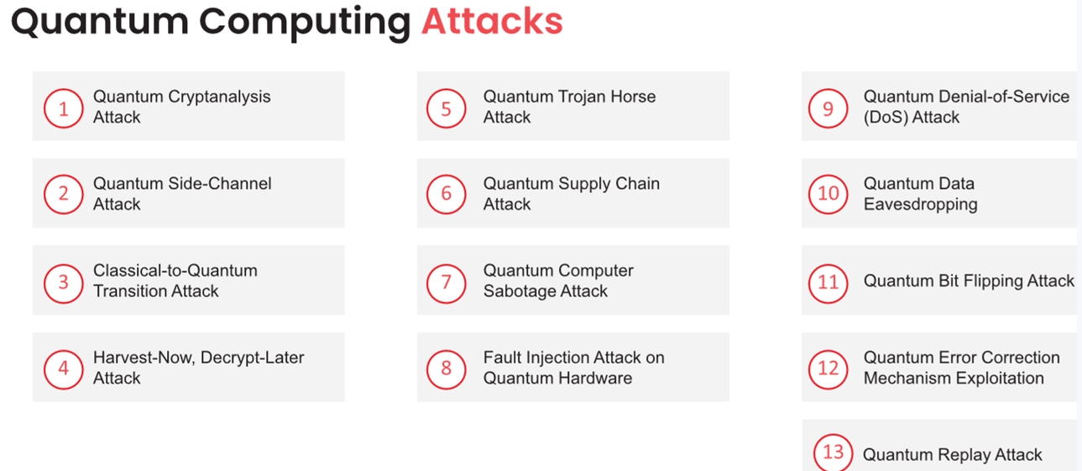
Quantum Cryptography
Quantum cryptography is based on quantum mechanics, such as quantum key distribution (QKD) Data is encrypted by a sequence of photons with a spinning trait while travelling from one end to another
These photons keep changing their shapes during their course through filters: vertical, horizontal, forward slash, and backslash
Attackers can eavesdrop but cannot manipulate the data because the photons are transferred through arbitrary filters

Slide 42
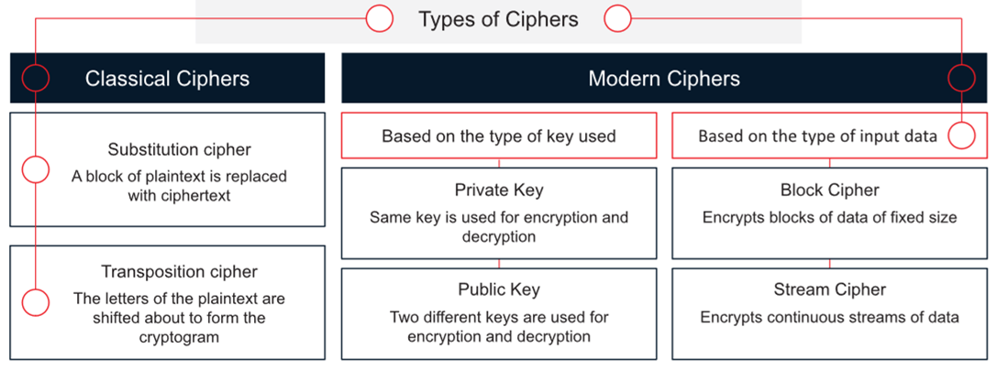
Ciphers
Ciphers are algorithms used to encrypt or decrypt the data

Slide 43
Cryptography Tools
MD5 Calculator
Source: http://www.bullzip.com
Hash Calculators for Mobile:
MD5 Hash Calculator -
Source: http://md5calculator.chromefans.org
Hash Droid - Source: https://play.google.com
HashMyFiles
Source: https://www.nirsoft.net
Advanced Encryption Package 2017 Source: https://www.aeppro.com
Additional MD5 hash calculators are:
HashCalc (https://www.slavasoft.com)
Hash Calculator (https://www.mcafee.com)
HashTool (https://www.digitalvolcano.co.uk)
BCTextEncoder
Source: https://www.jetico.com
Some of the additional cryptography tools:
AxCrypt (https://www.axcrypt.net)
Folder Lock (http://www.newsoftwares.net)
CryptoExpert 8 (https://www.cryptoexpert.com)
CertainSafe (https://certainsafe.com)
VeraCrypt (https://veracrypt.codeplex.com)
Cryptainer LE Free Encryption Software (http://www.cypherix.com)
CryptoForge (https://www.cryptoforge.com)
winAES (https://winaes.com)
EncryptOnClick (https://www.2brightsparks.com)
GNU Privacy Guard (https://www.gnupg.org)
Steganos Safe 19 (https://www.steganos.com)
Secure IT (http://www.cypherix.com)
AES Crypt (https://www.aescrypt.com)
Steganos LockNote (https://sourceforge.net)
Autokrypt (http://www.hiteksoftware.com)
cryptography tools for mobiles:
Secret Space Encryptor (https://paranoiaworks.mobi)
Decrypto (https://play.google.com)
SealNote Secure Encrypted Note (https://play.google.com)
Encrypt Decrypt (https://play.google.com)
Crypten : Encryption (https://play.google.com)
Cipher Sender (https://play.google.com)
Notes:
▪ MD5 Calculator Source: http://www.bullzip.com MD5 Calculator allows to calculate the MD5 hash value of the selected file. Right click the file and choose "MD5 Calculator," the program will calculate the MD5 hash. The MD5 Digest field contains the calculated value. To compare this MD5 digest to another, one can paste the other value into the Compare To field. Obviously, an equal sign (“=”) appears between the two values if they are equal; otherwise, the less than (“<”) or greater than (“>”) sign will tell you that the values are different.
▪ HashMyFiles Source: https://www.nirsoft.net
HashMyFiles is small utility that allows to calculate the MD5 and SHA1 hashes of one or more files in the system. It allows to copy the MD5/SHA1 hashes list into the clipboard or save them into text/html/xml file. One can launch HashMyFiles from the context menu of Windows Explorer and display MD5/SHA1 hashes of the selected file or folder.
Some of the additional MD5 hash calculators are listed below:
▪ HashCalc (https://www.slavasoft.com)
▪ Hash Calculator (https://www.mcafee.com)
▪ HashTool (https://www.digitalvolcano.co.uk)

Slide 44
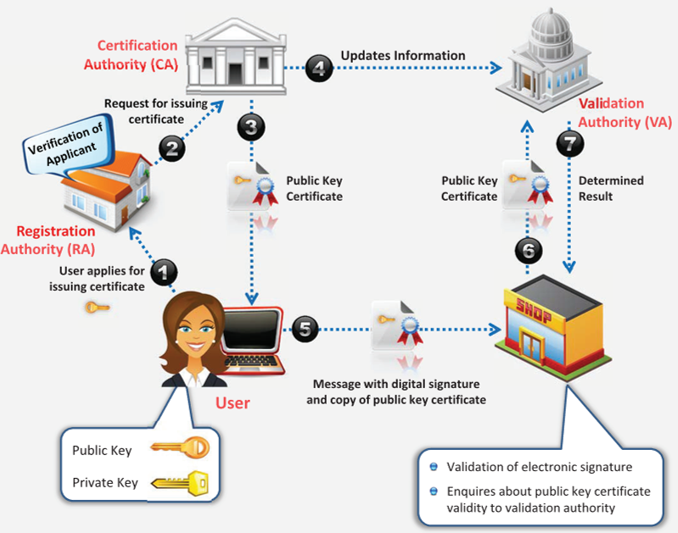
Public Key Infrastructure (PKI)
PKI) is a set of hardware, software, people, policies, and procedure required to create, manage, distribute, use, store, and revoke digital certificates.
Components of PKI:
Certificate Management System: Generates, distributes, stores, and verifies certificates
Digital Certificates: Establishes credentials of a person when doing online transactions
Validation Authority (VA): Stores certificates (with their public keys)
Certificate Authority (CA): Issues and verifies digital certificates
End User: Requests, manages, and uses certificates
Registration Authority (RA): Acts as the verifier for the certificate authority
Notes:
Public Key Infrastructure (PKI)
This section deals with Public Key Infrastructure (PKI) and the role of each components of PKI, certification authorities: Comodo, IdenTrust, Symantec, and GoDaddy, etc. and the signed certificate (CA) vs. the self-signed certificate.
Public Key Infrastructure (PKI) is a security architecture developed to increase the confidentiality of information exchanged over the insecure Internet. It includes hardware, software, people, policies, and procedures required to create, manage, distribute, use, store, and revoke digital certificates. In cryptography, the PKI helps to bind public keys with corresponding user identities by means of a Certificate Authority (CA).
Components of PKI
▪ Certificate Management System: Generates, distributes, stores, and verifies certificates
▪ Digital Certificates: Establishes credentials of a person when doing online transactions
▪ Validation Authority (VA): Stores certificates (with their public keys)
▪ Certificate Authority (CA): Issues and verifies digital certificates
▪ End User: Requests, manages, and uses certificates
▪ Registration Authority (RA): Acts as the verifier for the certificate authority
PKI is a comprehensive system that allows the use of public-key encryption and digital signature services across a wide variety of applications. PKI authentication depends on digital certificates (also known as public-key certificates) that certificate authorities sign and provide. Digital certificate is a digitally signed statement with a public key and the subject (user, company, or system) name in it. PKI uses public-key cryptography, which is widely used on the Internet to encrypt messages or authenticate message senders. In public-key cryptography, a Certification Authority generates a public and private key with the same algorithm simultaneously by (CA). The private key is held only by the subject (user, company, or system) mentioned in the certificate, while the public key is made publicly available in a directory that all parties can access. The subject keeps the private key secret and uses it to decrypt the text encrypted by someone else using the corresponding public key (available in a public directory). This way, others encrypt messages for the user with the user’s public key, and the user decrypts it with his/her private key.
Given below are the steps involved in PKI process:
1. The subject (user, company, or system) intended to exchange information securely, applies for a certificate with the Registration Authority (RA).
2. The Registration Authority (RA) receives request from the subject, verifies subject’s identity, and requests the Certification Authority (CA) to issue a public key certificate to the user.
3. The Certification Authority (CA) issues the public key certificate binding subject’s identity with subject’s public key and thereafter sends the updated information to the Validation Authority (VA).
4. When a user makes a transaction, the user duly signs the message digitally in the public key certificate and sends the message to the client.
5. The client verifies the authenticity of the user by inquiring about the user’s public key certificate validity with the VA.
6. The VA compares the public key certificate of the user with that of the updated information provided by the CA and determines the result (whether valid or not).
Certification Authorities
Certification authorities are trusted entities that issue digital certificates. The digital certificate certifies the possession of the public key by the subject (user, company, or system) specified in the certificate. This aids others to trust signatures or statements made by the private key that is associated with the certified public key.
Discussed below are some popular certification authorities:
▪ Comodo Source: https://www.comodo.com Comodo offers a range of PKI digital certificates with strong SSL encryption available 128/256 with SGC (Server-Gated Cryptography). It ensures standards of confidentiality, system reliability, and pertinent business practices as judged through qualified independent audits. It offers a PKI (public-key infrastructure) management solution such as Comodo Certificate Manager and Comodo EPKI Manager.
Digital Certificates offered by Comodo:
o Extended validation (EV)-SSL, Multi-domain EV SSL and Wildcard SSL
o Unified Communications (UC) o Intel Pro Series
o General Purpose SSL and Secure Email - S/MIME
o Client Authentication and Code Signing
▪ IdenTrust Source: https://www.identrust.com
IdenTrust is a trusted third party that provides certification authority services for many sectors like banks, corporate, government, and healthcare. It provides the following solutions:
o Digital Signing and Sealing
o Comply with NIST SP 800-171
o Global Identity Network o Managed PKI Hosting Services
o eSignature Solutions / Electronic Document Signing
o Individual Level Signing of Payment Files
o IdenTrust Community Bank PKI [PDF] and Secure Email
▪ Symantec Source: https://www.websecurity.symantec.com Symantec Corporation (NASDAQ: SYMC) provides solutions that allow companies and consumers to engage in communications and commerce online with confidence. SSL/TLS Certificates Offered:
o Secure Site, Secure Site with EV, Secure Site Pro, Secure Site Pro with EV, and Secure Site Wildcard
o Complete Website Security
▪ GoDaddy Source: https://in.godaddy.com
GoDaddy SSL Certificates offer a complete range of certificates that comply with CA/Browser Forum guidelines. Features:
o SHA-2 hash algorithm and 2048-bit encryption
o Protects unlimited servers
o Boost Google search ranking o Displays a Security Seal on client’s site
o Compatible with all major browsers
Some of the available Certification Authorities are listed below:
▪ GlobalSign (https://www.globalsign.com)
▪ DigiCert (https://www.digicert.com)
▪ Certum (http://www.certum.eu)
▪ Entrust (https://www.entrustdatacard.com)
▪ StartCom (https://www.startcomca.com)
▪ thwate (https://www.thawte.com)
▪ Verisign (https://www.verisign.com)
▪ RapidSSL (https://www.rapidssl.com)
▪ Escrow (https://www.escrow.com)
Signed Certificate (CA) Vs. Self-Signed Certificate
▪ Signed Certificates Certification authorities (CAs) sign and issue signed certificates. These certificates contain a public key and the identity of the owner. The corresponding private key is kept secret by the CA. By issuing the certificate, the CA confirms or validates that the public key contained in the certificate belongs to the person, company, server, or other entity mentioned in the certificate. CA verifies an application’s credentials, thus users and relying parties trust the information in the CA’s certificates. The CA takes accountability for saying, “Yes, this person is who they state they are, and we, the CA, certify that.” Some of the popular CAs include Comodo, IdenTrust, Symantec, and GoDaddy.
The first diagram in the above slide illustrates the process of using a signed certificate. A user approaches a CA and purchases a digital certificate. The CA issues a certificate to the user and updates the VA with the same information. The user signs a document with the public key and sends it to the receiver. The receiver verifies the certificate with VA, who verifies the authenticity but does not share the private key.
▪ Self-Signed Certificates
A self-signed certificate is an identity certificate signed by the same entity whose identity it certifies. Self-signed certificates are widely used for testing purposes. In self-signed certificates, a user creates a pair of public and private keys using a certificate creation tool such as Adobe Reader, Java's keytool, Apple's Keychain, etc. and signs the document with the public key. The receiver requests the sender for the private key to verify the certificate. However, the certificate verification rarely occurs due to necessity of disclosing the private key. This makes self-signed certificates useful only in a self-controlled testing environment.

Slide 45
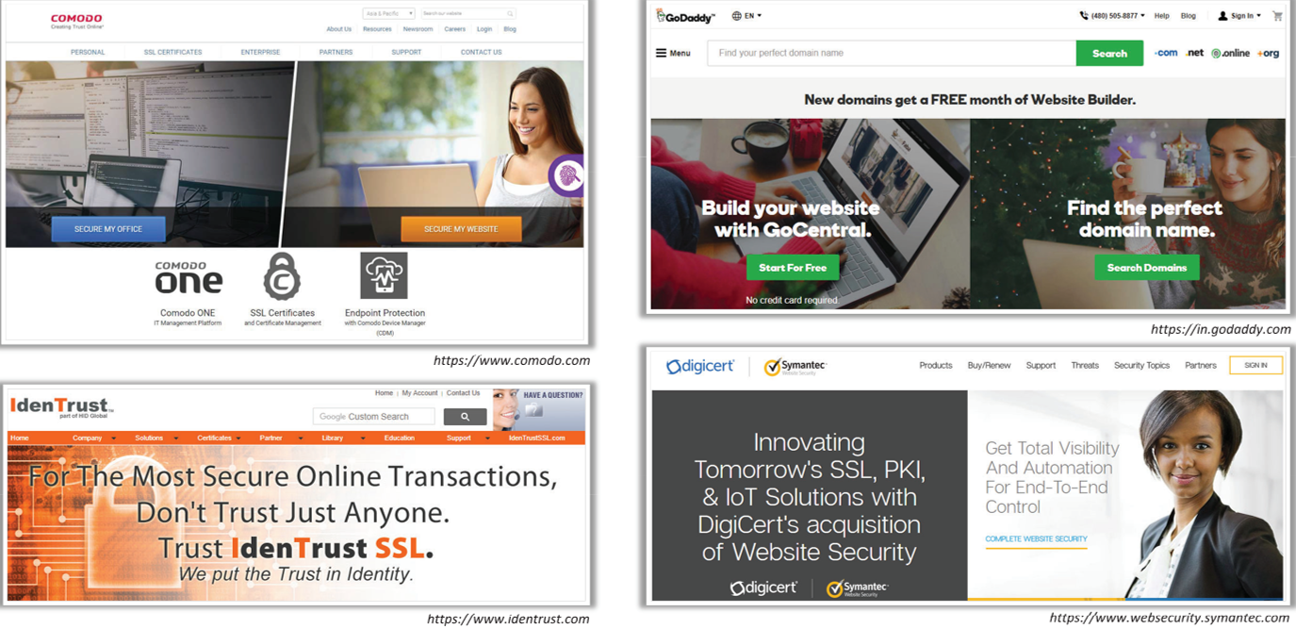
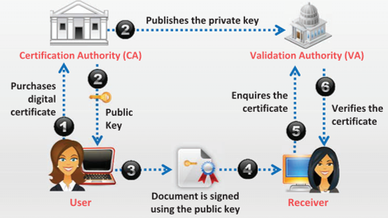
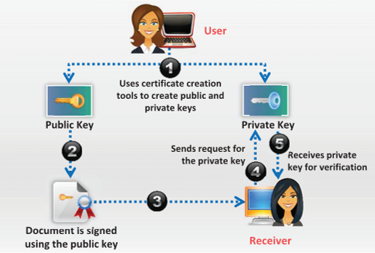
Certification Authorities
Signed Certificates
Self-Signed Certificates
Notes:
Certification authorities are trusted entities that issue digital certificates. The digital certificate certifies the possession of the public key by the subject (user, company, or system) specified in the certificate. This aids others to trust signatures or statements made by the private key that is associated with the certified public key.
Signed Certificate (CA) Vs. Self-Signed Certificate
▪ Signed Certificates Certification authorities (CAs) sign and issue signed certificates. These certificates contain a public key and the identity of the owner. The corresponding private key is kept secret by the CA. By issuing the certificate, the CA confirms or validates that the public key contained in the certificate belongs to the person, company, server, or other entity mentioned in the certificate. CA verifies an application’s credentials, thus users and relying parties trust the information in the CA’s certificates. The CA takes accountability for saying, “Yes, this person is who they state they are, and we, the CA, certify that.” Some of the popular CAs include Comodo, IdenTrust, Symantec, and GoDaddy.
The first diagram in the above slide illustrates the process of using a signed certificate. A user approaches a CA and purchases a digital certificate. The CA issues a certificate to the user and updates the VA with the same information. The user signs a document with the public key and sends it to the receiver. The receiver verifies the certificate with VA, who verifies the authenticity but does not share the private key.
The second diagram a user creates a pair of public and private keys using a certificate creation tool such as Adobe Reader, Java's keytool, Apple's Keychain, etc. and signs the document with the public key. The receiver requests the sender for the private key to verify the certificate. However, the certificate verification rarely occurs due to necessity of disclosing the private key. This makes self-signed certificates useful only in a self-controlled testing environment.
Module

Slide 46
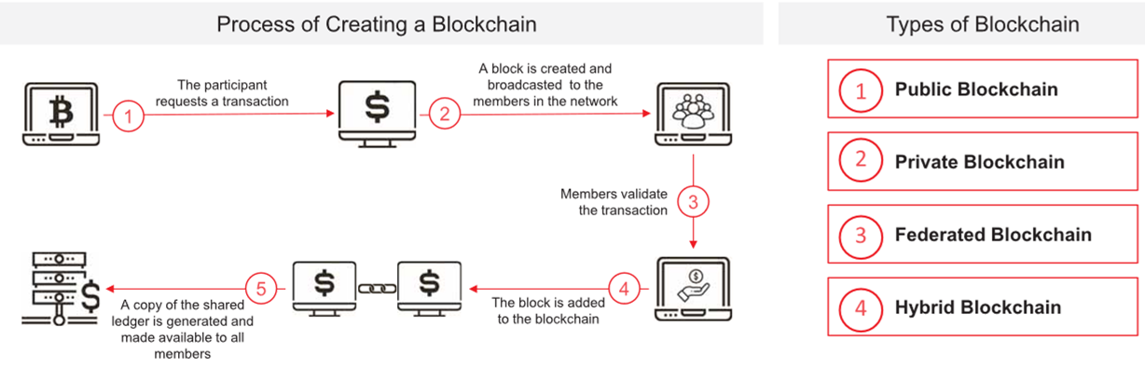
Blockchain
A blockchain, also referred to as distributed ledger technology (DLT), is used to record and store the history of transactions in the form of blocks
• For multiple transactions, multiple blocks are created, which are linked together to form a “blockchain”

Slide 47
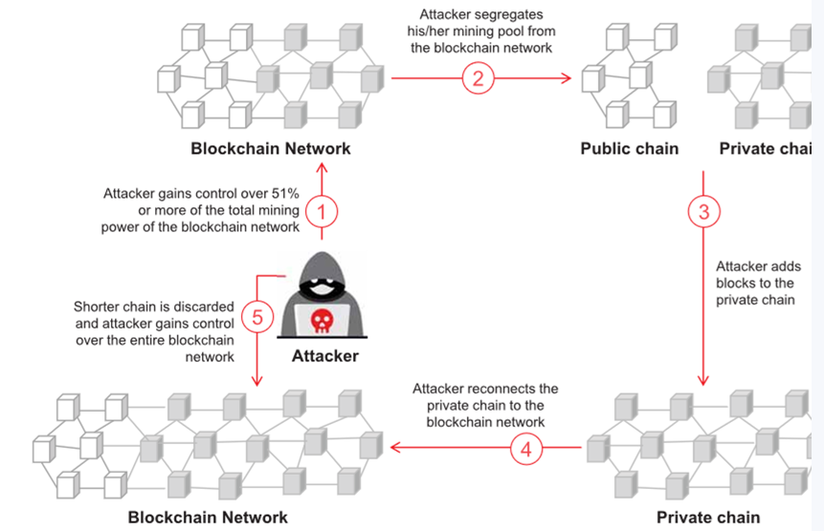
Attacks on Blockchain
51% attack, also known as majority attack, occurs when an attacker or group of attackers gains control of more than 50% of the computational power (hash rate) or staking power in a blockchain network
This level of control allows them to manipulate the blockchain by conducting double-spending attacks, denial-of-service (DoS) attacks, transaction reversals, and other malicious activities

Slide 48
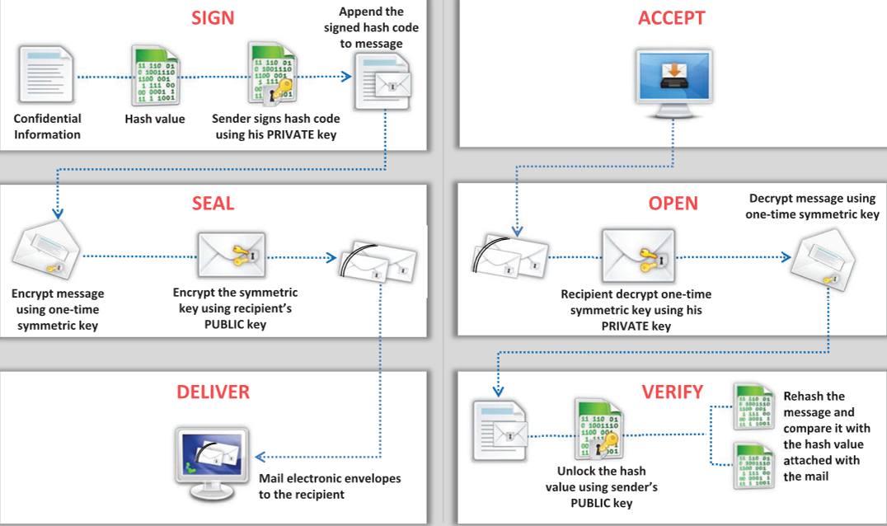
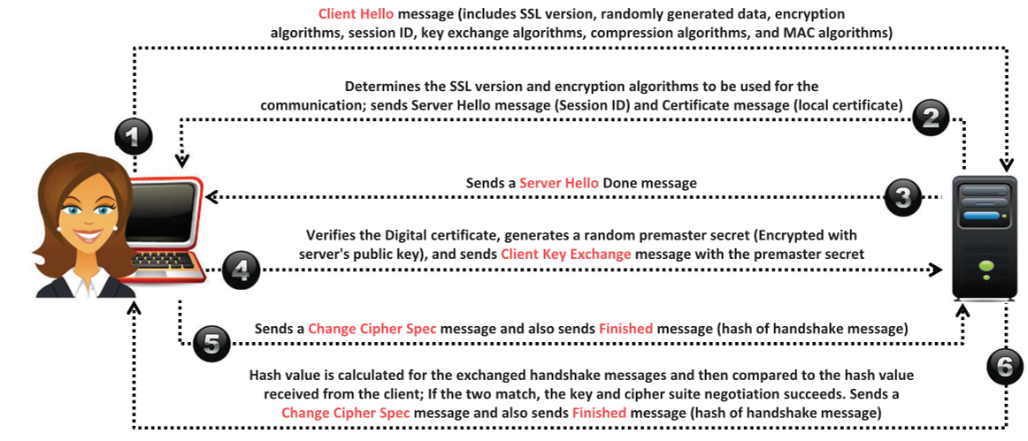
Email Encryption
Digital signature uses asymmetric cryptography
The Secure Sockets Layer (SSL) is an application layer protocol that uses RSA asymmetric encryption
Transport Layer Security (TLS) is a protocol used to establish a secure connection between a client and a server and ensure privacy and integrity of information during transmission.
Cryptography Toolkits:
OpenSSL (https://www.openssl.org )
Keyczar (https://github.com )
Notes:
Digital signature uses asymmetric cryptography to simulate the security properties of a
signature in digital, rather than written form. A digital signature is a cryptographic means of authentication. Public-key cryptography uses asymmetric encryption and helps the user to create a digital signature. The two types of keys in public key cryptography are the private key (only signer knows this key and uses it to create digital signature) and the public key (more widely known and a relying party uses it to verify the digital signature). A hash function is an algorithm that helps user to create and verify a digital signature. This algorithm creates a digital representation, also known as the message fingerprint. This fingerprint has a hash value that is much smaller than the message, but one that is unique to it. If the attacker changes the message, the hash function will automatically produce a different hash value.
To verify the digital signature, one needs the hash value of the original message and the hash function used to create the digital signature. With the help of both the public key and the new result, the verifier checks to see if the digital signature was created with the related private key, and whether the new hash value is the same as the original. A digital signature may be further protected by encrypting the signed email for confidentiality.
The Secure Sockets Layer (SSL) is an application layer protocol developed by Netscape for managing the security of a message transmission on the Internet. It is a protocol used to provide a secure authentication mechanism between two communicating applications, such as a client and a server. The SSL requires a reliable transport protocol, such as TCP, for data transmission and reception. It uses RSA asymmetric (public key) encryption to encrypt data transferred over SSL connections.
Transport Layer Security (TLS)
Transport Layer Security (TLS) is a protocol used to establish a secure connection between a client and a server and ensure privacy and integrity of information during transmission. It uses symmetric key for bulk encryption, asymmetric key for authentication and key exchange, and message authentication codes for message integrity. It uses the RSA algorithm with 1024-and 2048-bit strengths. With the help of TLS, one can reduce security risks such as message tampering, message forgery, and message interception. An advantage of TLS is that it is application-protocol independent. Higher-level protocols can layer on top of the TLS protocol transparently.
OpenSSL is an open source cryptography toolkit implementing the Secure Sockets Layer (SSL v2/v3) and Transport Layer Security (TLS v1) network protocols and related cryptography standards required by them. The openssl program is a command line tool for using the various cryptography functions of OpenSSL’s crypto library from the shell.
Keyczar is an open source cryptographic toolkit designed to make it easier and safer for
developers to use cryptography in their applications. It supports authentication and encryption with both symmetric and asymmetric keys.
PGP (Pretty Good Privacy) is a protocol used to encrypt and decrypt data that provides authentication and cryptographic privacy. It is often used for data compression, digital signing, encryption and decryption of messages, emails, files, directories, and to enhance privacy of email communications. The algorithm used for message encryption is RSA for key transport and IDEA for bulk-message encryption. PGP uses RSA for computing digital signatures and MD5 for computing message digests. PGP combines the best features of both conventional (about 1,000 times faster than public-key encryption) and public-key cryptography (solution to key distribution and data transmission issues) and is therefore known as hybrid cryptosystem.

Slide 49
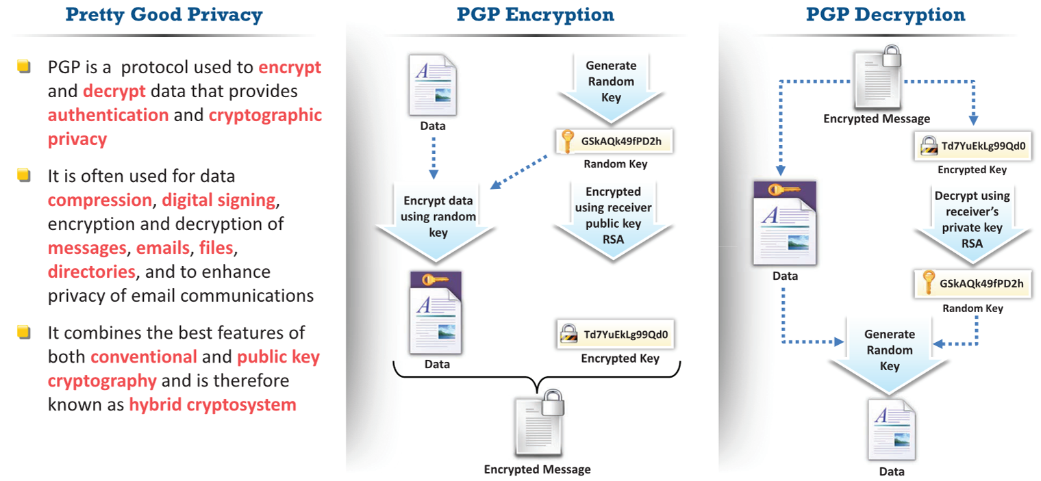
Email Encryption

Slide 50
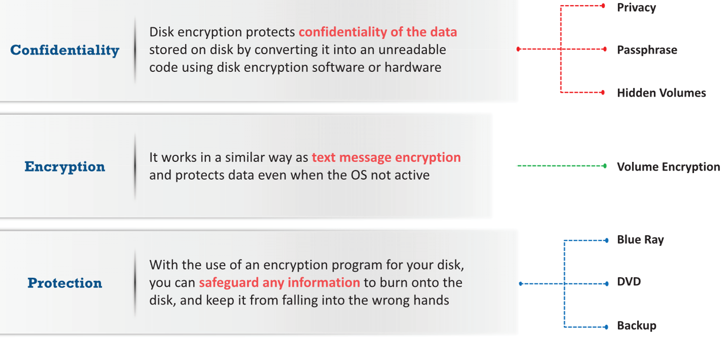
Disk Encryption
Disk encryption encrypts every bit of data stored on a disk or a disk volume, thus preventing illegal access to data storage.
Notes:
Disk encryption encrypts every bit of data stored on a disk or a disk volume, thus preventing
illegal access to data storage. This section deals with disk encryption concepts and various disk encryption tools. Disk encryption is a technology, which protects the confidentiality of the data stored on disk by converting it into an unreadable code using disk encryption software or hardware, thus preventing unauthorized users from accessing it. Disk encryption provides confidentiality and privacy using passphrases and hidden volumes. Disk encryption works in a manner similar to text-message encryption and protects data even when the OS is not active. By using an encryption program for the user’s disk (Blue Ray, DVD, Backup), the user can safeguard any or all information burned onto the disk and save it from falling into the wrong hands. Disk-encryption software scrambles the information burned on the disk into an illegible code. It is only after decryption of the disk information that one can read and use it.
Disk encryption is useful when the user needs to send sensitive information through the mail. In addition, disk encryption can prevent the real-time exchange of information from compromising threats. When the users exchange encrypted information, it minimizes the chances of compromising the information. The only way an attacker could access the information is by decrypting the message. Furthermore, encryption software installed on a user’s system ensures the security of the system. Install encryption software on any systems that hold valuable information or the ones exposed to unlimited data transfer.
VeraCrypt
Source: https://veracrypt.codeplex.com VeraCrypt is a software for establishing and maintaining an on-the-fly-encrypted volume (data storage device). On-the-fly encryption means that data is automatically encrypted right before it is saved and decrypted right after it is loaded, without any user intervention. No data stored on an encrypted volume can be read (decrypted) without using the correct password/keyfile(s) or correct encryption keys. The entire file system is encrypted (e.g., file names, folder names, free space, metadata, etc.). Files can be copied to and from a mounted VeraCrypt volume just like they are copied to/from any normal disk (for example, by simple drag-and-drop operations). Files are automatically being decrypted on the fly (in memory/RAM) while they are being read or copied from an encrypted VeraCrypt volume. Similarly, files that are being written or copied to the VeraCrypt volume are automatically being encrypted on the fly (right before they are written to the disk) in RAM.
Symantec Drive Encryption
Source: https://www.symantec.com Symantec Drive Encryption (formerly PGP Whole Disk Encryption) provides organizations with complete, transparent drive encryption for all data (user files, swap files, system files, hidden files, etc.) on laptops, desktops, and removable media. It protects data from unauthorized access, providing strong security for intellectual property, customer, and partner data. Symantec Encryption Management Server can centrally manage the protected systems, as it simplifies deployment, policy creation, distribution, and reporting.
BitLockerDrive Encryption
Source: https://docs.microsoft.com BitLocker Drive Encryption is a data protection feature that integrates with the operating system and addresses the threats of data theft or exposure from lost, stolen, or inappropriately decommissioned computers. BitLocker provides the most protection when used with a Trusted Platform Module (TPM) version 1.2 or later. The TPM is a hardware component installed in many newer computers by the computer manufacturers. It works with BitLocker to help protect user data and to ensure that a computer has not been tampered with while the system was offline.
FIGURE

Slide 51
Disk Encryption
Disk Encryption Tools
The common goal of disk encryption tools is encrypting a disk partition to provide confidentiality to the information stored on it.
VeraCrypt (https://veracrypt.codeplex.com)
Symantec Drive Encryption (https://www.symantec.com)
BitLockerDrive Encryption (https://docs.microsoft.com)
Some of the additional disk encryption tools are listed below:
Gillsoft Full Disk Encryption (http://www.gilisoft.in)
Endpoint Full Disk Encryption (https://www.checkpoint.com)
Dell Data Protection | Encryption (http://www.dell.com)
AxCrypt (https://www.axcrypt.net)
Folder Lock (http://www.newsoftwares.net)
Full Disk Encryption Software (https://www.winmagic.com)
SafeGuard Encryption (https://www.sophos.com)
Alertsec (https://www.alertsec.com)
DriveCrypt (http://www.securstar.com)
ShareCrypt (http://www.securstar.com)
PocketCrypt (http://www.securstar.com)
DriveCrypt Plus Pack (http://www.securstar.com)
Rohos Disk Encryption (http://www.rohos.com)
east-tec SafeBit (https://www.east-tec.com)
Cryptainer LE (http://www.cypherix.com)
DiskCryptor (https://diskcryptor.net)

Slide 52
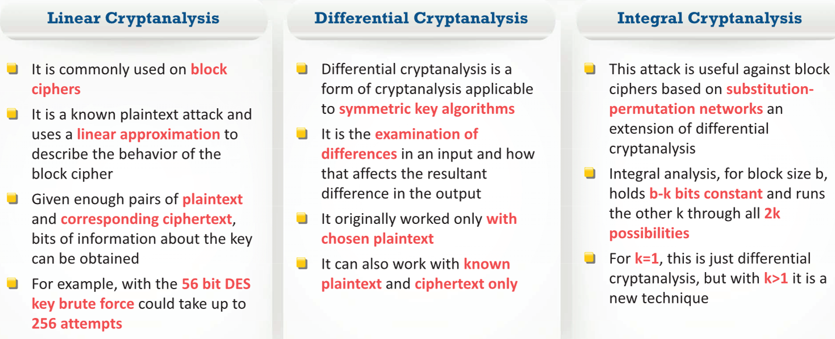
Cryptanalysis
Attackers may implement various cryptography attacks in order to evade security of a cryptographic system by exploiting vulnerabilities in a code, cipher, cryptographic protocol, or key management scheme.
Notes:
Attackers may implement various cryptography attacks in order to evade security of a cryptographic system by exploiting vulnerabilities in a code, cipher, cryptographic protocol, or key management scheme. This process is known as cryptanalysis. Cryptanalysis is the study of ciphers, cipher text, or cryptosystems with the ability to identify vulnerabilities in them that allows to extract plaintext from the ciphertext even if the cryptographic key or algorithm used to encrypt the plaintext is unknown. This section deals with various cryptography attacks that an attacker uses to compromise cryptographic system and various cryptanalysis techniques and tools that help in breaching cryptographic security.
Linear cryptanalysis is based on finding affine approximations to the action of a cipher. It is commonly used on block ciphers. This technique was invented by Mitsarue Matsui. It is a known plaintext attack and uses a linear approximation to describe the behavior of the block cipher. Given enough pairs of plaintext and corresponding ciphertext, bits of information about the key can be obtained. Obviously, the more pairs of plaintext and ciphertext one has, the greater the chance of success. Remember cryptanalysis is an attempt to crack cryptography. For example, with the 56-bit data encryption standard (DES) key brute force could take up to 256 attempts. Linear cryptanalysis will take 243 known plaintexts. This is better than brute force, but still impractical for most situations. The math may be a bit complex for beginning cryptographers, but let’s look at the basics of it. With this method, a linear equation expresses the equality of two expressions which consist of binary variables XORed.
Differential cryptanalysis is a form of cryptanalysis applicable to symmetric key algorithms. This was invented by Eli Biham and Adi Shamir. Essentially, it is the examination of differences in an input and how that affects the resultant difference in the output. It originally worked only with chosen plaintext. It could also work with known plaintext and ciphertext.
Integral cryptanalysis was first described by Lars Knudsen. This attack is particularly useful against block ciphers based on substitution-permutation networks as an extension of differential cryptanalysis. Differential analysis looks at pairs of inputs that differ in only one-bit position, with all other bits being identical. Integral analysis, for block size b, holds b-k bits constant and runs the other k through all 2k possibilities. For k = 1, this is just differential cryptanalysis, but with k > 1, it is a new technique.
▪ Brute Force
Code-breakers or cryptanalysts work to recover the plaintext of a message without knowing the required key in advance. They may first try to recover the key, or they may go after the message itself. A common cryptanalytic technique is a brute-force attack, or exhaustive search, in which the keys are determined by trying every possible combination of characters. The efficiency of a brute-force attack depends on the hardware configuration. Use of faster processors means testing more keys per second. Cryptanalysts carried out a successful brute-force attack on a DES encryption method that effectively made DES obsolete.
▪ Frequency Analysis
Frequency analysis is the study of the frequency of letters or groups of letters in a ciphertext. Frequency analysis of letters and words is another method used to attack ciphers. It works on the fact that, in any given stretch of written language, certain letters and combinations of letters occur with varying frequencies. This technique examines the number of times that a particular symbol comes up in a ciphertext. For example, the letter “e” is a common letter in the English language. If the letter “k” appears commonly in a ciphertext, it can be reasonably concluded that “k” in the encrypted language is equivalent to “e” in English. Encrypted source code is more vulnerable to these types of attacks because words like “#define,” “struct,” “else,” and “return” are repeated frequently in code. Sophisticated cryptosystems are required to maintain the security of messages against frequency analysis.
Trickery and Deceit
Trickery and Deceit requires a high level of mathematical and cryptographic skills. It involves the use of social engineering techniques to extract cryptography keys.
Example: It is fairly easy to decrypt an entire message if the user knows some of its content.
An attacker can use social engineering techniques to trick or bribe someone to encrypt and send a known message, which, when intercepted, could then be easily decrypted using standard cryptanalysis techniques.
▪ One-Time Pad
One can crack any cipher if provided with sufficient time and resources. However, there is an exception called a one-time pad, which the users assume to be unbreakable even with infinite resources.
A one-time pad contains mostly a non-repeating set of letters or numbers, which the system chooses randomly. The user writes them on small sheets of paper and then pastes them together in a pad.
Example of One-time pad usage:
Sender encrypts only one plaintext character using each key letter on the pad, and the receiver decrypts each letter of the ciphertext using an identical pad. Once the letter uses a page, he or she tears it off the pad and securely discards it, thus it got the name One-time Pad.
Drawback:
The key length is same as that of the message, thus making it impossible to encrypt and send large messages.

Slide 53
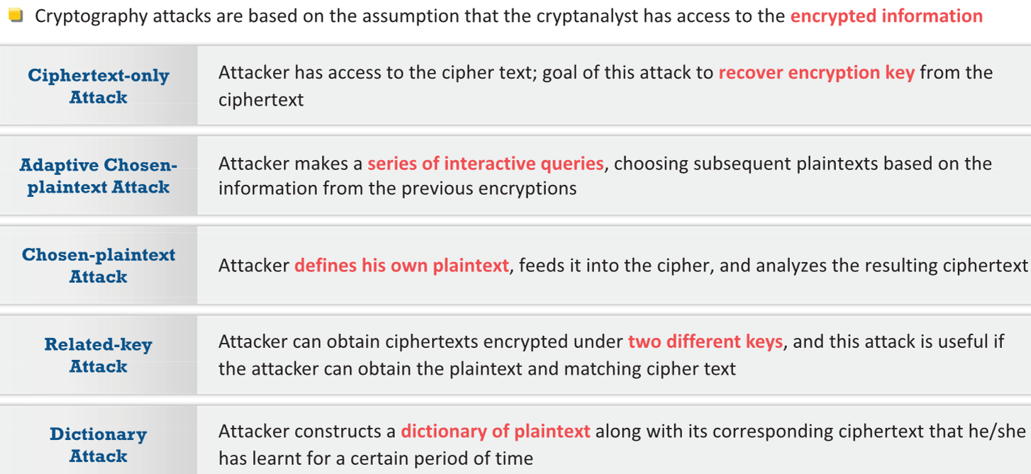
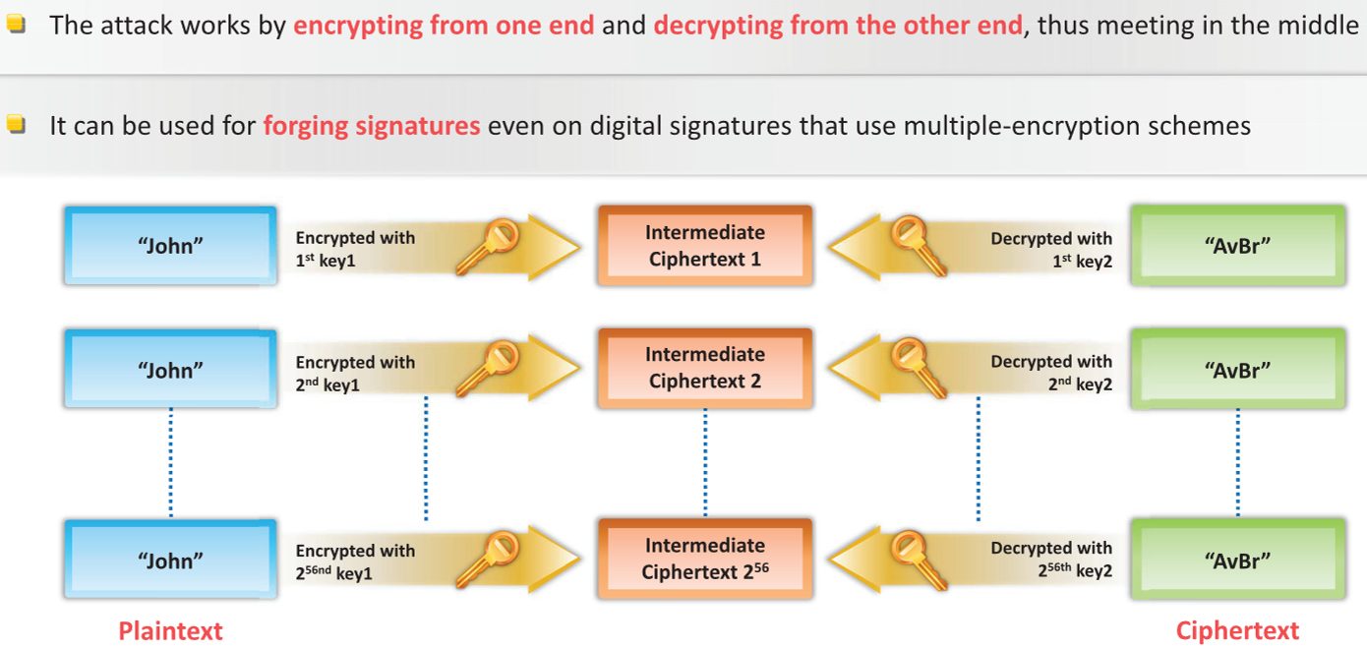
Cryptanalysis
Code Breaking Methodologies
One can measure the strength of an encryption algorithm using various code-breaking techniques, some of which are as follows:
Brute Force
Frequency Analysis
Trickery and Deceit
One-Time Pad
Meet-in-the-Middle Attack on Digital Signature Schemes

Slide 54
Cryptanalysis Tools
Online MD5 Decryption Tools
Below are some online MD5 decryption tools that can be used to decrypt the MD5 hash value, thus discovering the original message:
MD5 Decoder (https://www.dcode.fr)
MD5 Decrypt (http://www.md5decrypt.org)
MD5 Decrypter (http://www.md5online.org)
MD5Decrypter (https://www.md5decrypter.com)
OnlineHashCrack.com (https://www.onlinehashcrack.com)
HashKiller.co.uk (https://hashkiller.co.uk)
Md5.My-Addr.com (http://md5.my-addr.com)
cmd5.org (http://www.cmd5.org)
CrackStation (https://crackstation.net)
md5this (http://www.md5this.com)
MD5/Sha1 hash cracker (http://crackhash.com)
Md5() Encrypt & Decrypt (http://md5decrypt.net)
MD5Decryption (http://md5decryption.com)
md5hashing (https://md5hashing.net)
Online Reverse Hash Lookup (http://reverse-hash-lookup.online-domain-tools.com)
CrypTool (https://www.cryptool.org )
CryptoBench (http://www.addario.org)
Cryptol (https://cryptol.net)
Ganzúa (http://ganzua.sourceforge.net)
EverCrack (http://evercrack.sourceforge.net)
AlphaPeeler (http://alphapeeler.sourceforge.net)
Mediggo (https://www.darknet.org.uk)
SubCypher (https://sourceforge.net)
Notes:
▪ CrypTool Source: https://www.cryptool.org The CrypTool project develops e-learning programs in the area of cryptography and cryptanalysis. It consists of e-learning software (CT1, CT2, JCT, and CTO). CrypTool 1 (CT1) – It is written in C++ and is a Windows program. Features: o Supports classic and modern cryptographic algorithms (encryption and decryption, key generation, secure passwords, authentication, secure protocols, etc.)
o Visualization of several algorithms (Caesar, Enigma, RSA, Diffie-Hellman, digital signatures, AES, etc.)
o Cryptanalysis of several algorithms (Vigenère, RSA, AES, etc.) o Cryptanalytical measurement methods (entropy, n-grams, autocorrelation, etc.) o Related auxiliary methods (primality tests, factorization, base64 encoding, etc.) CrypTool 2 (CT2) – Supports visual programming GUI and execution of cascades of cryptographic procedures. It runs under Windows.
JCrypTool (JCT) –Allows comprehensive cryptographic experimentation on Linux, MAC OS X, and Windows. It also allows users to develop and extend its platform in various ways with their own crypto plug-ins.
CrypTool-Online (CTO) –Runs in a browser and provides a variety of encryption methods and analysis tools.

Slide 55
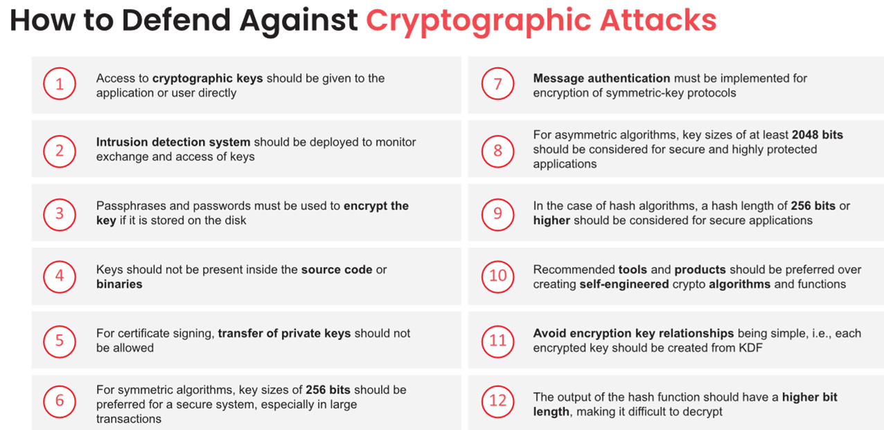
Countermeasures
Notes:
Attackers use various cryptanalysis methods and techniques to break the cryptosystems and steal confidential information that is being transmitted in the network. This section discusses some of the countermeasures to be followed to protect from such type of attacks.
Follow the countermeasures given below to prevent cryptographic attacks:
▪ Access of cryptographic keys should be given to the application or to the user directly.
▪ Intrusion detection system should be deployed to monitor exchanging and access of keys.
▪ Passphrases and passwords must be used to encrypt the key, if stored in disk.
▪ Keys should not be present inside the source code or binaries.
▪ For certificate signing, transfer of private keys should not be allowed.
▪ For symmetric algorithms, key size of 168 bits or 256 bits should be preferred for a secure system, especially in case of large transactions.
▪ Message authentication must be implemented for encryption of symmetric-key protocols.
▪ For asymmetric algorithms, key size of 1536 bits and 2048 bits should be considered for secure and highly protected application.
▪ In case of hash algorithm, key size of 168 or 256-bit should be considered.
▪ Only recommended tools or products should be preferred rather than creating self-engineered crypto algorithms or functions.
▪ Put a limit on number of operations per key.
▪ The output of the hash function should have larger bit length that makes it hard to decrypt.

Slide 56
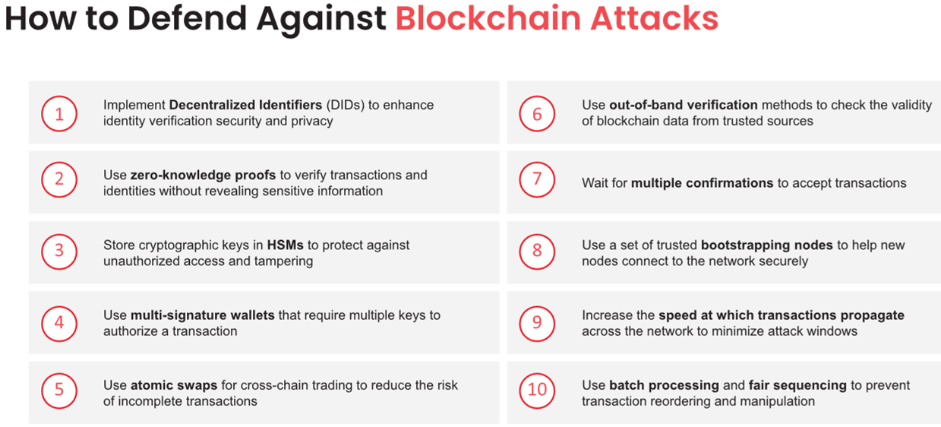
Countermeasures

Slide 57
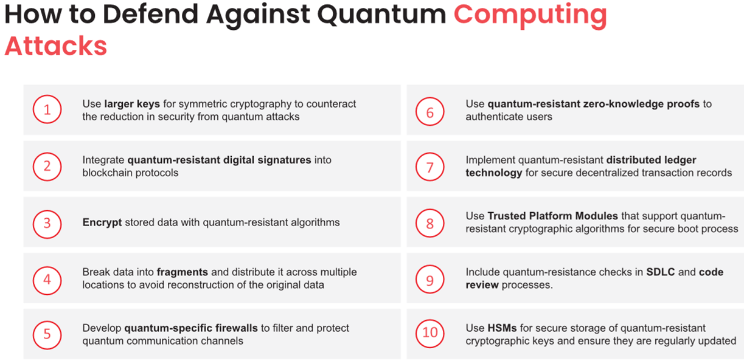
Countermeasures

Slide 58
Questions?

Slide 59
References
M. T Whitman, H. J. Mattford, Principles of Information Security, Cengage Learning, 4th ed 2012.
https://aspen.eccouncil.org/
https://attack.mitre.org
http://ceh.vn/
http://www.symantec.com/security_response/publications/threatreport.jsp
EC-Council Certified Ethical Hacker (CEH) - https://www.eccouncil.org
Offensive Security Certified Professional (OSCP) - https://www.offensive-security.com
NIST Cybersecurity Framework - https://www.nist.gov
OWASP Top 10 Security Risks - https://owasp.org

