Slide 1


Slide 2
IDEA
To make a boxes size according to goods
Reason
Positive impact on climate change
Customers satisfaction

Slide 3
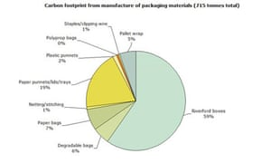

Slide 4
PROCESS
Packaging: cut it down unnecessary stuffs( plastic/paper) and make a package as sizeable goods while packaging and impact on environment

Slide 5
RISK
Effect on supply chain nationally and internationally
Initial cost will be expensive for Amazon
Need to deal with other different delivery company
Ned to produce lots of different sizeable boxes

Slide 6

BENEFITS
Positive impact on climate change
Cost effective
Easy to deliver
Customer happy
In a one lorry we can put more goods
Time safe

Slide 7
PLAN
Discuss with suppliers , parties, customers
After three months launch at market and after year go for internationally

Slide 8
IMPLEMENTATION
First try to do in a one place
Take a feedback from customers
Take a feedback from companies, third parties
if positive feedback then straight to apply. Start from one country and after internationally

