Slide 1
The Communists and Nationalists from 1921-1937
Modern Chinese History

Slide 2
Chinese Communist Party
Influenced by Bolshevik Revolution in 1917
Founded in 1921 in Shanghai
Mao Zedong (1893-1976) and Li Dazhao (1889-1927) among founding members
Li Dazhao: Professor of Philosophy and librarian at Peking University, author of The Victory of Bolshevism
Assistance from Third International (1920)

Slide 3
1st United Front, 1921-1927
Proposed by International to develop the organization of both Communists and Nationalists
Increase in party membership
Membership in both parties possible
Example: Mao Zedong → leader of the peasant Bureau within the Nationalist Party

Slide 4
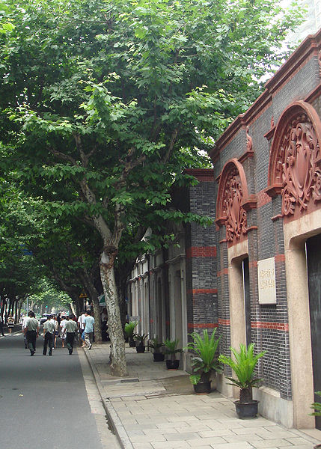
Location of the First Congress of the Chinese Communist Party Xintiandi Shanghai July 1921

Slide 5
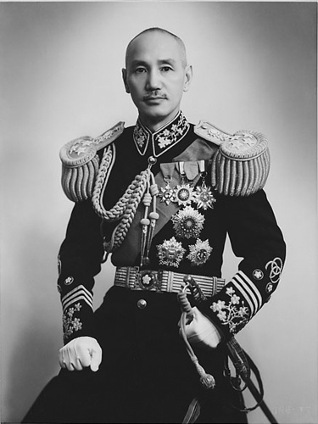
Chiang Kai-shek (1887-1975), aka Jiang Jieshi
Married to Song Meiling, Sun Yatsen’s brother-in-law
military academy at Whampoa (Huangpu), Canton
Undertakes Northern Exhibition (1926-1928)

Slide 6
Jiangxi-Soviet
November 7, 1931
National Soviet People's Delegates Conference in Ruijin 瑞金, Jiangxi Province
Founding of the "Chinese Soviet Republic" (Chinese: 中華蘇維埃共和國), existed until 1934
Mao was Head of State and Prime Minister
Own bank, currency, and tax bureau

Slide 7
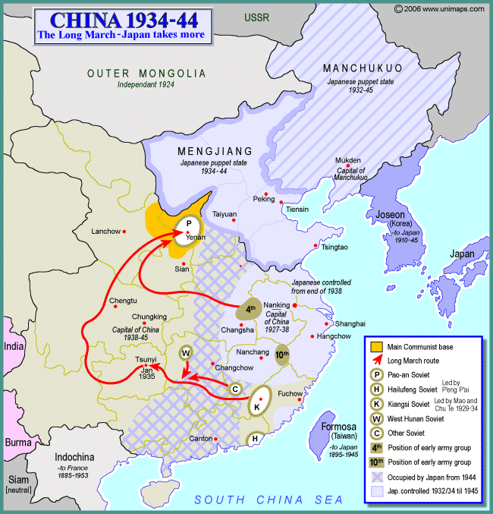
The Long March, Oct. 1934-Dec. 1935
From Jiangxi to Yan’an (Yenan)
150,000 set out, 15,000 complete it
Mao becomes Chairman of the Communist Party
Yan’an beomes new base area

Slide 8
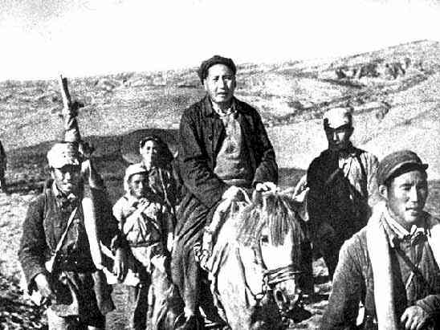
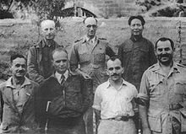
Yan’an Period (1936-1948)

