Slide 1

Datblygu Ymchwil:
Theori ac Ymarfer
Developing Research:
Theory and Practice
Epistemoleg ac Ontoleg
Epistemology and Ontology

Slide 2
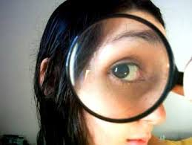
Sut rydym yn gwybod beth rydym yn ei wybod? How do we know what we know?
Mae ymchwil yn golygu cymryd safbwynt athronyddol
Rydym yn mabwysiadu bydolwg neu lens ar gyfer gwylio’r byd….
  Bydd y bydolwg neu’r safbwynt paradeim a fabwysiadwn yn dylanwadu ar y modd y gwnawn ein gwaith ymchwil, a’r canlyniadau.
Research is about taking a philosophical position
We adopt a worldview or a lense to view the world through….
  The worldview or paradigm position we adopt will influence how we do research, and the results.
Notes:
When doing research we are engaging in philosophy.
Some of you may feel more comfortable with qualitative research some of you quantitative ,

Slide 3
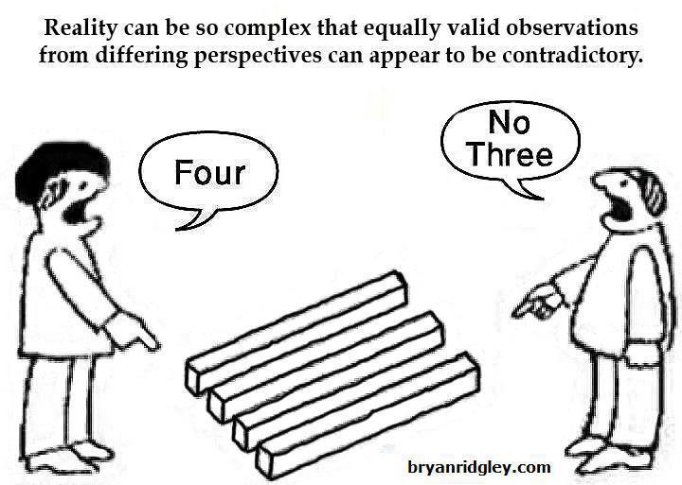

Slide 4
Paradeim/Paradigm
Ontoleg/ Ontology
Gwertheg/ Axiology
Epistemoleg/
Epistemology

Slide 5
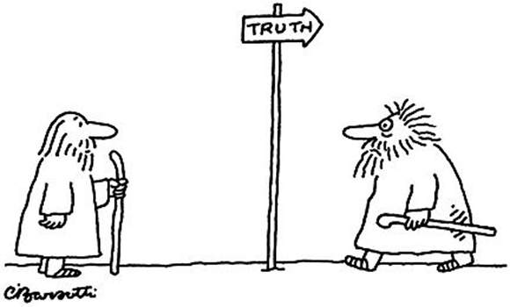
Epistemoleg/ Epistemology
Beth yw natur gwybodaeth a sut rydym yn ei chreu?
  Beth yw gwirionedd?
  A oes un gwirionedd y gellir ei gyffredinoli?
  Neu a oes llawer o wirioneddau?
What is the nature of knowledge how do we create it?
  What is truth?
  Is there one truth that can be generalised?
  Or are there multiple truths?

Slide 6


Ontoleg/ Ontology
Beth yw natur realiti a sut y caiff ei chreu?
  A oes realiti sefydlog neu a yw’n symud yn ôl y cyd-destun, amser, amgylchiadau…?
What is the nature of reality and how is it created?
  Is there a fixed reality or does it shift depending on the context time, circumstances…?

Slide 7
Different Ways to view the World: Pardigms
Quantitative
Postpositivism Determination Reductionism Empirical observation and measurement Theory verification | Constructivism Understanding Multiple participant meanings Social and historical construction Theory generation
Advocacy/Participatory (Critical Theory) Political Empowerment issue-oriented Collaborative Change-oriented | Pragmatism (Mixed Methods) Consequences of actions Problem-centred Pluralistic Real-world practice oriented.
Qualitative
Mixed Methodology
Qualitative

Slide 8
Gwertheg Axiology
Mae Epistemoleg ac ontoleg yn ymwneud â gwirionedd, a natur realiti/gwybodaeth, mae gwertheg yn ymwneud â gwerthoedd a moeseg (Mingers, 2003).
Epistemology and ontology deal with truth, and the nature of reality/knowledge, axiology is about values and ethics (Mingers, 2003).

Slide 9

Gwertheg Axiology
Gwelir bod pob darn o ymchwil yn drwm o werthoedd gan gynnwys:
  systemau gwerthoedd yr ymchwilydd,
  y paradeim a ddefnyddir,
  A’r normau cymdeithasol a diwylliannol ar gyfer naill ai’r holwr neu’r ymatebydd (Guba a Lincoln, 1988).
All research is seen to be value laden including:
  the value systems of the researcher,
  the paradigm used,
  and the social and cultural norms for either the inquire or respondents
    (Guba and Lincoln, 1988).

Slide 10
Gwertheg Axiology
Os yw pob darn o ymchwil yn drwm o werthoedd:
  beth mae hyn yn ei olygu o safbwynt rhagfarn ym maes ymchwil o safbwynt meintiol ac ansoddol?
If all research is value laden:
  what does this mean for bias in research from both a qualitative and quantitative perspective?

Slide 11




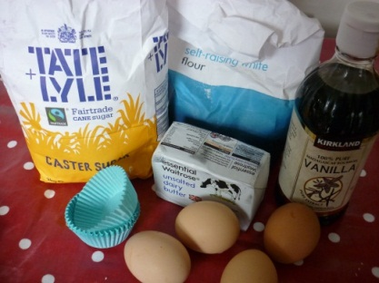

Athroniaeth/ Philosophy
Strategaeth Ymchwil/ Research Strategy
Dulliau/
Methods
Epistemoleg/ Epistemology
Gwertheg/ Axiology
Alinio Athronyddol/ Philosophical Alignment
Ontoleg/ Ontology

Slide 12
Beth yw eich Bydolwg?
What's Your World View ?
Trafodwch gyda’ch partner ble y byddech chi’n eich gosod eich hun ar y continwwm.
Cwestiynau?
Discuss with your partner where you may place yourself on the continuum.

Slide 13
Paradeim / Paradigms
Review the A3 handout on Paradigm options available to you.
In small groups discuss your preferences an record these for your future purpose.

Slide 14
Cwestiynau?
Questions

