Slide 2
Chapter 6
POLICY LAYERS
Notes:
Security Policy management can be labor intensive. The process is simplified with the use of policy layers. In this chapter, we cover the
benefits of having Rulebase options for policy management.

Slide 3
Learning Objectives
Demonstrate understanding of the Check Point policy layer concept.
Explain how policy layers affect traffic inspection.
Notes:
Security Policy management can be labor intensive. The process is simplified with the organization of policies into Policy Layers. In this
chapter, we cover the benefits of having rulebase options for policy management.

Slide 4

Policy Layer Concept
Set of rules or rulebase in a policy.
Lets you separate Security Policy into smaller, more manageable components.
A layer can contain the following Blades:
  Firewall (Network Access Control)
  Application & URL Filtering
  Content Awareness
  Mobile Access
Notes:
Managing the Security Policy of a large network can be overwhelming. When the Security Policy has many rules, enforcing the policy becomes resource intensive and managing the rules becomes a difficult task.
Policy layers are sets of rules or a rulebase. They let you divide a policy, such as the Access Control policy, into smaller, more manageable sections that serve a certain purpose.
The layers concept also provides more options for policy management, including the ability to set different views and edit permissions per layer for different administrator roles.
A layer can contain the following Blades:
Firewall (Network Access Control)
Application & URL Filtering
Content Awareness
Mobile Access

Slide 5
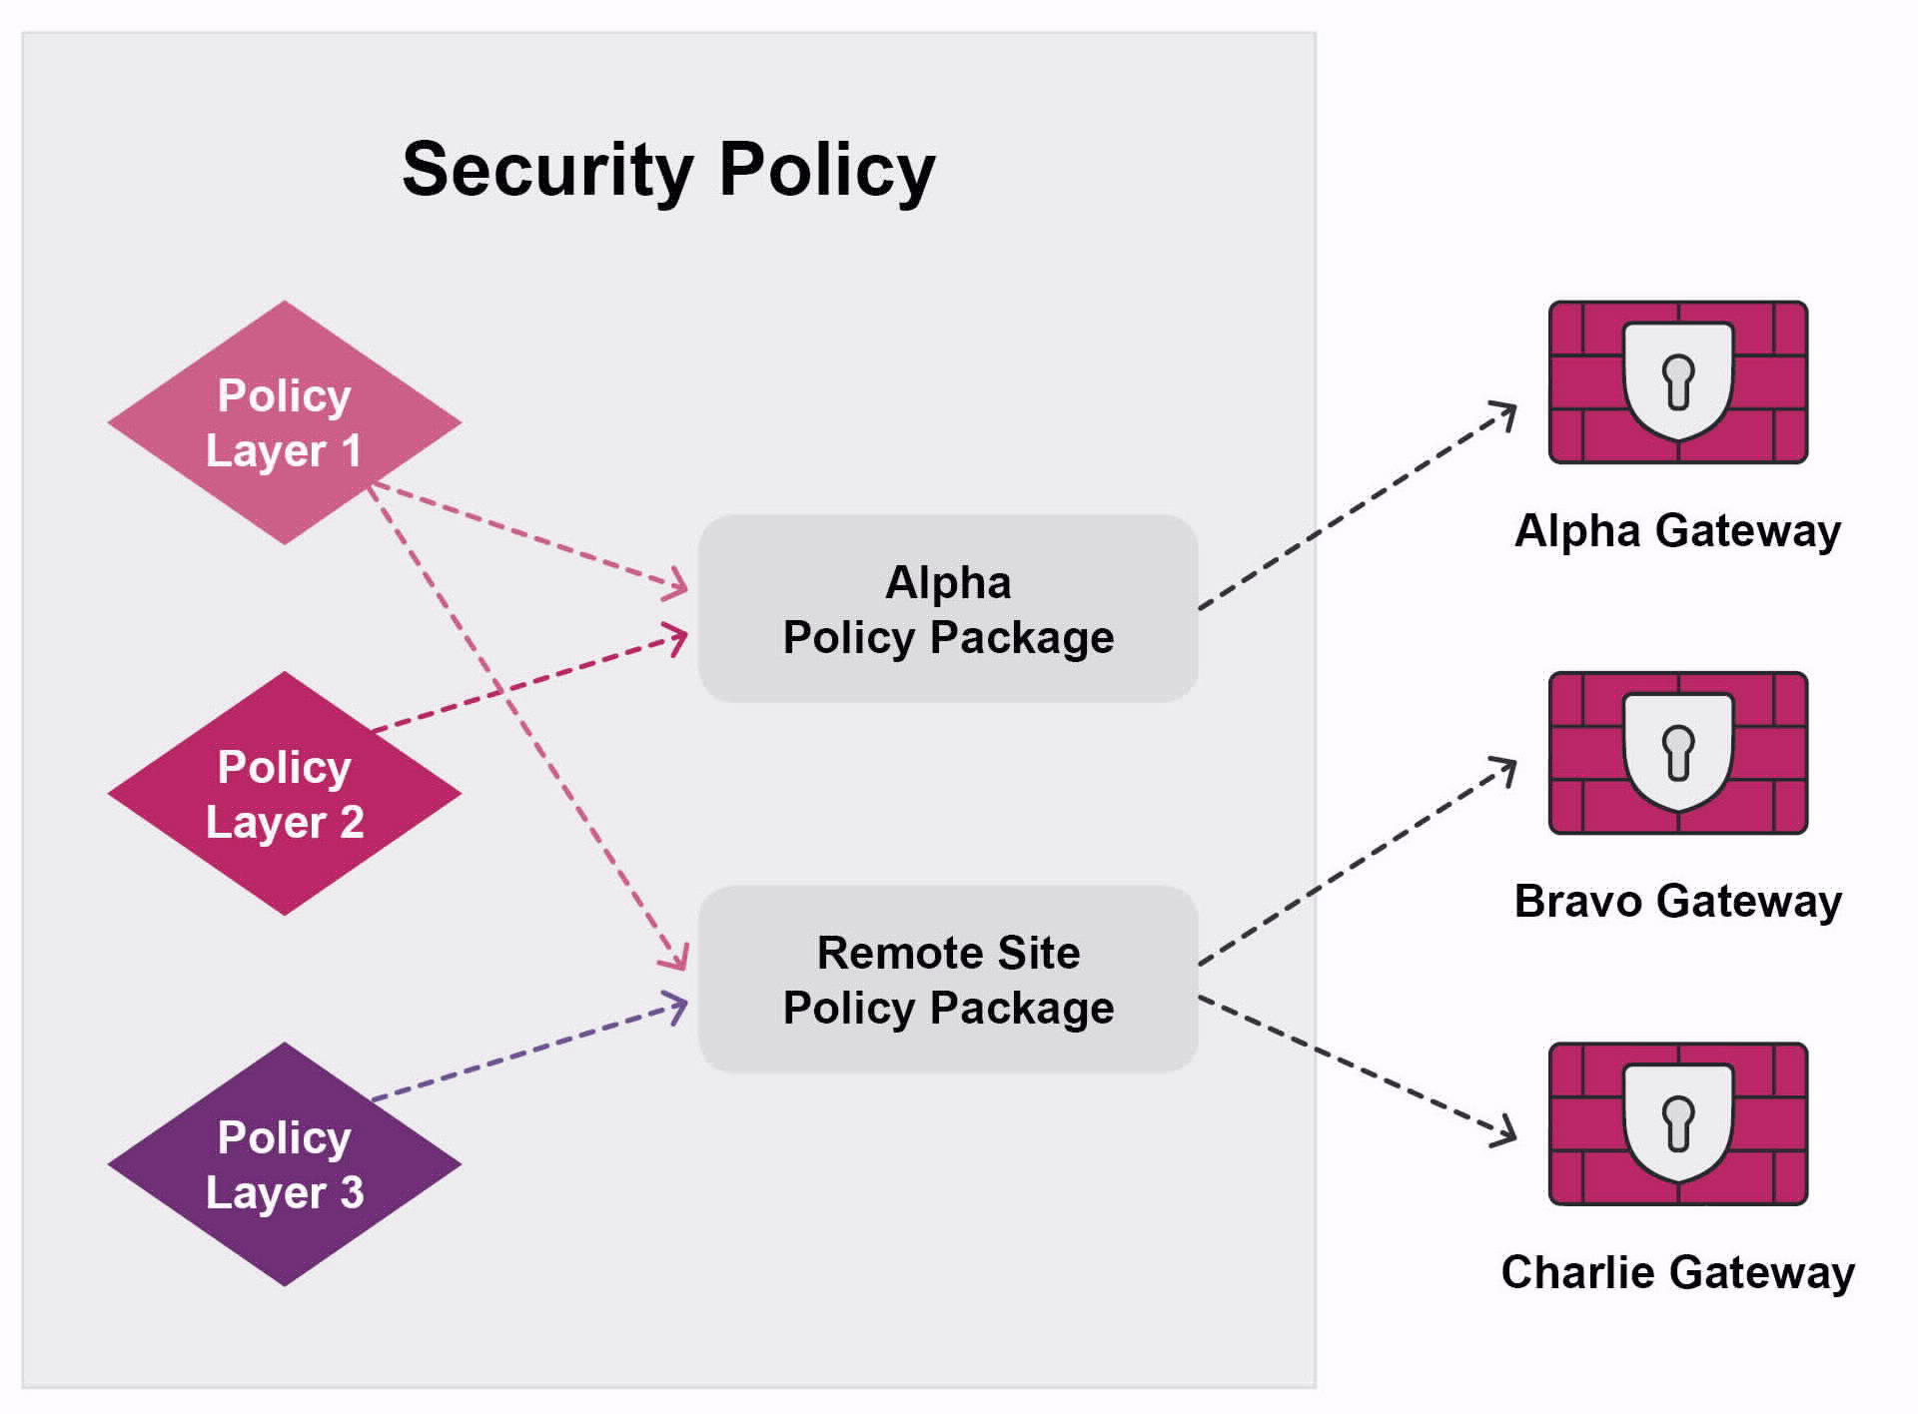
Benefits of Policy Layers
Helps you visually organize the rulebase.
Simplifies Policy management by allowing delegation of ownership of different layers.
Improves performance by reducing the number of rules in a layer.
Notes:
Benefits of Policy layers include the following:
• Helps you visually organize the rulebase.
• Simplifies Policy management by allowing delegation of ownership of different layers.
• Improves performance by reducing the number of rules in a layer.

Slide 6
Ordered and Inline Layers
Ordered layer:
  Flat rulebase.
  Each layer is processed sequentially for a match.
  If an accept match is found, it is processed by the next layer until a final decision is made.
  Can contain inline layers.
Inline layer:
  Sub-policy that is independent of rest of rulebase.
  Attached to specific rules.
  If rule is matched, inspection continues in attached sub-policy.
  If rule is not matched, the sub-policy is bypassed.
Notes:
The two main types of Policy layers are described below.
Ordered layer:
• Flat rulebase.
• Each layer is processed sequentially for a match.
• If an Accept match is found, it is processed by the next layer until a final
decision is made.
• Can contain inline layers.
Inline layer:
• Sub-policy that is independent of the rest of the rulebase.
• Attached to specific rules.
• If a rule is matched, inspection continues in attached sub-policy.
• If a rule is not matched, the sub-policy is bypassed.

Slide 7
Inspection of Policy Layers
Layers
Layers Concept Options
Setting different view and edit permissions per layer.
Inspected in order they are defined.
Exercise control over the rulebase flow and security functionality.
Accept action causes inspection to continue in the next layer.
Reusing a layer in different places.
Notes:
Layers are inspected in the order in which they are defined.
They exercise control over the rulebase flow and security functionality. If an Accept action is completed in a layer, inspection continues in the next layer.
The layers concept generates more options for policy management. These options include the following:
• Setting different view and edit permissions per layer for different administrator roles.
• Reusing a layer in different places: the same application control layer in different policy packages or the same inline layer for different scopes.

Slide 8
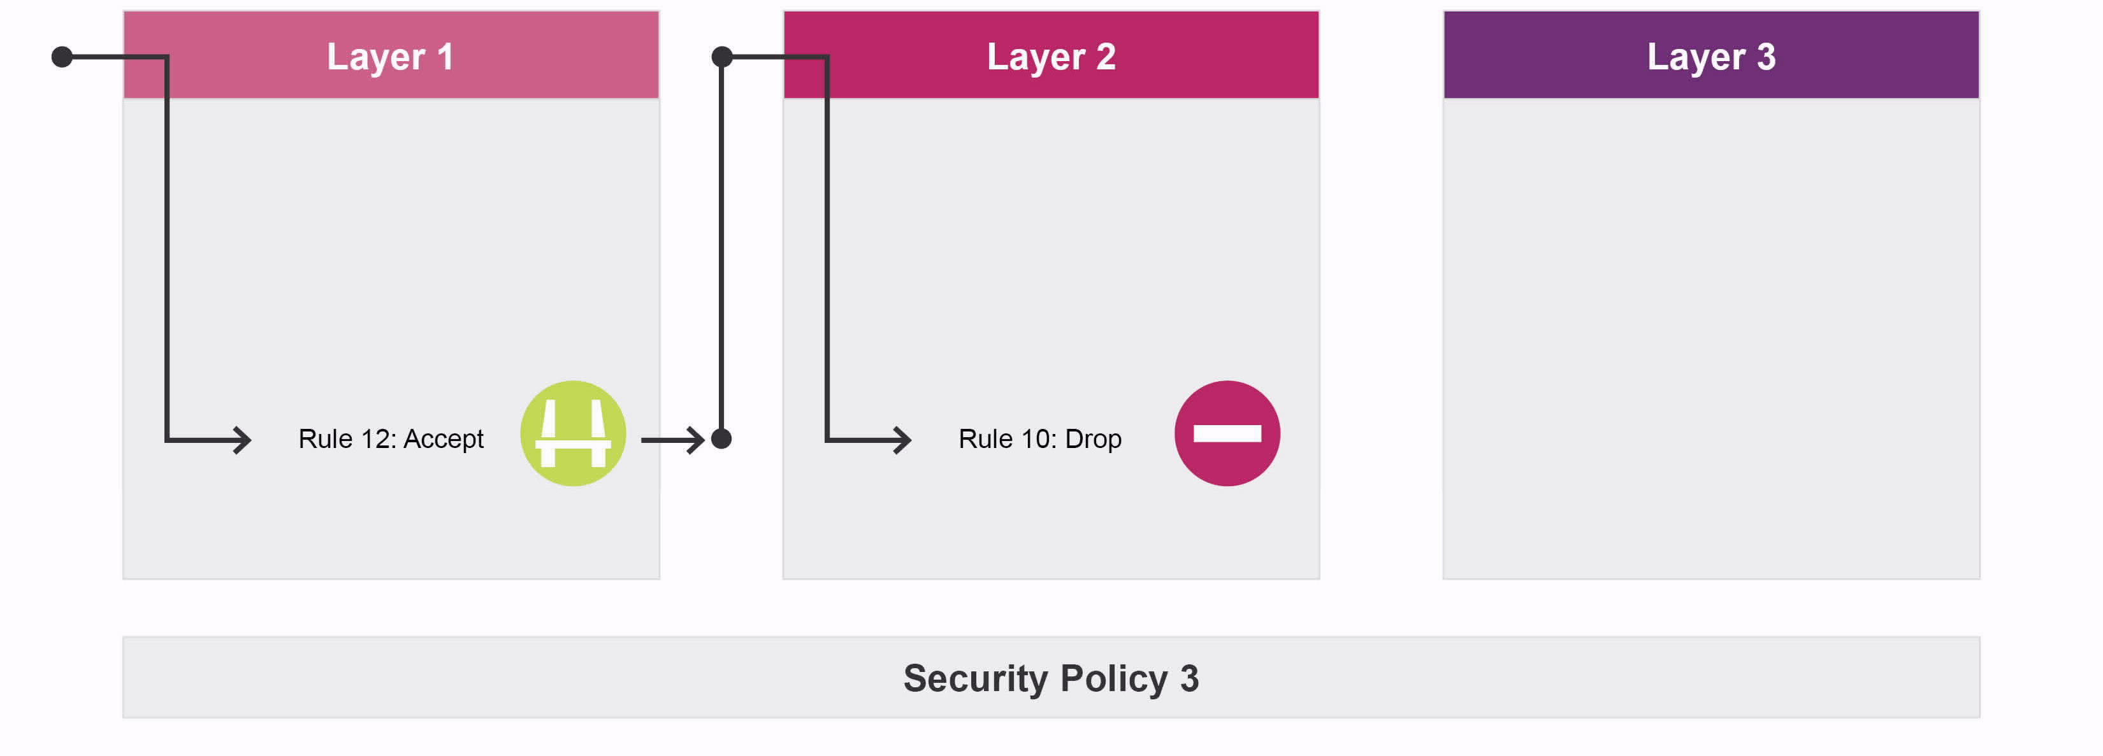
Ordered Layers
Notes:
Ordered Layers are inspected after any acceptable match on the first layer. To pass through the Gateway, the connection must match an acceptable rule on all ordered layers. For example, Gateways that have the Firewall and Application control blades enabled have their policies split into two ordered layers: Network and Applications.

Slide 9
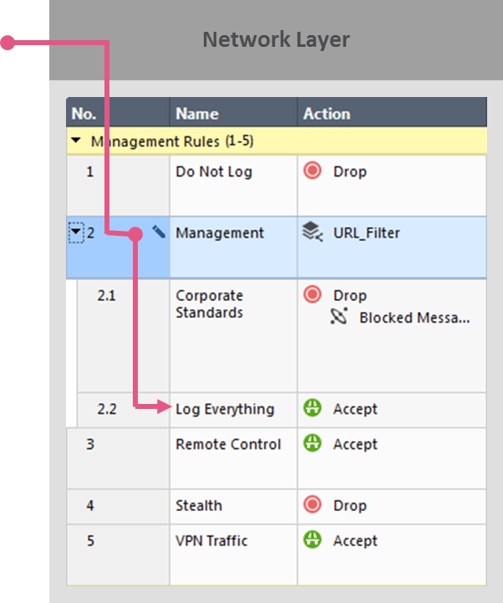
Inline Layers
Notes:
As opposed to an ordered layer, which is considered flat, inline layers organize the Access Control policy into a hierarchy. To explain the traffic flow of a packet going through an inline layer, take the following example:
1. A packet arrives at the gateway.
2. The gateway starts matching the packet against the rules in the Network policy layer, and matches rule 2.
3. The action for rule 2, instead of accepting or dropping the packet, matches the packet against an inline layer, the URL_Filter layer. The rules in the URL_Filter layer, when used
in another layer, are referred to as sub-policies.
4. In the URL_Filter layer, the packet matches sub-rule 2.2, which accepts the traffic.
5. The packet is transmitted to its final destination.
Note: Only traffic matching the parent rule (in this case, rule 2) reaches and is matched against the sub-rules (in this case, rules 2.1 and 2.2). Any sub-rule
will only affect traffic that matches the parent rule, not the entire Access Control rulebase.

Slide 10
Policy Layer Management
Important factors to consider when creating policy layers:
  Determine the number of layers.
  Determine the Software Blades to enable in each layer.
  Determine the order of rules in each layer.
  Determine the order of layers in a policy.
Notes:
Policy layers are managed using SmartConsole. Some guidelines and important considerations before you begin are listed below.
Determine the number of layers.
Determine the Software Blades to enable in each layer.
Determine the order of rules in each layer.
Determine the order of layers in a policy.

Slide 11
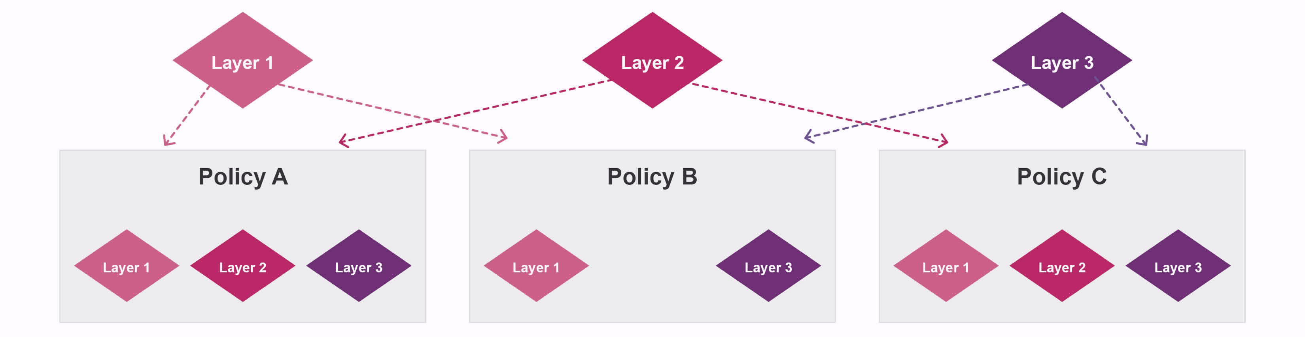
Policy Layer Management (Continued)
A policy can have one or more layers as its building blocks.
You can move layers up/down the policy list based on security needs.
You can also share layers in multiple policies.
Notes:
A policy can have one or more layers as its building blocks.
You can move layers up/down the policy list based on security needs.
You can also share layers in multiple policies.

Slide 12
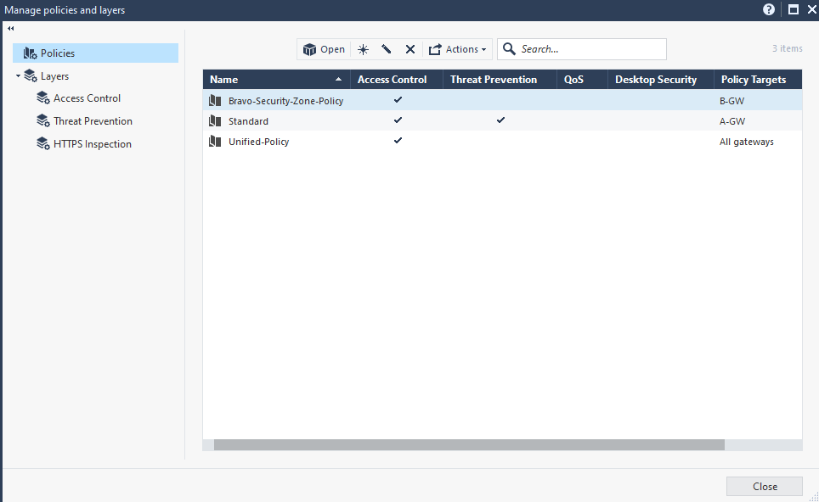
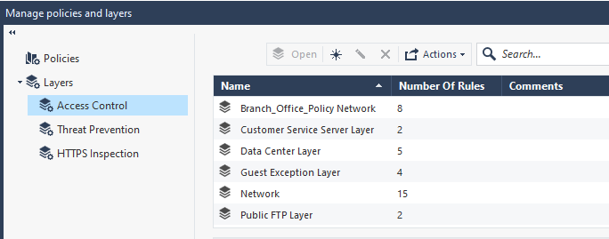
Managing Policy Layers with SmartConsole
Manage policies and layers page
Notes:
Follow the steps listed in your Student Guide to manage policy layers with SmartConsole.

Slide 13
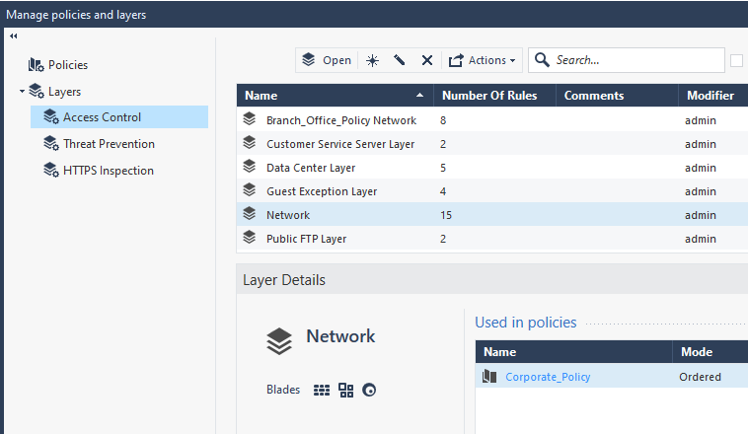
Managing Policy Layers with SmartConsole (Continued)
Select a layer to view its details

Slide 14
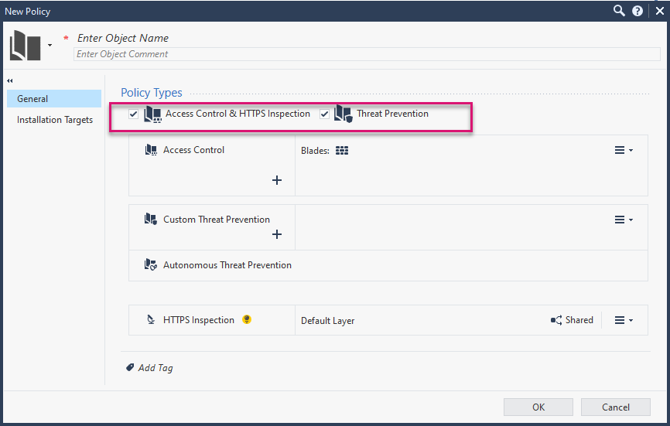
Creating a New Policy Layer
From the Application menu:
Select Manage policies and layers.
Click the New icon.
Configure policy details.
Notes:
Follow the steps in your Student Guide to create a new policy layer.

Slide 15
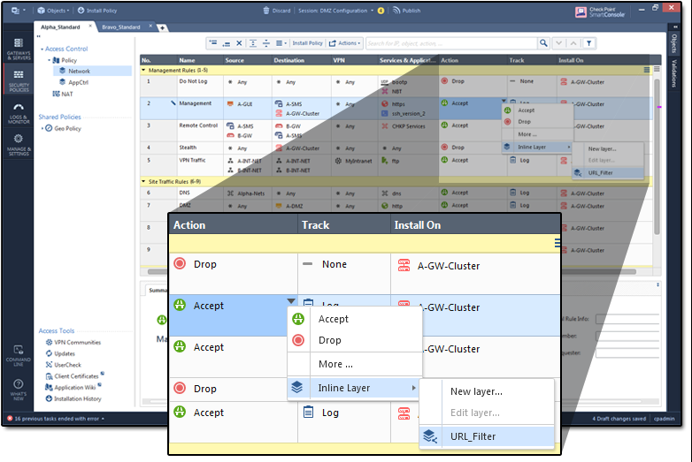
Adding an Inline Policy Layer
Select parent rule.
Under Action column of parent, select Inline Layer.
Select or create new layer to be added.
Note: It is possible for a layer to function as an ordered layer in one policy package and as an inline layer in another policy package.
Notes:
To add an inline policy layer, select the parent rule in the rulebase. Under the Action column of the parent rule, select Inline Layer and then select or create a new layer to be added to the policy.
Note: It is possible for a layer to function as an ordered layer in one policy package and as an inline layer in another policy package.

Slide 16
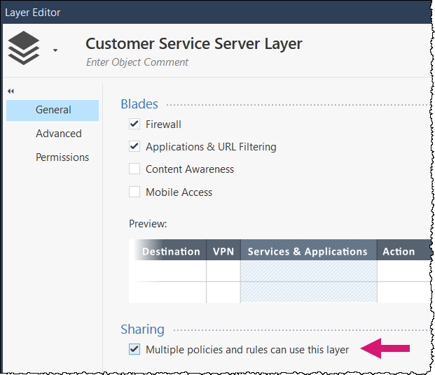

Modifying an Existing Policy Layer
From the Manage policies and layers window:
Select Access Control.
Open the layer and edit settings.
When possible, it is a best practice to share policy layers with other policy packages. To enable this, check the Multiple policies and rules can use this layer checkbox.
Notes:
To modify an existing policy layer configuration, complete the following steps from the Manage Policies and Layers window.
1. Within the Layers section, select Access Control.
2. Open a newly created layer of the policy and edit the settings, as necessary.
It is a best practice to share policy layers with other policy packages.
Enable the Multiple policies and rules can use this layer option.

Slide 17

Exporting Layer Rules
To export to a CSV file:
Select Menu g Manage policies and layers.
Select a layer and then select Actions g Export.
Type a path and file name.
Notes:
To export layer rules to a CSV file, complete the following steps:
1. In SmartConsole, select Menu > Manage policies and layers.
2. The Manage Layers window opens.
3. Select a layer and select Actions > Export.
4. Enter a path and file name.

Slide 18
What is the purpose of Policy layers?
What type of Policy layer is independent of the rest of the rulebase?
Review Questions
Notes:
Answers:
Question 1:
Policy layers are sets of rules or a rulebase. They let you divide a policy, such as the Access Control policy, into smaller, more manageable sections that serve a certain purpose. The layers concept also provides more options for policy management, including the ability to set different views and edit permissions per layer for different administrator roles.
Question 2:
Inline

