Slide 1

Effective team working and communication
Module code: BMSW4002
Group – 5
Monika Lapukaite 2119519
Edvinas Statkus 2118898
Andreea Nicoleta Micdan 2118517
Stefan Mihai Ciolan 2118520

Slide 2
Table of content
Introduction
Stock list
Brands
Communication channels
Benefits of effective communication
Benefits of workplace communication
Theory related to model of communication
Types of barriers

Slide 3
Kitchen craft
Originally established in 1850 by a gentleman named Thomas Plant that specialised in manufacturing and wholesale of ironmongery and household products. Many of their customers still refer comany as Thomas Plant and have dealt with us for decades reflecting our rich heritage. In 1996 he changed the name from Thomas Plant to Kitchen Craft to give customers more indication of what business do and began establishing them self as market leaders in all types of kitchen and homewares products and accessories(Kitchen Craft, 2022).

Slide 4

Stock list
(Kitchen Craft, 2022)

Slide 5




BRANDS
(Kitchen Craft, 2022)

Slide 6
Communication channels
Internet page
Instagram
Facebook
Youtube
Pinterest
(Kitchen Craft, 2022)

Slide 7
What are the benefits of effective communication on the organization’s business process?
Effective communication helps organizations connect with their clients, sponsors, and any other external bodies. Customers who feel listened to and valued by an organization are more likely to stick around . Likewise, businesses with loyal customers gain a reputation for credibility and superior customers services (Kate Vogel, 2021).

Slide 8
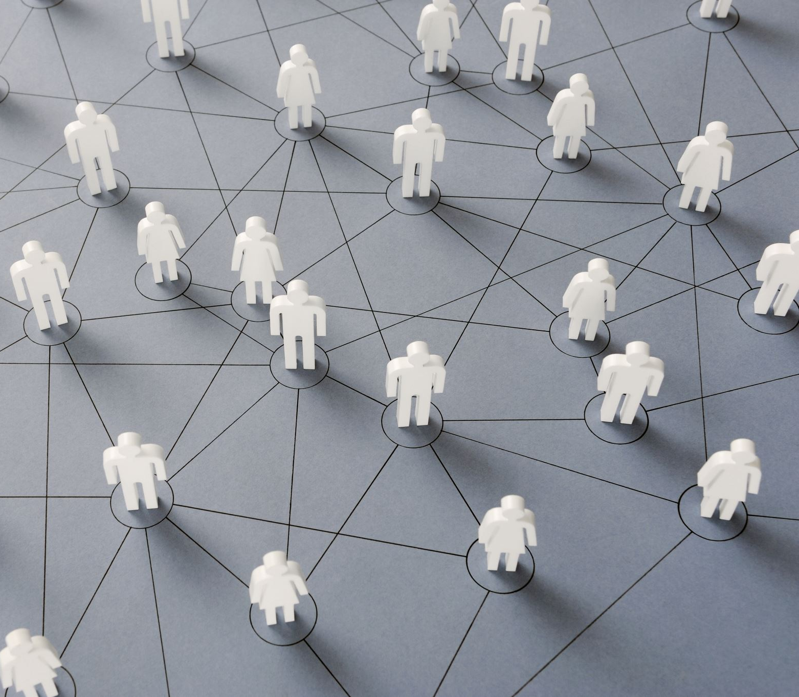
Benefits of workplace communication
Communication mitigates conflict
It improves public relations
Communication fuels innovation
Communication builds existing skills
It increases job satisfaction and loyalty
Communication powers productivity
It builds a culture of teamwork and trust
(Kate Vogel, 2021)

Slide 9
How should the organization use the theories relating to models of communication?
The company uses social platforms, so the Shannon Weaver communication model is the best fit. The Shannon model is designed to communicate through technology. It shows how information is interrupted and helps people identify areas for improvement in communication. The communication model was originally made for explaining communication through technological devices, however, it’s been used to explain just about any form of communication you can think of (Garrett Dickinson, 2022).

Slide 10
The types of barriers that can prevent effective communication between the organisation and their external stakeholders.
Culture factors play an important role as invisible barriers. With the continuous globalization the firms should focus on eliminating the invisible cross culture communication barriers. Solving these barriers is important in order to foster the organizational climate. This will also create opportunities for expansion of the organization and widen their geographical outlook.
Cross culture communication barriers in workplace:
Misunderstanding
Norms and Roles
Belief and values
(R. Delecta Jennifer, 2015).

Slide 11
What are the channels of communication used by the organization and channels that can be used to improve communication?
These days, it is best to promote yourself using the internet and platforms such as:
Facebook
Instagram
Tik Tok
Email
YouTube
The company advertises itself by using these communication channels to promote its name and increase sales.

Slide 12
Reference
KitchenCraft. (n.d.). About Kitchen Craft. [online] Available at: https://www.kitchencraft.co.uk/customer/about [Accessed 23 Jul. 2022].
Vogel, K. (2021). What are the benefits of workplace communication? [online] RingCentral. Available at: https://www.ringcentral.com/us/en/blog/top-7-benefits-of-workplace-communication/.
Drew, C. (2019). 7 Key Concepts | The Shannon-Weaver Model of Communication. [online] The Helpful Professor. Available at: https://helpfulprofessor.com/shannon-weaver-model/.
R. Delecta Jenifer, 2015. “Cross Culture Communication Barriers in workplace “ International Journal of Management (IJM). Pp. 348-349
Garrett Dickinson, 2022. Shannon-Weaver Model of Communication.
Study.com. (2022). [online] Available at: https://study.com/learn/lesson/shannon-weaver-model-communication-theory-parts-transmission-model.html.

Slide 13


