Slide 1
Stakeholders of a Project
Lecture 4

Slide 2
Lecture Outline
Introduction to stakeholders
Stakeholders of a project or supply chain function
Corporate Social Responsibility (CSR)
Stakeholder management

Slide 3
What Are Stakeholders?
‘Stakeholders are those individuals or groups who depend on the organisation to fulfil their own goals and on whom, in turn, the organisation depends’ (Johnson & Scholes)
‘A stakeholder of a company is an individual or group that either is harmed by, or benefits from, the company or whose rights have been violated, or have to be respected, by the company’ (Jobber).

Slide 4
What Are Stakeholders?
Stakeholders can be both internal and external;
Stakeholders aren’t always directly connected to an organisation – governments, trade unions, professional bodies, etc.);
Stakeholder theory recognises that an organisation affects its environment and is affected by its environment;
project and supply is likely to have an important role in stakeholder management as it occupies a key role at the interface between the internal and external supply chains.

Slide 5
Why are stakeholders important?
  They may seek to influence the organisation
  There is strong public and regulatory pressure for business organisations to be ‘socially responsible’
  Organisations themselves increasingly follow (and publicise) ethical and CSR frameworks

Slide 6
Categories of stakeholders
  Internal stakeholders – Members of the organisation
  Connected stakeholders – have direct contractual or commercial dealings
  External or secondary stakeholders – no direct contractual or commercial relationship but have an interest in, or are affected by the organisations activities.
  Think of an organisation with which you are familiar – who are the organisations stakeholders in each category?

Slide 7
Internal stakeholders of project
STAKEHOLDER
Directors/managers
Staff/team members or other organisation members
Technical/design function
Manufacture/production/operations function
Sales and marketing function
Finance/admin function
Storage and distribution (or logistics)

Slide 8
Connected stakeholders of project
STAKEHOLDER
Shareholders
End customers
Intermediary customers (e.g. agents, distributors, retail outlets)
Suppliers
Financial institutions/ lenders

Slide 9
External stakeholders of project
STAKEHOLDER
Government and regulatory bodies
Pressure groups (e.g. Greenpeace) and interest groups (e.g. consumer associations, trade unions)
Community and society at large

Slide 10
The Supplier as a Stakeholder
The main external focus of project’s stakeholder management activity is likely to be:
External suppliers, who have a key stake in any project exercise, and are the subject of purchasers’ key social responsibilities (Lysons and Farrington)
External collaborators, such as outsourced-service providers (project management, logistics, etc.) research consultants, legal advisors and so on.

Slide 11
The Supplier as a Stakeholder
Large or strategic suppliers – and, arguably, the supply chain as a whole – are potentially key stakeholders in any organisation;
The activities and performance of suppliers are directly affected by their dealings with buyers, and the buyer-supplier relationship;
The buying organisation has contractual responsibilities in regard to suppliers and also ethical responsibilities (allowance of adequate profits to survive, payment on time, source fairly) – especially if the balance of power is in the buyer’s favour, or if the supplier is highly dependent on the buyer for its survival.

Slide 12
Supply Stakeholders Adding Value
New product development and process innovation – Early Supplier Involvement (ESI)
Availability/ Delivery – short lead times
Quality of goods supplied
Value for money
Service, advice and information

Slide 13
External Stakeholders of project
Traditionally, the interests of secondary stakeholders have been peripheral to business organisations, whose primary responsibility is to their stakeholders.
This view has somewhat broadened to recognise stakeholders who are less directly affected by its activities and its results.
Secondary stakeholders may include:
  The community from where the labour is drawn
  Those affected by environmental and economic impacts
  Groups concerned with trading practices, consumer rights, etc

Slide 14
What is Corporate Social Responsibility
‘CSR means the commitment to systematic consideration of the environmental, social and cultural aspects of an organisation’s operations. This includes the key issues of sustainability, human rights, labour and community relations, and supplier and customer relations beyond legal obligations. The objective [is] to create long-term business value and contribute to improving the social conditions of the people affected by our operations.’
Give some examples of CSR initiatives

Slide 15
Social responsibility objectives
  Sustainability issues
  Environmental issues
  Ethical trading, business relationships and development

Slide 16
Environmental responsibility
  Recycling and re-using of materials and waste products
  Safe disposal of waste products that cannot be recycled
  Supplier selection policies (and tender criteria) to support firms that conform to environmental standards
  Supplier and product selection policies that reflect concern for conservation and renewal of resources
  Safe and animal-friendly testing of products and materials
  Concern for noise, spray, dirt, vibration and congestion in the planning and operation of transportation

Slide 17
Public and Private Sector
While private sector businesses often have profit maximisation as their primary objective, public sector and not-for-profit organisations have a range of non-economic and social goals, many of which reflect the interests of wider stakeholders;
In practice, this means that public and third-sector organisations are more likely to take a range of stakeholders views in account when making major decisions;
It should also be noted, typically public sector stakeholders often have less direct influence in the form of market power to protect their interests.

Slide 18
Stakeholder management
  Take their interests and likely responses into account
  Communicate effectively with them on matters that affect them
  Engage the interest, support and commitment of influential (and potentially helpful) groups
  Manage potential issues and problem areas that might arouse resistance or opposition from influential groups

Slide 19
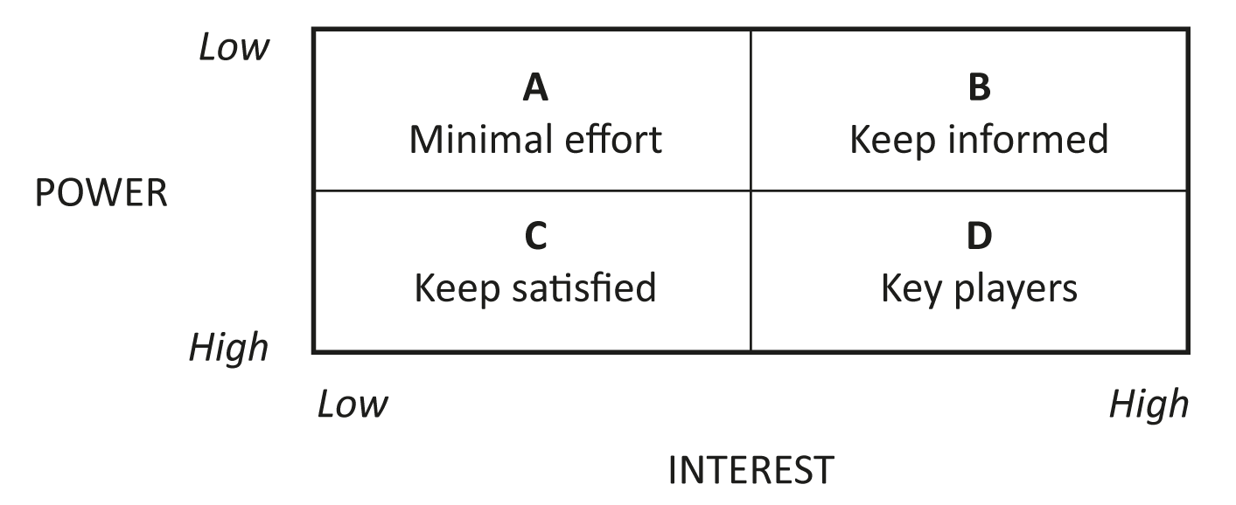
Mendelow’s power/interest matrix

Slide 20
Stakeholder position analysis (Egan)
  Partners: those who support the change agent
  Allies: those who will support him or her, given encouragement
  Fellow travellers: passive supporters
  Bedfellows: people who support the agenda, but do not know or trust the change agent
  Fence sitters: those whose allegiances are not yet clear
  Loose cannons: people who may vote either way
  Opponents: people who oppose the agenda, but not the change agent personally
  Adversaries: people who oppose the change agent and the agenda
  The voiceless: ‘silent’ stakeholders

Slide 21
Stakeholder management
  Goal analysis
  Desired outcomes
  Stakeholder marketing and communication programmes
  Relationship management
  Issues management

Slide 22
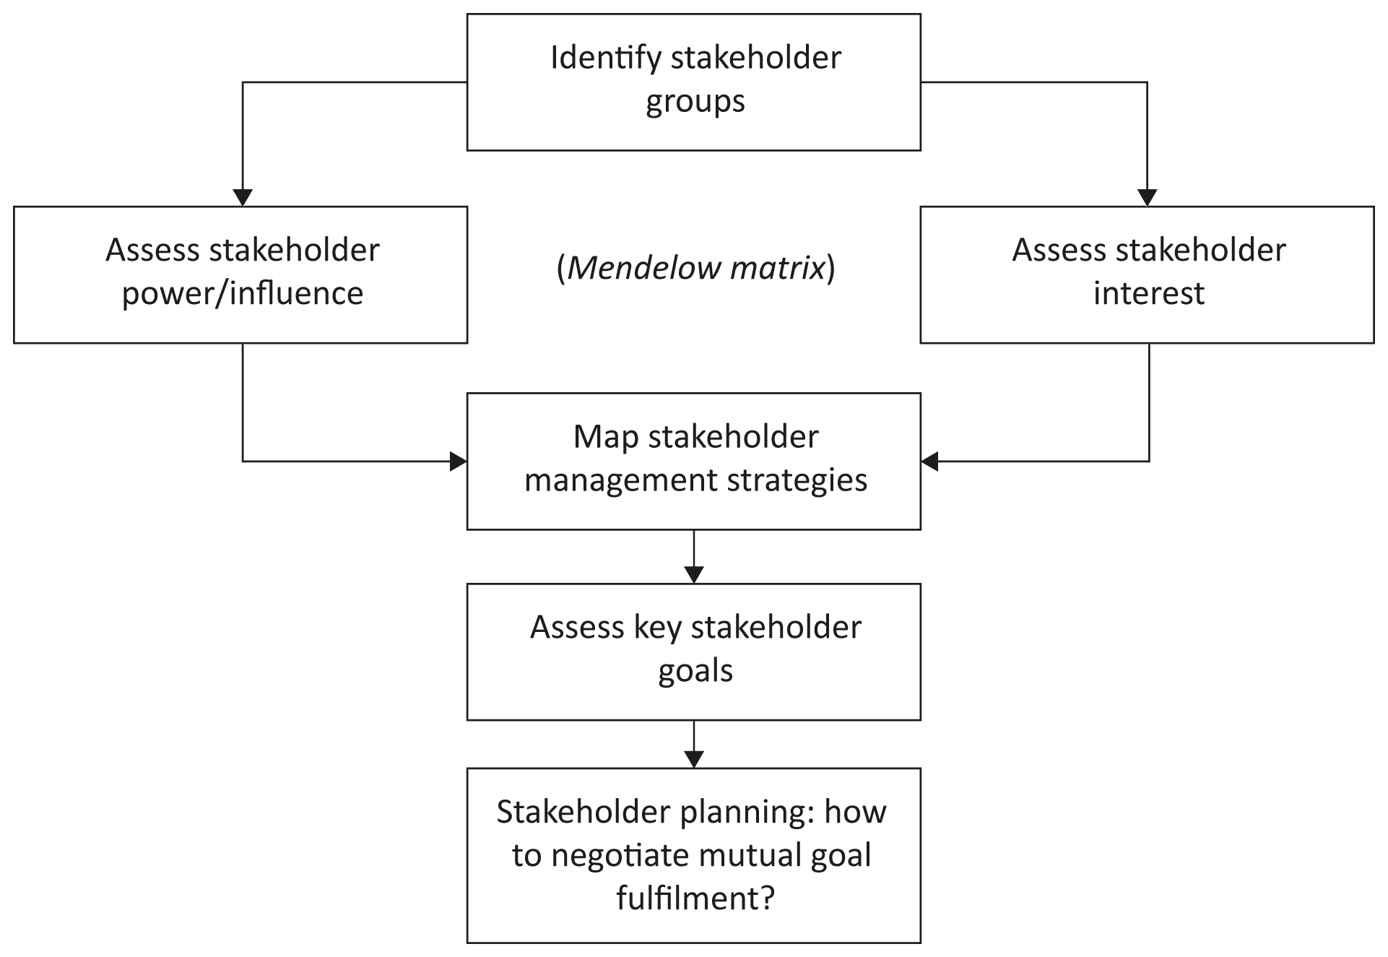
Stakeholder management

Slide 23
Internal Stakeholder Communication
Organisations depend on their employees to implement plans and deliver services. Employee awareness of, engagement in and commitment to organisational goals is essential to support external customer satisfaction and business success;
Some methods used for employee and cross-functional communication:
  Office manuals and in-house newsletters
  Corporate intranet
  Team meetings
  Briefings and presentations
  Conferences
  Bulletins and announcements
  Etc.

Slide 24
Summary
Stakeholders are people or groups with a legitimate interest in the organisation. It is important to take their views into account so as to derive benefits and avoid negative consequences.
Organisational stakeholders are often classified as internal, connected and external
CSR is the concept that organisations have a duty to behave as good citizens, taking account of their own impact on environmental, social and cultural issues;
An important tool in stakeholder analysis is Mendelow’s matrix, which classifies stakeholders according to their power and interest. An alternative model is Egan’s nine stakeholder groups;
The purpose of analysing stakeholders is so that an appropriate management strategy may be selected for each group;
It is important to keep stakeholders informed, particularly when new information emerges or there have been changes to ideas previously agreed upon;
Stakeholder communications techniques include focus groups, consultation forums, briefings, seminars and conferences.

Slide 25

Break

Slide 26
Introduction to Project Risk

Slide 27
Learning Objectives
Understand risk and the importance of good project risk management
Discuss the elements of planning risk management and the contents of a risk management plan
List common sources of risks
Describe the process of identifying risks and create a risk register
Discuss qualitative risk analysis and explain how to calculate risk factors, create probability/impact matrixes, and apply the Top Ten Risk Item Tracking technique to rank risks

Slide 28
Learning Objectives (cont’d)
Explain quantitative risk analysis and how to apply decision trees, simulation, and sensitivity analysis to quantify risks
Provide examples of using different risk response planning strategies to address both negative and positive risks
Discuss how to control risks
Describe how software can assist in project risk management

Slide 29
The Importance of Project Risk Management
Project risk management is the art and science of identifying, analyzing, and responding to risk throughout the life of a project and in the best interests of meeting project objectives.
Risk management is often overlooked in projects, but it can help improve project success by helping select good projects, determining project scope, and developing realistic estimates.

Slide 30
Research Shows Need to Improve Project Risk Management
Study by Ibbs and Kwak (2002) shows risk has the lowest maturity rating of all knowledge areas
A similar survey was completed with software development companies in Mauritius, South Africa in 2003, and risk management also had the lowest maturity
KLCI (2001) study shows the benefits of following good risk management practices

Slide 31
Global Issues
Many people around the world suffered from financial losses as various financial markets dropped in the fall of 2008, even after the $700 billion bailout bill was passed by the U.S. Congress
According to a global survey of 316 financial services executives, over 70 percent of respondents believed that the losses stemming from the credit crisis were largely due to failures to address risk management issues
They identified several challenges in implementing risk management, including data and company culture issues

Slide 32
Negative Risk
A dictionary definition of risk is “the possibility of loss or injury”
Negative risk involves understanding potential problems that might occur in the project and how they might impede project success
Negative risk management is like a form of insurance; it is an investment

Slide 33
Risk Can Be Positive
Positive risks are risks that result in good things happening; sometimes called opportunities
A general definition of project risk is an uncertainty that can have a negative or positive effect on meeting project objectives
The goal of project risk management is to minimize potential negative risks while maximizing potential positive risks

Slide 34
Best Practice
Some organizations make the mistake of only addressing tactical and negative risks when performing project risk management
Overcoming this problem by widening the scope of risk management to encompass both strategic risks and upside opportunities, which he refers to as integrated risk management

Slide 35
project Risk Management Processes
Plan risk management : Deciding how to approach and plan the risk management activities for the project
Identify risks: Determining which risks are likely to affect a project and documenting the characteristics of each
Perform qualitative risk analysis: Prioritizing risks based on their probability and impact of occurrence

Slide 36
project Risk Management Processes (cont’d)
Perform quantitative risk analysis: Numerically estimating the effects of risks on project objectives
Plan risk responses: Taking steps to enhance opportunities and reduce threats to meeting project objectives
Control risk: Monitoring identified and residual risks, identifying new risks, carrying out risk response plans, and evaluating the effectiveness of risk strategies throughout the life of the project

Slide 37
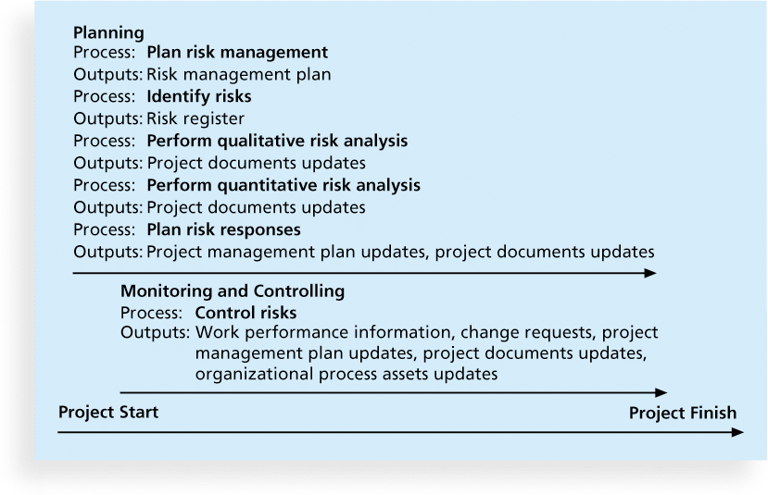
Project Risk Management Summary

Slide 38
Plan Risk Management
The main output of this process is a risk management plan—a plan that documents the procedures for managing risk throughout a project
The project team should review project documents and understand the organization’s and the sponsor’s approaches to risk
The level of detail will vary with the needs of the project

Slide 39
Topics Addressed in a Risk Management Plan
Methodology
Roles and responsibilities
Budget and schedule
Risk categories
Risk probability and impact
Revised stakeholders’ tolerances
Tracking
Risk documentation

Slide 40
Contingency and Fallback Plans, Contingency Reserves
Contingency plans are predefined actions that the project team will take if an identified risk event occurs
Fallback plans are developed for risks that have a high impact on meeting project objectives, and are put into effect if attempts to reduce the risk are not effective
Contingency reserves or allowances are provisions held by the project sponsor or organization to reduce the risk of cost or schedule overruns to an acceptable level; management reserves are funds held for unknown risks

Slide 41
Broad Categories of Risk
Market risk
Financial risk
Technology risk
People risk
Structure/process risk

Slide 42
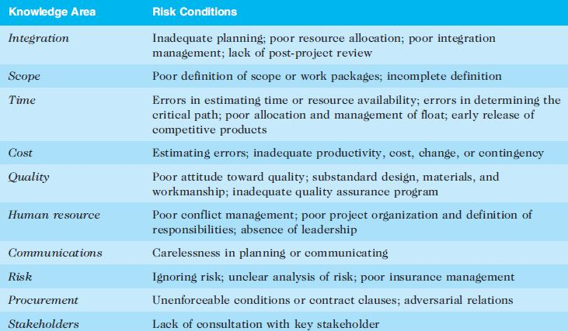
Potential Negative Risk Conditions Associated With Each Knowledge Area

Slide 43
Identify Risks – the second …..
Identifying risks is the process of understanding what potential events might hurt or enhance a particular project
Another consideration is the likelihood of advanced discovery
Risk identification tools and techniques include:
  Brainstorming
  The Delphi Technique
  Interviewing
  SWOT analysis

Slide 44
Brainstorming
Brainstorming is a technique by which a group attempts to generate ideas or find a solution for a specific problem by amassing ideas spontaneously and without judgment
An experienced facilitator should run the brainstorming session
Be careful not to overuse or misuse brainstorming.
  Psychology literature shows that individuals produce a greater number of ideas working alone than they do through brainstorming in small, face-to-face groups
  Group effects often inhibit idea generation

Slide 45
Delphi Technique
The Delphi Technique is used to derive a consensus among a panel of experts who make predictions about future developments
Provides independent and anonymous input regarding future events
Uses repeated rounds of questioning and written responses and avoids the biasing effects possible in oral methods, such as brainstorming

Slide 46
Interviewing
Interviewing is a fact-finding technique for collecting information in face-to-face, phone, e-mail, or instant-messaging discussions
Interviewing people with similar project experience is an important tool for identifying potential risks

Slide 47
SWOT Analysis
SWOT analysis (strengths, weaknesses, opportunities, and threats) can also be used during risk identification
Helps identify the broad negative and positive risks that apply to a project.

Slide 48
Risk Register
The main output of the risk identification process is a list of identified risks and other information needed to begin creating a risk register
A risk register is:
  A document that contains the results of various risk management processes and that is often displayed in a table or spreadsheet format
  A tool for documenting potential risk events and related information
Risk events refer to specific, uncertain events that may occur to the detriment or enhancement of the project

Slide 49
Risk Register Contents
An identification number for each risk event
A rank for each risk event
The name of each risk event
A description of each risk event
The category under which each risk event falls
The root cause of each risk

Slide 50
Risk Register Contents (cont’d)
Triggers for each risk; triggers are indicators or symptoms of actual risk events
Potential responses to each risk
The risk owner or person who will own or take responsibility for each risk
The probability and impact of each risk occurring.
The status of each risk

Slide 51
Perform Qualitative Risk Analysis
The Third Process of six in the risk management knowledge area
Assess the likelihood and impact of identified risks to determine their magnitude and priority
Risk quantification tools and techniques include:
  Probability/impact matrixes
  The Top Ten Risk Item Tracking
  Expert judgment

Slide 52
Probability/Impact Matrix
A probability/impact matrix or chart lists the relative probability of a risk occurring on one side of a matrix or axis on a chart and the relative impact of the risk occurring on the other
List the risks and then label each one as high, medium, or low in terms of its probability of occurrence and its impact if it did occur
Can also calculate risk factors:
  Numbers that represent the overall risk of specific events based on their probability of occurring and the consequences to the project if they do occur

Slide 53
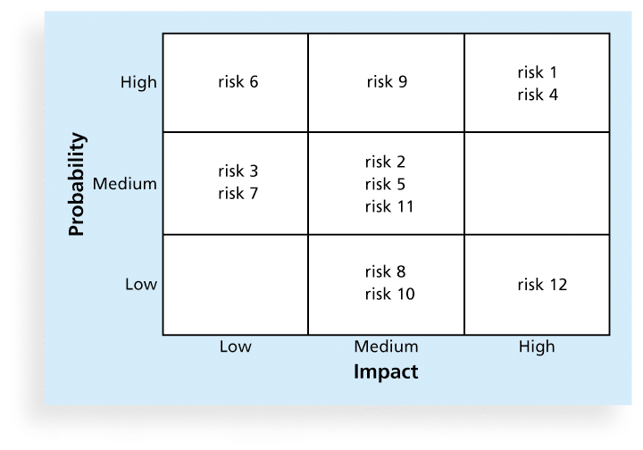
Sample Probability/Impact Matrix

Slide 54
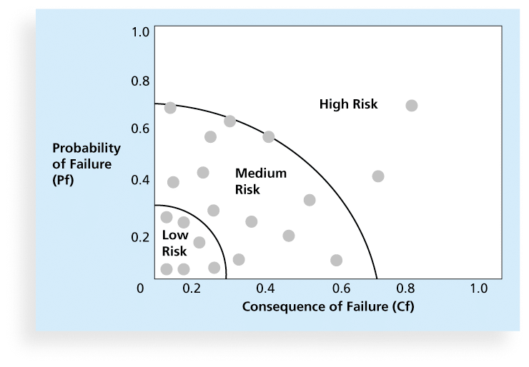
Chart Showing High-, Medium-, and Low-Risk Technologies

Slide 55
Top Ten Risk Item Tracking
Top Ten Risk Item Tracking is a qualitative risk analysis tool that helps to identify risks and maintain an awareness of risks throughout the life of a project
Establish a periodic review of the top ten project risk items
List the current ranking, previous ranking, number of times the risk appears on the list over a period of time, and a summary of progress made in resolving the risk item

Slide 56
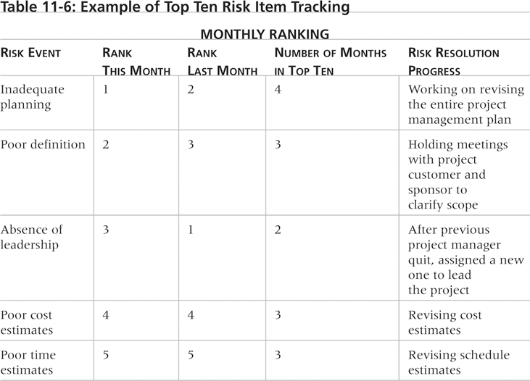
Example of Top Ten Risk Item Tracking

Slide 57
Watch List
A watch list is a list of risks that are low priority, but are still identified as potential risks
Qualitative analysis can also identify risks that should be evaluated on a quantitative basis

Slide 58
Perform Quantitative Risk Analysis
The Fourth Process of six in the Risk Management Knowledge Area
Often follows qualitative risk analysis, but both can be done together
Large, complex projects involving leading edge technologies often require extensive quantitative risk analysis
Main techniques include:
  Decision tree analysis
  Simulation models
  Sensitivity analysis

Slide 59
Decision Trees and Expected Monetary Value (EMV)
A decision tree is a diagramming analysis technique used to help select the best course of action in situations in which future outcomes are uncertain
Expected monetary value (EMV) is the product of a risk event probability and the risk event’s monetary value
You can draw a decision tree to help find the EMV

Slide 60
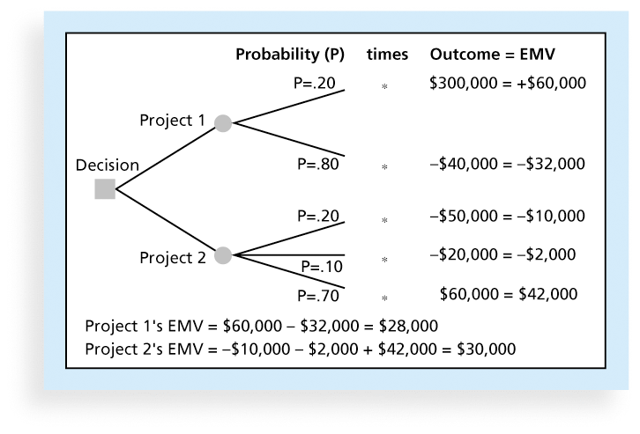
Expected Monetary Value (EMV) Example

Slide 61
Sensitivity Analysis
Sensitivity analysis is a technique used to show the effects of changing one or more variables on an outcome
For example, many people use it to determine what the monthly payments for a loan will be given different interest rates or periods of the loan, or for determining break-even points based on different assumptions
Spreadsheet software, such as Excel, is a common tool for performing sensitivity analysis

Slide 62

Sample Sensitivity Analysis for Determining Break-Even Point

Slide 63
Planning Risk Responses
After identifying and quantifying risks, you must decide how to respond to them
Four main response strategies for negative risks:
  Risk avoidance
                Just use the old system
  Risk acceptance
                Have a backup or contingency plan
  Risk transference
                Purchase insurance or a warranty
  Risk mitigation
                Reduce the impact or the probability of occurrence

Slide 64
Response Strategies for Positive Risks
Risk exploitation
Risk sharing
Risk enhancement
Risk acceptance

Slide 65
Residual and Secondary Risks
It’s also important to identify residual and secondary risks
Residual risks are risks that remain after all of the response strategies have been implemented
Secondary risks are a direct result of implementing a risk response

Slide 66
Control Risks – the Sixth……
Involves executing the risk management process to respond to risk events and ensuring that risk awareness is an ongoing activity performed by the entire project team throughout the entire project
Workarounds are unplanned responses to risk events that must be done when there are no contingency plans
Main outputs of risk control are:
  Work performance information
  change requests
  updates to the project management plan, other project documents, and organizational process assets

Slide 67
Using Software to Assist in project Risk Management
Risk registers can be created in a simple Word or Excel file or as part of a database
More sophisticated risk management software, such as Monte Carlo (probability software) simulation tools, help in analyzing project risks
You can purchase add-ons for Excel to perform simulations

Slide 68
Results of Good project Risk Management
Unlike crisis management, good project risk management often goes unnoticed
Well-run projects appear to be almost effortless, but a lot of work goes into running a project well
project managers should strive to make their jobs look easy to reflect the results of well-run projects.
project analytics are becoming a more popular tool in this area.

Slide 69
Lecture Summary
We have explored risk from a practitioners’ perspective.
Literature streams that relate to risk are Supply Chain Resilience and Supply Chain Robustness.
project risk management is the art and science of identifying, analyzing, and responding to risk throughout the life of a project and in the best interests of meeting project objectives
Main processes include:
  Plan risk management
  Identify risks
  Perform qualitative risk analysis
  Perform quantitative risk analysis
  Plan risk responses
  Control risks
Effective risk management is the result of a systematic approach.

